Slide 1

CONTROLLING
S.JAYALAKSHMI
Assistant Professor
BON SECOURS COLLEGE FOR WOMEN, THANJAVUR.

Slide 2

SUBTITLES OF THIS CONCEPT
CONCEPT OF CONTROLLING
IMPORTANCE OF CONTROLLING
TYPES OF CONTROLLING
STEPS OF CONTROLLING

Slide 3
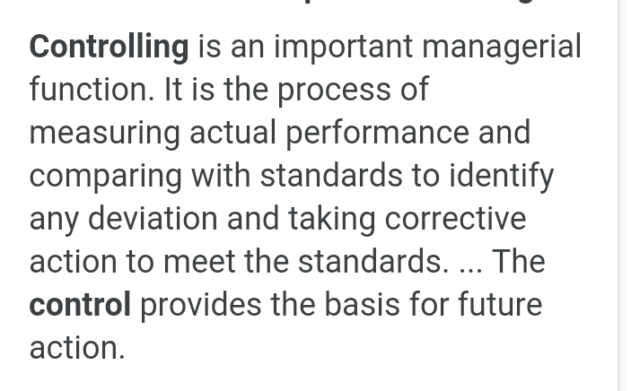

CONCEPT OF CONTROLLING

Slide 4
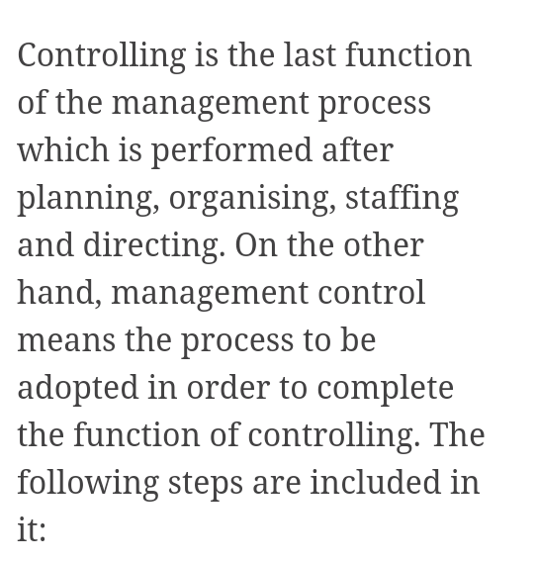
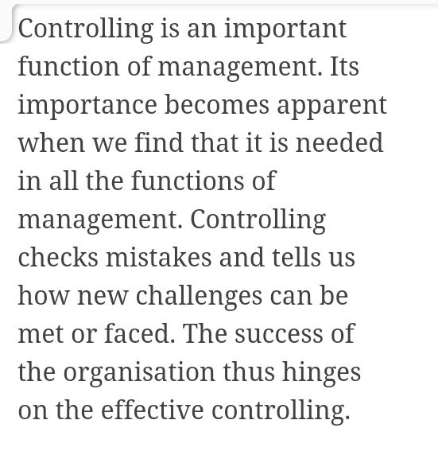
IMPORTANCE OF CONTROLLING

Slide 5
IMPORTANCE OF CONTROLLING ARE IN SIX FACTS. THEY ARE
ACCOMPLISHING ORGANISATIONAL GOALS
JUDGING ACCURACY OF STANDARDS
MAKING EFFICIENT USE OF RESOURCES
IMPROVING EMPLOYEE MOTIVATION
ENSURING ORDER AND DISCIPLINE
FACILITATING COORDINATION IN ACTION

Slide 6
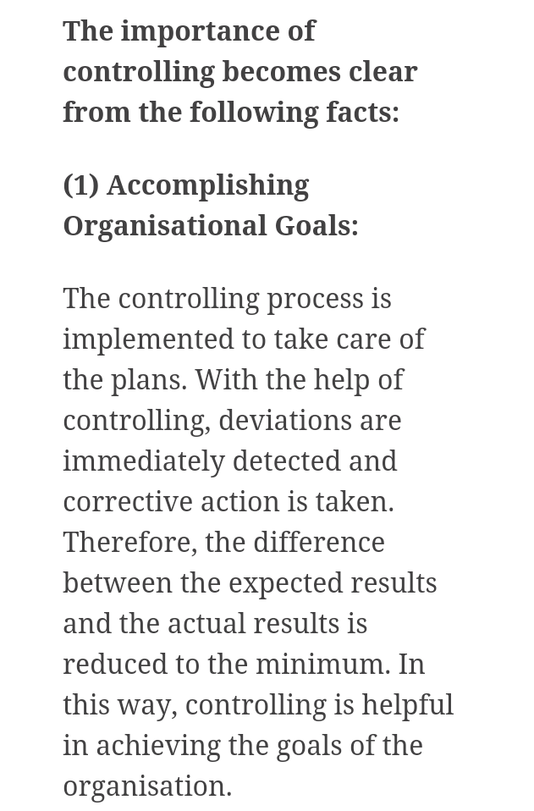


Slide 7
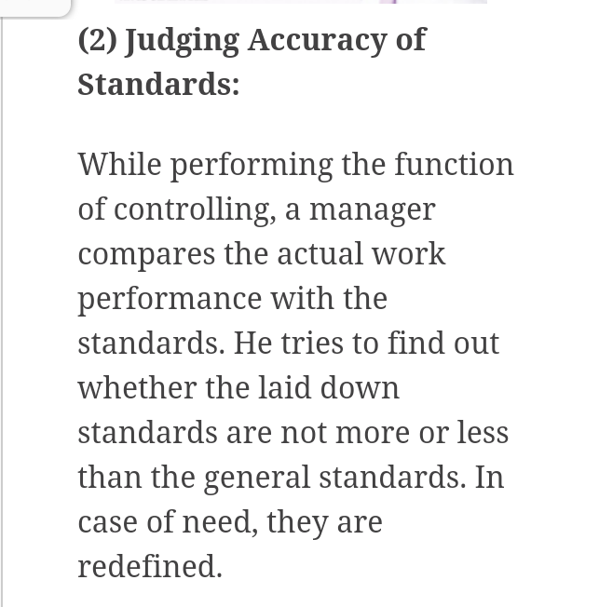
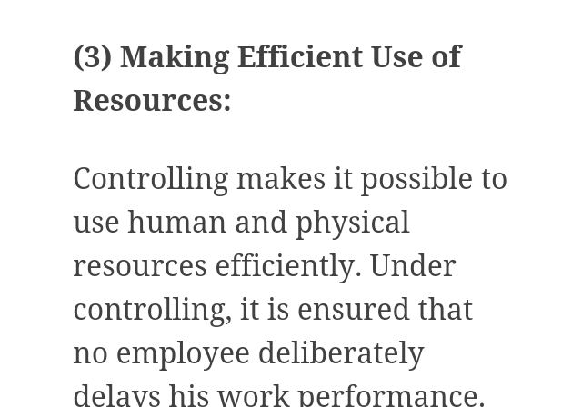

Slide 8
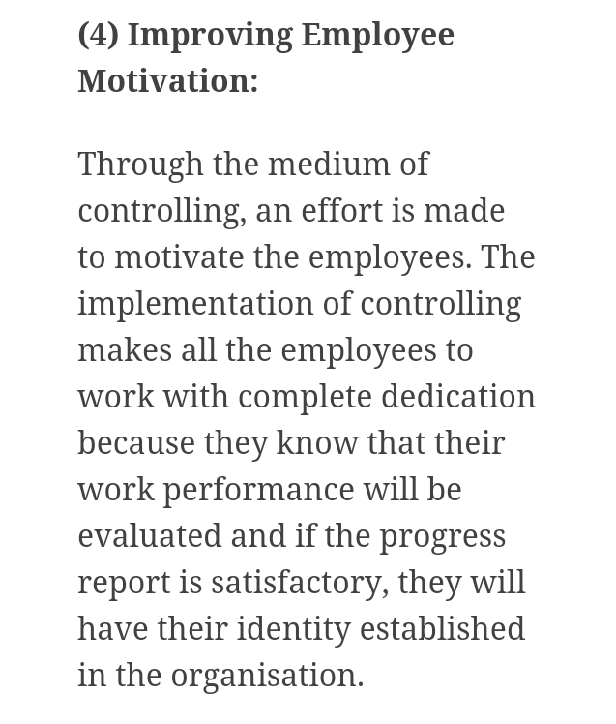
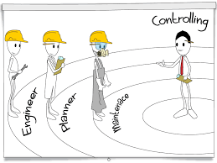

Slide 9
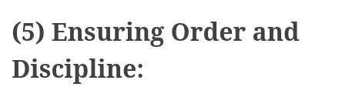


Slide 10
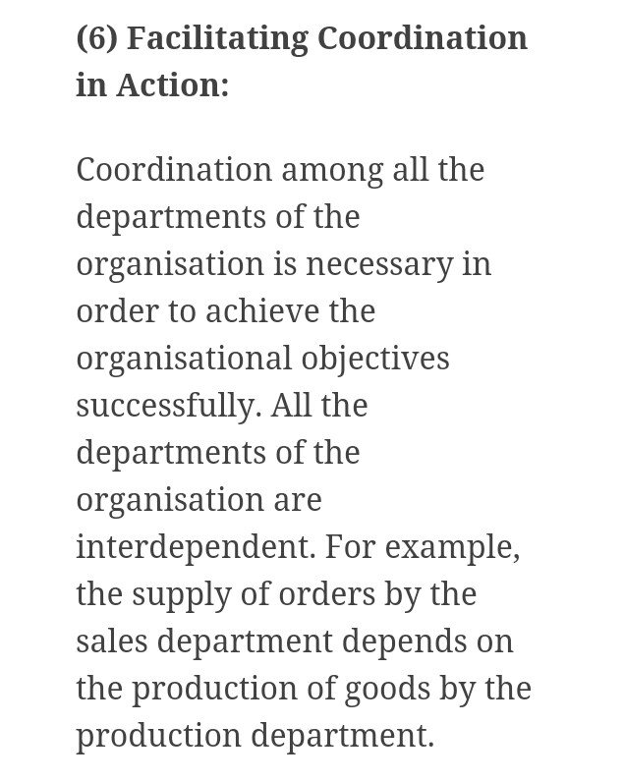


Slide 11
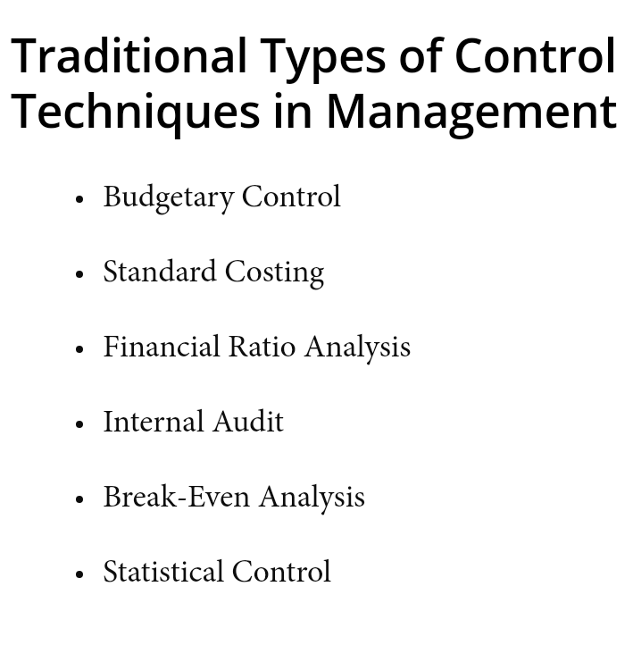

Slide 12
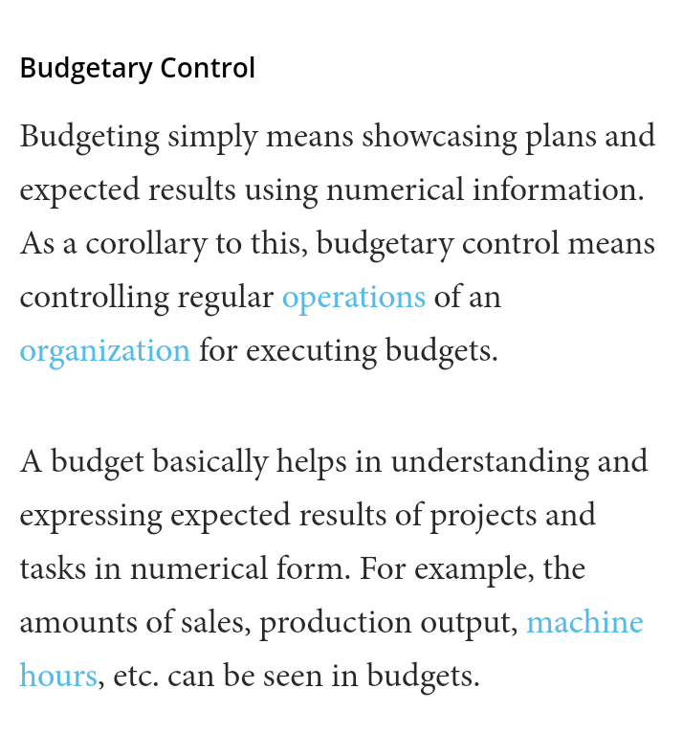
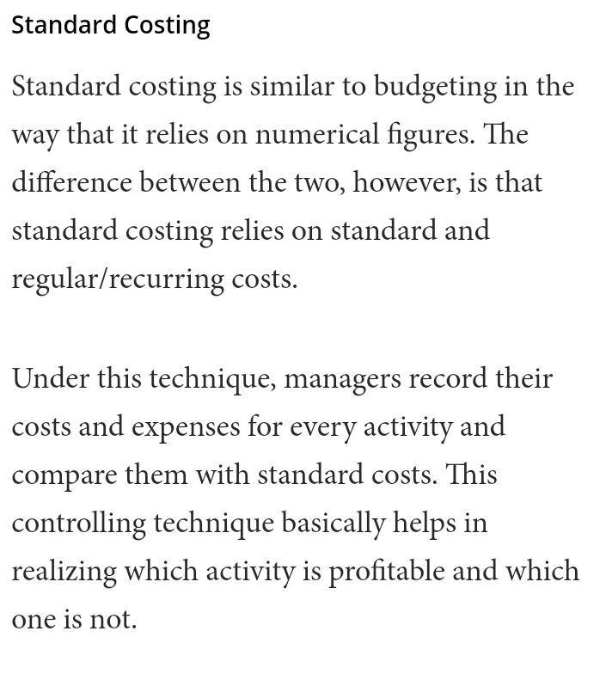

Slide 13
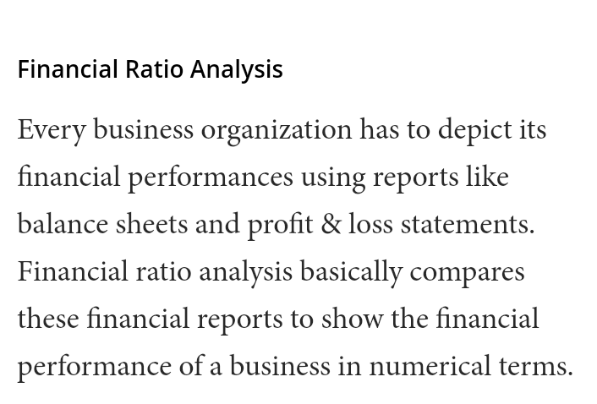

Slide 14
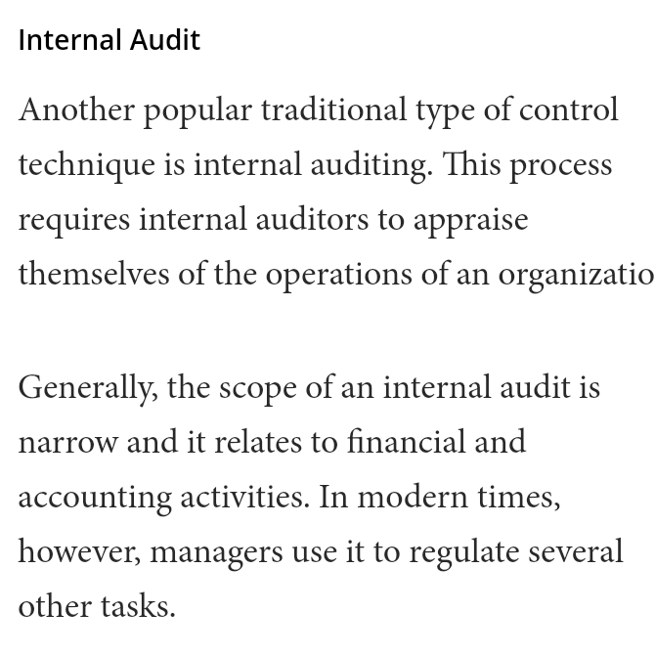

Slide 15
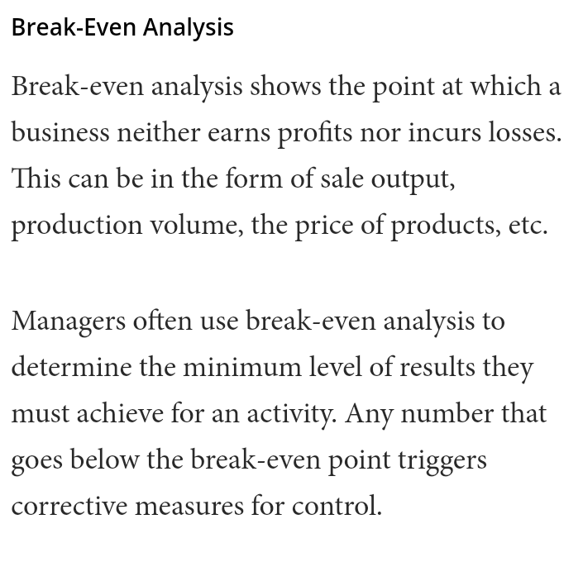
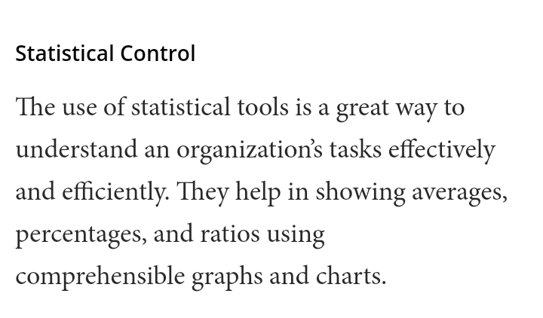

Slide 16

STEPS OF CONTROLLING
ESTABLISHING STANDARDS AND METHODS FOR MEASURING PERFORMANCE
MEASURING PERFORMANCE
DETERMINING WHETHER PERFORMANCE MATCHES THE STANDARAD.
TAKING CORRECTIVE ACTION.

Slide 17
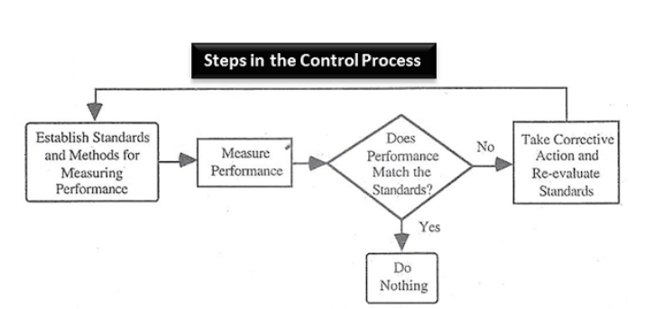

Slide 18

THESE ARE THE EXPLANATIONS OF CONTROLLING.
THANK YOU…….

