Slide 1

S.JAYALAKSHMI
Assistant Professor
BON SECOURS COLLEGE FOR WOMEN, THANJAVUR.

Slide 2

PLANNING
SYNOPSIS
MEANING
DEFINITION
TYPES OF PLANNING
OBJECTIVES
STEPS IN PLANNING

Slide 3
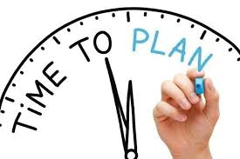
MEANING
Planning is deciding in advance what should be done in future.
Organising, staffing, co-ordinating and controlling, which are the other important functions of management, succeed planning.

Slide 4
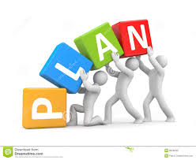
DEFINITION
Planning is a concept of executive action that embodies the skills of anticipating, influencing and controlling the nature and direction of change- McFarland.

Slide 5
TYPES OF PLANNING
LONG TERM
MEDIUM TERM
SHORT TERM

Slide 6
TYPES OF PLANNING
LONG TERM PLANNING
Its needed in the following circumstances
Introduction of a new product
Entering a new market.
Changing the technique of production.
Increasing the scale of operation, etc.

Slide 7
TYPES OF PLANNING
2) MEDIUM-TERM PLANNING
Its needed in the following circumstances
Making additions to an existing plant.
Expanding output from its present level.
Appointment of additional staff to cope with the volume of work, etc.
3) SHORT-TERM PLANNING
Its needed in the following circumstances
Purchase of raw materials.
Arranging for employee training.
Provision of certain amenities for the staff with the available funds, etc.

Slide 8
OBJECTIVES
Objectives are also known by certain other names- aims, goals, targets, missions, etc.
The following are the some of them.
A higher market share.
Innovation.
Cost control.
Customer satisfaction.

Slide 9
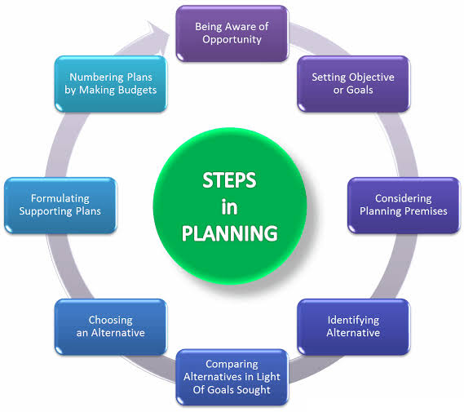
STEPS IN PLANNING

Slide 10

THANK YOU

