Slide 1

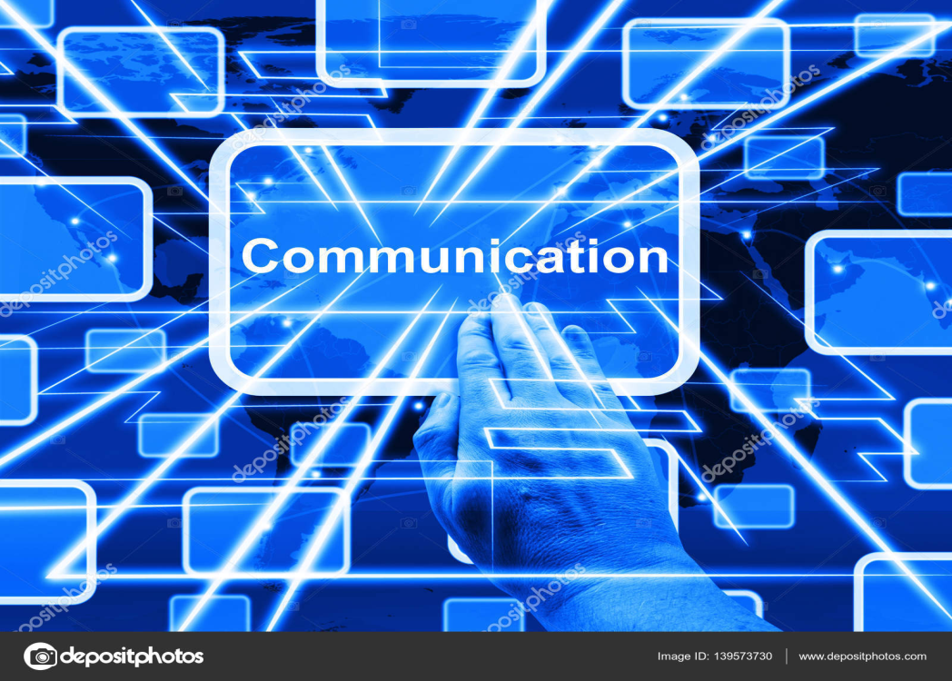




Slide 2


Communications is fundamental to the existence and survival of humans as well as to an organization. It is a process of creating and sharing ideas, information, views, facts, feelings, etc. among the people to reach a common understanding. Communication is the key to the Directing function of management.
A manager may be highly qualified and skilled but if he does not possess good communication skills, all his ability becomes irrelevant. A manager must communicate his directions effectively to the subordinates to get the work done from them properly.

Slide 3


The Communication is a two-way process wherein the message in the form of ideas, thoughts, feelings, opinions is transmitted between two or more persons with the intent of creating a shared understanding.
The term communication is derived from the Latin word “Communis” which means to share. Effective communication is when the message conveyed by the sender is understood by the receiver in exactly the same way as it was intended.

Slide 4

“ Communication is transfer of information from one person to another, whether or not it elicits confidence. But the information transferred must be understandable to the receiver” – G.G. Brown.
“Communication is the intercourse by words, letters or messages”- Fred G. Meyer

Slide 5
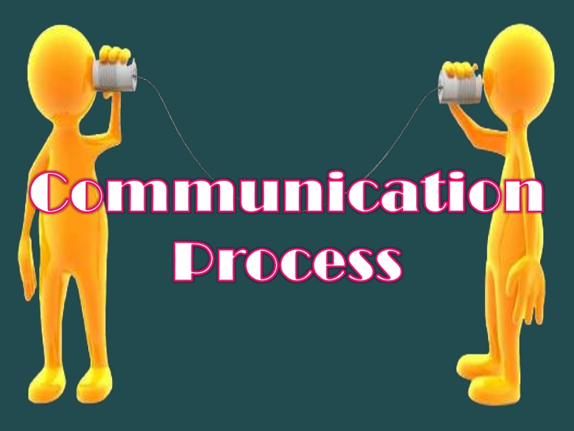
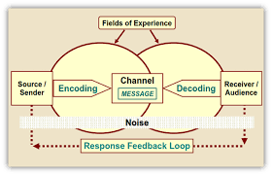

The communication is a dynamic process that begins with the conceptualizing of ideas by the sender who then transmits the message through a channel to the receiver, who in turn gives the feedback in the form of some message or signal within the given time frame.

Slide 6

1. Sender
The sender or the communicator generates the message and conveys it to the receiver. He is the source and the one who starts the communication
2. Message
It is the idea, information, view, fact, feeling, etc. that is generated by the sender and is then intended to be communicated further.
Communication process
Sender
Message
Encoding
Media
Decoding
Receiver
Feedback
Noise
3. Encoding
The message generated by the sender is encoded symbolically such as in the form of words, pictures, gestures, etc. before it is being conveyed.
4. Media
It is the manner in which the encoded message is transmitted. The message may be transmitted orally or in writing. The medium of communication includes telephone, internet, post, fax, e-mail, etc. The choice of medium is decided by the sender.

Slide 7

5. Decoding
It is the process of converting the symbols encoded by the sender. After decoding the message is received by the receiver.
6. Receiver
He is the person who is last in the chain and for whom the message was sent by the sender. Once the receiver receives the message and understands it in proper perspective and acts according to the message, only then the purpose of communication is successful.
7. Feedback
Once the receiver confirms to the sender that he has received the message and understood it, the process of communication is complete.
8. Noise
It refers to any obstruction that is caused by the sender, message or receiver during the process of communication. For example, bad telephone connection, faulty encoding, faulty decoding, inattentive receiver, poor understanding of message due to prejudice or inappropriate gestures, etc.

Slide 8

1. The Basis of Co-ordination
The manager explains to the employees the organizational goals, modes of their achievement and also the interpersonal relationship among them. This provides coordination between various employees and also departments. Thus, communications act as a basis for coordination in the organization.
Importance of Communication
The Basis of Co-ordination
Fluent Working
The Basis of Decision Making
Increases Managerial Efficiency
Increases Cooperation and Organizational Peace
Boosts Morale of the Employees
2. Fluent Working
A manager coordinates the human and physical elements of an organization to run it smoothly and efficiently. This coordination is not possible without proper communication.
3. The Basis of Decision Making
Proper communication provides information to the manager that is useful for decision making. No decisions could be taken in the absence of information. Thus, communication is the basis for taking the right decisions.

Slide 9

4. Increases Managerial Efficiency
The manager conveys the targets and issues instructions and allocates jobs to the subordinates. All of these aspects involve communication. Thus, communication is essential for the quick and effective performance of the managers and the entire organization.
5. Increases Cooperation and Organizational Peace
The two-way communication process promotes co-operation and mutual understanding amongst the workers and also between them and the management. This leads to less friction and thus leads to industrial peace in the factory and efficient operations.
6. Boosts Morale of the Employees
Good communication helps the workers to adjust to the physical and social aspect of work. It also improves good human relations in the industry. An efficient system of communication enables the management to motivate, influence and satisfy the subordinates which in turn boosts their morale and keeps them motivated.

Slide 10
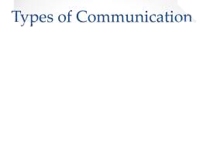

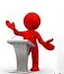
1. Formal Communication
Formal communications are the one which flows through the official channels designed in the organizational chart. It may take place between a superior and a subordinate, a subordinate and a superior or among the same cadre employees or managers. These communications can be oral or in writing and are generally recorded and filed in the office.
Formal communication may be further classified as Vertical communication and Horizontal communication.

Slide 11

1.Vertical Communication
Vertical Communications as the name suggests flows vertically upwards or downwards through formal channels. Upward communication refers to the flow of communication from a subordinate to a superior whereas downward communication flows from a superior to a subordinate.
Application for grant of leave, submission of a progress report, request for loans etc. are some of the examples of upward communication. Sending notice to employees to attend a meeting, delegating work to the subordinates, informing them about the company policies, etc. are some examples of downward communication.
2.Horizontal Communication
Horizontal or lateral communication takes place between one division and another. For example, a production manager may contact the finance manager to discuss the delivery of raw material or its purchase.

Slide 12
Types of formal communication
SINGLE CHAIN: In this type of network communications flows from every superior to his subordinate through a single chain.
WHEEL: In this network, all subordinates under one superior communicate through him only. They are not allowed to talk among themselves.
CIRCULAR: In this type of network, the communication moves in a circle. Each person is able to communicate with his adjoining two persons only.
FREE FLOW: In this network, each person can communicate with any other person freely. There is no restriction.
INVERTED V: In this type of network, a subordinate is allowed to communicate with his immediate superior as well as his superior’s superior also. However, in the latter case, only ordained communication takes place.

Slide 13
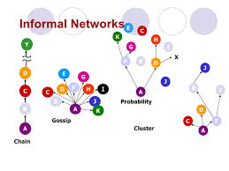

2. Informal Communication
Any communication that takes place without following the formal channels of communication is said to be informal communication. The Informal communication is often referred to as the ‘grapevine’ as it spreads throughout the organization and in all directions without any regard to the levels of authority.
The informal communication spreads rapidly, often gets distorted and it is very difficult to detect the source of such communication. It also leads to rumors which are not true. People’s behavior is often affected by the rumors and informal discussions which sometimes may hamper the work environment.

Slide 14


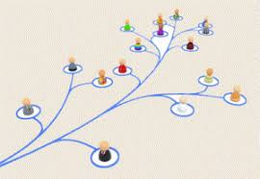
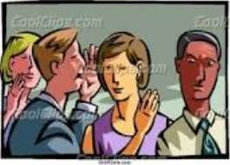
Types of Grapevine network
Single strand:
In this network, each person communicates with the other in a sequence.
Gossip network:
In this type of network, each person communicates with all other persons on a non-selective basis.
Probability network:
In this network, the individual communicates randomly with other individuals.
Cluster Network:
In this network, the individual communicates with only those people whom he trusts. Out of these four types of networks, the Cluster network is the most popular in organizations.

Slide 15
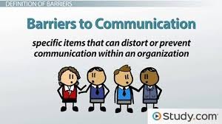

The communication barriers may prevent communication or carry incorrect meaning due to which misunderstandings may be created. Therefore, it is essential for a manager to identify such barriers and take appropriate measures to overcome them. The barriers to communication in organizations can be broadly grouped as follows:

Slide 16
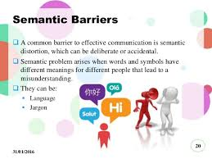
1. Semantic Barriers
These are concerned with the problems and obstructions in the process of encoding and decoding of a message into words or impressions. Normally, such barriers result due to use of wrong words, faulty translations, different interpretations, etc.
For example, a manager has to communicate with workers who have no knowledge of the English language and on the other side, he is not well conversant with the Hindi language. Here, language is a barrier to communication as the manager may not be able to communicate properly with the workers.

Slide 17

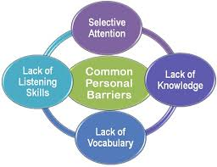
2. Psychological Barriers
Emotional or psychological factors also act as barriers to communication. The state of mind of both sender and receiver of communication reflects in effective communication. A worried person cannot communicate properly and an angry recipient cannot understand the message properly.
Thus, at the time of communication, both the sender and the receiver need to be psychologically sound. Also, they should trust each other. If they do not believe each other, they cannot understand each other’s message in its original sense.
3. Organizational Barriers
The factors related to organizational structure, rules and regulations authority relationships, etc. may sometimes act as barriers to effective communication. In an organization with a highly centralized pattern, people may not be encouraged to have free communication. Also, rigid rules and regulations and cumbersome procedures may also become a hurdle to communication.

Slide 18
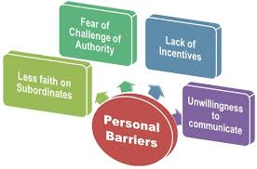
4. Personal Barriers
The personal factors of both sender and receiver may act as a barrier to effective communication. If a superior thinks that a particular communication may adversely affect his authority, he may suppress such communication.
Also, if the superiors do not have confidence in the competency of their subordinates, they may not ask for their advice. The subordinates may not be willing to offer useful suggestions in the absence of any reward or appreciation for a good suggestion.

Slide 19
CONCLUSION
Communication in Organizations is characterized as the procedure by which information is transmitted and comprehended between at least two person.
The communicational parts of a business have turned into a progressively strategic issue underlining that communication must be successfully balanced for the planned target group.
Communication can be portrayed as data moving through different channels between a sender and a recipient, including adaptation of a message and elements of disturbance in the process. Senders and receivers of information portray a photo that is labeled a profile.
Communication also includes non-verbal messages, for example, pictures, logos and images.

Slide 20



