Slide 1
Networking
Presented
By
Dr. K. Punitha Devi
Head & Asst. Prof. of Commerce(CA)
Bon Secours College for Women,
Thanjavur.

Slide 2


Introduction
The need of human beings to communicate gave rise to various forms of communication techniques. Networking is one of them. Today computers are being used to send information across the globe. A stand alone computer, which is a very efficient and productive tool by itself, can be made more so by connecting it with other computers. Networking now plays a major role in computing application.
A computer network, often simply referred to as a network, is a collection of computers and devices interconnected by communications channels that facilitate communications among users and allows users to share resources.
A computer network allows sharing of resources and information among interconnected devices.
In the 1960s, the Advanced Research Projects Agency (ARPA) started funding the design of the Advanced Research Projects Agency Network (ARPANET) for the United States Department of Defense.

Slide 3
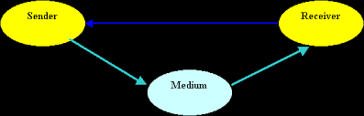
Communication
Communication is the transfer of information from one place to another. The process of communication essentially involves the following three components.
Sender: The component from where the information is transferred.
Receiver: The component to which the information is transferred.
Medium: The component through which the information is transferred.
In our day-to-day lives we come across various forms of communication.
Every form of communication involves a sender, a receiver and a medium connectng them.

Slide 4
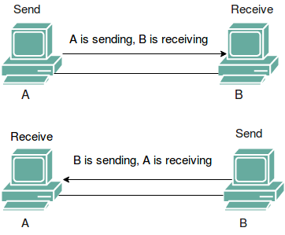
The form of communication that is becoming popular these days is communication between computers. In this form of communication, the sender and receiver are both computers and the medium through which the information is transferred may be electromagnetic waves, cables or other such physical media.
The need of human beings to communication gave rise to various forms of communication techniques. Networking is one of them. Today computers are being used to send information across the globe. A standalone computer, which is a very efficient and productive tool by itself, can be made more so by connecting it with other computers. Networking now plays a major role in computing applications.

Slide 5
Why Network exists?
During 80’s, the concept of desktop computers working independently was very popular. This was, and still is called the stand-alone environment.
Slowly, businessmen all over the world began to realize that information was useful only when it was communicated between human beings. The process of distributing and processing information among individuals, each with an independent desktop computer being slow and prone to error, led to the concept of connecting computers together to form computer networks.

Slide 6
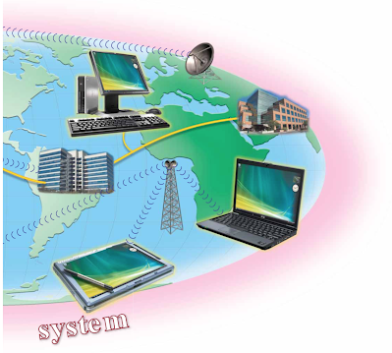
Computer Networks
A computer network is a communication system where a group of computers and other devices like printers are connected by cables and other hardware. The data is shared between the computers. A network, besides facilitating data communication, allows resources to be shared among all the systems connected to the network. Thus, users on the second floor of a building can use the printer on the eleventh floor if their computer and the printer are connected to the network. This concept of connected computers sharing resources is called networking.

Slide 7
Computers that are connected in a network can share:
      Data
      Messages
      Printers
      Hard Disks
      CD-ROMs
      Modems
      Other hardware resources

Slide 8
Advantages of Network
Networks allow efficient management of resources. For example, multiple users can share a single high-quality printer, rather than having multiple, possibly lower printers on individual desktops.
Networks help keep information reliable and up-to-date. A well managed, centralized data storage system allows multiple users to access data from different locations.
Networks help speed up data sharing. Transferring files across a network is always faster than other non-network means of sharing files.
Services like electronic mail being offered by computer networks, allow much more efficient communication among individuals.

Slide 9
Types of Network
Networks can be classified as follows:
Local Area Network (LAN):
If a network is confined to a single location, typically one building or complex, it is called a Local Area Network. The maximum distance from one end of a network to another is usually limited by the signal strength or the network system’s built-in time limit for sending and receiving messages through a physical connection, such as a cable.
Wide Area Network (WAN):
As the advantages of networking became known, business saw the need to expand the networks. LANs could not adequately support the network needs of a large business, with offices and operations spread over a wide area. This led to the development of Wide Area Networks.

Slide 10
When a network is spread over wide areas, such as across cities, states or countries, it is called a Wide Area Network. Communication on a WAN takes place via telephone lines, satellites or microwave links, rather than through a physical cable.
Metropolitan Area Network (MAN):
In between LAN and WAN is the Metropolitan Area Netork. A MAN is a network that covers an entre city, but uses LAN technology. Cable television networks are examples of MANs distributing television signals. The MANs we are interested in, carry information in the form of computer signals from one computer to another.

Slide 11
Components of Network
The following are the components and features that all networks have in common:
Server: Computers that provide shared resources to network users.
Clients: Computers that access shared network resources provided by a server.
Media: The way in which the computers are connected.
Resources: Files, printers or other items to be used by network users.
Even with these shared components, networks can be divided into two broad categories:
Server – Based networks
Peer-to-peer netwoks

Slide 12
Server-Based network:
Most networks have a dedicated server. A dedicated server is a computer on a network that functions as a server, and is not used as a client or a workstation. A dedicated server is optimized to service requests from network clients.
Servers perform a wide variety of tasks. Usually, large networks have specialized servers for different tasks.
Examples of specialized servers are:
File and print servers – manage user access and use of file and printer resources.
Application servers – make the data on the server available to clients.
Mail servers – manage electronic messaging between network users.
Communication servers – handle data flow and E-mail messages.

Slide 13
Peer-to-peer Networks:
In a peer-to-peer network, there are no dedicated servers. All the computers are equal and, therefore are termed as peers. Normally each computer functions as both a client and a server.
A peer-to-peer network has the advantage of simplicity in design and maintenance. It is usually less expensive to set up as compared to server-based networks. Peer-to-peer networks are also called workgroups. The term workgroup implies a small group of users.
Peer-to-peer networks are suitable for environments where:
There are limited users (usually 10 or less)
The users are located in the same area
Security is not an important issue
The organization and the network have limited growth
Users need to freely access data and programs that reside on other computers across the network.

Slide 14
In a peer-to-peer network there is no one assigned to be an administrator responsible for the entire network. Users administer their own computers. All users can share any of their resources.
The features of peer-to-peer and server-based networks
Features | Peer-to-peer Network | Server-based Network
Size | Good for up to 10 users | Limited only by server and network hardware
Security | Users are responsible for their own security | Offers extensive user security
Administration | Is administrated by the user of each computer | Is centrally administered

Slide 15
Thank you

