Slide 1

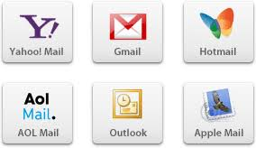
CREATION OF MAIL ID
S.JAYALAKSHMI
Assistant Professor
BON SECOURS COLLEGE FOR WOMEN, THANJAVUR.

Slide 2
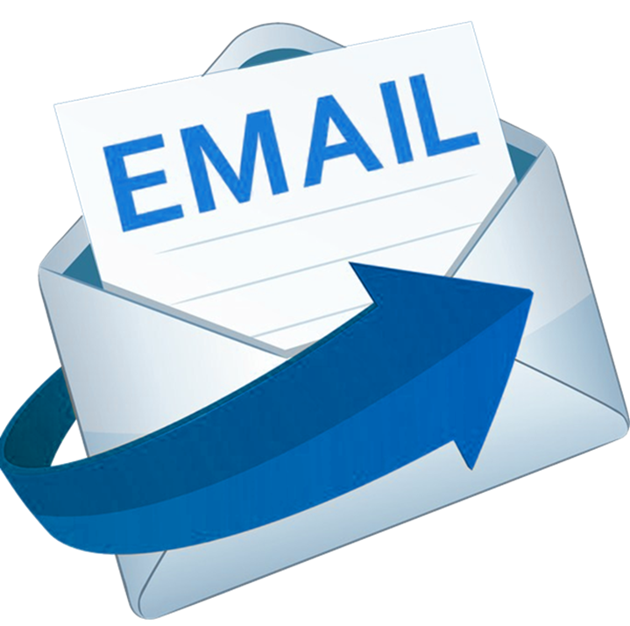
MEANING
Electronic mail is a way to exchange messages between people using electronic devices. When Detected by Retalminson, the email first entered limited usage in the 1960s and by the middle of the 1970s, this form was now recognized as an email.
Before the Internet, we used to write letters and write down the name and address of the letter that was to be sent and put it in the post box. Through the Internet, the process of email is the same but it is very fast.

Slide 3

How to create an e-mail id ?

Slide 4
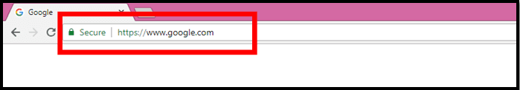
Step 1:
First of all, open your laptop or computer’s browser and type Google in Address Bar as shown in the below image

Slide 5
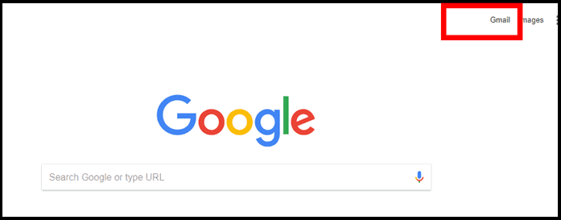
Step 2:
Google’s screen will open and something like this will open in front of you. Click on the right side Gmail will appear.

Slide 6
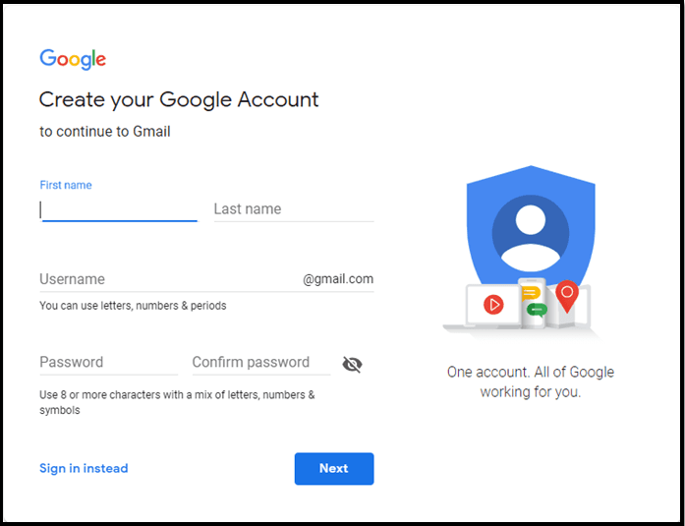
Step 3: Now a form will open in front of you in the new window which will read to fill you with something like this.
In First Name: you get the first word
Your Last Word in the Last Name
Example:
If your name is Swetha Murugesan then Swetha will be your First Name and Murugesan will be your Last Name
In Username: you will have to fill in the name you want to create an Email ID.
Create Password: You have to create a password for your email ID.
The password must be at least 8 digits.
The password should contain numbers of special symbols and words Example: A @ 12345678

Slide 7
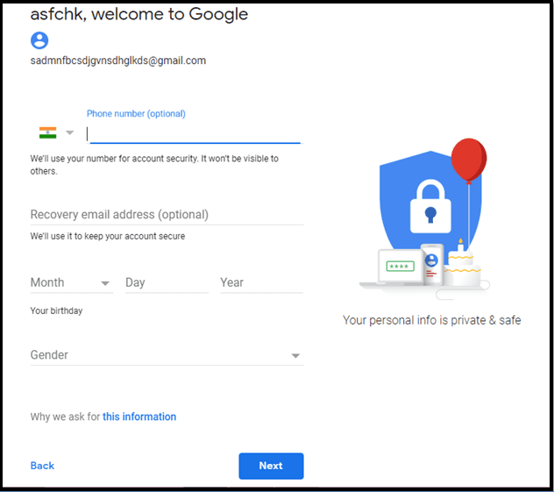
Step 4:
Phone Number: You have to fill your phone number
You will be filled up your date of birth, the first time you were born in the last day and the last year, all these details are necessary.
Gender: If you are a boy in a gender then Male and girl, then select Female.
Click the Next button.

Slide 8
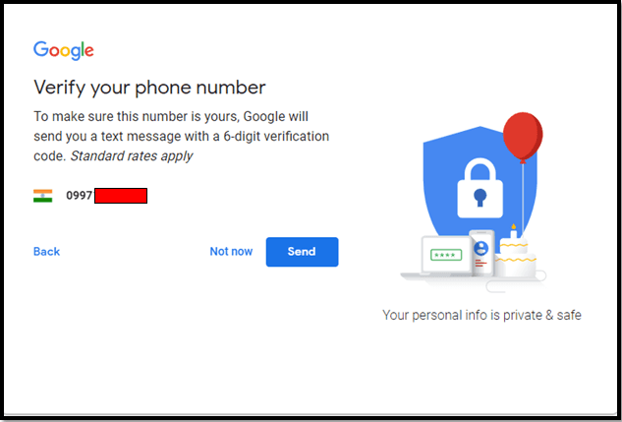
Step 5:
In this step, Google will verify your mobile number. And will send a 6 digit code on your mobile. By filling out the code you can get the mobile number verified. After the verification click on Next button

Slide 9
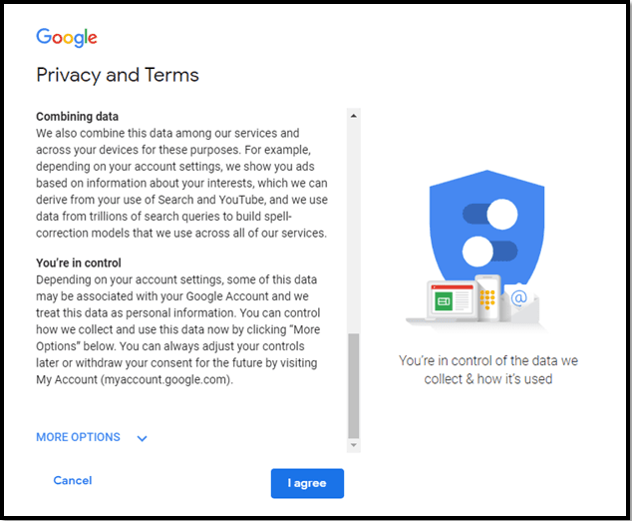
Step 6:
Now you will open a new window in this window, in this window you will need to read Google’s term and condition and click on ‘I Accept’.
Then your e-mail id created successfully

Slide 10


