Slide 1

Dr.S.BELLARMIN DIANA
ASSISTANT PROFESSOR
PG & RESEARCH DEPARTMENT OF MANAGEMENT STUDIES
BON SECOURS COLLEGE FOR WOMEN, THANJAVUR.

Slide 2


FINANCIAL SYSTEM – AN INTRODUCTION
Financial system comprises of set of subsystems of financial institutions, financial markets, financial instruments and services which helps in the formation of capital. It provides a mechanism by which savings are transformed to investment.
A financial system functions as an intermediary between savers and investors. It facilitates the flow of funds from the areas of surplus to the areas of deficit. It is concerned about the money, credit and finance.

Slide 3

FINANCIAL SYSTEM – AN INTRODUCTION
Direct Finance
FUND
FUND
FUND
Borrower- Spender
Business firms
Government
Households
Foreigners
Lender – Saver
Households
Business firms
Government
Foreigners
Financial
Markets
FUND
FUND
Direct Finance

Slide 4
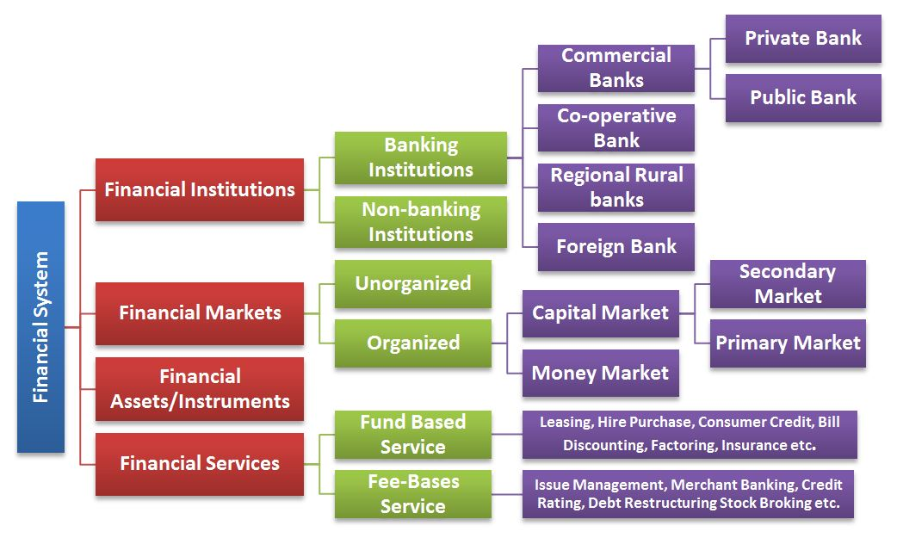


Slide 5

FINANCIAL SERVICES
Financial services refer to services provided by the finance industry
It may be defined as the products and services offered by financial institutions for the facilitation of various financial transactions and other related activities
It can also be called financial intermediation. Financial intermediation is a process by which funds are mobilized from a large number of savers and make them available to all those who are in need of it and particularly to corporate customers. There are various institutions which render financial services. Some of the institutions are banks, investment companies, accounting firms, financial institutions, merchant banks, leasing companies, venture capital companies, factoring companies, mutual funds etc.

Slide 6

FUNCTIONS OF FINANCIAL SERVICES
Facilitating transactions (exchange of goods and services) in the economy.
Mobilizing savings (for which the outlets would otherwise be much more limited).
Allocating capital funds (notably to finance productive investment).
Monitoring managers (so that the funds allocated will be spent as envisaged).
Transforming risk (reducing it through aggregation and enabling it to be carried by those more willing to bear it).

Slide 7

NATURE OF FINANCIAL SERVICES
Intangibility
Inseparability
Perishability
Variability
Dominance of human element
Information based

Slide 8

IMPORTANCE OF FINANCIAL SERVICES
Creation of employment opportunities
Contribution to GNP
PROVISION OF LIQUIDITY
Capital
formation
Promotion of
Savings
ECONOMIC
Growth

Slide 9

CONSTITUENTS OF FINANCIAL SERVICES
Constituents
Financial
Instruments
Market
Players
Regulatory
Bodies
Specialized
Institutions
Commercial
Banks
Market makers
Underwriters
Stock brokers
Financing
Companies
Consultants

Slide 10
CLASSIFICATION OF FINANCIAL SERVICES
Fund based services
leasing
Insurance services
Housing
Finance
Venture
capital
Bill discounting
Forfaiting
Mutual fund
Factoring
Hire purchase
Fee based services
Loan syndication
Securitization
Merchant banking
Credit rating
Stock broking
Custodial services

Slide 11
CHALLENGES FACING FINANCIAL SERVICES SECTOR
Lack of investor awareness
Lack of specialization
Lack of recent data
Lack of transparency
Lack of qualified personnel
Lack of efficient risk management system

Slide 12
PRESENT SCENARIO
PROCESS OF LIBERALIZATION
EMERGENCE OF PRIMARY EQUITY MARKET
CONCEPT OF CREDIT RATING
PROCESS OF GLOBALIZATION
CONSERVATISM TO DYNAMISM

Slide 13
THANK YOU

