Slide 1
S.SWEETY ELIZABETH THANGAM,
ASSISTANT PROFESSOR,
DEPARTMENT OF COMMERCE,
BON SECOURS COLLEGE FOR WOMEN,
THANJAVUR-613006
INSOLVENCY ACCOUNT STATEMENT OF AFFAIRS

Slide 2
INTRODUCTION
A person is commonly said to be insolvent if he is unable to meet his liabilities as and when claimed. That is, when a person becomes heavily indebted due to various circumstances and it be­comes impossible for him to pay his debts fully. In law, the term “insolvent” is restricted to a person whose liabilities exceed his assets and against whom the court makes an order of adjudication.
Thus insolvent is a person who is not in a position to pay his liabilities in full and has been declared as an insolvent by an Insolvency court. Insolvency means the procedure by which the State takes in its possession the property of the Debtor for realization and equitable distribution among the creditors of the insolvent.

Slide 3
ACT Of INSOLVENCY IS COMMITTED
When a person transfers his property, wholly or partly, to a third person for the benefit of his creditors.
When he transfers his property with the intention to defraud or delay his creditors.
When he notifies his creditors that he has suspended or is about to suspend payment of his debts.
When he departs from or remains out of India.
When he departs from his dwelling house or usual place of business or otherwise absents himself.
When the debtor is imprisoned in execution of a court degree for payment money.

Slide 4
When any of the property of the debtor is sold or attached for a period of not less than 21 days in execution of a degree of any court.
When he secludes himself so as to deprive his creditors of the means of communicating with him.
When the debtor petitions the court to be adjudged an insolvent.
When an insolvent-debtor transfers property or pays a particular creditor in preference to another creditor, more than what he could have got had the insolvent’s assets been proportionately distributed amongst all the creditors, he is deemed to have shown fraudulent preference in favors of a particular creditor

Slide 5
INSOLVENCY PROCEDURE
1. A petition for adjudication as insolvent may be presented either by the debtor himself or by the creditor to the appropriate Insolvency Court.
2. A creditor shall not be entitled to present insolvency petition unless the debt, singly or jointly, is at least Rs. 500 and the Debtor commits an act of insolvency.
3. When the petition is admitted, the Court fixes a date for hearing the petition.
4. When the petition is admitted, Court may appoint an Interim Receiver to take immediate possession of the property of the Debtor. The appointment of the Interim Receiver is compulsory only when the petition is filed by the Debtor himself.
5.The Interim Receiver functions till the regular officer is appointed.

Slide 6
6. On the date of hearing the petition, the court may either dismiss the petition or pass an order of adjudication. If the court is satisfied that the petition is reasonable, it shall make an order of adjudication.
7. It is only when this order of adjudication is passed that the Debtor is said to have been declared insolvent.
8. As soon as the Debtor is thus declared insolvent, all his property vests in an Officer, ap­pointed by the Court to conduct the insolvency proceeding. The officer is called “Official Receiver”, usually a lawyer, under the Provincial Insolvency Act or “Official Assignee” under the Presidency Towns Insolvency Act.
9. When the official Assignee or Receiver takes over the property of the insolvent, it becomes his duty to sell the property with all convenient speed, at reasonable price. 10. Out of the sale proceeds, the expenses of realization are met off and then the liabilities of the insolvent debtor are paid off to the possible extent.

Slide 7
11. A debtor may, at any time after the order of adjudication and within the period specified by the Court, apply to the court for an Order of Discharge.
12. The court may, if satisfied with the debtor’s conduct and the report of the Official Receiver, grant or refuse an order of Discharge.
13. The court may pass either an absolute or conditional Order of Discharge. On obtaining the order of absolute Discharge, the Debtor is freed from all his liabilities and can start his life afresh.
The Order of Discharge will release the insolvent from all debts and removes the disqualification imposed by the order of adjudication. He is not responsible for any debt which could not have been paid in full during his insolvency proceedings. Again, the Debtor becomes a free man and gets all the rights and privileges of an ordinary citizen of the country.
There are two legislations in India to protect the interests of Debtors. One is the Presidency Towns Insolvency Act of 1909 which is applicable to the cities of Bombay, Calcutta and Madras. And the other is the Provincial Insolvency Act of 1920 applicable to the rest of India.

Slide 8
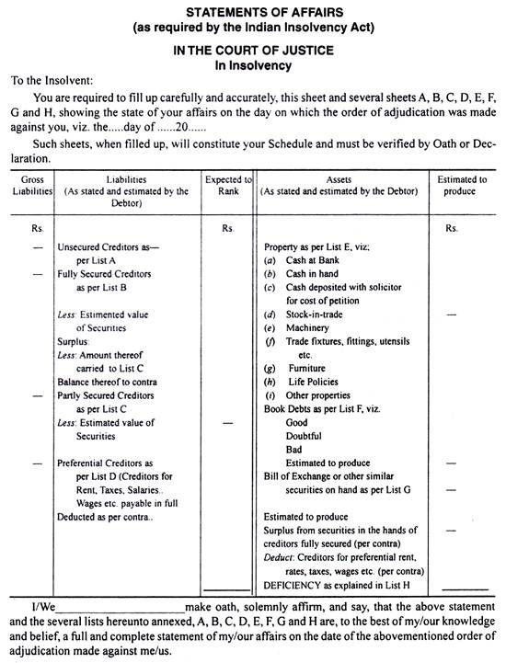

Slide 9
EXPLANA­TION Of EACH LIST
1. List A-Unsecured Creditors as per List A:
This list includes all Creditors, who do not possess any security of the Insolvent Debtor. That is, the Creditors without security fall under this list.
Some of such Creditors are:
  Trade Creditors without security
  Loan Creditors without security
  Bank Overdraft unsecured
  Bills Payable and Promissory Notes
  Bills Receivable discounted likely to be dishonoured
  Salary, Wages, Rent etc. over Preferential limit.

Slide 10
2. List B-Fully Secured Creditors:
This list includes all the Creditors, who have a claim against the debtor and have obtained a lien, guarantee or possession of some deeds or other securities. That is, the creditors, who have sufficient securities of the insolvent Debtor to meet their claims. The value of the securities may be equal to or more than the amount of their claims.
If there is any surplus of securities in the hands of fully secured creditors, such surplus will be shown on the asset side of the Statement of Affairs and will be available for distribution among the unsecured Creditors. For instance, if a loan of Rs 10,000 has been taken on a security worth Rs 15,000, this loan is fully secured. The Surplus of Rs. 5,000 (Rs. 15,000-10,000) is shown on the asset side of the Statement of Affairs.

Slide 11
  3. List C-Partly Secured Creditors:
There are certain Creditors, who have the security for a lesser value than the amount of their claims. That is, the Creditors of this type got only partial security for the loan advanced by them.
The securi­ties are insufficient to meet the claims. For instance, a loan of Rs 10,000 has been taken and the security for this loan is only Rs. 6,000. So, the loan is partly secured. The value of the security is not sufficient to cover their claims fully. The excess of loan over the security is shown in the outer col­umn.

Slide 12
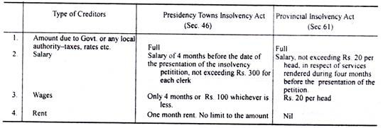
4. List D-Preferential Creditors:
This list shows the Preferential Creditors, who are entitled to priority over other debts of the insol­vent. For instance, taxes, rates, wages, salaries etc. are paid in full.
The amounts of the Preferential Creditors, who are paid in full, are shown in the inner column and this amount is to be deducted from the available assets.
The amount of salaries or wages or rent, in excess over the limit prescribed by the law, shall be included in the list of Unsecured Creditors under List A. All the above four lists, A to D, are shown in liability side of the Statement of Affairs.

Slide 13
5. List E-Properties:
This is a list which includes all the assets of the Insolvent, except Book Debts, Bills Receivable and assets which have not been given as security to Creditors. Here all the assets-unencumbered properties i.e., free assets are shown. For instance, Cash in hand, Cash at Bank, Furniture, Machinery etc. Both book value and realisation value are shown.
6. List F-Book Debts:
All the debtors of the insolvent are shown in this list. Good, Doubtful and Bad debts are shown separately.
7. List G—Bills of Exchange etc.:
This list contains the information about Bills Receivable and Promissory Notes. The book value and the realizable value are shown separately.

Slide 14
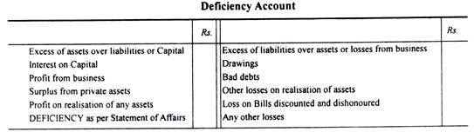
8. List H-Deficiency Account:
This list shows the deficiency i.e., liabilities of the Debtors over realizable value of his assets. For this purpose a separate Deficiency Account is prepared. (This is explained separately.) Now, after writing the Lists E, F and G, the surplus, as per List B, appears on the liability side, is added to the assets. From this amount, the Preferential Creditors as per List D are deducted. The balance, so arrived, is the amount of assets available for distribution among the Creditors.
Deficiency Account:
In addition to various lists- Lists A to List G-the Debtor has to prepare a Deficiency Account which explains as to how the deficiency shown in the Statement of Affairs has arisen. The insolvent debtor is required to account for the loss to the amount of his capital and of his Creditors.

Slide 15
On the left- hand side of Deficiency Account appears:
(1) The amount of capital,
(2) Increment to the Capital from the business i.e., profits, interest on capital, salaries, commission etc.,
(3) Additional contributions and
(4) Realisation profits etc.
On its right side appear all the losses and withdrawals by which capital is decreased. The difference between the two sides represents deficiency and this must agree with the deficiency amount as disclosed by the Statement of Affairs.

Slide 16
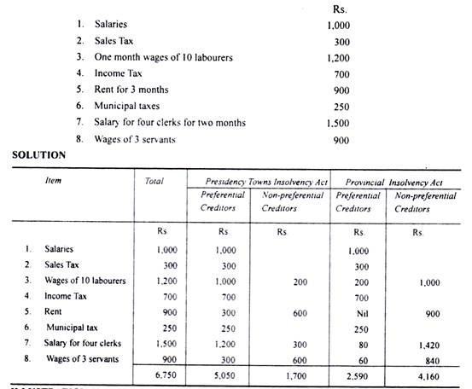
1.What are Preferential Creditors in the following liabilities of an insolvent, Gopal, according to the Presidency Towns Insolvency Act and Provincial Insolvency Act?

Slide 18
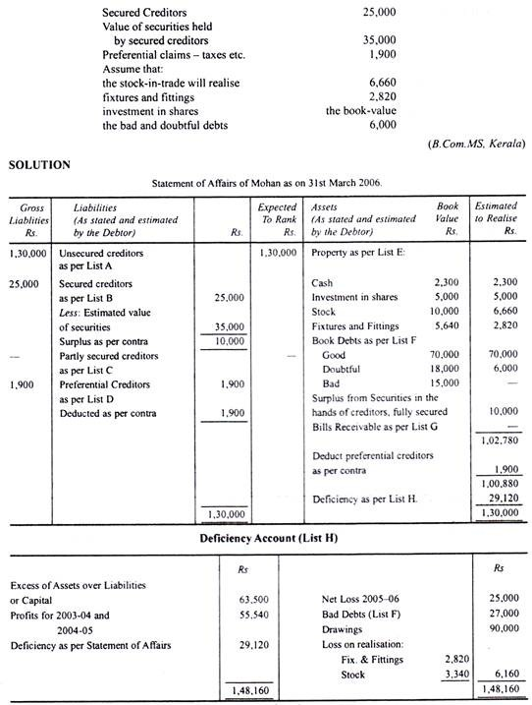
2.On 1st April 2003, Mohan commenced business with a capital of Rs. 63,500. His profits for the years 2003-04 and 2004-05 amounted to Rs. 55,540. He suffered a loss of Rs. 25,000 in the year 2005-06. His total drawings up to 31st March 2006 were Rs. 90,000. From the following figures, prepare a Statement of Affairs and Deficiency Account of Mohan as at 31st March 2006:

Slide 20
THANK YOU

