Slide 1
ngah; : gh.mDuhjh

Slide 2
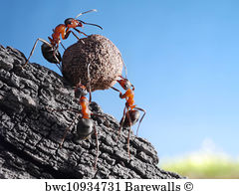
gonkhop ehD}W
“njhd;W gL gonkhop ,d;W ngha;j;jd;W”
Mrphpah;: Kd;Wiwaiuadhh;.
,jidg; gjpg;gpj;jth; nry;t Nfrtuha Kjypahh; Mthh;

Slide 3

4. Kd; ,d;dh %j;jhh; tha;r;nrhy;
nray;Ntz;lh ey;yd nra;tpf;Fk; jPa
nray; Ntz;b epw;gpd; tpyf;Fk; ,fo; Nte;jd;
jd;id eype;J jdf;FWjp $wyhy;
Kd;dpd;dh %j;jhh;tha;r; nrhy;.

Slide 4
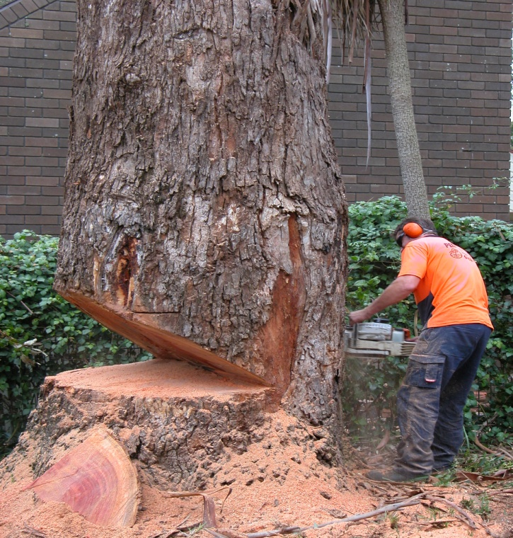
5. epidg;gpd;wpj; jhk; ,Ue;j NfhL Fiwj;Jtply;
ehb eknud;W ed;F Gue;jhiuf;
NfL gpwNuhL #o;jy; fpsh;kzp
ePLfy; ntw;g epidg;gpd;wpj; jhk; ,Ue;j
NfhL Fiwe;J tply;.

Slide 5
ed;wp

