Slide 1
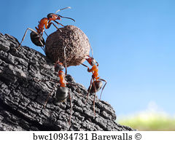
gonkhop ehD}W
“njhd;W gL gonkhop ,d;W ngha;j;jd;W”
Mrphpah;: Kd;Wiwaiuadhh;.
,jidg; gjpg;gpj;jth; nry;t Nfrtuha Kjypahh; Mthh;

Slide 2
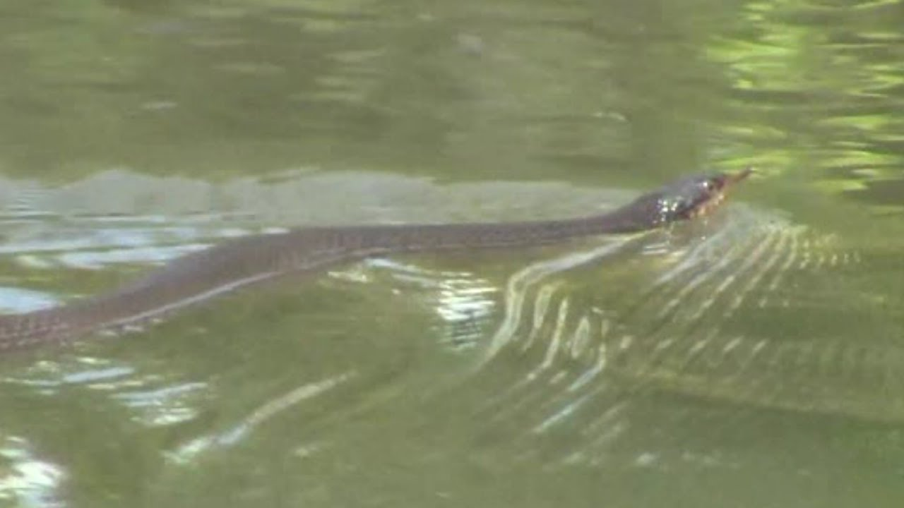
1. ghk;gwpAk; ghk;gpd; fhy;
Gykpf; ftiug; Gyik njhpjy;
Gykpf; fth;f;Nf GyNdhk;- eykpf;f
G+k;Gdy; Cu nghJkf;fl;(F) MfhNj
ghk;gwpAk; ghd;gpd; fhy;.

Slide 3
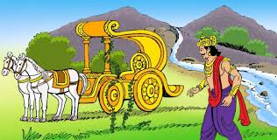
2. mwpklKk; rhd;Nwhh;f;F mzp
Ky;iyf;Fj; NjUk; kapYf;Fg; Nghh;itAk;
njhy;iy mspj;jhiuf; Nfl;lwpJk;- nrhy;ypd;
newpklh; g+e;jhio ePLePh;r; Nru;g;g
mwpklKk; rhd;Nwhh;f;(F) mzp

Slide 4
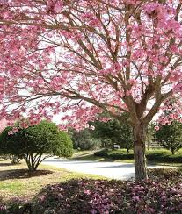
3. Ngijf;F ciuj;jhYk; Njhd;whJ czh;T
G+j;jhYk; fhah kuKs %j;jhYk;
ed;fwpahu; jhKk; edpAshu;- ghj;jp
tpijj;jhYk; ehwhj tpj;Js Ngijf;(F)
Ciuj;jhYk; Njhd;wh Jzh;T

