Slide 1
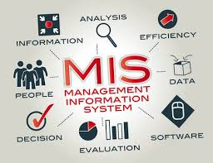
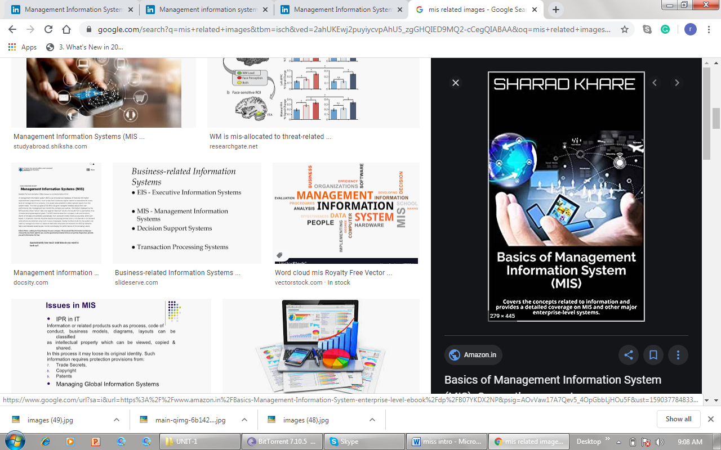

Slide 2
MANAGEMENT INFORMATION SYSTEM
MEANING:Management Information System is a formal method of collecting timely information ina resentable form. It is designed withn the frame work that emphasizes Profit, Planning Performance planning and control of all level.
DEFINATION: According to Phillip Kolter- MIS consist of people, equipment and procedure together, sort, analyse, evaluated and distribute the needed timely and accurted information and making decision makers

Slide 3
What is MIS?
Right information
To the right person
At the right place
At the right time
At the right form
At the right cost

Slide 4
CHARACTERISTICS OF A MANAGEMENT INFORATION SYSTEM
Provides reports with fixed and standard formats- Hard copy and soft copy report
Uses internal data stored in the computer system
End users can develop custom reports
Requires formal requests form users

Slide 5
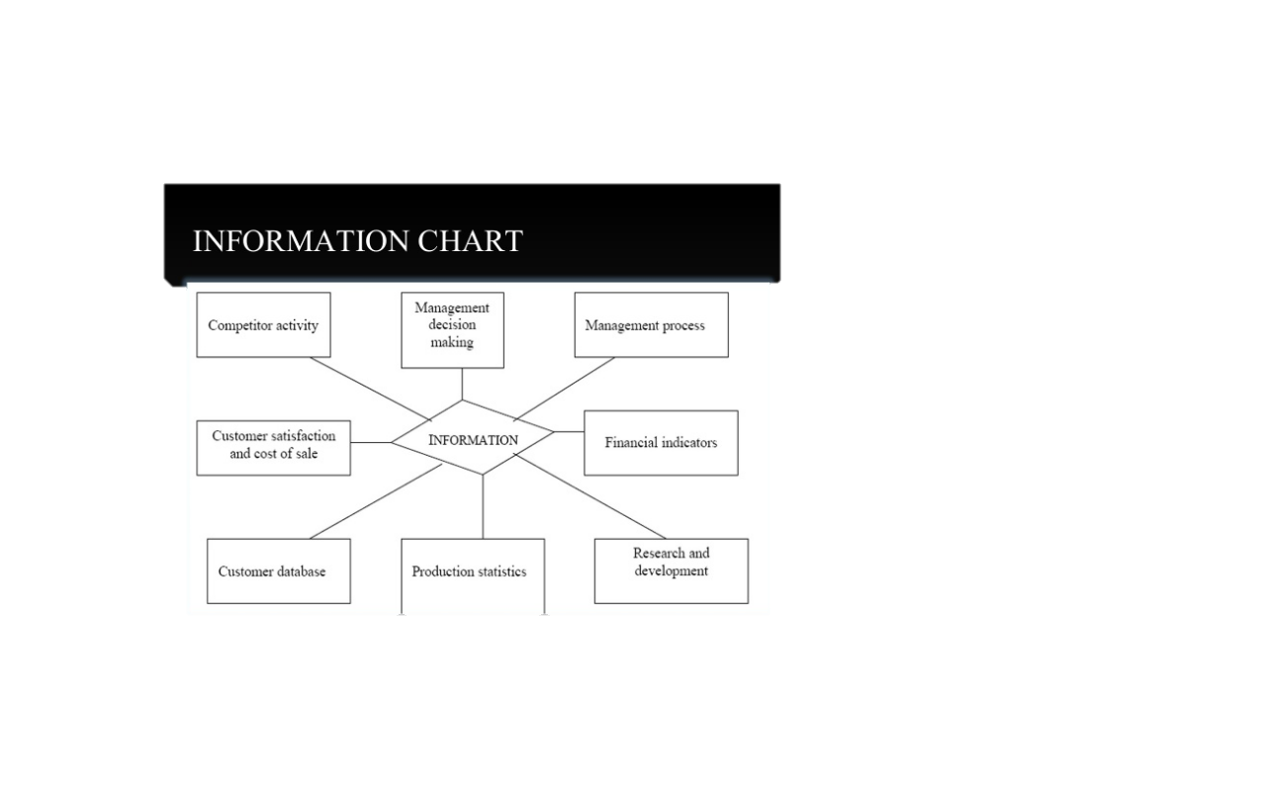

Slide 6
THE TYPICAL MIS IS BASED ON 4 MAJOR COMPONENTS
1.Data Gathering: Date pertinent to the operations of the organization are gathered form both external and internal sources.
2. Data Entry : The above data is inputted and stored in databases as the information processing core of the system
3. Data Transformation: Data is transformed into useful information through this application of computer software programs and judgements made by technical support staff and the system users.
4. Information Utilization: This useful information is retrieved as needed by the management and technical personnael and applied to wide variety of decisions related to the conduct of organizational operations.

Slide 7
TYPES OF MIS
TRANSATION PROCESSING SYSTEM (TPS)
TRANSATION PROCESSING SYSTEM (TPS)
TRANSATION PROCESSING SYSTEM (TPS)
TRANSATION PROCESSING SYSTEM (TPS)
TRANSATION PROCESSING SYSTEM (TPS)
DECISION SUPPORT SYSTEM (DSS)
DECISION SUPPORT SYSTEM (DSS)
DECISION SUPPORT SYSTEM (DSS)
DECISION SUPPORT SYSTEM (DSS)
EXECUTIVE INFORMATION SYSTEM(EIS)
EXECUTIVE INFORMATION SYSTEM(EIS)
EXECUTIVE INFORMATION SYSTEM(EIS)
EXECUTIVE INFORMATION SYSTEM(EIS)
MARKEING INFORMATIONSYSTEM (MIS)
MARKEING INFORMATIONSYSTEM (MIS)
MARKEING INFORMATIONSYSTEM (MIS)
MARKEING INFORMATIONSYSTEM (MIS)
OFFICE AUTOMATION SYSTEM (OAS)
OFFICE AUTOMATION SYSTEM (OAS)
SCHOOL MANGEMENT INFORMATION (SMI)

Slide 8
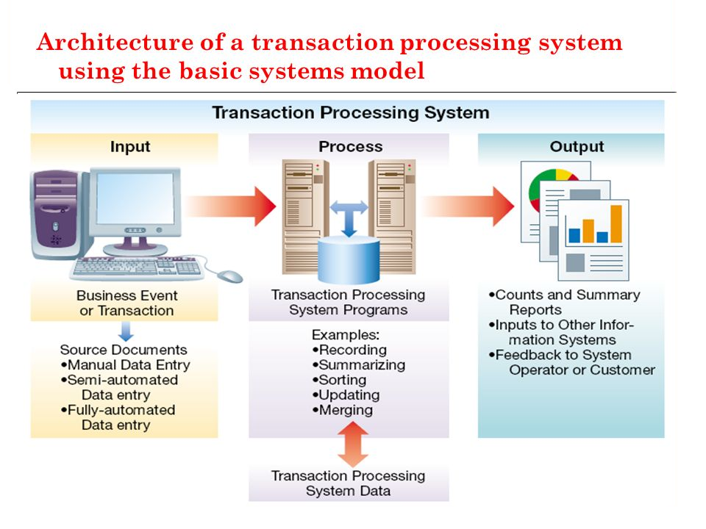
TRANSATION PROCESSING SYSTEM (TPS)
It produce fixed regularly scheduled reports based on data extracted and summarized from the firm’s underlying transaction processing system to middle and operational level manager’s to identify and inform structured and semi-structured decision problem.

Slide 9
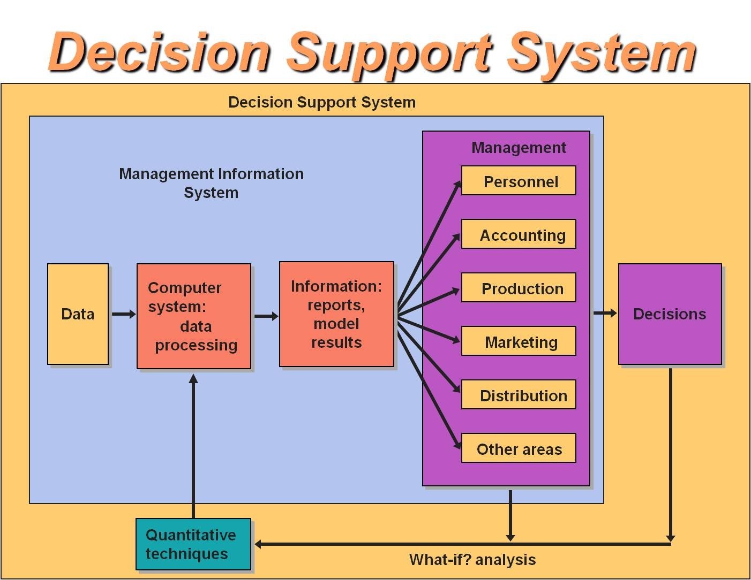
DECISION SUPPORT SYSTEM (DSS)
It is computer program applications used by middle management to compile information from a wide range of source to support problem solving and decision making.

Slide 10
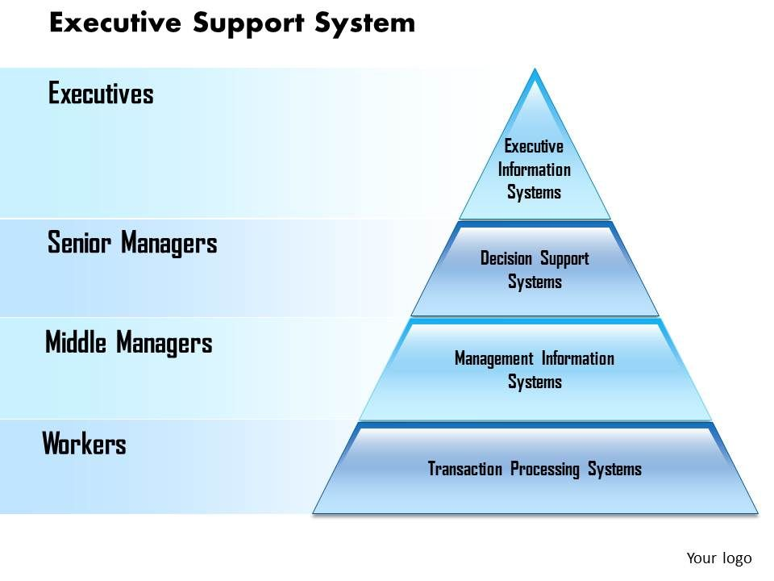
EXECUTIVE INFORMATION SYSTEM(EIS)
A reporting tool that provides quick access to summarized reports coming from all company levels and departments such as accounting human resources and operational

Slide 11
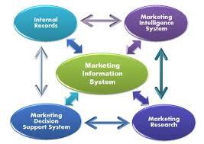
MARKEING INFORMATIONSYSTEM (MIS)
MIS designed specifically for Managing the marketing aspects of the business

Slide 12
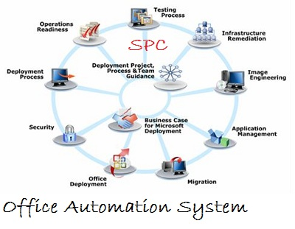
OFFICE AUTOMATION SYSTEM (OAS)
It support communication and productivity in the enterprise by automating work flow and eliminating bottlenecks. OAS may be implemented at any and all levels of management.

Slide 13
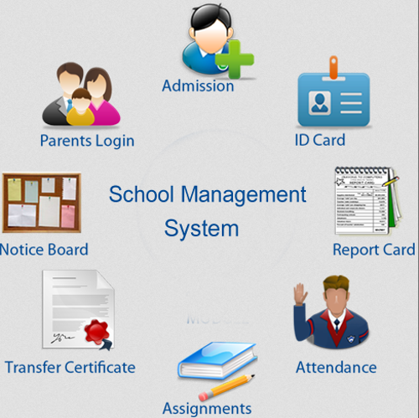
SCHOOL MANGEMENT INFORMATION (SMI)
It cover school administration and often including teaching and learning materials.

Slide 14
CONCLUSION
MIS differ form regular information system because the primary objective of these system are to analyze other system dealing with the operational activities in the organization.
MIS is a subject of the overall planning and control activities covering the application of humans, technologies and procedure of the organization within the field of scientific management. MIS is most of ten tailored to the automation or support of human decision marketing.

Slide 15


