Slide 1
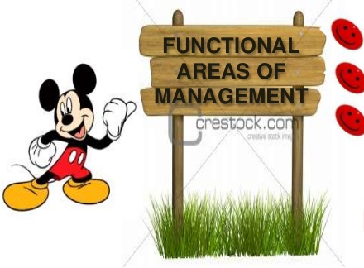


INFORMATION SYSTEM

Slide 2
ACCOUNTING INFORMATION SYSTEM
Accounting is one of the significant activities in any business. Accounting is mainly concerned with the collecting, recording and evaluation of financial data and then communicating this information to the management and other people, It is viewed as an information system since it has inputs process and outputs.
There are 3 general types of Accounting information systems:
FINANCIAL ACCOUNTING SYSTEM: This system provides financial statement to investors, governmental authorities and other interested parties in accordance with their reporting formats

Slide 3
MANAGEMENT ACCOUNTING SYSTEM:
It provides reports to managers both, for strategic and tactical decisions and on profitability of the organization.
COST ACCOUNTING SYSTEM:
It provides reports to managers for cost planning and cost control of operations.
All the above three types of accounting information systems process the same accounting transactions and often share the data files. Therefore, an accounting information system is generally developed as an integrated system providing all the report of the above three types. Many types of account books and financial statements can be generated by a financial.

Slide 4

The major Types of account books
Voucher
Journal
General Ledger
Purchase book
Sales book
Cash book
Bank book
Creditor’s ledger
Debtor’s ledger
Trial balance
Trading account
Profit and loss account
Balance sheet
Accounts Receivable statement
Accounts Payable statement

Slide 5
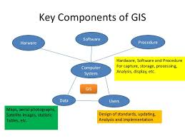
Geographical Information System
A Geographical information system(GIs) is a computer based system that stores and manipulated data that is viewed from a geographical point of reference.
This system has four main capabilities:
Data input
Data storage and retrieval
Data manipulation and analysis.
Data output

Slide 7
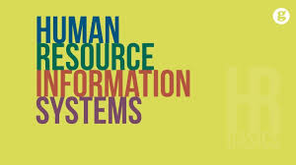
Human resource information system is a system that supports planning, control, co-ordination, administration and management of human resources of organizations. HRIS also includes a large number of subsystems that address the information , policies, and procedures concerning recruiting, layoffs, employee evaluation, promotion, termination, transfer, salary equity monitoring, job descriptions and responsibilities training etc,

Slide 8
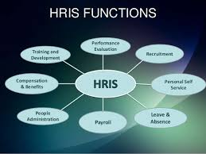

Slide 9
INVENTORY INFORMATION SYSTEM
Inventory refers to the stock of raw materials and finished goods available in the organization for production and sale. All organizations need an efficient system to maintain and control the optimum level of investment in all types of each item are maintained.
The major object for implementing a computerized inventory control in the organization are:
Maintain an optimum level of raw materials and finished goods inventory.
Preparation of purchases orders and inventory status reports accurately and on time.
Preparation of various analysis reports.
Generation of MIS reports that help management for making effective and timely decsions.

Slide 10
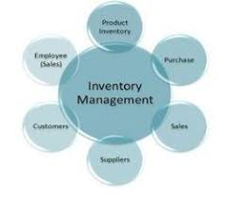

Slide 11
MANUFACTURING INFORMATION SYSTEM
Manufacturing information system is a system that supports the manufacturing functions of purchasing, receiving, quality control, inventory management, material requirements planning, capacity planning, production scheduling, and plant design. It applied to both manufacturing and service environments.
Information needed for manufacturing decisions stems from a variety of data sources as follows:
Production data
Inventory data
Vendor data
Personnel data
Union data
Labour data
External environment data
Engineering specifications
Internal Marketing data

Slide 12
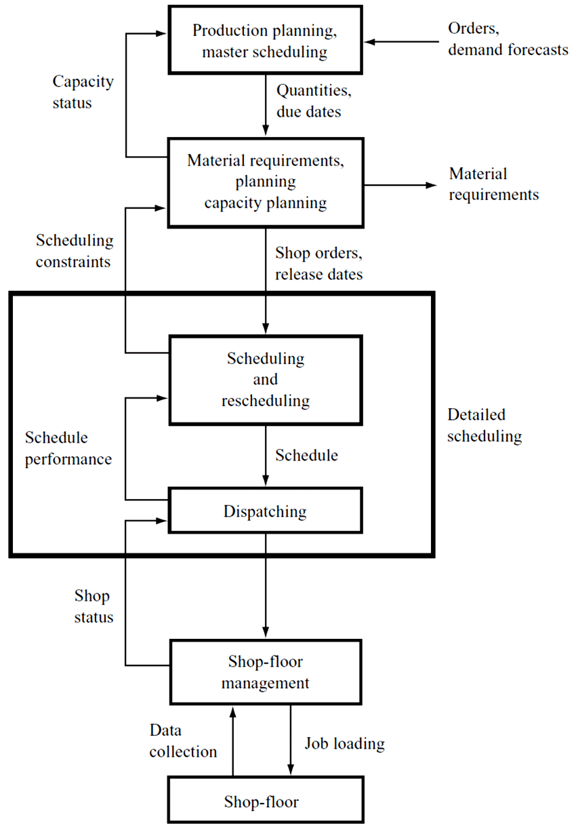

Slide 13

Conclusion. Therefore, MIS are made for a speedy access to accurate data and to help the managers achieve their goals. Management Information System (MIS) is so useful in the organization which it creates an impact on the organization's performance, functions, and of course productivity.
MIS

Slide 14


