Slide 1
COMPUTER FUNDAMENTALS
PREPARED BY
MS. R. GOMATHIJAYAM
ASSISTANT PROFESSOR
DEPARTMENT OF COMPUTER APPLICATIONS
BON SECOURS COLLEGE FOR WOMEN
THANJAVUR

Slide 2
Definition of Computer
A computer is a machine that can be instructed to carry out sequences of arithmetic or logical operations automatically via computer programming. Modern computers have the ability to follow generalized sets of operations, called programs. These programs enable computers to perform an extremely wide range of tasks.

Slide 3
Types of Computer
Computers can be generally classified by size and power as follows:
Personal computer
Workstation
Minicomputer
Mainframe
Supercomputer

Slide 4
Parts of a Computer System
Monitor
CPU (Central Processing Unit)
Keyboard
Mouse
Speakers
Printer

Slide 5
Characteristics of Computers
Speed
Accuracy
Diligence
Versatility
Power of Remembering
No IQ
No Feeling
Storage

Slide 6
Generation of Computers
The period of first generation: 1946-1959. Vacuum tube based.
The period of second generation: 1959-1965. Transistor based.
The period of third generation: 1965-1971. Integrated Circuit based.
The period of fourth generation: 1971-1980. VLSI microprocessor based.
The period of fifth generation: 1980-onwards. ULSI microprocessor based.

Slide 7
Computer memory
Computer memory is any physical device capable of storing information temporarily,
like RAM (random access memory), or permanently, like ROM (read-only memory). Memory devices utilize integrated circuits and are used by operating system, software and hardware.

Slide 8
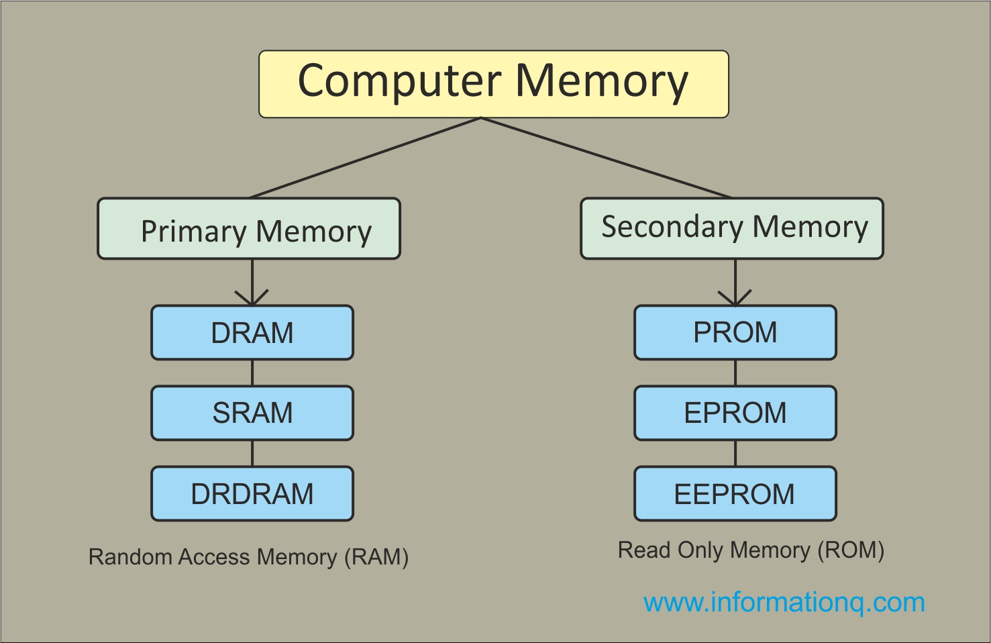
Types of Memory

Slide 9
Input Devices
Keyboard
Mouse
Touchpad
Scanner
Digital Camera
Microphone
Joystick
Graphic Tablet
Touch Screen
Webcam

Slide 10
Output Devices
Monitor
Printer
Headphones
Computer Speakers
Projector
GPS
Sound Card
Video Card
Braille Reader
Speech-Generating Device

Slide 11
Storage Devices
Hard Drive Disk
Floppy Disk
Tape
Compact Disc (CD)
DVD and Blu-ray Discs
USB Flash Drive
Secure Digital Card (SD Card)
Solid State Drive (SSD)
Cloud Storage
Punch Card

Slide 12
THANK YOU

