Slide 1
Principles of Information Technology
COMPUTER SOFTWARE
Ms. M. Florence Dayana
Head, Dept. of BCA
Bon Secours College for Women, Thanjavur

Slide 2
INTRODUCTION TO COMPUTER SOFTWARE
A computer needs both hardware and software for its proper functioning.
Software classified into two types
1. System software
2. Application software
System software consists of low-level programs that interact with the computer at a very basic level.
Application software also called end-user programs.
It includes database programs, word processors, and spreadsheets.

Slide 3
SOFTWARE TYPES
Systems Software | Applications Software
Operating Systems | Image Processors
File Management Tools | Word Processors
Assemblers | Databases
Compliers | Spreadsheets
Debuggers | Games
Utilities | Communication Software

Slide 4
CLASSES OF SOFTWARE
OPERATING SYSTEMS
Operating systems are the most important programs that run on a computer.
Operating systems include Microsoft Windows, DOS, Xenix, Mac OS, OS/2, UNIX, MVS, etc.
UTILITIES
Utility is a program that performs a very specific tasks, usually related to managing system resources.
For example: word processors, spreadsheet programs, and database applications.
COMPILERS AND INTERPRETERS
Compiler is a program that translate source code into object code.
The advantage of interpreters is that they execute a program immediately.

Slide 5
CLASSES OF SOFTWARE
WORD PROCESSORS
A word processor is a program that enables you to perform word processing functions.
Some of the commonly used word processors are Microsoft Word, WordStar, WordPerfect, Amipo, etc.
SPREADSHEETS
A Spreadsheet is a tables of values arranged in rows and columns.
PRESENTATION GRAPHICS
Presentation graphics enable users to create highly stylized images for slide shows and reports.
DATABASE MANAGEMENT SYSTEMS (DBMS)
A DBMS is a collection of programs that enables you to store, modify, and extract information from a database.

Slide 6
CLASSES OF SOFTWARE
IMAGE PROCESSORS
Image processors or graphics programs enable you to create, edit, manipulate, add special effects, view, print and save images.
PAINT PROGRAMS
A paint program is a graphics program that enables you to draw pictures on the display screen, which are represented as bit maps (bit mapped graphics).
DRAW PROGRAMS
A draw programs is another graphics program that enables you to draw pictures, then store the images in files, merge them into document, and print them.
IMAGE EDITORS
Image Editors is a graphics program that provides a variety of special features for altering bit-mapped images.

Slide 7
OPERATING SYSTEMS
INTRODUCTION
An operating systems manages and coordinates the functions performed by computer hardware, including the CPU, input/output devices, secondary storage devices, and communication and network equipment.
The primary purpose of an operating system is to maximize the productivity of a computer system by operating it in the most efficient manner and minimizing the amount of human intervention required.
Many operating systems are designed as a collection of program modules, which can be organized in combination with various capabilities around a central module, or kernel.
Example of popular microcomputer operating systems are Windows, DOS, OS/2, for PCs and Mac OS for Apple computers, etc. Some examples of operating systems for minicomputers are UNIX, OS/400, etc. An example of an operating system for a mainframe in MVS.

Slide 8
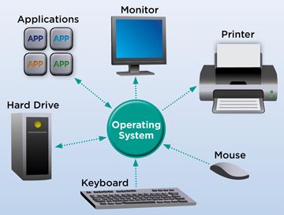
FUNCTIONS OF OPERATING SYSTEM

Slide 9
UNIX OPERATING SYSTEM
KERNEL
Interprets user’s commands
a. Programming languages
b. Text Processors
2. Interfaces with other subsystems
a. File and directory systems
3. Provides a flexible command language
a. Communications & Networking
b. Utilities
4. Shell
a. Programs

Slide 10
OPERATING SYSTEM
OS/2 Kernel
Presentation Manager
Communication Manager
Database Manager
Application Programming Interface
Device Drivers
Utilities
THE MVS OPERATING SYSTEM
Storage Management
Data Management
Recovery Management
Supervisor services
Job Entry Subsystems

Slide 11
FUNCTIONS OF AN OPERATING SYSTEM
Job Management - Job management software manages the jobs waiting to be proceed.
Batch Processing - System software is available to support the different methods of processing a job.
On-line Processing - In on-line processing, data are processed instantaneously.
Data Management - In the process of managing the resources of the computer system, operating system software also manages the storage and retrieval of data.
Virtual Storage - Operating systems also manages the allocation of main memory jobs. Some Operating system have a feature called virtual storage.
Input/Output Management - Operating systems also manage the input to and output from a computer system.

Slide 12
CLASSIFICATION OF OPERATING SYSTEM
Multi-user
Multi-user operating systems allow two or more users to run programs at the same time.
Multiprocessing
Multiprocessing refers to a computers system’s ability to support more than one process (program) at the same time.
Multitasking
Multitasking allows more than one program to run concurrently.
Two types are preemptive and cooperative
Multithreading
Multithreading is the ability of an operating system to execute different parts of program, called threads, simultaneously.
Real-time
Real-time operating systems are systems that respond to input immediately.

Slide 13
PROGRAMMING LANGUAGE
INTRODUCTION
Programming languages are said to be lower or higher, depending on whether they are closer to the language the computer itself uses or to the language that people use.
The five levels of language.
1. Machine Languages/First-generation languages
2. Assembly Languages/Second-generation languages
3. Procedural Language/Third-generation languages
4. Problem-oriented Languages/Fourth-generation Languages
5. Natural Languages/Fifth-generation Languages
The high-level languages – such as pascal, BASIC, and COBOL, and – are the ones used to code applications programs, it is described as a “user-friendly” language.

Slide 14
LANGUAGES
MACHINE LANGUAGES
The binary system is based on two digits - 0 and 1. The decimal system that we all use is based on ten digits - to 9.
Letters of the alphabet are also represented as numbers. Commas, semicolons, and other special characters are also represented as bunches of 0s and 1s.
ASSEMBLY LANGUAGES
Assembly languages, also known as symbolic languages use abbreviations or mnemonic code – codes more easily memorized – to replace the 0s and 1s of machine languages.
Assembly languages do not replace machine languages.
Assembly languages code is very similar in form to machine language code.

Slide 15
HIGH LEVEL LANGUAGES
High level languages assisted programmers by reducing further the number of computer operation details they had to specify, so that they could concentrate more on the logic needed to solve the problem.
High level languages into three generations:
1. Procedural-oriented or third generation
2. Problem-oriented or fourth generation
3. Natural or fifth generation

Slide 16
DIFFERENCES BETWEEN 3GLs and 4GLs
Third-generation languages | Fourth-generation languages
Use by professional programmers | Used by a non-programming end user as well as a professional programmers
All alternatives must be specified | Default alternatives are build in;
Require large number of procedural instructions | Require far fewer instructions
Code may be difficult to read, understand and maintain | Code is easy to understand and maintain because of English-like commands
Language developed for batch operation | Language developed primarily for on-line use.
Can be difficult to learn | Easy to learn
Difficult to debug | Easy to debug

Slide 17
NATURAL LANGUAGES
Natural languages are still in the developmental stages, but they promise to have profound effect, particularly in the areas of artificial intelligence and expert systems.
TWO CHARACTERISTICS
1.More humanlike
2. Smarter
Two popular natural languages are LISP and PROLOG

Slide 18
COMPILERS
In a complied language, a translation program is run to covert the programmer’s entire high-level program, which is called the source code, into a machine language code. This translation process is called compilation.
Some of the most widely used complied languages are COBOL, C, C++, FORTRAN, etc.
INTERPRETERS
In an interpreted language, a translation program converts each program statement into machine code just before the program statement is to be executed.
THE COMPILATION PROCESS
The objective of the compiler is to transform a program written in a high-level programming language from source code into object code.
Programmers write programs in a form called source code.

Slide 19
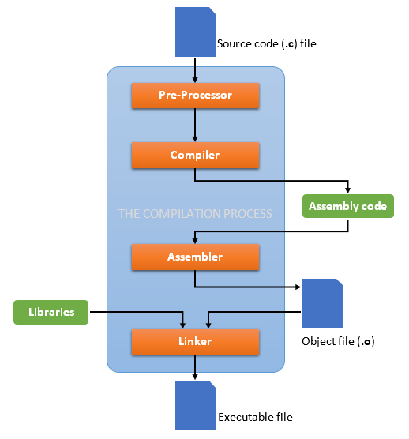
THE COMPILATION PROCESS

Slide 20
GENERAL SOFTWARE FEATURES AND TRENDS
INTRODUCTION
A series of instructions that perform a particular task is called a program.
System software is made up of control programs, communications software and database manager.
Application software is any program that process data for the user (inventory, payroll, spreadsheet, word processor, etc.
Computer software is becoming more and more complex and the amount of software that is being developed each year is increasing at an exponential rate.
The software is being used to control a range of activities from mission critical applications like controlling the operations of satellites and Intercontinental Ballistic and Missiles (ICBMs)
Software systems are subject to constant changes—during design, during development and even after development.

Slide 21
FEATURES AND TRENDS
EASE OF USE
The software systems and applications are becoming more and more easy to use.
GRAPHICAL USER INTERFACE (GUI)
GUI or graphical user interface has now become the de facto standard for most of the software applications.
MORE FEATURES
The number of new software companies and the number of new software products are increasing day by day.
MULTI-PLATFORM CAPABILITY
There are software applications that support hardware platforms ranging from mainframes to PCs and different software platforms like MVS, Solaris, AIX, UNIX, Windows and so on.
Important feature of today’s software applications is that they support multiple language and multiple currencies.

Slide 22
FEATURES AND TRENDS
NETWORK CAPABILITIES
Network computers are computers with minimal memory, disk, storage and processor power designed to connect to a network, especially the Internet.
COMPATIBILITY WITH OTHER SOFTWARE
User of one software can migrate or convert all his/her existing files to the other system without any trouble.
OBJECT LINKING AND EMBEDDING
OLE is a compound document standard developed by Microsoft Corporation. It enables you to create objects with one applications and then link or embed them in a second application.

Slide 23
FEATURES AND TRENDS
GROUPWORK CAPABILITIES
Groupware is an umbrella term describing the electronic technologies they support person-to-person collaboration. Groupware includes E-mail, Electronic Meeting system (EMS), Desktop Video Conferencing (DVC) as well as systems for workflow and Business Process Re-engineering (BPR).
MAIL ENABLING
The mail enabling of an application is the process through which e-mail is gradually replacing many of the single purpose applications now used on personal computers.
Mail enabled applications are designed to capitalize on e-mail.

Slide 24
FEATURES AND TRENDS
WEB ENABLING
Web enabling helps the user in many different ways. Its use starts while the user is installing the applications.
Today’s web-enabled software programs are capable of accessing the Internet for getting the information they do not have locally on the user’s machine.
For example, Word 2000 can now connect to the Microsoft’s web site and get clipart images and pictures that are not available on the local machine or if the user is not satisfied with the available images.

Slide 25
THANK YOU

