Slide 1
Computer networking Basics
Prepared by,
G.Sripriya,
Department of computer Applications ,
Bon secours college for women,
Thanjavur.

Slide 2
What is computer Networks:
Computer networks share common devices, functions, and features including servers, clients, transmission media, shared data, shared printers and other hardware and software resources, network interface card(NIC), local operating system(LOS), and the network operating system (NOS).

Slide 3
A computer network is mainly of four types:
LAN(Local Area Network)
PAN(Personal Area Network)
MAN(Metropolitan Area Network)
WAN(Wide Area Network)

Slide 4
LAN:

Slide 5
WAN:

Slide 6
MAN:

Slide 7
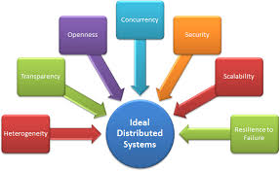
distributed system:
A distributed system is a system whose components are located on different networked computers, which communicate and coordinate their actions by passing messages to one another. The components interact with one another in order to achieve a common goal.

Slide 8
A distributed system allows resource sharing, including software by systems connected to the network. Examples of distributed systems / applications of distributed computing : Intranets, Internet, WWW, email. Telecommunication networks: Telephone networks and Cellular networks.
Types of distributed systems,
Client-server—Clients contact the server for data, then format it and display it to the end-user. ...
Three-tier—Information about the client is stored in a middle tier rather than on the client to simplify application deployment.

Slide 9
Internet & Intranet

Slide 10
Internet
The Internet is a global wide area network that connects computer systems across the world. It includes several high-bandwidth data lines that comprise the Internet "backbone" These lines are connected to major Internet hubs that distribute data to other locations, such as web servers and ISPs
In order to connect to the Internet, you must have access to an Internet service provider (ISP), which acts the middleman between you and the Internet. Most ISPs offer broadband Internet access via a cable, DSL, or fiber connection. When you connect to the Internet using a public Wi-Fi signal, the Wi-Fi router is still connected to an ISP that provides Internet access. Even cellular data towers must connect to an Internet service provider to provide connected devices with access to the Internet.
The Internet provides different online services. Some examples include:
Web – a collection of billions of webpages that you can view with a web browser
Email – the most common method of sending and receiving messages online
Social media – websites and apps that allow people to share comments, photos, and videos
Online gaming – games that allow people to play with and against each other over the Internet
Software updates – operating system and application updates can typically downloaded from the Internet

Slide 11
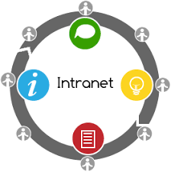
Intranet:
An intranet is a computer network for sharing information, collaboration tools, operational systems, and other computing services within an organization, usually to the exclusion of access by outsiders.
Examples of intranet services include Microsoft SharePoint, Huddle, Igloo, and Jostle. While some services are open source and free of charge, most intranet solutions require a monthly fee. The cost is usually related to the number of users within the intranet.

Slide 12
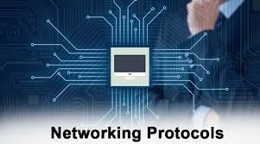
Protocols

Slide 13
Types of Protocols
A network protocol is an established set of rules that determine how data is transmitted between different devices in the same network. Essentially, it allows connected devices to communicate with each other, regardless of any differences in their internal processes, structure or design.
Types:
Transmission Control Protocol (TCP)
Internet Protocol (IP)
User Datagram Protocol (UDP)
Post office Protocol (POP)
Simple mail transport Protocol (SMTP)
File Transfer Protocol (FTP)
Hyper Text Transfer Protocol (HTTP)
Hyper Text Transfer Protocol Secure (HTTPS

Slide 14
Communication Systems

Slide 15
The communication system is a system which describes the information exchange between two points. The process of transmission and reception of information is called communication. The major elements of communication are the Transmitter of information, Channel or medium of communication and the Receiver of information.
In telecommunication, a communications system or communication system is a collection of individual communications networks, transmission systems, relay stations, tributary stations, and data terminal equipment usually capable of interconnection and interoperation to form an integrated whole.

Slide 16
E- Commerce

Slide 17
E-commerce (electronic commerce) is the buying and selling of goods and services, or the transmitting of funds or data, over an electronic network, primarily the internet. These business transactions occur either as business-to-business (B2B), business-to-consumer (B2C), consumer-to-consumer or consumer-to-business.
E-Commerce or Electronic Commerce means buying and selling of goods, products, or services over the internet. E-commerce is also known as electronic commerce or internet commerce. ... Online stores like Amazon, Flipkart, Shopify, Myntra, Ebay, Quikr, Olx are examples of E-commerce websites.

