Slide 1
Sewing tools and equipments
S.Manohari, Msc.,
Assistant professor,
Department of fashion technology and costume designing,
Bon secours college for women,
Thanjavur.

Slide 2
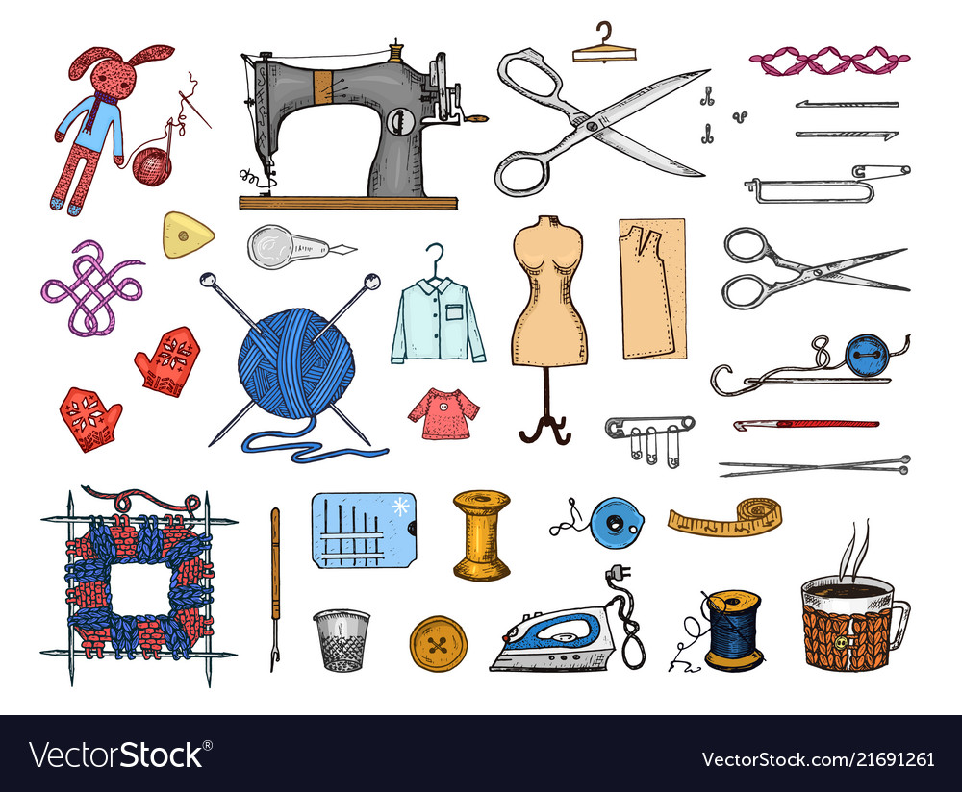
Sewing tools
Sewing tools may be divided into four main categories,
Measuring
Marking
cutting
Pressing

Slide 3
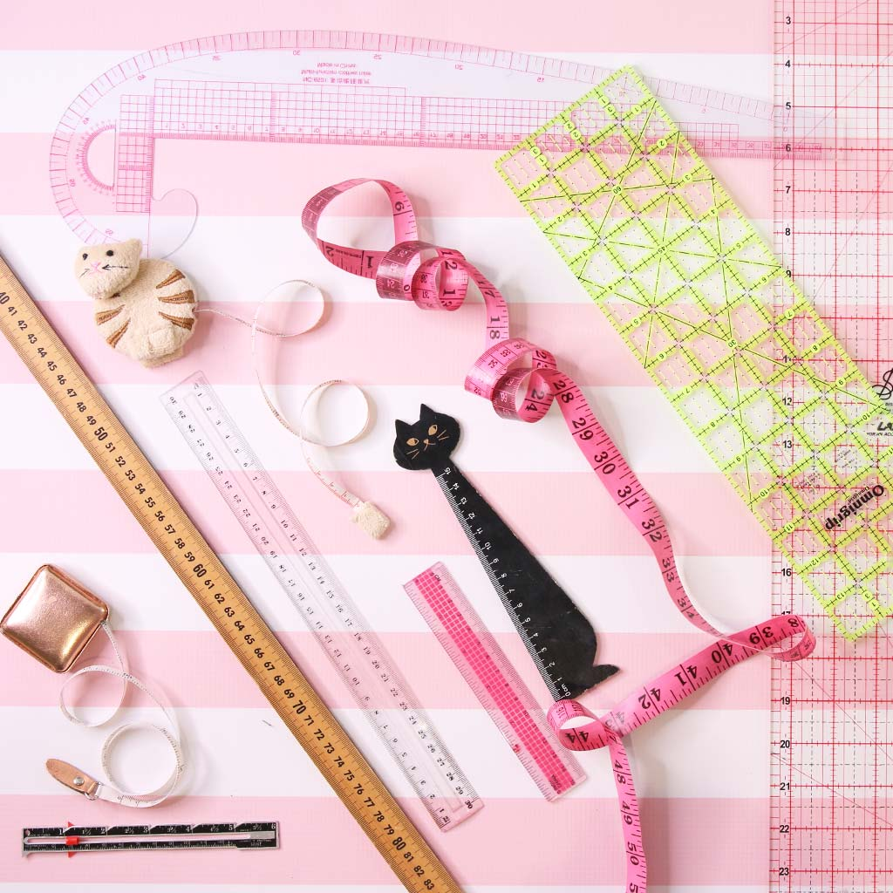
MEASURING TOOLS

Slide 4
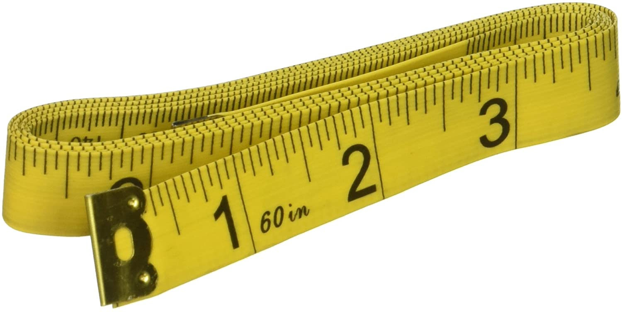
Measuring tape
a flexible measuring device used in taking body measurements.
The front has the measurement of 150 cm and 60 inches on the other side.

Slide 5
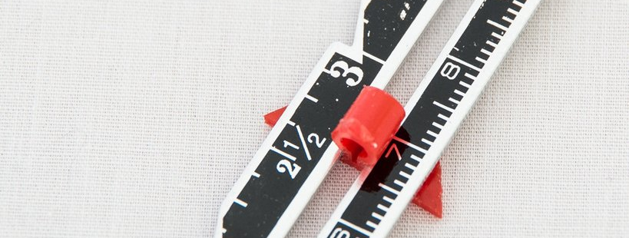
Sewing guage
A small ruler with sliding guide and is about 6 inches long.
This gauge is used for measurements at hemlines, buttonholes and areas where other small measurements required checking, Such as pleats and tucks.

Slide 6
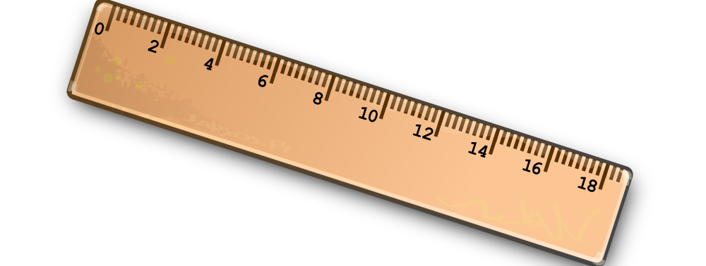
Ruler
A ruler measuring 12 inches or even 8 inches, either clear or solid.
It is a useful tool to have for measuring and drawing side seam lines and cutting lines.
It’s also aids in connecting lines.A clear ruler is also a good tool for marking buttonholes.

Slide 7
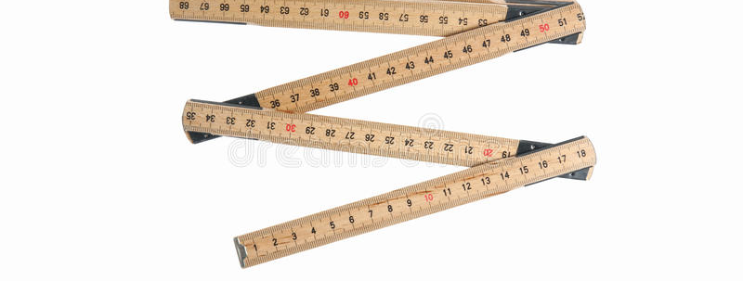
Yardstick
Is used for marking hemlines and checking grind lines when laying out the pattern.

Slide 8
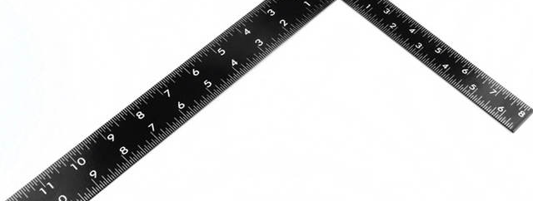
L – square or tailor square
used to transfer measurements to the trapped pattern.
Divides the garment into the desired measurements.
It has perfect squares and is useful in making straight lines and numbers.
It can also function as a tape measure.

Slide 9
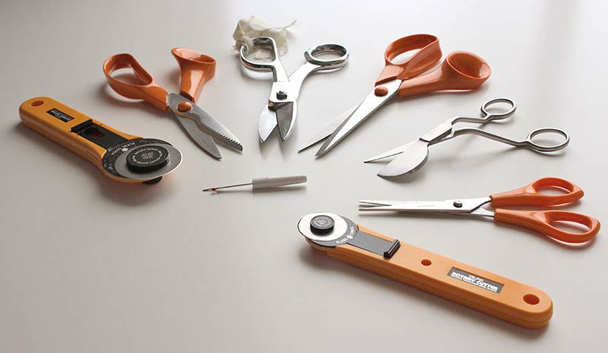
Cutting tools

Slide 10
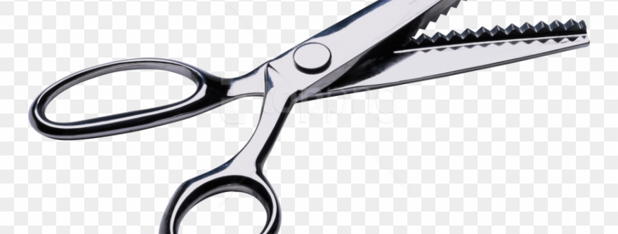
Pinking shears
This is popular In zigzagging or scalloped edge or For seam finishes.
This is used to finish dreams and edges and to create decorative pages on many types of fabric.
It cuts Ravel -resistant Edge.
This is not satisfactory for straight cutting.

Slide 11
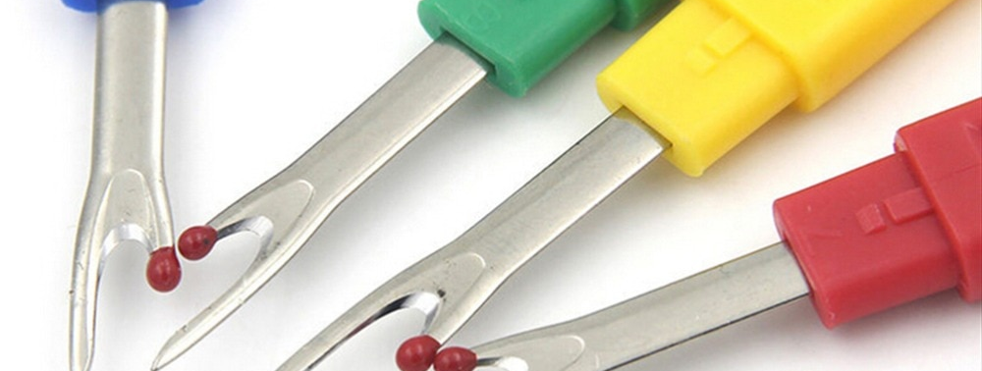
Seam ripper
Seam ripper specifically designed for repairing out stitches from seams, And as a result of an error or during alterations.
They should be used carefully to prevent damage to the fabric.

Slide 12
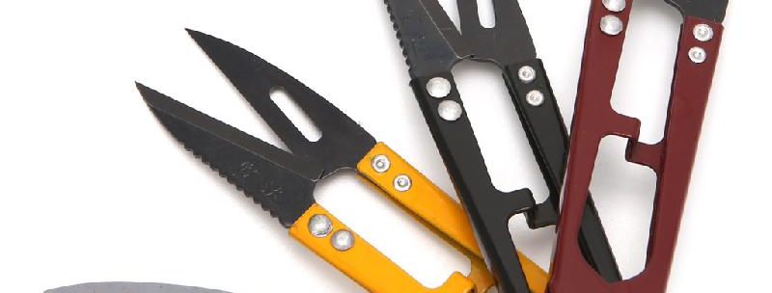
Thread clippers
A handy little spring loaded cutting tool that allows for the snipping of threads.
Specifically used to snip threads and they are not designed to cut fabric.

Slide 13
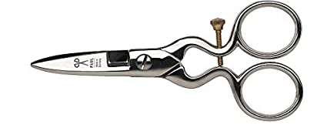
Buttonhole scissor
This is intended for making buttonholes.

Slide 14
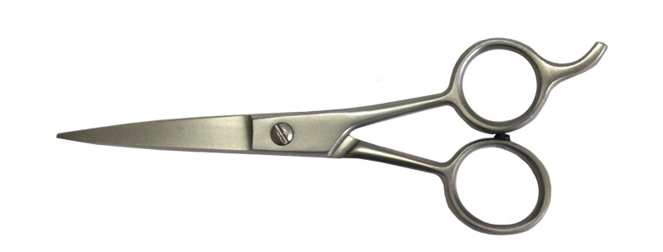
Trimming scissor
It is 3 – 4 inches long. It is used for trimming, clipping threads and snipping slashes.

Slide 15
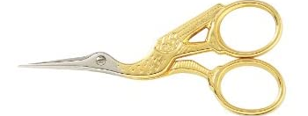
Embroidery scissor
4 – 5 inches finely tapered blades. Both points are for use in working with find details in delicate fabrics and in embroidery work.

Slide 16
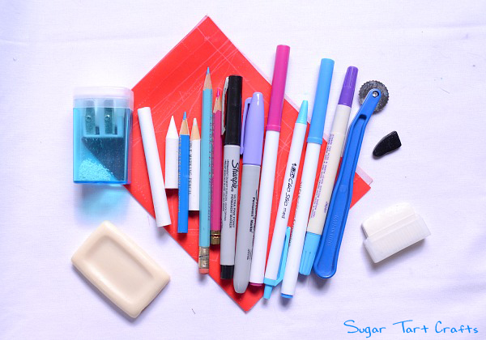
Marking tools

Slide 17
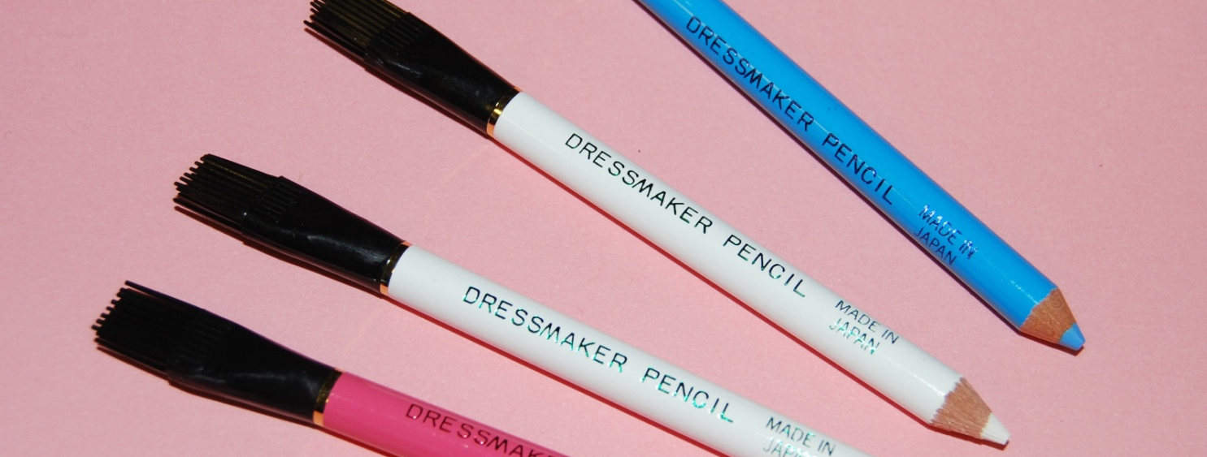
Chalk pencils dressmaker pencil
This is available in white aur pastel shades. This chalk pencil is used to make fine lines on fabric and it has and arising brush at one end.

Slide 18
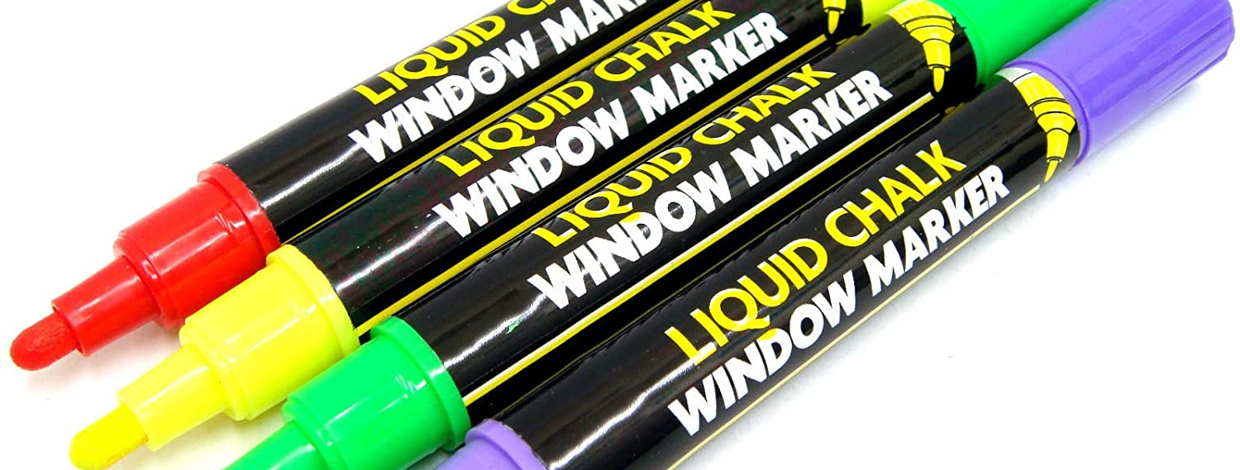
Liquid marking pen
Liquid marking pens come in 2 types there is one that washes out and one that fades after 48 hours those that washout should not be used on fabric that show water marks.
The marks should be removed before pressing the. fabric

Slide 19
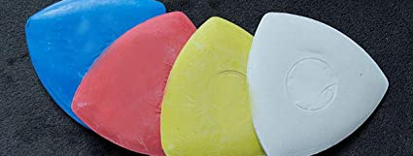
Tailors chalk
This is essential as a marker for use on materials. Tailors chalk is available in a range of colours and removed by brushing.

Slide 20
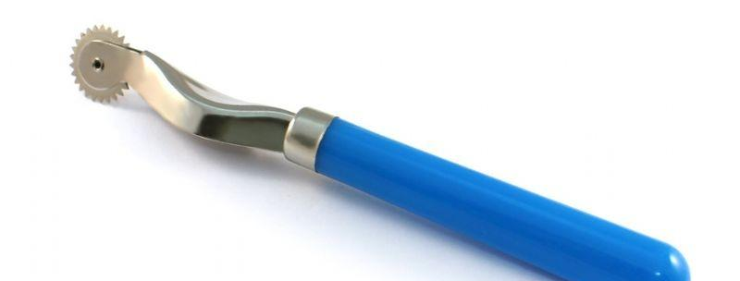
Tracing wheel
There are two types of tracing wheels, those with a serrated edge and those with a smooth edge.
The serrated edge wheel produces dots on the fabric and it suitable for most types of fabrics.
The smooth wheel is best for delicate fabrics and unlike the serrated edge will not pierce more delicate fabrics.The smooth edge wheel create a solid line.

Slide 21
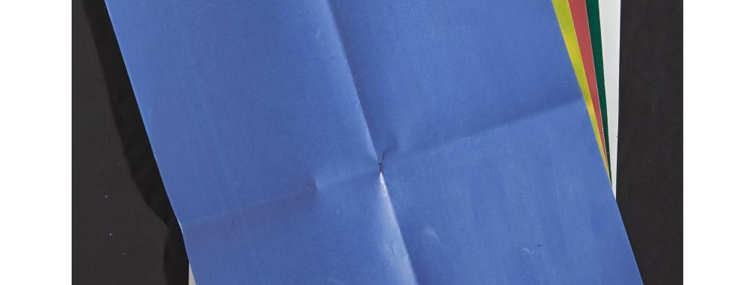
Dressmakers carbon paper
A specially waxed carbon paper that transfers that tracing wheels marking to the fabric.
Colour of tracing paper should be chosen that is close to the colour of the fabric.
Different brands of tracing paper have different instructions that for the instruction for the particular brand that is purchased should be followed.

Slide 22
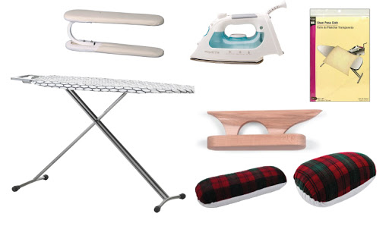
Pressing tools

Slide 23
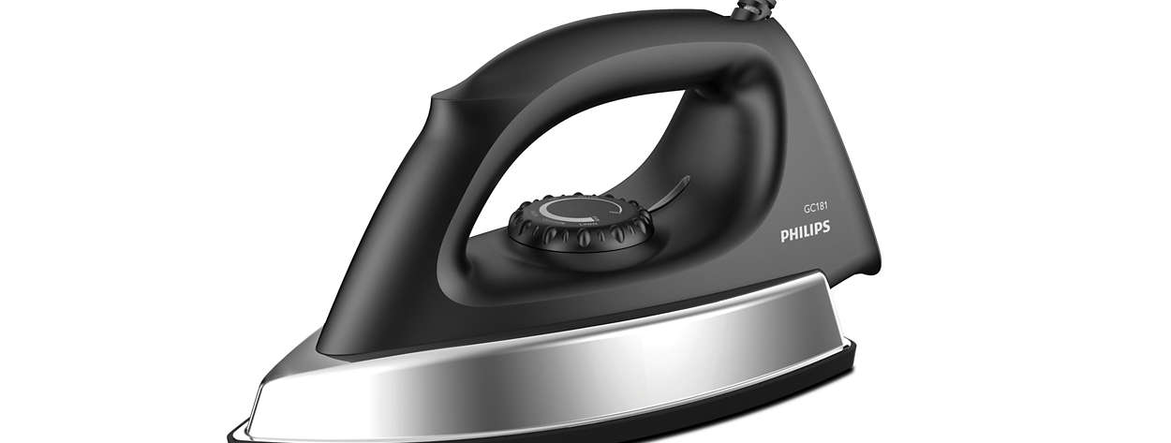
Iron
Is of great help in pressing.It avoid damaging the garments or fabric by setting the heat control to maintain a suitable temperature for any fabric.

Slide 24
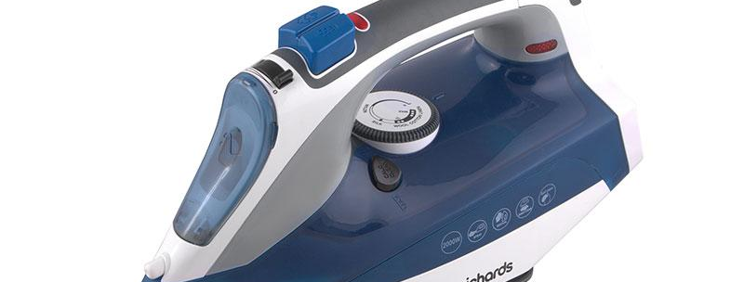
Steam iron
Contains Tampa where water is converted into steam. Itcan be used to create perfect pleats and iron out the wrinkles on clothes.

Slide 25
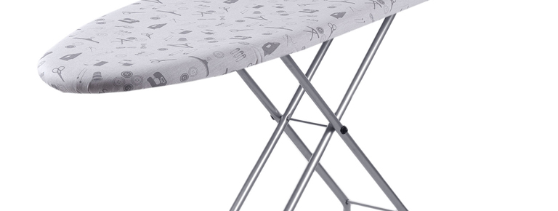
Iron board
Is made of wood or still where in cloth and garments are pressed it should be padded, and old woolen blanket is an excellent padding. On top is a snug- fitting removable cover of a smooth firm of cotton material.

Slide 26
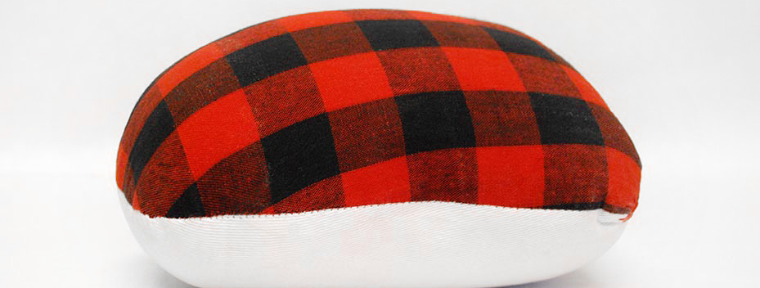
Tailors ham
A firm round cushion used to preserve the areas of a government for example darts,curved seams.

Slide 27
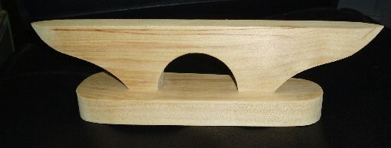
Point presser
A narrow wooden surface with a pointed end.
Pressing collar points.
Curved and straight edges.

Slide 28
THANK YOU

