Slide 1
RULES TO REMEMBER IN PATTERN LAYOUT
S.SUGANTHI M.Sc., M.Phil.
ASSISTANT PROFESSOR
DEPARTMENT OF FASHION TECHNOLOGY
BON SCOURS COLLEGE FOR WOMEN
THANJAVUR

Slide 2
Press the fabric as well as the pattern pieces flat before laying the pattern on the fabric.
2.Use a large table or any hard flat surface for accommodating the work.
3.If an open layout is used, place the fabric right side up on the table
For all other layouts fold the fabric right sides facing and wrong sides out

Slide 3
4.Decide on the best way to fold your cloth this will depend on the width of the cloth,width of your pattern pieces, the type of cloth and design of the garment (whether leftand right haves are identical.
The common methods of folding the cloth for laying out pattern pieces arethe following
Lengthwise centre fold
Off center lengthwise fold:
Crosswise center fold
Off Center Crosswise fold
Double fold
Combination fold
Open layout

Slide 4
5.Straight grain lines on patterns must be kept parallel to the fabric selvedge.
To ensure this, measure and adjust the pattern so that both ends of the straight grain line are the same distance from the selvedge and pin the pattern to the fabric along the grain line arrows.
6.Fold lines on the patterns must be kept on folded edges of fabric.
7.Leave enough space between patterns for cutting outward notches and marking seam allowance (if the patterns do not include seam allowances).
.

Slide 5
Also make sure that there is enough material left for cutting out belts, facings, etc. for which you may not have made paper patterns
8. The patterns must be placed on the fabric in the most economical way.
9.Pin patterns to the fabric firmly, after placement of the pattern has been decided, pin the corners and the long outside edges of the patterns, placing pins close to and approximately perpendicular to the cutting line.
.

Slide 6
Use just enough pins to keep the pattern in position. Too many pins will distort the edges. You should start cutting thefabric only after pinning all the pattern pieces
10.Take care to use special layouts for asymmetric designs and for fabrics with bold designs, striped and checked designs, designs going in one direction and fabrics with nap and pile.

Slide 7

11. Take care to use special layouts for asymmetric designs and for fabrics with bold designs, striped and checked designs, designs going in one direction and fabrics with nap and pile.
1.Fabric with lengthwise striped design
Notes:
Fabric with bold designs such as plaids

Slide 8
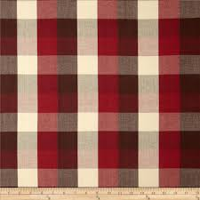
2.FABRIC WITH BOLD DESIGNS SUCH AS PLAIDS

Slide 9
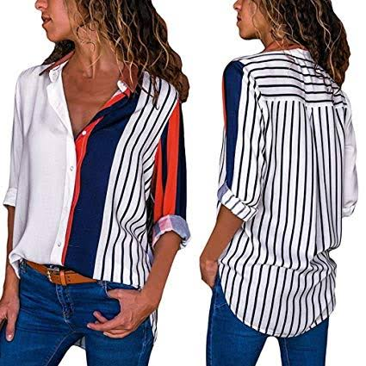
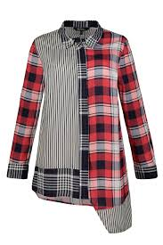
3. ASYMMETRIC DESIGNS

Slide 10
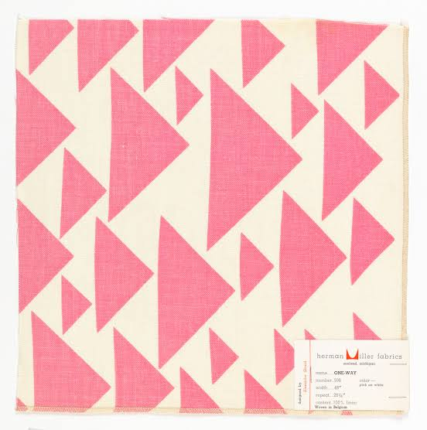
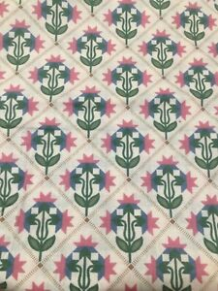
4.FABRIC WITH ONE WAY DESIGN

Slide 11
Thank you

