Slide 1
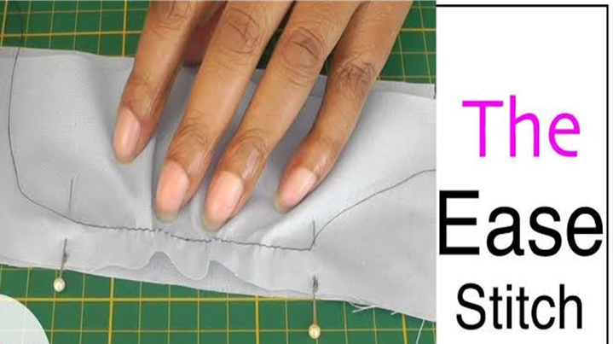
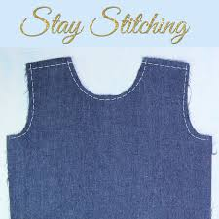
STAY AND EASE STITCHING
S.SUGANTHI M.Sc., M.Phil.
ASSISTANT PROFESSOR
DEPARTMENT OF FASHION TECHNOLOGY
BON SCOURS COLLEGE FOR WOMEN
THANJAVUR

Slide 2
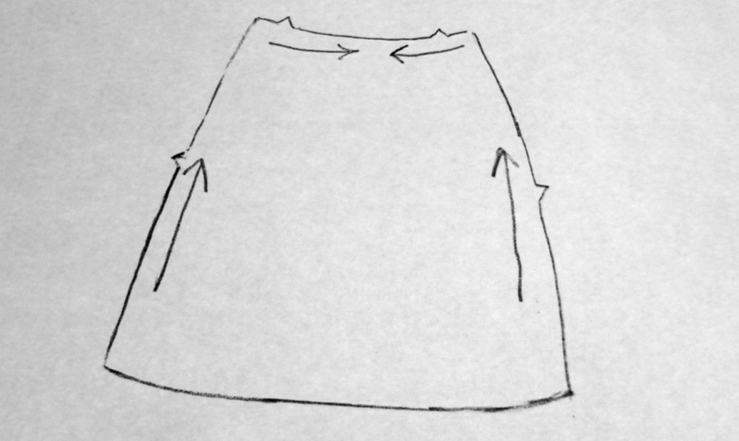
STAY STITCHING
Stay stitching is a single line of stitching through one layer of fabric.
It is sewn to stabilize the fabric and prevent it from becoming stretched or distorted.
Though you may be tempted to skip this step, it's very important and will ensure that your handmade clothing drapes properly.

Slide 3
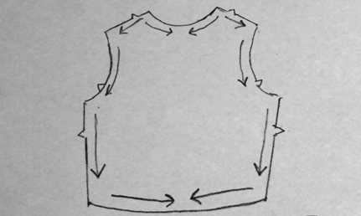
WHERE IT IS USED
This type of stitch is usually called for on the edge of a piece of fabric that has a bias cut, which can become distorted more easily than other fabric grain cuts.
It's also commonly used on curved cuts, such as necklines, to ensure pieces fit together properly in the most crucial places.

Slide 4
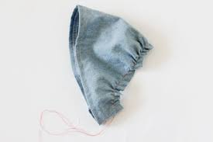
BIAS-CUT FABRIC
There are three types of fabric grain: lengthwise grain, crosswise grain, and bias grain
This naturally occurring difference is why stay stitching is particularly important on the bias

Slide 5
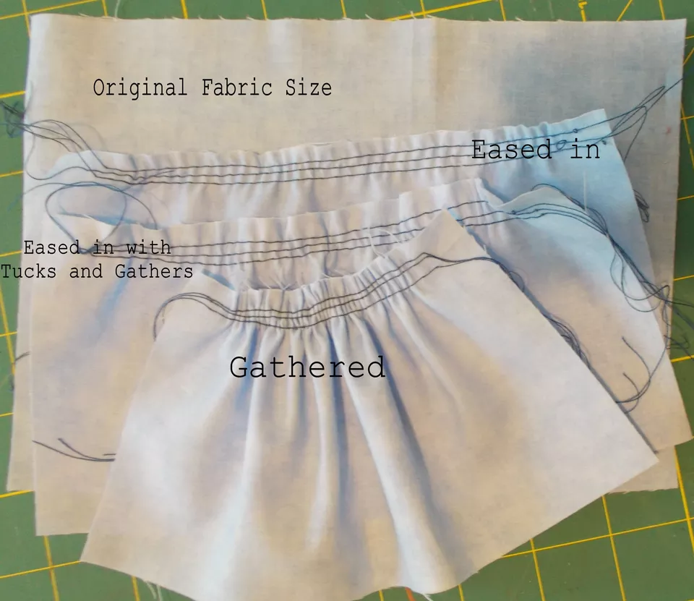

Slide 6
Ease is a sewing term used in many pattern instructions.
It means to draw the fibers of fabric closer together than they were woven or originally manufactured.

Slide 7
WHAT ARE SOME OF THE COMMON USES OF EASING IN SEWING
On a set-in sleeves
On princess seams
Shoulder seam

Slide 8
THE PURPOSE OF EASING
The idea is to provide fullness to a particular area of the garment with it looking as seamless as possible

Slide 9
EXAMPLE OF WHEN EASING IS USED
Easing in the fabric allows a curved capped sleeve to fit into the straight line of the jacket body,
which can look like an impossible task if you don't ease in the sleeve cap between the markings.
One of the telltale signs of a "homemade garment" is to see puckers or gathers, especially in the sleeve cap of a garment.

