Slide 1
Mrs .A. Denis Rani,
OBESITY
Assistant Professor,
Bon Secours College for Women.

Slide 2
Obesity
Obesity is a complex disease involving an excessive amount of body fat. It is a medical problem that increases the risk of other diseases and health problems, such as heart disease, diabetes, high blood pressure and certain cancers.

Slide 3
CAUSES OF OBESITY
Physical inactivity
Overeating
Genetics
Frequency of eating
A diet in simple carbohydrates
Medications
Psychological factors
Diseases
Social issues

Slide 4
Symptoms
Obesity is diagnosed when your body mass index (BMI) is 30 or higher. To determine your body mass index, divide your weight in pounds by your in inches squared and multiply by703. Or divide your weight kilograms by our height in meters squared.

Slide 5
Symptoms
BMI | WEIGTH STATUS
Below 18.5 | Underweight
18.5 – 24.9 | Normal
25.0 – 29.9 | Overweight
30.0 and higher | obesity

Slide 6
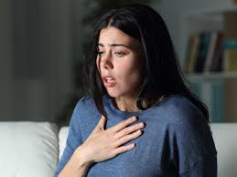
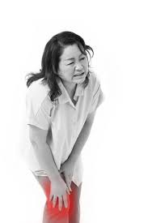
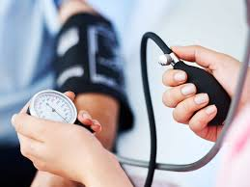
Symptoms
Shortness of breath
Aching knees
High blood pressure

Slide 7
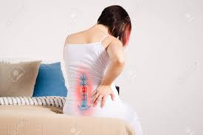
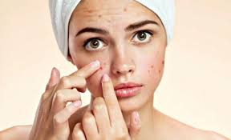
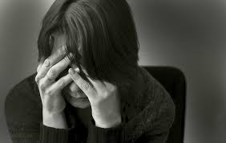
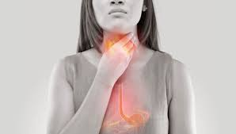
Backache
Skin problem
Depression
Heartburn

Slide 8
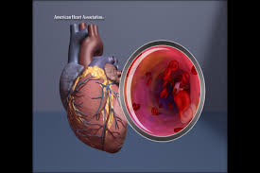
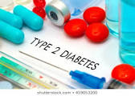
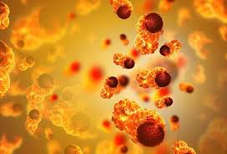
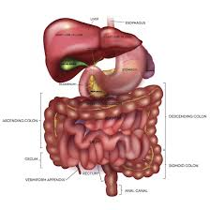
COMPLICATIONS
Heart disease and strokes
Types 2 diabetes
Certain cancer
Digestive Problems

Slide 9
Complications
Sleep apnea
Gynecological
Osteoarthritis

Slide 10
Diagnosis
Taking your health history
A general physical exam
Calculating your BMI
Measuring your waist circumference
Checking for other health problems
Blood Test

Slide 11
Treatment
Dietary changes
Physical activity and exercise
Behaviour changes
Weight loss medication
Weight loss surgery

Slide 12
Quality of life
Obesity can diminish your overall quality of life. You may not be able to do things such as participating in enjoyable activities. You may avoid public places.
Other weight related issues that may affect your quality of life include:

Slide 13
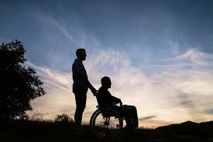




QUALITY OF LIFE
Disability
Depression
Shame and guilt
Sexual problem
Lower work achievement
Social isolation

Slide 14
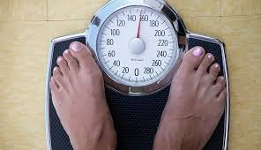
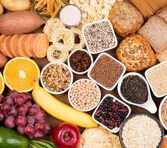
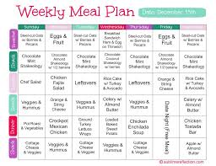

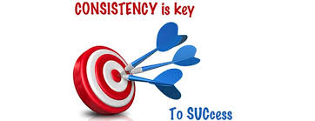
PREVENTION
Monitor your weight regularly
Avoid the food traps that cause you to eat
Follow a healthy-eating plan
Exercise Regularly
Be Consistent

Slide 15

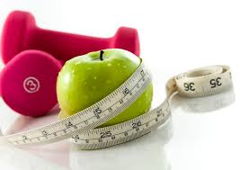



TREATMENT
Regular Physical Activity
Changing Your Habits
Weight mgt programmer
Weight Loss Devices
Weight loss Devices
Bariatric Surgery
Special diets

Slide 16


