Slide 1
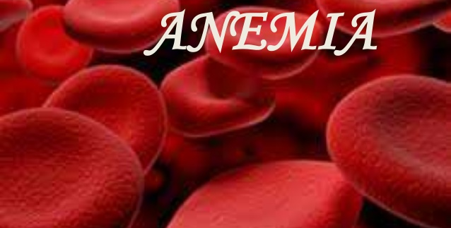
Mrs.A.Denis Rani,
Assistant Professor,
Bon Secours College for Women,
Thanjavur.

Slide 2
INTRODUCTION
Anemia is a major killer disease in India.
Statistics reveal that every second Indian woman is anemic.
One in every five maternal deaths is directly due to anemia.
Anemia affects both adults and children of both sexes, although pregnant women and adolescent girls are most susceptible and most affected by this disease.

Slide 3
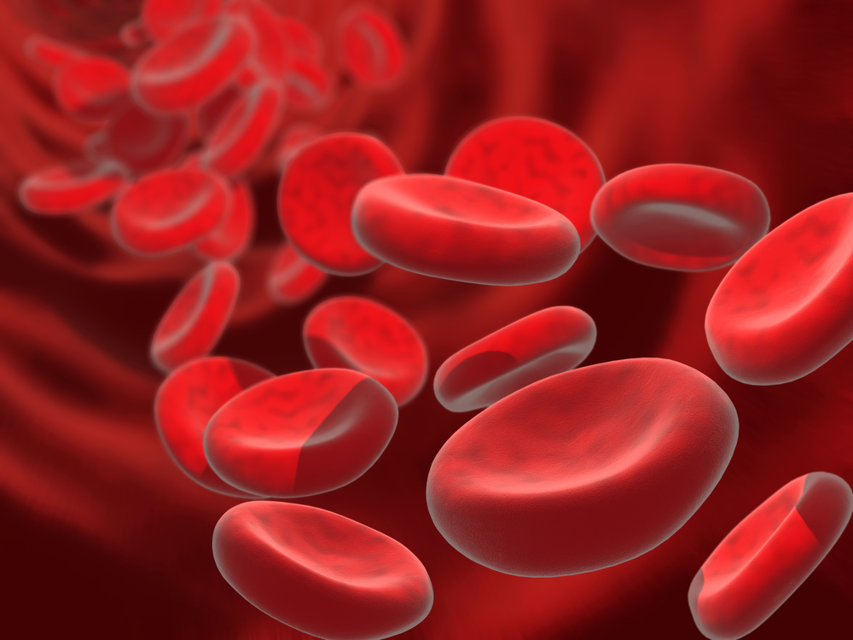
DEFINITION
Anemia is a condition in which the blood doesn’t have enough healthy red blood cells.
Anemia results from a lack of red blood cells or dysfunctional red blood cells in the body. This leads to reduced oxygen flow to the body’s organs.

Slide 4
CAUSES
Anemia caused by blood loss through bleeding
Gastrointestinal conditions such as ulcers, hemorrhoids, gastritis, and cancer.
Non- steroidal anti-inflammatory drugs such as aspirin or ibuprofen which can cause ulcers and gastritis.
A women’s period especially if there’s too much bleeding.
Post- trauma or post- surgery as well.

Slide 5
CAUSES
Anemia caused by decreased or faulty red blood cell production.
Bone marrow and stem cell problems.
Iron deficiency anemia
Sickle cell anemia.
Vitamin- deficiency anemia, specially b12 or folate

Slide 6
CAUSES
Anemia caused by destruction of red blood cells.
When red cells are fragile and can’t handle the stress of travelling through the body, they may burst causing hemolytic anemia. The causes of hemolytic anemia are unclear, but they can include:
An attack by immune system.
Conditions that can by passed down through your genes such as sickle cell anemia, thalassemia.
Enlarged spleen.
Something that puts strain on your body such as infections, drugs, or certain foods.
Vascular grafts, tumors, severe burns, severe hypertension, and clotting disorders.

Slide 7
Types of Anemia
Aplastic anemia
Iron deficiency anemia
Sickle cell anemia
Thalassemia
Vitamin deficiency anemia

Slide 8
SYMPTOMS
Fatigue
Weakness
Pale or yellow skin
Irregular heart beats
Shortness of breath
Dizziness
Chest pain
Cold hands and feet
Headaches

Slide 9
DIAGNOSIS
To diagnose anemia, your doctor is likely to ask you about your medical and family history, perform a physical exam, and run the following tests:
Complete blood count(CBC): A CBC is used to count the number of blood cells in a sample of your blood.
A test to determine the size and shape of your red blood cells: Some of your red blood cells might also be examined for unusual size, shape and color.
ADDITIONAL DIAGNOSTIC TESTS
To study a sample of your bone marrow to diagnose anemia.

Slide 10
ANEMIA TREATMENT
Anemia treatment depends on the cause.
Iron deficiency anemia. Treatment for this form of anemia usually involves taking iron supplements and changing your diet.
If the cause of iron deficiency is loss of blood-other than from menstruation-the source of the bleeding must be located and the bleeding stopped. This might involve surgery
Vitamin deficiency anemia. Treatment for folic acid and vitamin C deficiency involves dietary supplements and increasing these nutrients in your diet.
If your digestive system has trouble absorbing vitamin B-12 from the food you eat, you might need vitamin B-12 shots.

Slide 11
ANEMIA TREATMENT
Anemia of chronic disease. There’s no specific treatment for this type of anemia. Doctors focus on treating the underlying disease. If symptoms become severe, a blood transfusion or injections of a synthetic hormone normally produced by your kidneys might help stimulate red blood cell production and ease fatigue.
Aplastic anemia. Treatment for this anemia can include blood transfusions to boost levels of red blood cells. You might need a bone marrow transplant if you bone marrow can’t make healthy blood cells

Slide 12
ANEMIA TREATMENT
Anemia associated with bone marrow disease: Treatment of these various diseases can include medication, chemotherapy or bone marrow transplantation.
Sickle cell anemia. Treatment might include oxygen, pain relievers and oral intravenous fluids to reduce Pain relievers, and oral and intravenous fluids to reduce pain and prevent complications. Doctors might also recommend blood transfusions, folic acid supplements and antibiotics.
A cancer drug also is used to treat sickle cell anemia.

Slide 13
ANEMIA TREATMENT
Thalassemia: Most forms of thalassemia are mild and require no treatment. More severe forms of thalassemia generally require blood transfusions, folic acid supplements, medication, removal of the spleen, or a blood and bone marrow stem cell transplant.
Hemolytic anemia. Managing hemolytic anemias includes avoiding suspect medications treating infections and taking drugs that suppress your immune system, which could be attacking your red blood cells. Depending on the cause or your hemolytic anemia you might be referred to a heart or vascular specialist.

Slide 14
PREVENTION
Many types of anemia can’t be prevented. But we can avoid iron deficiency anemia and vitamin deficiency anemias by eating a diet that includes variety of vitamins and minerals, including:
Iron rich foods include meats, beans, dark green leafy vegetables, iron – fortified cereals, dried fruit.
Folate - folic acid found in fruits and fruit juices, dark green leafy vegetables, green peas, peanuts, and cereals.
Vitamin c includes citrus fruits and juices, broccoli, tomatoes, melons and strawberries also help increase iron absorption.

Slide 15


