Slide 1
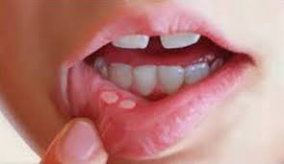
stomatitis
A.Denis Rani,
Assistant Professor,
Bon Secours College for Women

Slide 2
STOMATITIS
Stomatitis is a general an inflamed and sore mouth, disrupt a person’s ability to eat talk and sleep.
Stomatitis can occur anywhere in the mouth, including the inside of the cheeks, gums, tongue, lips and palate.
They are two types
i) Canker sore
ii)Cold sore

Slide 3
Canker sore
It is also known as aphthous ulcer, is a single pale or yellow ulcer with a red outer ring or cluster of such ulcers in the mouth, usually on the cheeks, tongue or inside the lip.
Cold sore
It is also called fever blisters, cold sores are fluid-filled sore that occurs on around the lips.
They rarely form on the gums or the root of the mouth.

Slide 4
Gum disease.
Hypersensitivity to certain things such as foods or medicines.
Auto immune disease affecting.
Biting your cheeks, tongue or lip.
Chewing tobacco.
Mouth irritation

Slide 5
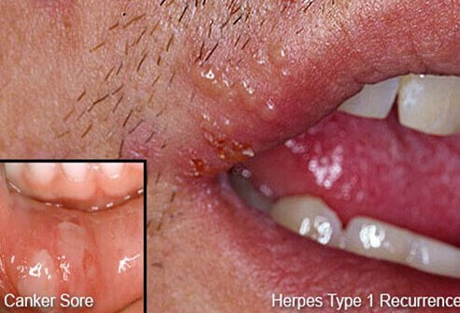
Symptoms of Stomatitis
Are generally not associated with fever
Can be painful
Canker sore
Tend to come back
Usually last 5 to 10 days

Slide 6
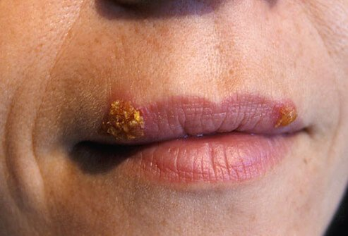
Cold sore
Are usually painful
Sometimes associated with cold or flu like symptoms
Are usually gone in 7 to 10 days

Slide 7
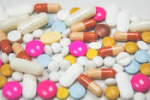
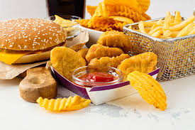

Causes
Medication
Poor nutrition
Lack of sleep

Slide 8
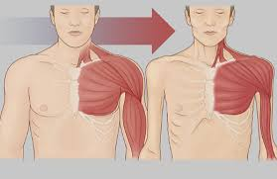


Sudden weight loss
bacteria
stress

Slide 9
Treatment
Medications
Local anesthetic
Topical antiseptic
Steroid and Antiviral drug
Supportive care
Avoidance of triggers- Reducing exposure to environmental factors
Oral hygiene
Keeping the mouth clean by regularly brushing teeth, flossing and using

Slide 10
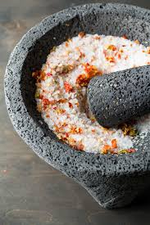
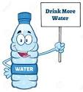
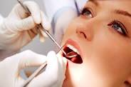
Treatment
Avoid salty and spicy food
Drink more water
Practice proper dental care

Slide 11


