Slide 1
EPIDEMIOLOGY AND
COMMUNITY HEALTH
BY:
T. Pushpa Latha
Dept. of Hospital Administration
Bon Secours College for Women, Thanjavur

Slide 2

COMMUNITY HEALTH
DEFINITION OF HEALTH
DEFINITION OF COMMUNITY HEALTH
HISTORY OF COMMUNITY HEALTH
CONCEPT OF HEALTH
DETERMINANTS OF HEALTH

Slide 3
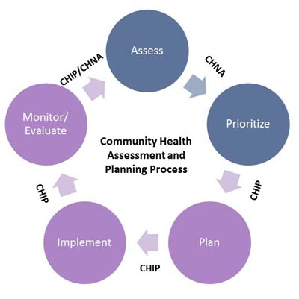
DEFINITION OF HEALTH:
WHO Defines Health as a state of complete physical , Mental and Social Well Being not merely the absence of disease or infirmity.
NUTRITION
LIFESTYLE
GENETICS
SOCIAL STATUS

Slide 4

COMMUNITY HEALTH
Definition:
Community health is a branch of public health.
Which focuses on people and their role as determinants of their own and other peoples
Community health is a field of study within the medical and clinical science.
Focuses on maintenance,protection and improvement of the health status of population groups and communities.

Slide 5
ASSESS
PLAN
PRIORITIZE
HEALTH COMMUNITY
IMPLEMENT
MONITOR
EVALUATE

Slide 6


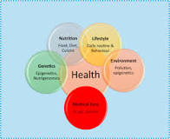

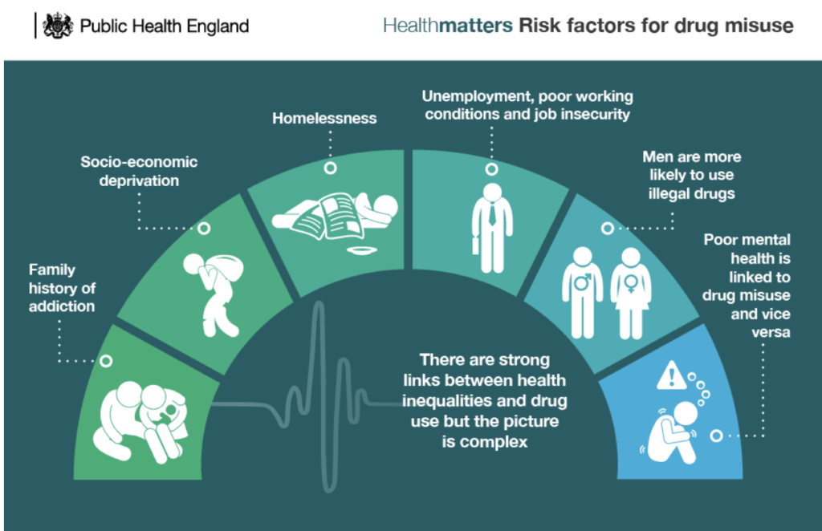


Slide 7
HISTORY OF COMMUNITY HLEATH
Community Health Founded in 1993 by serafino garella MD, a board certified internist and nephrologist.
At that time, the main concern was
related to certain epidemics that needed
be stopped and prevented through an
appropriate hygiene education.
Community health foundation , improving people’s knowledge about disease prevention and controlling.
Different association were created to deliver CHP that consisted of care campaigns about infection prevention.

Slide 8
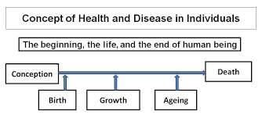
CONCEPT OF HEALTH:
BIOMEDICAL CONCEPT
ECOLOGICAL CONCEPT
PSYCHOSOCIAL CONCEPT
HOLISTIC CONCEPT

Slide 9
A) BIOMEDICAL CONCEPT :
Traditionally health has been considered as an absence of disease and if someone was free from disease then that person was considered healthy.
This concept is known as biomedical concept and it is based on the “GERM THEORY OF THE DISEASE”.
The medical profession viewed the human body as a machine and disease is an outcome of the breakdown of the machine and one of the doctor tasks was to repair the machine.
This concept has minimized the role of the environment ,social and cultural determinants of the health.
Developments in medical and social sciences led to the conclusion that the biomedical concept of health was inadequate.

Slide 10
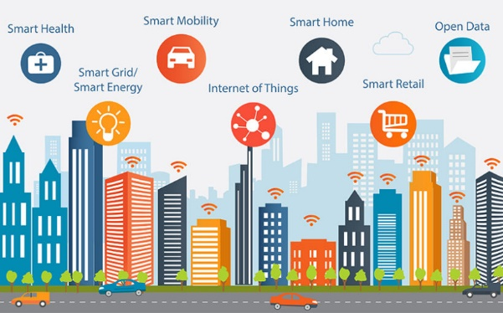
B) ECOLOGICAL CONCEPT:
Deficiencies in the biomedical concept gave rise to the other concepts.
The ecologist put forward the concept of ecological concept.
Ecologist viewed health as a dynamic equilibrium between man and his environment and the disease as a maladjustment of the human organism to environment.

Slide 11
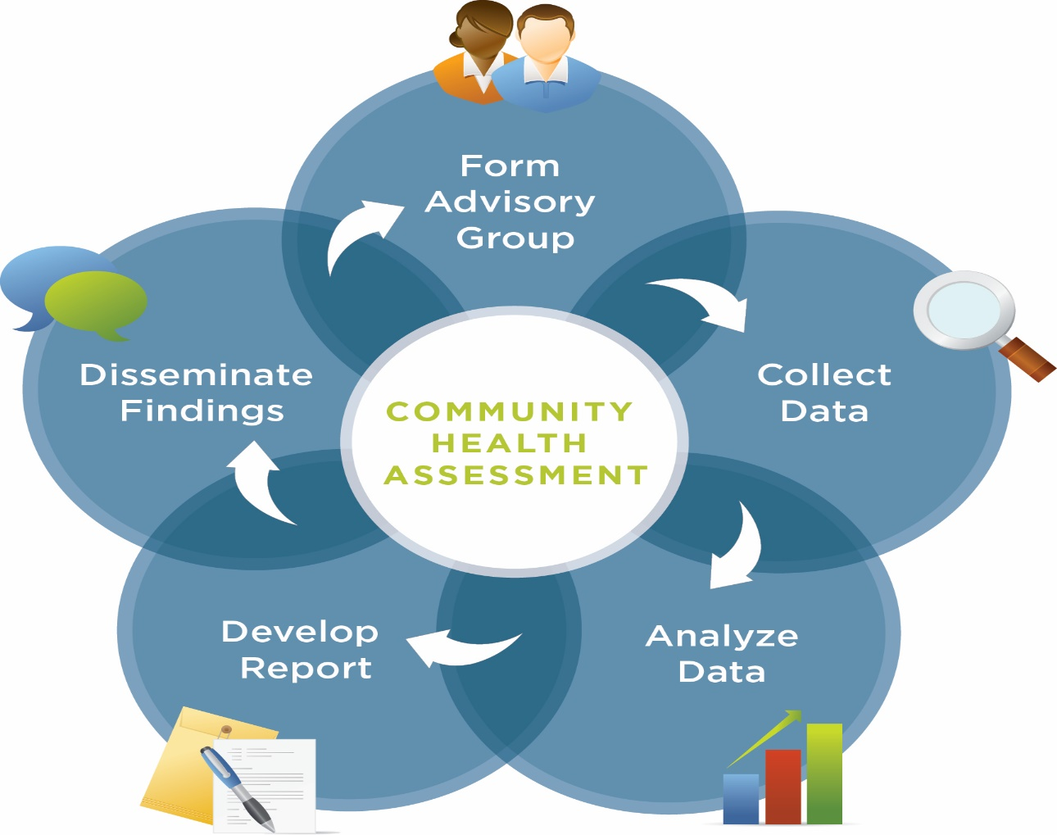
C) PSYCHOSOCIAL CONCEPT:
Advances in social science showed that health is not only a biomedical phenomenon ,but one which is influenced by social , psychological , cultural , economic and political factor of the people concern .
These factor must be taken into consideration in defining and measuring health.
Thus health is both a biological and social phenomenon .

Slide 12

D) HOLISTIC CONCEPT:
The holistic model is a synthesis of all above the concept.
Holistic concept recognizes the strength of social ,economic , political and environmental influences on health.
It has been variously described as multidimensional process involving the well being of the person as a whole.
It emphasis is on the promotion and protection of health .
The holistic approach implies that all sectors of the society have an effect on health in particular agriculture ,animal husbandry , food , industry , education , housing , public works and other sectors .

Slide 13


Slide 14

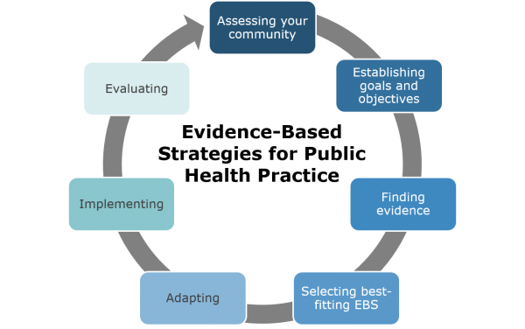
DETERMINANTS OF HEALTH:
Health may be biological, behavioral, sociocultural , economic and ecological. Broadly the determinants of health can be divided into four categories :
*Nutrition
*Lifestyle
*Environment
*Genetics
Which are like 4 pillars of the foundation.

Slide 15

The Determinants of health include:
Income and social status – Richest and poorest people different in health .
Education – Low education levels are linked with poor health .
Physical environment – Safe water , clean air and health workplace .
Social support networks – Greater support from families , friends , communities is linked to better health .
Genetics – smoking , drinking affect the health .
Health services – Prevent and treat disease .
Gender – Men and women suffer from different types of diseases at different ages .

Slide 16
