Slide 1
HEALTH AND ENVIRONMENT
POLLUTION AND SANITATION,HEALTH ECONOMICS
“WAYS OF MEASURING HEALTH”

Slide 2
SYNOPSIS
OBJECTIVES
INTRODUCTION
DEFINITION
CONCEPT OF DISEASE
EPIDEMIOLOGICAL TRIAD
ENVIRONMENTAL IMPACT
ENVIRONMENT &TYPES COMPONENTS
HAZARTS
POLLUTION&SANITATION
WAYS OF MEASURING HEALTH

Slide 3

OBJECTIVES
Health in its physical , mental , social and spiritual contect;
Environment to be an important factor in the interaction of agent and host in the epidemiological or Ecological triad;
The physical , biological and psychological environment and understand their impact on health.

Slide 4
INTRODUCTION
“ Healthy people are those who live in healthy homes on a healthy diet; In an Environment equally fit for Birth, growth, work, healing, and dying….
Healthy people need no bureaucratic interference to mate, give birth, share the human condition, and die.”
-IVAN ILLICH

Slide 5
DEFINITION
HEALTH: Health is a state of physical , mental and social well-being in which disease and infirmity are absent.
It is a condition under which the individual is able to mobilize all his resources, intellect, emotional and physical for optimum living.
*.HOUSTIC CONCEPT OF HEALTH
This concept recognizes the strength of social, economic, political and environmental influences on Health.

Slide 6
*.DETERMINATS OF HEALTH
Heredity & life style
Welfare services
Environment
Socio-economic conditions
Health and family
Disease is a result from complex interaction between man, an agent ant the environment.
From ecological point of view , disease is defined as
“maladjustment of the human organism to the environment”.
CONCEPT OF DISEASE

Slide 7
ENVIRONMENTAL IMPACT -
EPIDEMIOLOGICAL TRIAD
ENVIRONMENT IMPACT
(Physical, biological and psychosocial)
Human Health
Activities status
individual
EPIDEMIOLOGICAL TRIAD
Environment
Agent Host

Slide 8

ENVIRONMENT
All of the external factors affecting an organism. These factors may be other living organisms (biotic factors) or nonliving variables (abiotic factors), such as temperature, rainfall, day length, wind, and ocean currents.
The interactions of organisms with biotic and abiotic factors from an ecosystem.

Slide 9
TYPES OF ENVIRONMENT
*MACRO-ENVIRONMENT
-Is said to be responsible for millions of preventable diseases originating in it.
*MICRO ENVIRONMENT
-Is the Domestic environment in which man lives.
*INTERNAL ENVIRONMENT
-is some time used for the environment inside the body.

Slide 10
COMPONENTS OF ENVIRONMENT
PHYSICAL:
Air, water, soil, housing, climate, geography, heat, light, noise, debris, radiation, etc.
BIOLOGICAL:
Man, viruses, microbial agents, insects, rodents, animals and plants, etc.
PSYCHOSOCIAL:
Cultural values, customs, beliefs, habits, attitudes, moral, religion, education, lifestyles, community life, health services, social and political organization.

Slide 11
The environment is all external conditions, circumstances, and influences surrounding and affecting the growth and development of an organism or community of organisms.
HAZARDS:
`ENVIRONMENTAL HAZARDS
`BIOLOGICAL HAZARDS
`CHEMICAL HAZARDS
`PSHYCAL HAZARDS
`PSYCOLOGICAL HAZARDS
`SOCIOLOGICAL HAZARDS
`SITE AND LOCATION HAZARDS

Slide 12


Slide 13
POLLUTION & SANITATION
DEFINITION OF POLLUTION:
When harmful substances contaminate the environment it is called pollution.
pollution refers to the very bad condition of environment in terms of quantity and quality.
DEFINITION OF SANITATION :
The process of keeping place free from dirt, infection, disease etc., by removing waste, trash and garbage, by cleaning streets, washing yours self, safe drinking water, etc..

Slide 14
IMPORTANCE OF SANITATION
IMPORTANCE FOR HEALTH
Good sanitation can prevent you from getting diarrhea can also help prevent other serious diseases.
When you practice good sanitation, your family saves money on healthcare and treatment.
GOOD ECONOMIC
ENVIRONMENT
IMPORTANCE FOR SOCIAL DEVELOPMENT
When you keep yourself & your surroundings clean, your fall sick less often & are more likely to attend school/ work regularly.
HELPS THE ENVIRONMENT
  When you get rid of waste properly, you can help to protect water Sources. It also means that you don’t have to smell the disgusting mess all around you.
ACHIEVABLE
  Better sanitation is possible….but it all starts with me and you.

Slide 15
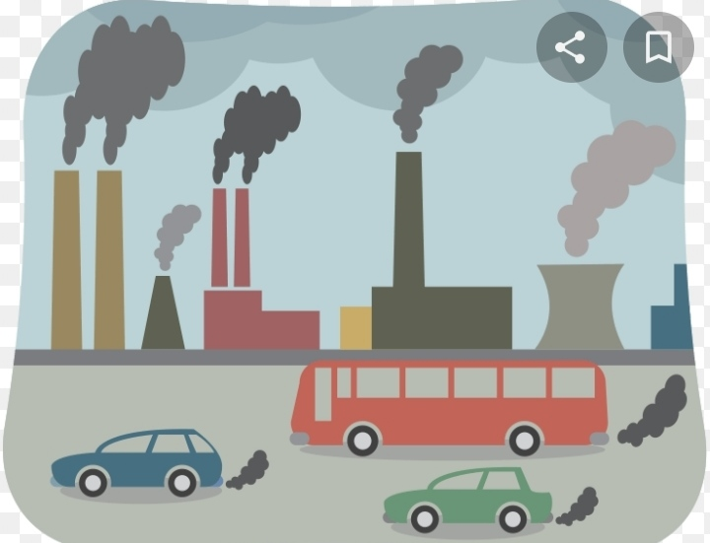
TYPES POLLUTION& WAY OF SANITATION:
AIR POLLUTION
SOURCE OF AIR POLLUTION;
Industries
Automobiles and domestic fuels
High proportion of undesirable gases, such as
sulphur dioxide and carbon monoxide.
HOW TO AVOIDE AIR POLLUTION:
Use natural gases, like LPG autos, do not burst crackers
use less amount of fuel for vehicles avoid using and use electric stoves (bio gas).

Slide 16
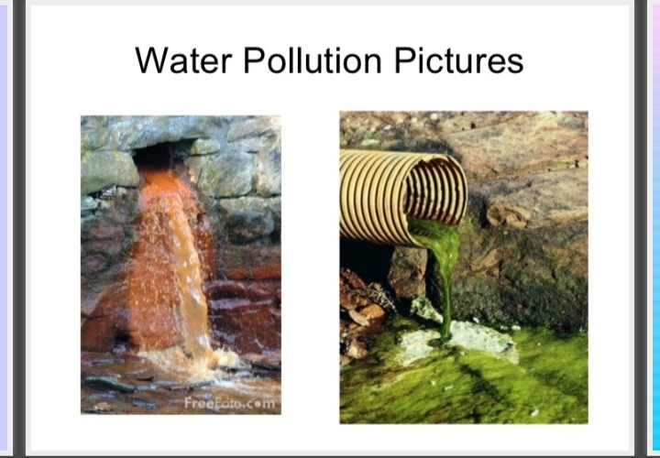
WATER POLLUTION
EFFECTS OF WATER POLLUTION
DISEASES LIKE CHOLERA
MALARIA
TYPHOID(Spread during the rainy season)
AQUATIC LIFE GETS DESTROYED
HOW TO AVOID WATER POLLUTION
Rivers should not used for washing clothes or bathing animals in.
Harwasting of rainwater to meet water requirements
The rivers must not be contaminated
Dams & embankments must be created

Slide 17
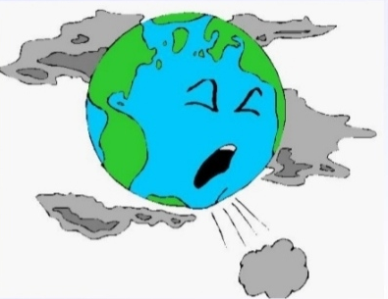
NOICE POLLUTION
EFFECTS OF NOICE POLLUTION
Hearing loss
High blood pressure
Stress
Sleep disturbances
Color blindness
HOW TO AVOID NOISE POLLUTION
The government should ensure the new machines that should be noise proof.
Air ports must be away from residential area.
The sound horn symbol is to be in school roads.

Slide 18
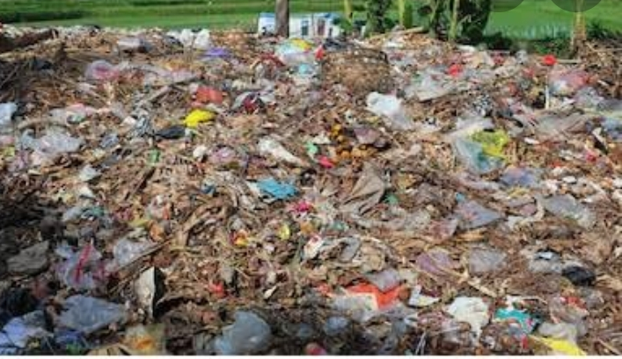
LAND POLLUTION
EFFECTS OF LAND POLLUTION
The land cannot be construct house
Man cannot be forming
Ground water will gets affected
House hold garbage like putting plastics
PREVENTION OF LAND POLLUTION
More and more land should be brought under farming.
Trees should be planted everywhere.
Avoid drilling the land for more underground water.
Avoid using more fertilizers and pesticides.
RADIO ACTIVE POLLUTION.

Slide 19

HEALTH ECONOMICS
DEFINITION
It is the allocation of resource within the health systems in the economy, as well as functioning of health care market.
Need for health economics;
Advances in health research
Higher expectation among people
Public awareness
Medical advances
Due to increase in life expectancy
Changes in family structure and norms

Slide 20

WAY OF MEASURING HEALTH
WAIST CIRCUMFERENCE
GLASSES OF WATER
BLOOD PRESSURE LEVEL
VEGETABLES EATEN
CHOLESTRSLS LEVELS
BLOOD SUGAR LEVEL
TIME SPEND MOVING
ALCOHOLIC DRINKS CONSUME
HOURS SPEND SLEEPIND

Slide 21


Slide 22
PRESENTED BY:
PUSHPA LATHA. T
Assistant Professor of Hospital Administration, Bon Secours College for women, Thanjavur.

