Slide 1
Introduction to Computer Organization and architecture
G.VINOTHINI MSC.,M.PHIL.
ASST PROF, DEPT OF INFORMATION TECHNOLOGY,
BON SECOURS COLLEGE FOR WOMEN,
THANJAVUR.

Slide 2
COMPUTER ORGANIZATION
It refers to the operational unit and their interconnection that realize the architectural specification .
Hardware detail represent to the programmer such as control signals interface between the computer on peripherals

Slide 3
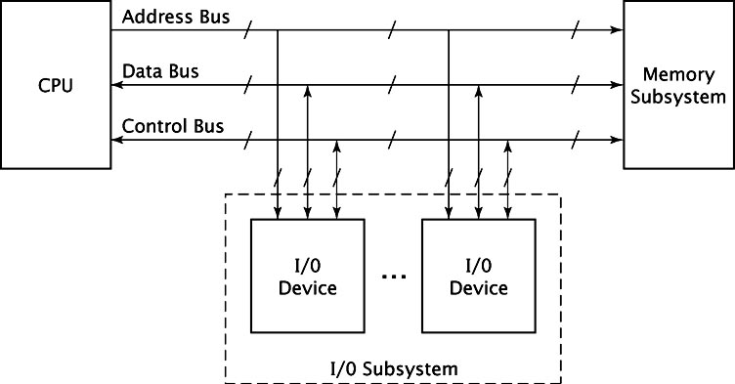
Computer Organization

Slide 4
COMPUTER ARCHITECTURE
Computer architecture refers to those parameter of a computer system that are visible to a programmer .
Examples of the computer architectural attributes.
Instruction set
i/o mechanism
Addressing techniques

Slide 5
Computer architecture
Set of instruction
Computer organization
Computer architecture

Slide 6
Components of the system
CPU and microprocessor
Memory Subsystems
I/O Subsystems

Slide 7
System Buses
Address Bus: An address bus is a computer bus , that is used to specify a physical address.
Data Bus: connectors or set of wires.
Control Bus: CPU to communicate with devices

Slide 8
System bus
cpu
memory
Input and output
Control bus
Address bus
Data bus

Slide 9
Instruction Cycle
Fetch:
processor operates by processing instruction.
Decode: the cycle is repeated continuously by a cpu.
Execute : result of the processing.

Slide 10
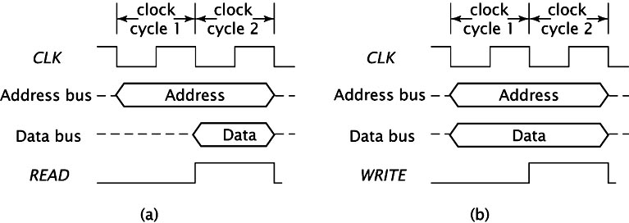
Instruction Fetch

Slide 11
I/O Organization
Peripheral devices
I/O interface
Asynchronous data transfer
Modes of transfer
Priority interrupt
Direct memory access
Input output processor
Serial communication

Slide 12
Types of Memory
Static RAM
Dynamic RAM
ROM
PROM
EPROM
EEPROM

Slide 13
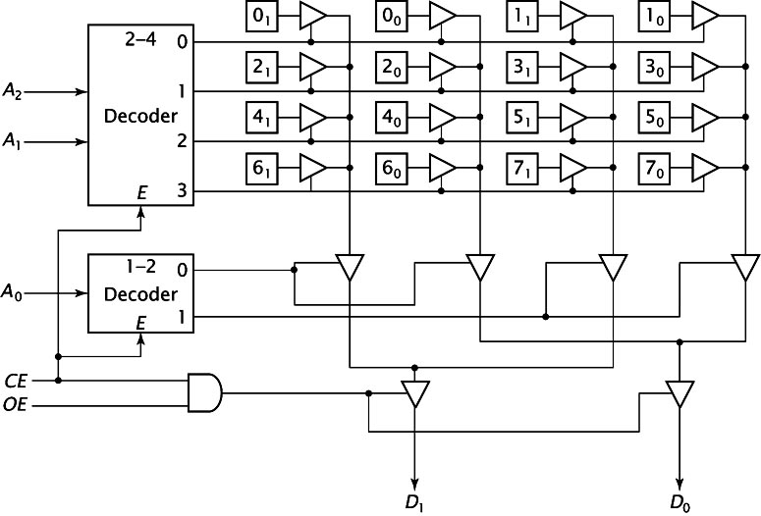
Memory Chip Organization

Slide 14
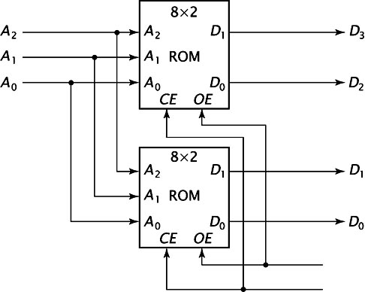
Combining Memory Chips to Increase Word Size

Slide 15
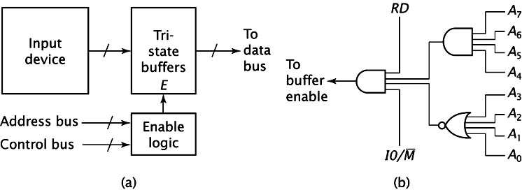
Input Organization

Slide 16
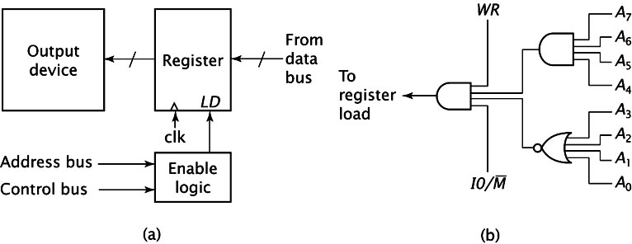
Output Organization

Slide 17
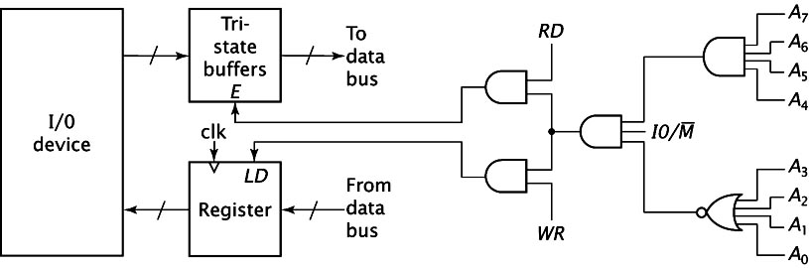
Bidirectional I/O Organization

Slide 18
THANK YOU…

