Slide 1
LARGE SAMPLE THEORY
DALLY MARIA EVANGELINE A
ASSISTANT PROFESSOR,
PG & RESEARCH DEPARTMENT OF MATHEMATICS,
BON SECOURS COLLEGE FOR WOMEN,
THANJAVUR

Slide 2
SAMPLES
A finite subset of statistical individuals in a population is called a sample.
The number of individuals in a sample is called the sample size.

Slide 3
SAMPLING
In statistics, quality assurance, and survey methodology, sampling is the selection of a subset of individuals from within a statistical population to estimate characteristics of the whole population.
Sampling is quite often used in our day – to – day life.

Slide 4
TYPES OF SAMPLING
Purposive Sampling,
Random Sampling,
Stratified Sampling,
Systematic Sampling.

Slide 5
Purposive Sampling
Purposive sampling is one in which the sample units are selected with definite purpose in view.
For example, if we want to give the picture that the standard of living has increased in the city of New Delhi, we may take individuals in the sample from rich and posh localities like Defense colony, Golf Links etc. and ignores the localities where low income group and the middle class families live.
This sampling suffers from the drawback of favoritism and nepotism and does not give a representative sample of the population.

Slide 6
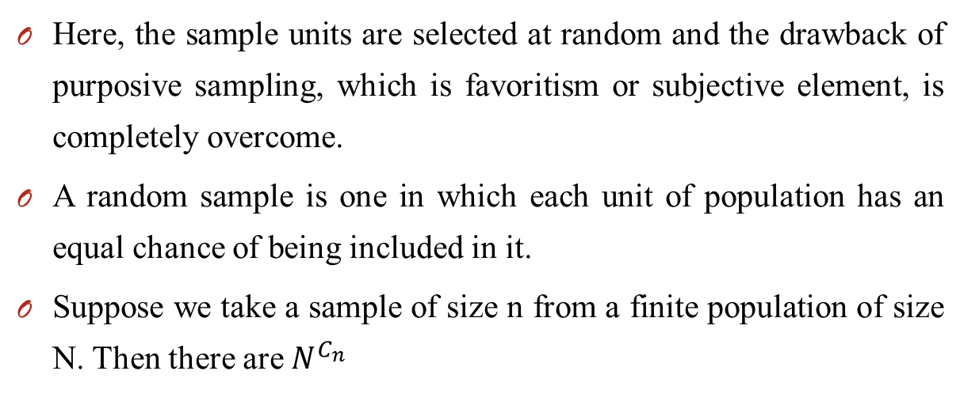
Random Sampling
Here, the sample units are selected at random and the drawback of purposive sampling, which is favoritism or subjective element, is completely overcome.
A random sample is one in which each unit of population has an equal chance of being included in it.
Suppose we take a sample of size n from a finite population of size N. Then there are $N^{C_{n}}$

Slide 7
Simple Sampling
Simple sampling is random sampling in which each unit of the population has an equal chance, say p, of being included in the sample and that this probability is independent of the previous drawings.
Thus a simple sample of size n from a population may be identified with series of n independent trials with constant probability ‘p’ of success for each trial.

Slide 8
Stratified Sampling
Here the entire heterogeneous population is divided into a number of homogeneous groups, usually termed as strata, which differ from one another but each of these groups is homogeneous within itself.
Then units are sampled at random from each of these stratum, the sample size in each stratum varies according to the relative importance of the stratum in the population.
The sample, which is the aggregate of the sampled units of each of the stratum, is termed as stratified sample and the technique of drawing this sample is known as stratified sampling.

Slide 9
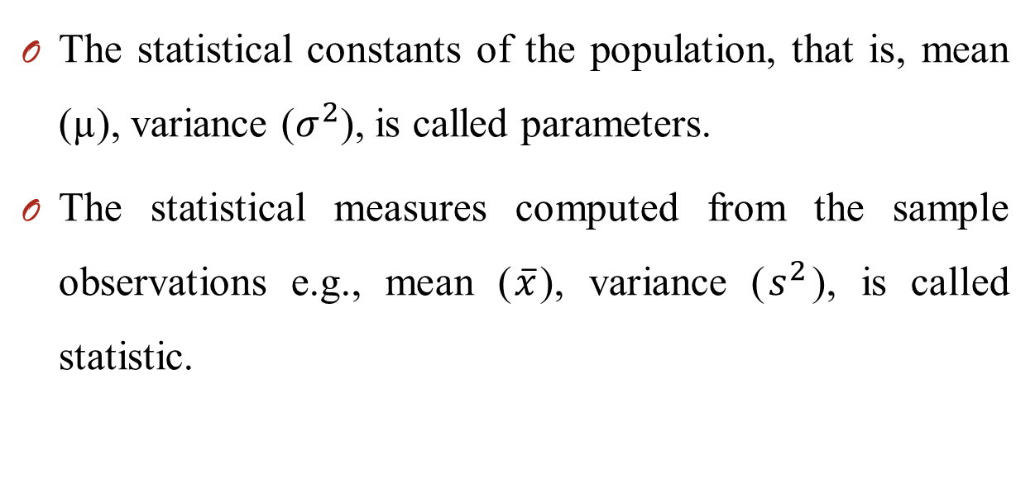
PARAMETERS & STATISTIC
The statistical constants of the population, that is, mean (µ), variance ($σ^{2}$), is called parameters.
The statistical measures computed from the sample observations e.g., mean ($\overline{x}$), variance ($s^{2}$), is called statistic.

Slide 10
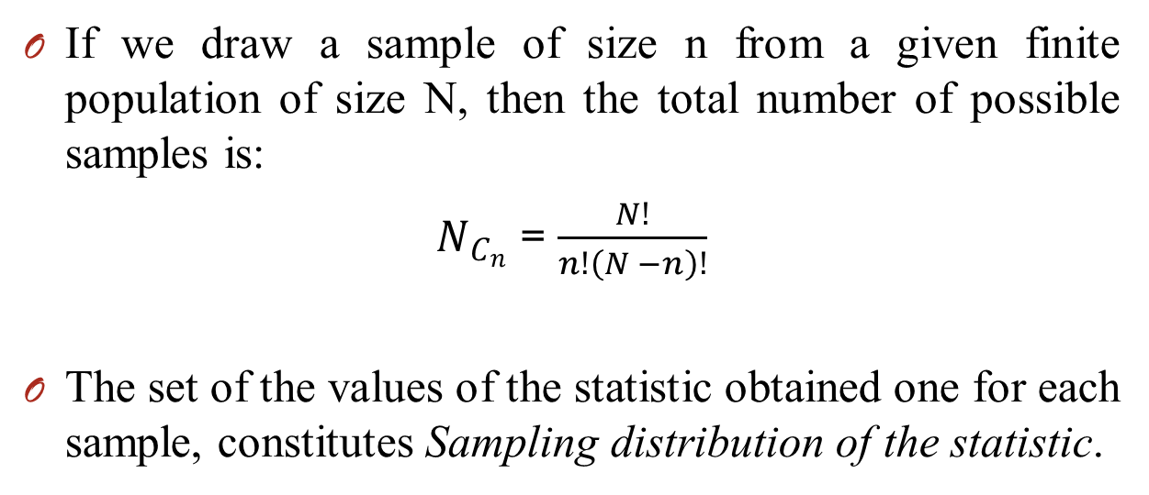
SAMPLING DISTRIBUTION OF A STATISTIC
If we draw a sample of size n from a given finite population of size N, then the total number of possible samples is:
$N_{C_{n}}$ = $\frac{N!}{n!\left(N −n\right)!}$
The set of the values of the statistic obtained one for each sample, constitutes Sampling distribution of the statistic.

Slide 11
The Central Limit Theorem
The average of your sample means will be the population mean. In other words, add up the means from all of your samples, find the average and that average will be your actual population mean. Similarly, if you find the average of all of the standard deviations in your sample, we can find the actual standard deviation for your population.

