Slide 1
Mathematical
Statistics
Dr. Beulah Mariya,
Assistant Professor of Mathematics,
Bon Secours college for Women, Thanjavur

Slide 2
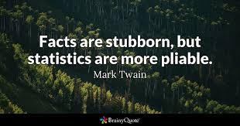

Slide 3
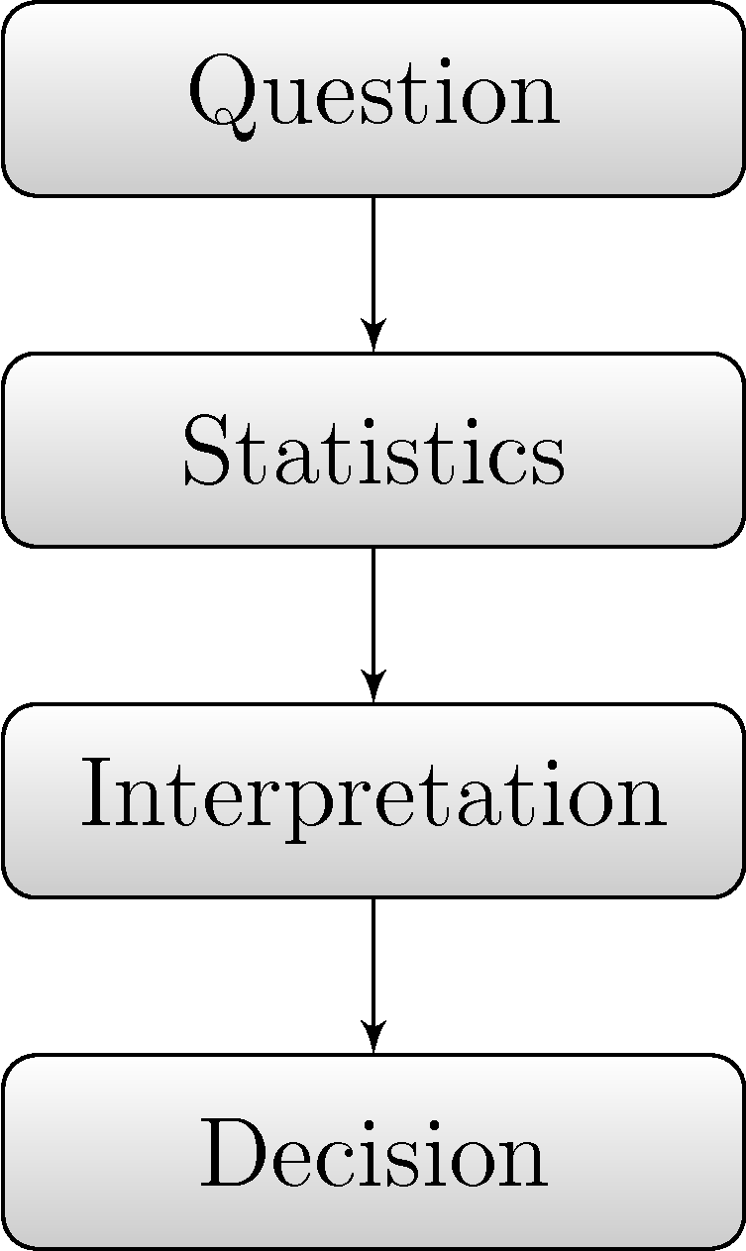

Slide 23
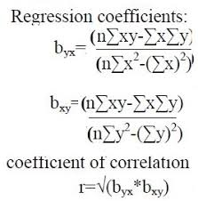
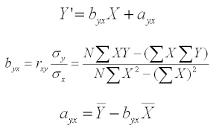
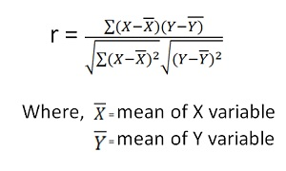

Slide 26
THANK YOU!

