Slide 1
Calvin cycle
*The Calvin cycle, light-independent reactions, bio synthetic phase, dark reactions, or photosynthetic carbon reduction (PCR) cycle of photosynthesis are the chemical reactions that convert carbon dioxide and other compounds into glucose.
* These reactions occur in the stroma, the fluid-filled area of a chloroplast outside the thylakoid membranes.
* These reactions take the products (ATP
and NADPH) of light- dependent reaction and perform further chemical processes on them.

Slide 2
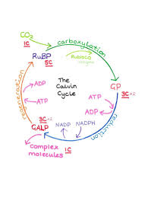

Slide 3
*The Calvin cycle uses the reducing powers ATP and NADPH from the light dependent reactions to produce sugars for the plant to use.
*These substrates are used in a series of reduction-oxidation reactions to produce sugars in a step-wise process.
* There is not a direct reaction that converts CO2 to a sugar because all off the energy would be lost to heat.
* There are three phases to the light-independent reactions, collectively called the Calvin cycle: carbon fixation, reduction reactions, and ribulose 1,5-bisphosphate (RuBP) regeneration.

Slide 4
* Though it is called the "dark reactions", the Calvin cycle does not actually occur in the dark or during nighttime.
* This is because the process requires reduced NADP which is short-lived and comes from the light-dependent reactions. In the dark, plants instead release sucrose into the phloem from their starch reserves to provide energy for the plant.
* The Calvin cycle thus happens when light is available independent of the kind of photosynthesis ( C3 carbon fixation, C4 carbon fixation, and Crassulacean Acid Metabolism (CAM); CAM plants store malic acid in their vacuoles every night and release it by day to make this process work.

Slide 5
* The cycle was discovered in 1950 by Melvin Calvin, James Bassham, and Andrew Benson at the University of California, Berkeley by using the radioactive isotope carbon -14.
* Photosynthesis occurs in two stages in a cell. In the first stage, light-dependent reactions capture the energy of light and use it to make the energy-storage and transport molecules ATP and NADPH.
* The Calvin cycle uses the energy from short-lived electronically excited carriers to convert carbon dioxide and water into organic compounds that can be used by the organism (and by animals that feed on it).

Slide 6
  * This set of reactions is also called carbon fixation. The key enzyme of the cycle is called RuBisCo. In the following biochemical equations, the chemical species (phosphates and carboxylic acids) exist in equilibria among their various ionized states as governed by the pH.
  * The enzymes in the Calvin cycle are functionally equivalent to most enzymes used in other metabolic pathways such as gluconeogenesis and the pentose phosphate pathway but they are found in the chloroplast stroma instead of the cell cytosol, separating the reactions.

Slide 7
* They are activated in the light (which is why the name "dark reaction" is misleading), and also by products of the light-dependent reaction.
* These regulatory functions prevent the Calvin cycle from being respired to carbon dioxide. Energy (in the form of ATP) would be wasted in carrying out these reactions that have no net productivity.
*3 CO₂ +6 NADPH +6H⁺ +9 ATP → Glyceraldehyde-3- phosphate (G3P) + 6 NADP⁺ + 9 ADP + 3 H₂O + 8 P_{i} (P_{i} = inorganic phosphate)

Slide 8
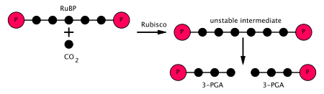
*In the first stage of the Calvin cycle, a CO
2 molecule is incorporated into one of two three-carbon molecules (glyceraldehyde 3- phosphate or G3P), where it uses up two molecules of ATP and two molecules of NADPH, which had been produced in the light-dependent stage. The three steps involved are:
Step:1

Slide 9

Step 2 and 3combined

Slide 10
*The enzyme RuBisCO catalyses the carboxylation of ribulose- 1,5- bisphosphate RuBP, a 5-carbon compound, by carbon dioxide (a total of 6 carbons) in a two-step reaction. The product of the first step is enediol-enzyme complex that can capture CO₂ or O₂. Thus, enediol-enzyme complex is the real carboxylase/oxygenase.
*The CO₂ that is captured by enediol in second step produces an unstable six-carbon compound called 2-carboxy 3-keto 1,5biphosphoribotol (or 3-keto-2-carboxyarabinitol 1,5-bisphosphate) that immediately splits into 2 molecules of 3-phosphoglycerate or 3-PGA, a 3-carbon compound (also: 3-phosphoglyceric acid, PGA, 3PGA).

Slide 11
*The enzyme phosphoglycerate kinase catalyses the phosphorylation of 3-PGA by ATP (which was produced in the light-dependent stage). 1,3 Bisphosphoglycerate (1,3BPGA, glycerate-1,3-bisphosphate) and ADP are the products. (However, note that two 3-PGAs are produced for every CO₂
that enters the cycle, so this step utilizes two ATP per CO₂ fixed.)
*The enzyme glyceraldehyde 3-phosphate dehydrogenase catalyses the reduction of 1,3BPGA by NADPH (which is another product of the light-dependent stage). Glyceraldehyde 3-phosphate (also called G3P, GP, TP, PGAL, GAP) is produced, and the NADPH itself is oxidized and becomes NADP⁺. Again, two NADPH are utilized per CO₂ fixed.

Slide 12
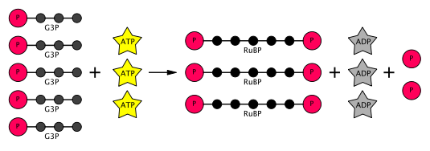
Regeneration stage of the Calvin cycle

Slide 13
* The next stage in the Calvin cycle is to regenerate RuBP. Five G3P molecules produce three RuBP molecules, using up three molecules of ATP. Since each CO2 molecule produces two G3P molecules, three CO2 molecules produce six G3P molecules, of which five are used to regenerate RuBP, leaving a net gain of one G3P molecule per three CO2 molecules (as would be expected from the number of carbon atoms involved).

Slide 15
THANK YOU

