Slide 1
ECOLOGY
By
Mrs.P.SATHIYAVANI
ASSISTANT PROFESSOR
DEPARTMENT OF BOTANY
BON SECOURS COLLEGE FOR WOMEN, THANJAVUR

Slide 2
What is Ecology?
Ecology is a branch of science including human science, population, community, ecosystem, and biosphere
Ecology is the study of organisms, environment and how the organisms interact with each other and their environment.

Slide 3
Biotic and Abiotic Factors
The main aim of ecology is to understand the distribution of biotic and abiotic factors of living things in the environment.
The biotic and abiotic factors include the living and non-living factors and their interaction with the environment.

Slide 4
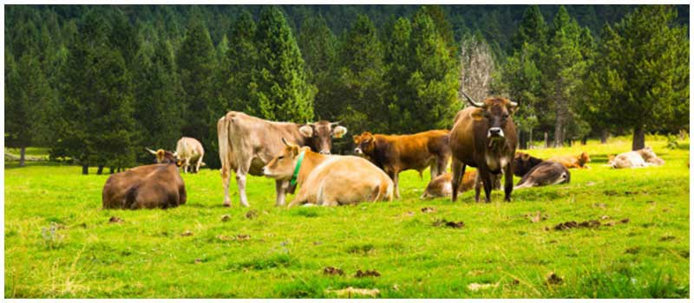
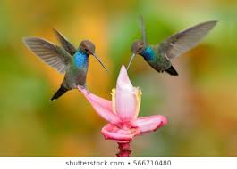
Biotic Components
Biotic components are living factors of an ecosystem. A few examples of biotic components include bacteria, animals, birds, fungi, plants, etc.

Slide 5
Abiotic Components
Abiotic components are non-living chemical and physical factors of an ecosystem. These components could be acquired from the atmosphere, lithosphere, and hydrosphere. A few examples of abiotic components include sunlight, soil, air, moisture minerals, and more.

Slide 6
TYPES OF ECOLOGY
There are two types of Ecology.
Autecology
Synecology
Autecology is the study of individual organism or individual species. It is also known as population ecology. Autecology help us to understand the relationship between plants and environment
Synecology is the study of group of organisms of different species which are associated together as a unit in form of a community. Synecology help us to understand the relationship between communities and environment

Slide 7
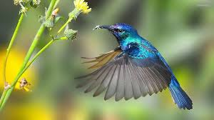
Thank you all

