Slide 1
I m m u no g l o b u li n s
Dr.J.REVATHY
ASSISTANT PROFESSOR
BIOTECHNOLOGY
BON SECOURS COLLEGE FOR WOMEN
THANJAVUR

Slide 2
Immunoglobulin
Immunoglobulin is a glycoprotein that is made in response to an antigen and can recognize and bind to the antigen that caused its production.

Slide 3
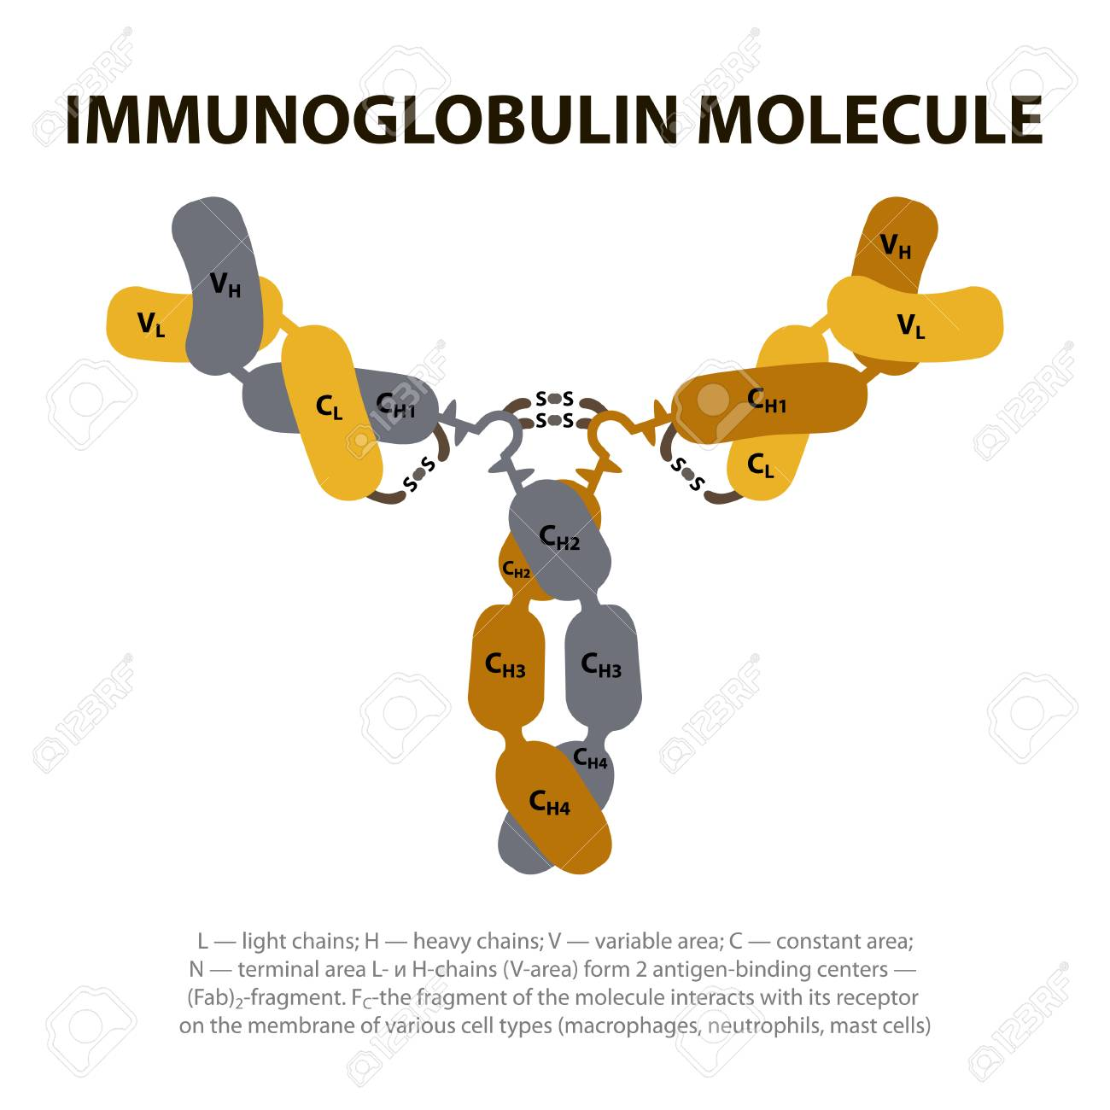

Slide 4
Are gamma globulins
Synthesized by plasma cells
Constitute 25-30 % of total serum proteins
Antibodies are present in serum, tissue fluids and mucosal surfaces.
All antibodies are immunoglobulins, but all immunoglobulins may not be antibodies

Slide 5
Basic structure
•
Composed of 4 polypeptide
chains.
•
2 identical light and 2 identical
heavy chains
•
•
Linked by disulphide bonds
Light chains similar in all
immunoglobulins
•
Light chains occur in 2
varieties kappa and lambda
•
Light and Heavy chains are
subdivided into variable and constant region.
•
Each heavy and light chain
contains amino terminal in variable region carboxy terminal in constant region

Slide 6
Heavy chains are structurally and antigenically distinct for each class
Each immunoglobulin peptide chain has intra chain disulphide bonds- form loops
Each loop is compactly folded to form a globular structure- domain
Light chain consists a single variable domain (VL) and a single constant domain (CL).
Heavy chain contains one variable domain (VH) and three constant domains (CH1, CH2, CH3).
Hinge region is the segment in heavy chain between- CH1 and CH2

Slide 7
D I G E S T I O N W I T H P R O T E O LY TI C E N Z Y M E
Papain enzyme
•
Peptide bonds in the
hinge region are broken
•
•
Produces 3 fragments
2 identical fragments
called Fab fragments – antigen binding activity.
•
Other fragment called Fc
fragment (Fraction crystallizable)

Slide 8
PEPSIN DIGESTION
Produce a single fragment composed of two Fab like subunits F(ab)2 binds antigen
Fc fragment is not recovered- digested to small numerous peptides.

Slide 9
Classification
Based on structure and antigenic nature of H chain the immunoglobulins are classified into 5 classes.
Ig G- (gamma)
Ig A- (alpha)
Ig M- (mu)
Ig D- (delta)
Ig E - (epsilon)

Slide 10
Immunoglobulin G (IgG)
•
Most abundant class in
serum
•
Constitutes 80% total
immunoglobulin
•
Present in blood, plasma and
tissue fluids
•
Contains less carbohydrate
than other immunoglobulins
•
It has a half life of 23 days:
the longest of all of the immunoglobulin isotypes

Slide 11
Crosses placenta and provide natural immunity to foetus and neonate at birth
Acts against bacteria and viruses by opsonizing
Neutralize toxin
Activate complement by classical pathway
Catabolism of IgG is unique in that it varies with its serum concentration

Slide 12
Sub classes of IgG
Ig G1, Ig G2, Ig G3, Ig G4

Slide 13
Biological function of subclasses
IgG1, IgG3, IgG4 – cross placenta and protect foetus
IgG3 activates complement
IgG1 and IgG3 binds to Fc receptor on phagocytic cells, monocytes and macrophages and mediate opsonisation.

Slide 14
Immunoglobulin A (Ig A)
•
Constitutes 10-15 % of
total immunoglobulins
•
Present in milk, saliva,
tears, mucous of respiratory tract, digestive tract and genitourinary tract.
•
•
In serum exist as monomer
In external secretions exist
as dimer called secretory Immunoglobulin.
•
Has ‘J’ chain and secretory
piece.
•
Half life: 6-8 days

Slide 15
Formation of secretory Ig A
•
Dimeric Ig A binds to the
receptor on the surface of the epithelial cells -endocytosed and transported across the cell to the luminal surface
•
After reaching the surface, the
poly-Ig receptor is cleaved
•
The portion of the receptor
that remains attached to the Ig A dimer – secretory component
•
Secretory piece protects Ig A
from digestive enzymes and denaturation by bacterial proteases

Slide 16
Secretory IgA - Functions
Provides local immunity
Binds to surface antigens of microorganism and prevent its attachment and invasion of the mucosal surfaces of respiratory and digestive tract- immune elimination.
Provides important line of defense against salmonella, Vibrio cholerae, N.gonorrhoeae, influenza virus and polio virus.
Present in breast milk protects newborn during first month of life.
Activates complement by the alternate pathway
Promotes phagocytosis and intracellular killing of microorganism.

Slide 17
Immunoglobulin M (IgM)
•
Accounts for 5-10% of
total serum proteins
•
Polymer of five monomeric
units (pentamer)
•
Held together by disulfide
bonds and ‘J’ chain
•
Mol. Wt. of 900,000-
10,00,000 (millionaire molecule)
•
Half life: 5 days

Slide 18
Most of IgM (80%) present intravascularly
Present in low concentration in intercellular tissue fluids
Cannot cross placenta
Presence of IgM antibody in serum of newborn indicate congenital infection.
Earliest immunoglobulin to be synthesized by foetus (20 weeks)
First immunoglobulin to be produced in primary response to antigen
Relatively short-lived hence it’s demonstration in the serum indicates recent infection
Monomeric IgM appears on the surface of unstimulated B lymphocytes and act as receptors for antigens

Slide 19
Functions
It agglutinates bacteria
Activates complement by classical pathway
Causes opsonization and immune heamolysis
Believed to be responsible for protection against blood invasion by microorganisms

Slide 20
Immunoglobulin E (Ig E)
•
•
Structure is similar to Ig G
Has 4 constant region
domains.
•
•
•
Mol. Wt. 1,90,000
Half life: 2 days
Heat labile (inactivated at
56⁰C in 1 hour)
•
Normal serum
concentration 0.3 ug/ml
•
Mostly present extra
cellularly
•
Does not cross placenta

Slide 21
Produced in the lining of respiratory and intestinal tract
Known as reagin antibody
Does not activate complement nor agglutinate antigens
Binds to the Fc receptors on the membranes of blood basophils and tissue mast cells
Mediates immediate hypersensitivity reaction and P.K. reaction
Responsible for symptoms of anaphylactic shock, hay fever and asthma.
Play a role in immunity against helminthic parasites

Slide 22
IgE binds to Fc receptors on the membrane of blood basophils and tissue mast cells.
When two IgE molecules on the surface of these cells are cross linked by binding of the same antigen- cells degranulates.
Release histamine and pharmacological mediators of anaphylaxis from cell.
•
The physiological role of IgE
appears to be protection against pathogens by mast cell degranulation and release of inflammatory mediators

Slide 23
Mediates P.K. reaction (PRAUSNITZ & KUSTNER)
The presence of a serum component responsible for allergic reaction was first demonstrated by Prausnitz and Kustner in 1921.
Kustner was suffering from atopic hypersensitivity to certain species of fish
Kustner’s serum was injected intracutaneously in Prausnitz
After 24 hrs small quantity of cooked fish antigen was injected at the same site
A wheal and flare reaction occurred within minutes.

Slide 24
Immunoglobulin D (Ig D)
•
•
Structure is similar to IgG
Serum concentration 30
micrograms per ml
•
Constitutes 0.2% of total
immunoglobulins
•
•
Half life: 3 days
IgD together with IgM is
major membrane bound immunoglobulin on unstimulated B lymphocytes-acts as recognition receptors for antigens

Slide 25
Properties and biological activities of Immunoglobulins
Ig G Ig A Ig M Ig D Ig E
1. Structure
Monomer
Monomer in
Pentamer
Monomer
Monomer
serum Dimer in secretion
2. Heavy chain
Gamma
Alfa
Mu
Delta
Epsilon
CH domain
3. Mol. Wt.
Three
Three
Four
Three
Four
1,50,000
1,60,000
9,00,000
1,80,000
1,90,000
4. Serum concentration (mg/ml)
12
2
1.2
0.03
0.00004
5. Present on membrane of mature B
_
_
+
+
_
cell
5. Intravascular
45
42
80
75
50
Distribution (%)
6. Crosses placenta
+
-
-
-
-
-
-
7. Present in milk
+
+
-
-
8. Selective secretion by seromucous
-
+
-
-
glands
9. Activation of complement
Classical
+
-
+
-
-
Alternate
-
+
-
-
-
10 Binds to FC receptor of phagocytes
+
-
-
-
-
11 Induces mast cell degranulation
-
-
-
-
+

Slide 26
Role of different immunoglobulin classes
IgG: Protects the body fluids IgA: Protects the body surfaces
IgM: Protects the blood stream
IgE: Mediates type I hypersensitivity IgD: Role not known

Slide 27
