Slide 1
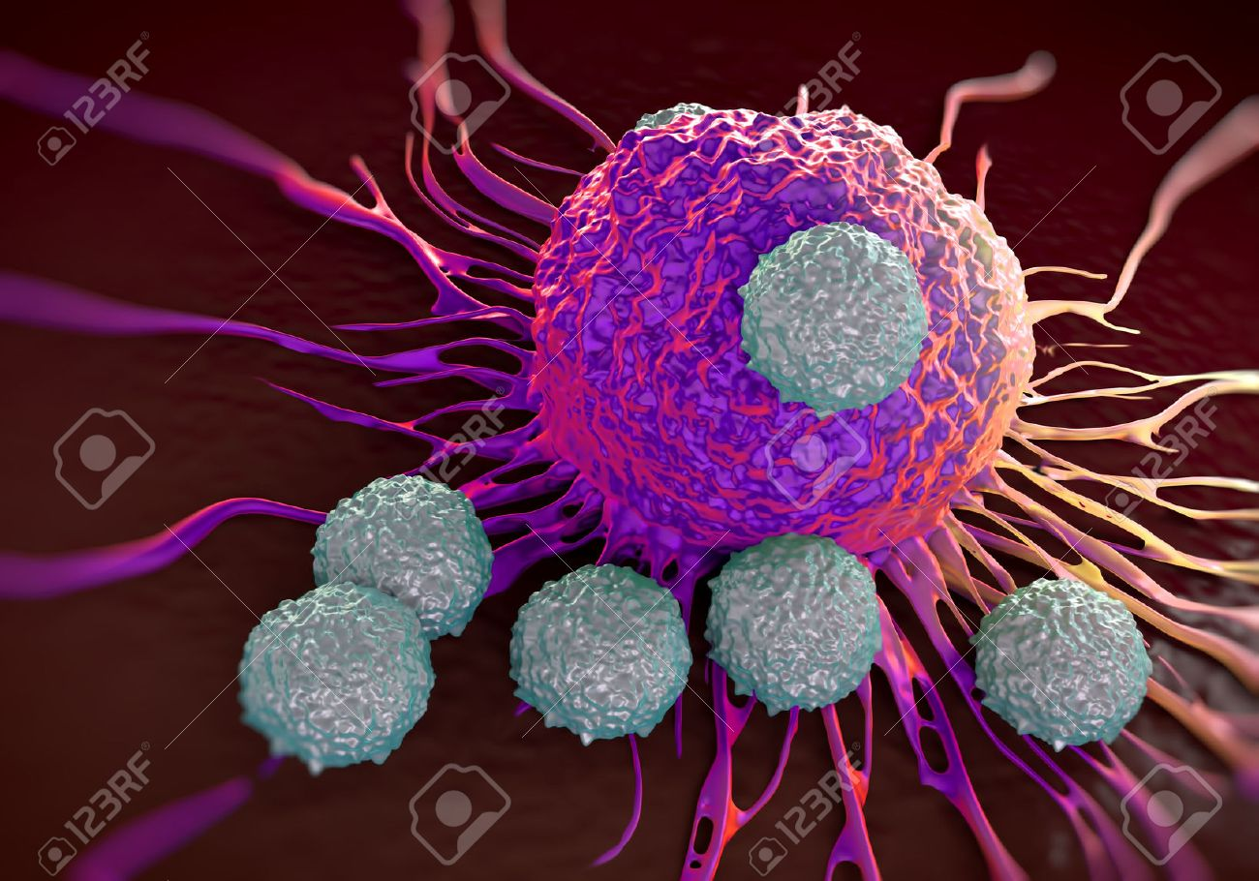
IMMUNOLOGY
Dr.J.Revathy,
Assistant Professor,
PG and Research Department Of Biotechnology,
Bon Secours College For Women.

Slide 2
IMMUNE SYSTEM
Immune system (from the Latin word immunis, meaning “free” or “untouched”)
It protects the body like a guardian from harmful influences from the environment and is essential for survival.
It is made up of different organs, cells and proteins and aside from the nervous system, it is the most complex system that the human body has

Slide 4
Organs of immune system LYMPHOID ORGANS
Classification-Based on functional development of lymphocytic cells, the lymphoid organs can be classified into three groups:
Lymphoid organs involved in genesis of lymphocytes
Yolk sac of embryo
Foetal liver
Bone marrow

Slide 5
2. Central/Primary lymphoid organs(involved in immunological differentiation of various lymphocytes) Thymus Bursa of fabricus Bone marrow 3. Peripheral/Secondary lymphoid organs (functionally matured lymphocytes concentrate and respond to antigenic stimuli) Lymph nodes Spleen Gut and Mucosa associated lymphoid tissue

Slide 6
Lymphoid organs
Primary Lymphoid organs
(Migration)
Stem cells
Differentiation &
Maturation of Stem cells

Slide 7
Yolk sac of embryo give rise to stem cell of haemopoietic tissue, lymphoid stem cell & colonize in foetal liver and the to bone marrow. Bone marrow – chief source of stem cell in adult life. Lymphopoiesis & genesis of other haemopoietic cells- occurs in red bone marrow found in foetal bones & postnatal life. In adults found in flat bones, bodies of vertebrates, short bones & ends of long bones. Remaining marrow is replaced by fat cells known as yellow marrow.

Slide 8
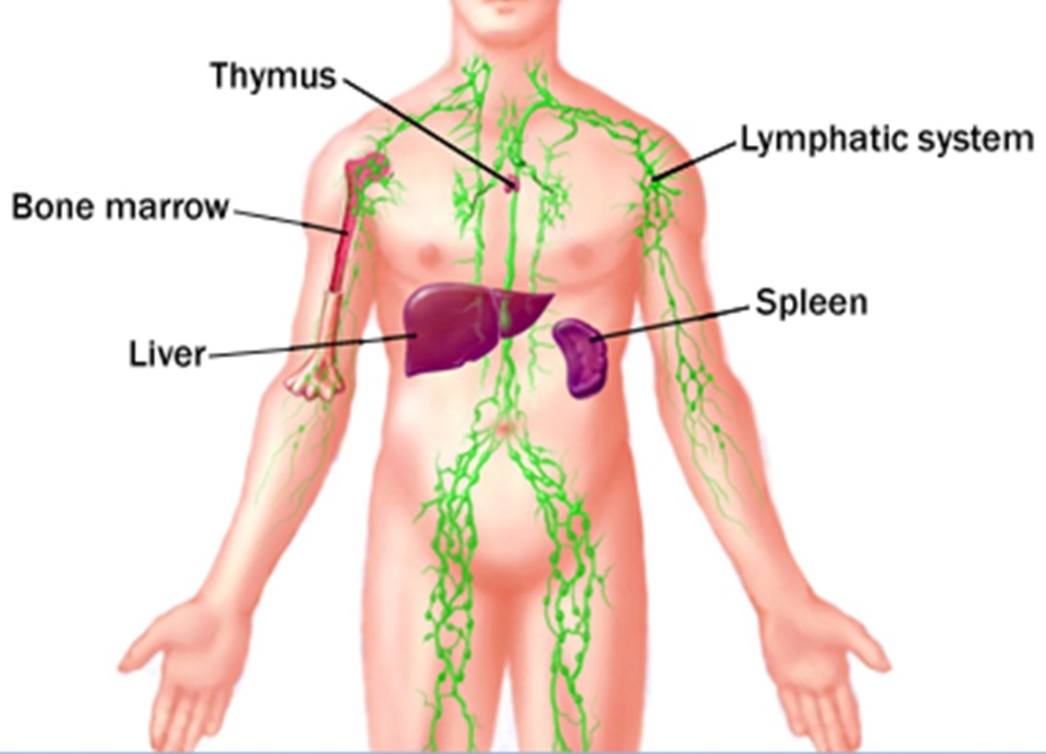

Slide 9
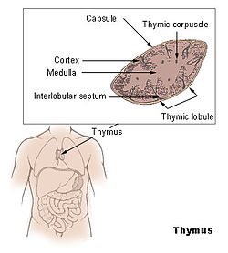

Slide 11
Thymus
Lymphoid organ where differentiation of T-lymphocyte occurs
It is a lymphoepithelial bilobed structure located behind the upper part of sternum.
It is capsulated and septate
Septa are called trabeculae arises from capsule which divides the gland into lobules.
Cells in the globules are arranged into outer cortex and inner medulla.

Slide 12
Cortex- composed of epithelial cells & lymphocytes
Epithelial cells are larger than lymphocytes and forms three dimensional network in meshes of which lymphocyte found.
Precursors of lymphocytes (SC) from yolk sac, foetal liver and bone marrow reaches thymus, matures in cortex, acquires surface characteristics of T-lymphocyte and then migrates to medulla.

Slide 13
Medulla- lymphocyte matures enters into blood as matured T-lymphocyte to the peripheral lymphoid organs.
Medulla also contains- reticular epithelial cells, interdigitating cells & some peculiar strucures called Hassall’s corpuscles which are small masses of epithelial cells with central degenerating epithelial cells.

Slide 14
Functions of Thymus Centre for development of immune system Major Site for lymphocyte proliferation and production of T-lymphocytes T-lymphocyte acquire surface markers and become immunologically competent

Slide 15
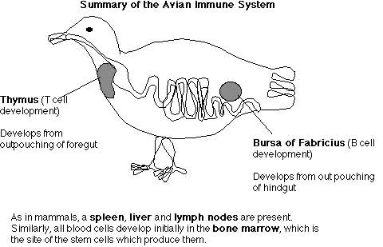

Slide 16
Bursa of Fabricus
Central lymphoid organ in birds where differentiation of B-lymphocyte occurs.
It was first described by fabricus in 1621 and it is absent in mammals.
In mammals the differentiation and maturation takes place in bone marrow.
The structure is similar to thymus and formed with many lobes called lymphoid follicles.

Slide 17
Functions Responsible for development of immunocompetent B cells. B Cells acquire the surface antigens and then migrate to secondary lymphoid organs where they become plasma cells producing antibodies.
Each follicle is divided into outer cortex and inner medulla which are composed of lymphocytes, macrophages and B cells.
Precursors of B cells (SC) from yolk sac, foetal liver reach bursa and mature into immunocompetent bursal lymphocytes or B cells which enter into blood and migrate to secondary/ peripheral organs.

Slide 18
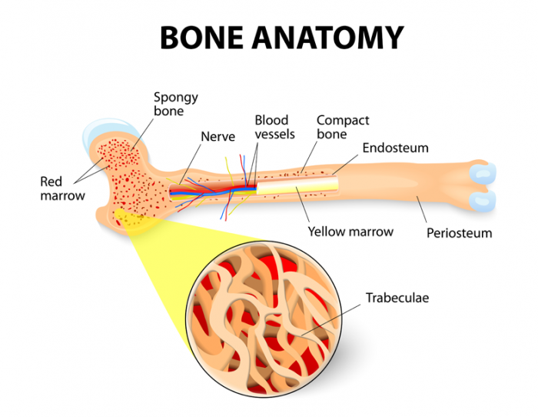

Slide 19
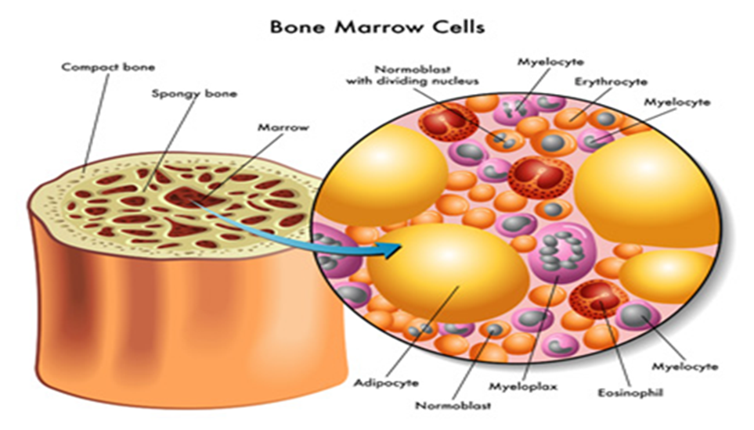

Slide 20
Bone marrow
In mammals B cells differentiate and become mature in bone marrow, a soft tissues present in bone cavities.
In addition to SC, they are involved in the production of various blood cells.
Bone marrow contains- erythrocytes, platelets, granulocytes, monocytes and lymphocytes with their precursors- megakaryotes, reticulum cells, macrophages and plasma cells.

Slide 21
FUNCTIONS OF Bone marrow
Production of different blood cells erythrocytes, leukocytes, platelets from HSC.
B cells differentiate, mature and acquire immune response.
Functions both as central & peripheral lymphoid organ.
During secondary response activated memory B cells migrate to bone marrow and mature to plasma cells that produce antibody secreting cells.

