Slide 1
OOPS CONCEPT IN C++
by
N.RUBA
Assistant professor
Dept. of Computer Applications
Bon Secours College for Women
Vilar bypass,Thanjavur

Slide 2
Features of Object Oriented Programming
Objects
Classes
Abstraction
Encapsulation
Inheritance
Polymorphism
Overloading
Exception Handling

Slide 3
ABSTRACTION
Definition: A model complex of a system that includes only the details essential to perspective of the viewer of the system.
An Abstraction is a model of a complex system that includes only the essential details.
Abstractions are the fundamental way that we manage complexity.
Helps to manage complexity of a large system.
Support our quality goals of modifiability and reusability.

Slide 4
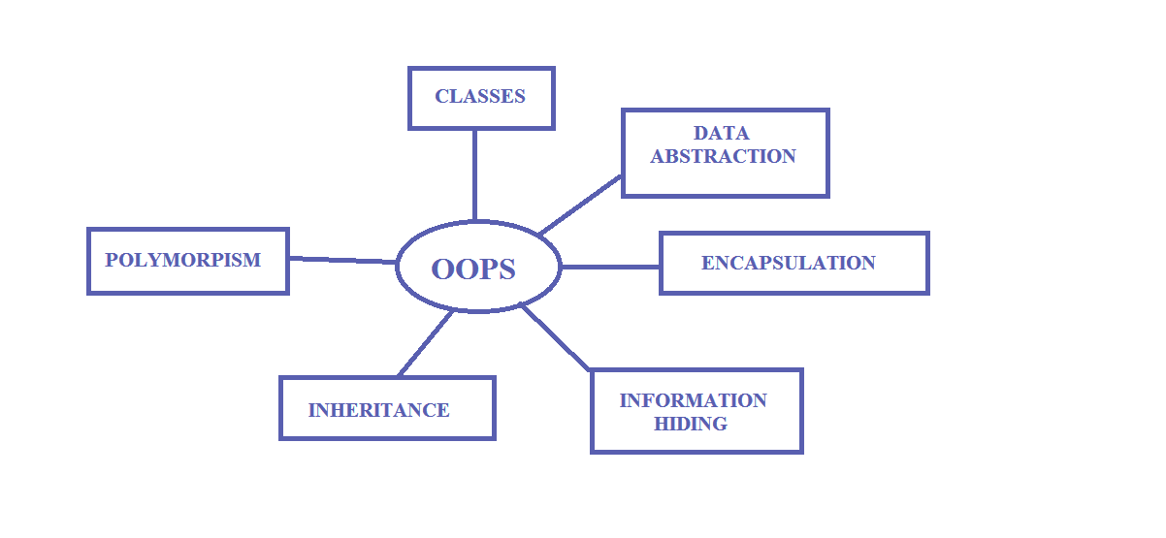
Object oriented programming

Slide 5
OBJECTS
Objects are basic unit of OOP.
They are instance of a class.
Consists of various data members and member functions.
These data types and member functions are bundled together as a unit is called objects.

Slide 6
Classes
It is similar to Structure in C.
Class is user defined data type.
It holds own data members and member functions.
Class can be accessed and used only by instance of that class.
It is basically blueprint for object.

Slide 7
Encapsulation
It can be said Data binding.
It binds VARIABLES and FUNCTIONS together inside a class.
Object Oriented Programming provides you to place, data and relevant functions together in the same object.

Slide 8
Inheritance
Code reusability.
Process of forming new class from an existing class.
Inherited class is called Base class.
Class which inherits is called Derived class.
Pros : Helps to reduce code size.

Slide 9
Types of Inheritance in C++
Single inheritance.
Multiple inheritance.
Hierarchical inheritance.
Multilevel inheritance.
Hybrid inheritance.

Slide 10
Polymorphism
It makes the code more readable.
Function with same name but different arguments.
Functioning is different.
Poly refers to many.
Types of Polymorphism
Compile time Polymorphism.
Run time polymorphism.

Slide 11
Overloading
It is a part of polymorphism. Existing function or operator is made to operate on new data type.

Slide 12
Exception Handling
It part of Object Oriented Programming Concept.
Used to handle unresolved exception or errors during runtime.

Slide 13
Thank YOU

