Slide 1
r.Rajalakshmi, asst.professor, department of chemistry, bon secours college for women, thanjavur.

Slide 2
Aromatic hydrocarbon

Slide 3
Anthracene

Slide 4
introduction
Hydrocarbon – it is made up of carbon and hydrogen only.
Aromatic – the molecule has alternating double and single bond all around the ring system.
Polycyclic – more than one ring system.
Anthracene is a Polycyclic aromatic hydrocarbons that has three benzene ring fused together.

Slide 5
isolation
Anthracene is present in very small quantities (less than 1%) in coal tar.
Anthracene oil is chilled to crystal.
This oil also contains phenanthrene and carbazole.
This is washed with solvent naphtha and pyridine.
Finally, anthracene is purified by sublimation.

Slide 6
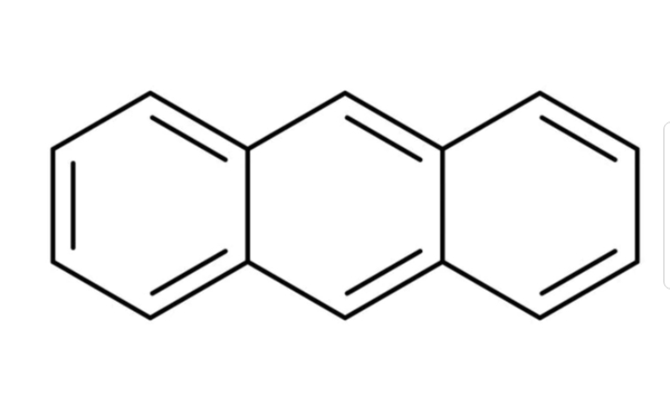
Molecular structure

Slide 7
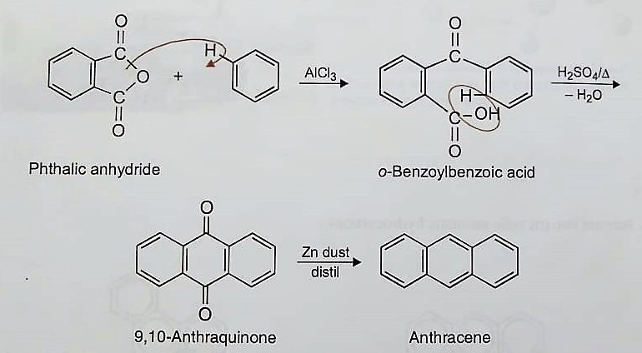
Laboratory preparation
Haworth synthesis :

Slide 8
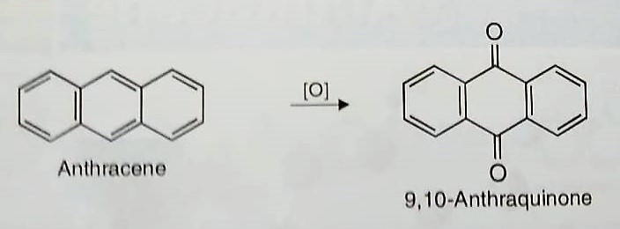
Presence of three fused benzene ring :

Slide 9
Physical properties
Anthracene is a colorless solid (mp – 217*c, bp – 340*c).
It exhibit a fine blue fluorescence when crystallized with benzene.
Insoluble in water.
Soluble in alcohol and ether.

Slide 10
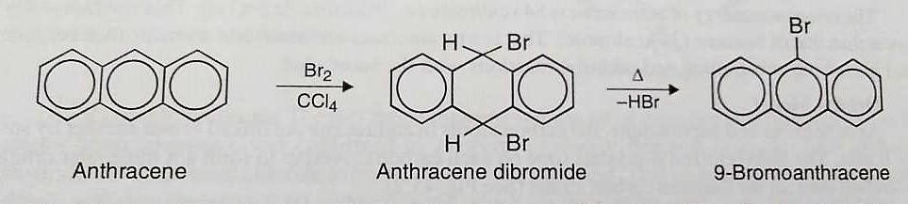
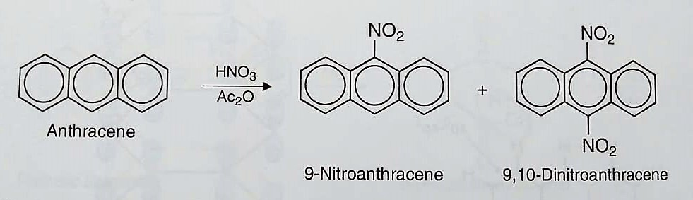
Chemical property
Halogenation :
Nitration :

Slide 11
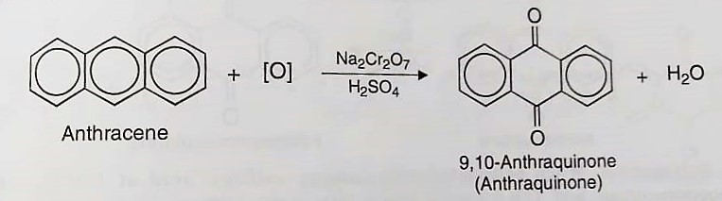
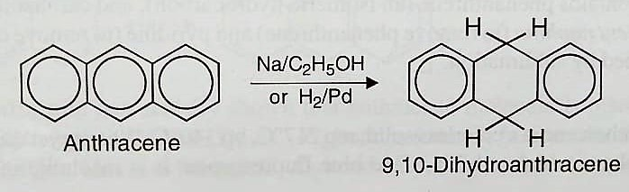
Oxidation :
Reduction :

Slide 12
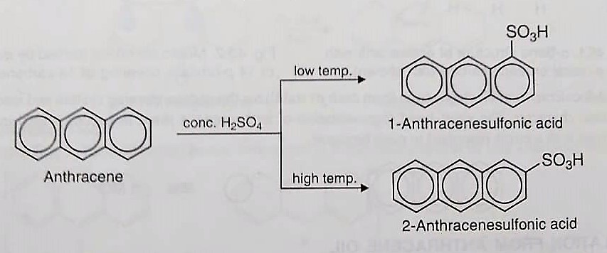
Sulfonation :

Slide 13
uses
For manufacture anthraquinone which is used as dyes.
Also used for making dyes.
Used as smoke screen.
Used as preservative in woods and lumber.
Used as insecticide for crops.
Also as coating materials.

Slide 14
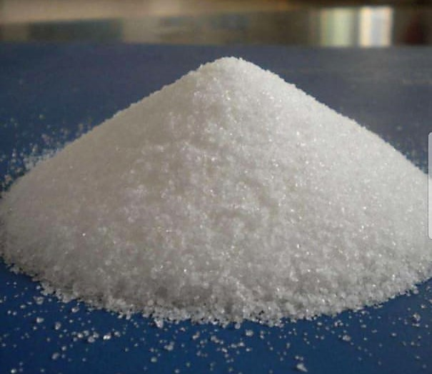
Appearance

Slide 15
If you’re not the part of the solution.
You’re part of the precipitate.

Slide 16
Thank you

Slide 17
PHENANTHRENE

Slide 18
isolation
Phenanthrene is an isomer of anthracene.
The crystal treated with solvent naphtha which dissolves phenanthrene.
Evaporation of this solution yields crude phenanthrene.
Further, purified by recrystallization of the picrate from ethanol.

Slide 19
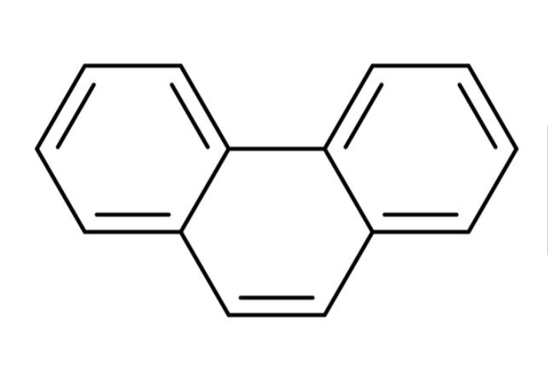
Molecular structure

Slide 20
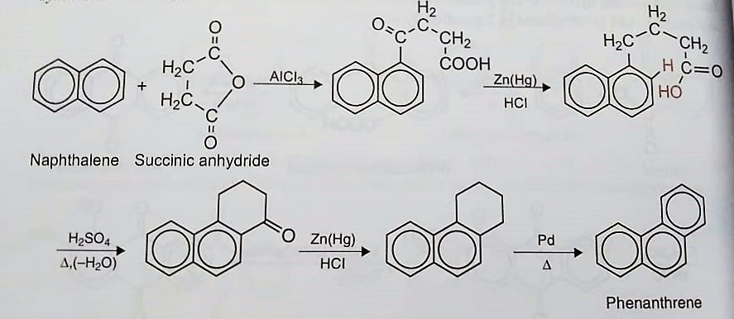
Laboratory preparation
Synthesis of phenanthrene :

Slide 21
Physical property
Phenanthrene is a colorless solid (mp – 100*c).
Phenanthrene gives blue fluorescence in benzene solution.
Insoluble in water.
Readily soluble in ethanol, benzene and ether.

Slide 22
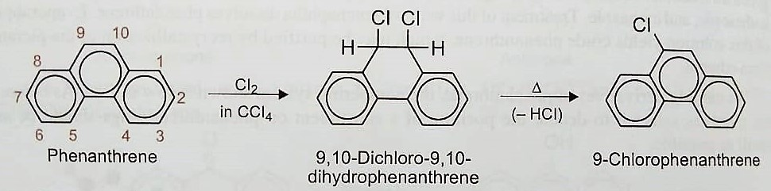
Chemical property
Reaction with halogen :

Slide 23
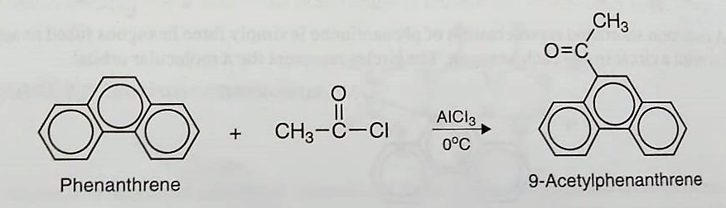
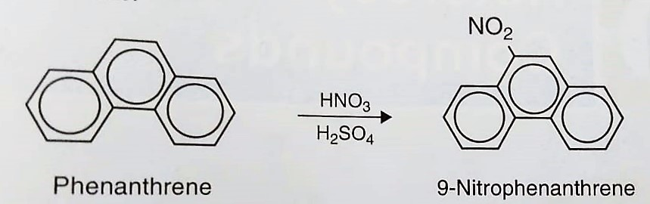
Friedel – crafts acylation :
Nitration :

Slide 24
uses
Used to make dyes, plastics and drugs.
Also used as explosives and pesticides.
Used to prepare bile acids, cholesterol and steroids.
Phenanthrene is industrially important.

Slide 25
