Slide 1
Chemical bonding
R.RAJALAKSHMI,
ASST.PROFESSOR,
DEPARTMENT OF CHEMISTRY,
BON SECOURS COLLEGE FOR WOMEN,THANJAVUR

Slide 2
VB theory
Valence bond theory is the work of Linus Pauling.
The overlap of atomic or hybrid orbital’s of individual atoms.
VB Theory is characterized by the bonding method.

Slide 3
Postulates of VB theory
The central metal atom/ion makes available a number of vacant orbital’s equal to its coordination number.
These vacant orbital’s form covalent bond with the ligand orbital’s.
A covalent bond is formed by the overlap of a vacant metal orbital.
This complete overlap leads to the formation of a sigma bond.
A strong covalent bond is formed only when the orbital’s overlap to the maximum extent.
A hybridized orbital has a better directional characteristics than an unhybridised one.

Slide 4
Defects of vb theory
It disfavors due to its inability to account for various:
Magnetic property
Electronic property
Spectroscopic property

Slide 5
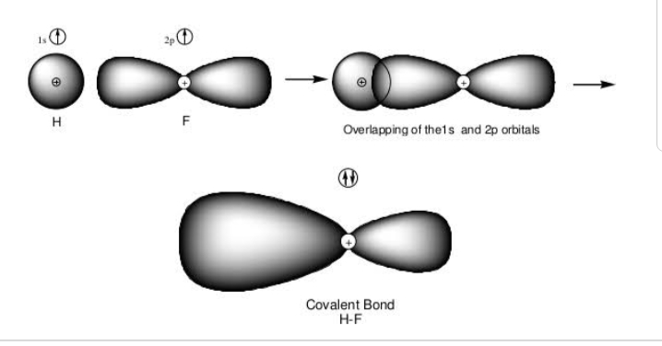
Examples:

Slide 6
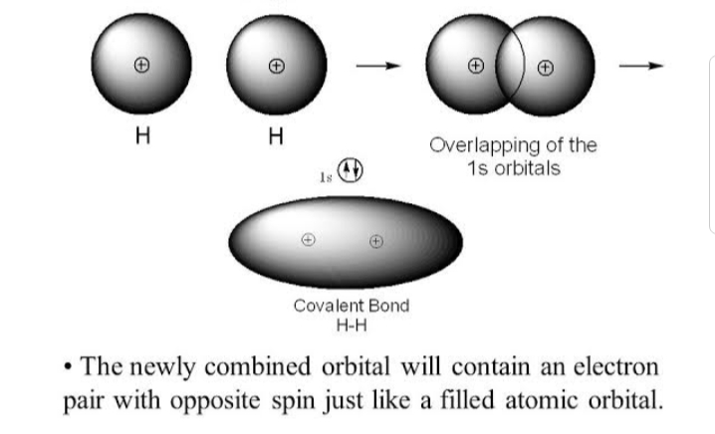

Slide 7
Molecular orbital theory
Molecular orbital theory was proposed by Hund and Mullikan in 1932.
Modern and more rotational.
Atomic orbital’s lose their identity and the electrons in molecules are present in new orbital’s.

Slide 8
Postulates of MO theory
Electrons present in new orbital’s called molecular orbital’s.
Molecular orbital’s are formed by the combination of atomic orbital’s of equal energies.
The number of molecular orbital’s formed is equal to the number of atomic orbital’s undergoing combination.
Two atomic orbital’s can combine to form two molecular orbital’s.
One has a lower energy and the other has a higher energy.

Slide 9
The molecular orbital with lower energy is called bonding molecular orbital.
The molecular orbital with higher energy is called anti bonding molecular orbital.
The shapes of molecular orbital’s depends upon the shapes of combining atomic orbital’s.

Slide 10
Defects of mo theory
Molecular orbital theory explains weather a molecule will exist or not on the basis of bond order.
Concept of bond order is not feasible and appropriate to explain existence of polyatomic molecule.
It does not give any idea about molecular geometry and shape of molecule etc……

Slide 11
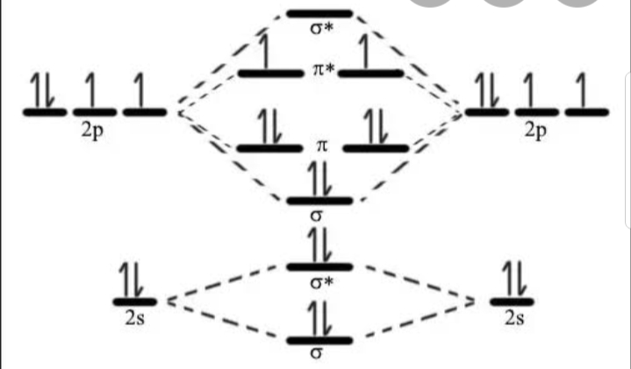
oxygen molecule as an example:

Slide 12
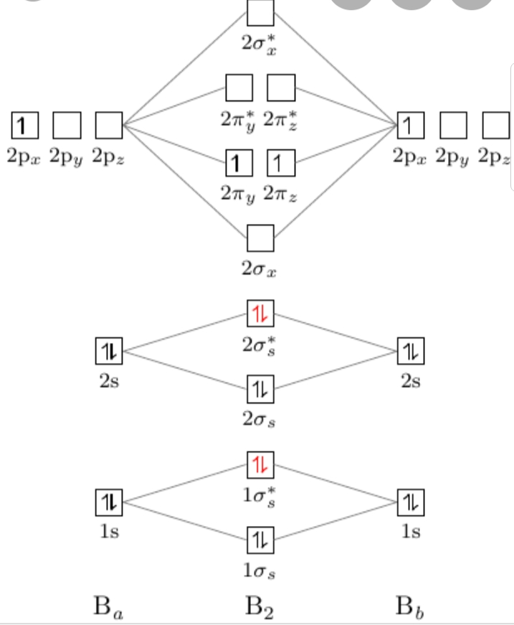
Boron molecule as an example:

Slide 13
Comparison of vb and mo theory
Similarities:
The basic principles involved in the distribution of electrons are similar.
In the normal covalent bond formation, the reaction according to both the theories, is sharing of the bonding electron density between the nuclei.
In the formation of a bond, orbital’s of the bonded atoms must overlap and have appropriate symmetric.

Slide 14
Difference:
Resonance plays an important role in VB theory while in MO theory it has less relevance.
VB theory is unable to explain the paramagnetic character of oxygen. MO theory offers a satisfactory explanation for the same.
VB theory starts with individual atoms and considers the interaction between them. MO theory starts with the nuclei of the interacting atoms.

Slide 15
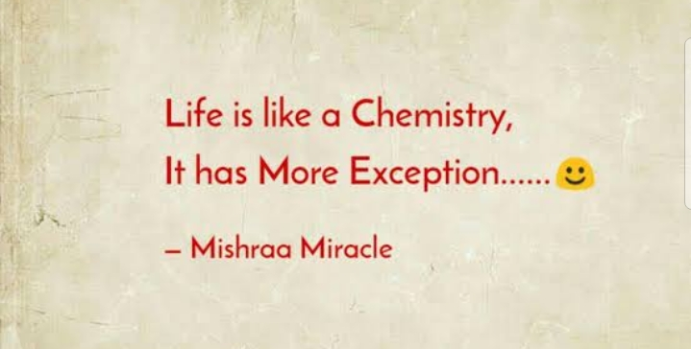

Slide 16
Thank you

