Slide 1
CHEMISTRY
OF
PHENOLS
Ms. J. Princess Gracia, M.Sc.,M.Phil.,
Assistant Professor,
Department of Chemistry,
Bon Secours College for Women, Thanjavur.

Slide 2
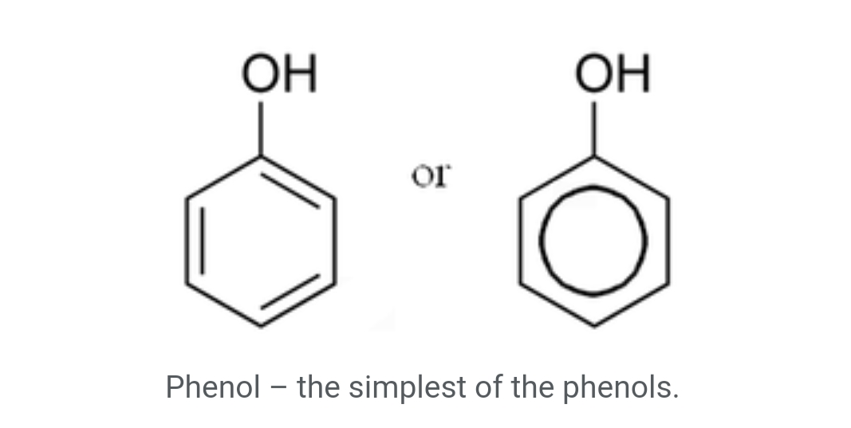
Introduction-
Phenols also called as phenolics are a class of chemical compounds consisting of a hydroxyl group (-OH) bonded directly to an aromatic hydrocarbon group.
The simplest of the class is phenol C₆H₅OH.
Phenolic compounds are classified as simple phenols or polyphenols based on the number of phenol units in the molecule.
Phenols are synthesized industrially and produced by plants and micro organisms , with variation between and within species.

Slide 3
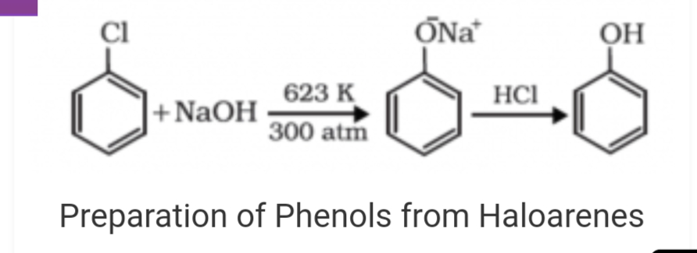
PREPARATION OF PHENOLS
FROM HALOARENES –
chlorobenzene is an example of haloarenes which is formed by the mono substitution of benzene ring. when chlorobenzene is fused with sodium hydroxide at 623K and 320 atm sodium phenoxide is produced.
Finally ,sodium phenoxide on acidification gives phenols.

Slide 4
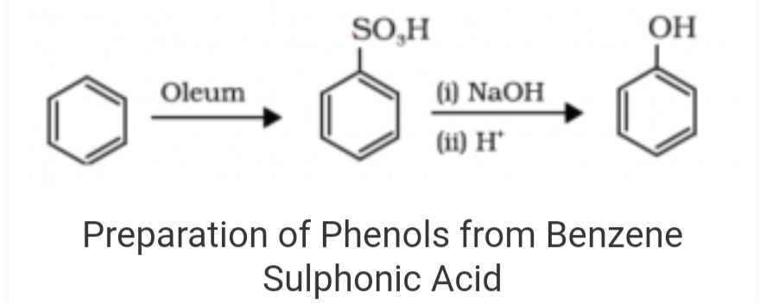
FROM BENZENE SULPHONIC ACID -
Benzene sulphonic acid can be obtained from benzene by reacting it with oleum.
Benzene sulphonic acid thus formed is treated with molten sodium hydroxide at high temperature which leads to the formation of sodium phenoxide on acidification gives phenols.

Slide 5
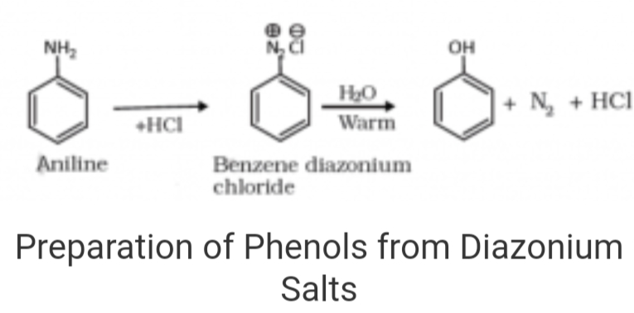
FROM DIAZONIUM SALTS
When an aromatic primary amine is treated with nitrous (NaNO₂ + HCL ) acid at 273 – 278 k , diazonium salts are highly reactive in nature.upon warming with water , these diazonium salts hydrolyze to phenols.
Phenols can also be obtained from diazonium salts by treating it with dilute acids.

Slide 6
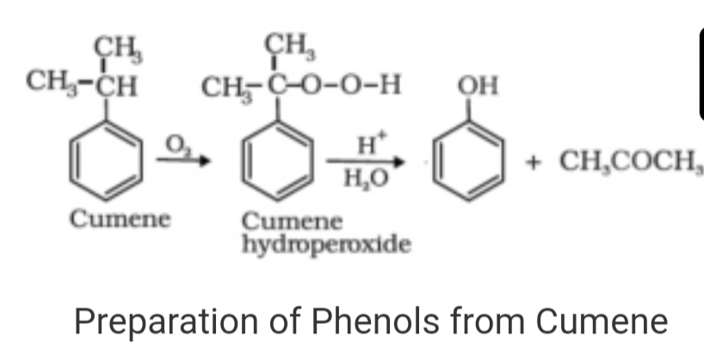
FROM CUMENE –
Cumene is an organic compound obtained by Friedel crafts alkylation of benzene with propylene. upon oxidation of cumene (isopropyl benzene) in the presence of air , cumene hydroperoxide is obtained. Upon further treatment of cumene hydroperoxide with dilute acid , phenols are obtained.
Acetone is also produced as one of the by-products of this reaction in large quantities by these methods need purifications.

Slide 7
PHYSICAL PROPERTIES-
They are colorless liquids or crystalline solids but become colored due to slow oxidation with air.
Due to the presence of strong intermolecular hydrogen bonding , phenols have a higher boiling point than the corresponding hydrocarbon or aryl haildes.
Due to their ability to form hydrogen bonds with water , phenols are moderately soluble in H₂O.
They are acidic in nature and stronger acids than alcohols. This is due to the fact Sp² hybridized carbon of phenol to which –OH is attached, is highly electronegative which causes a decrease in electron density on oxygen.

Slide 8
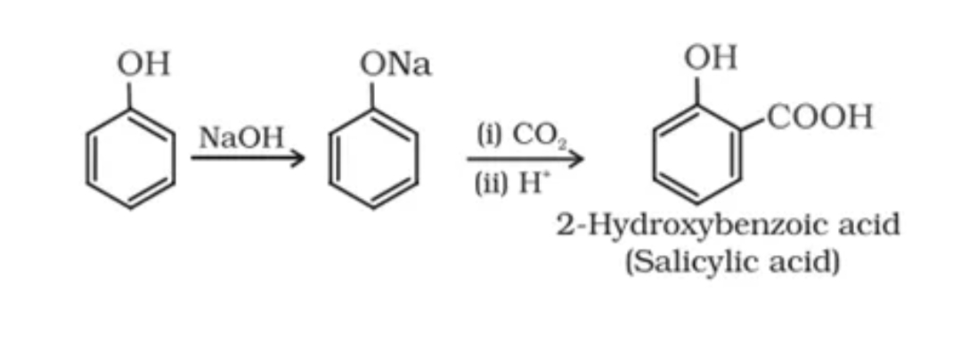
REACTIONS OF PHENOL INVOLVING THE CLEAVAGE OF O-H BOND
KOLBE’S REACTION –

Slide 9
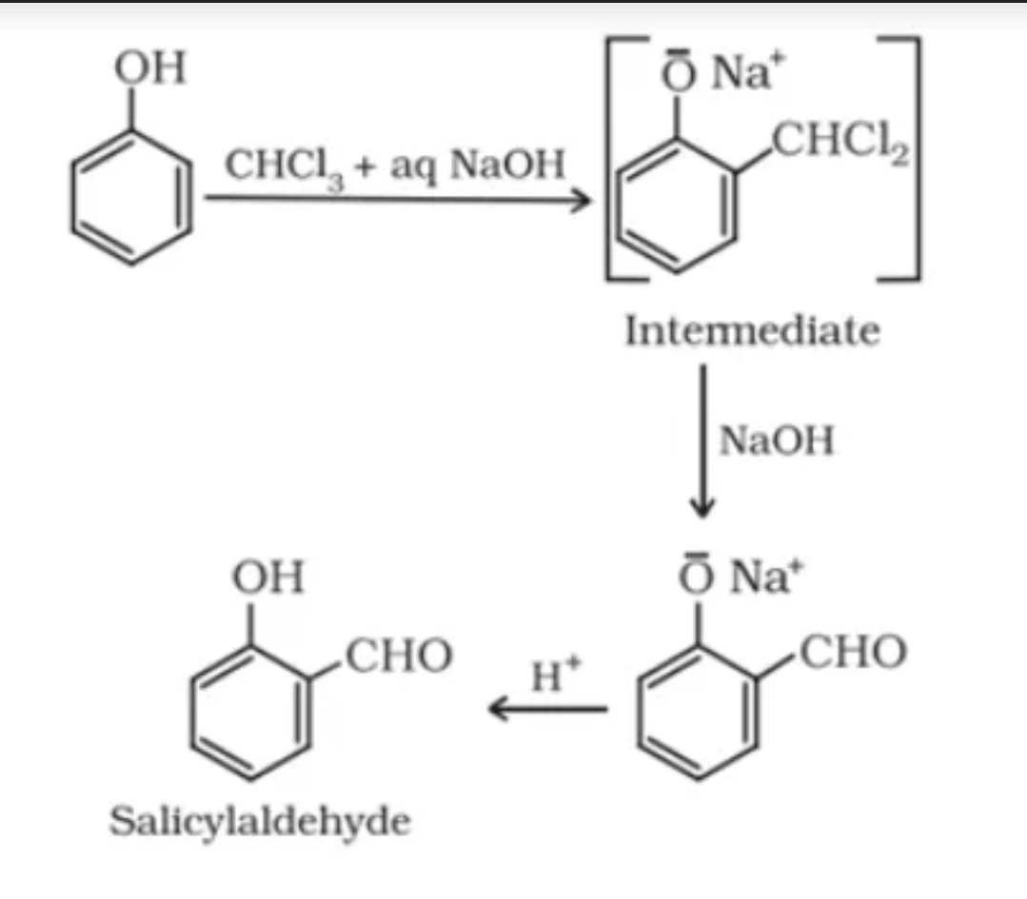
REIMER – TIEMANN REACTION –

Slide 10
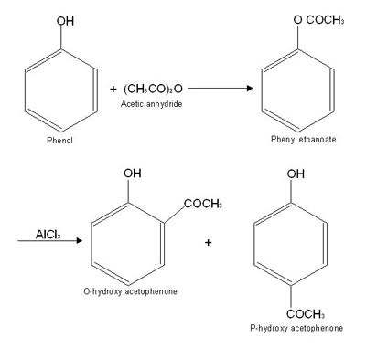
FRIES REARRANGEMENT –

Slide 11
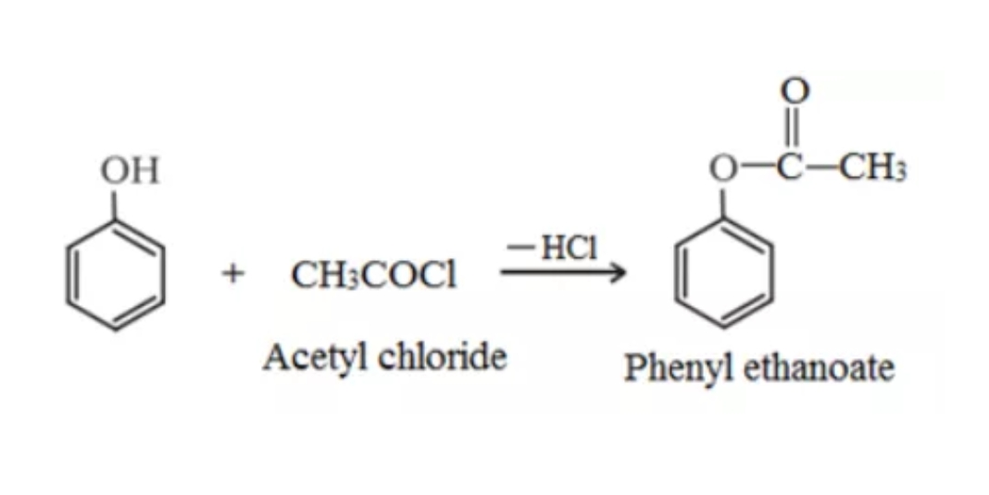
ACETYLATION -

Slide 12
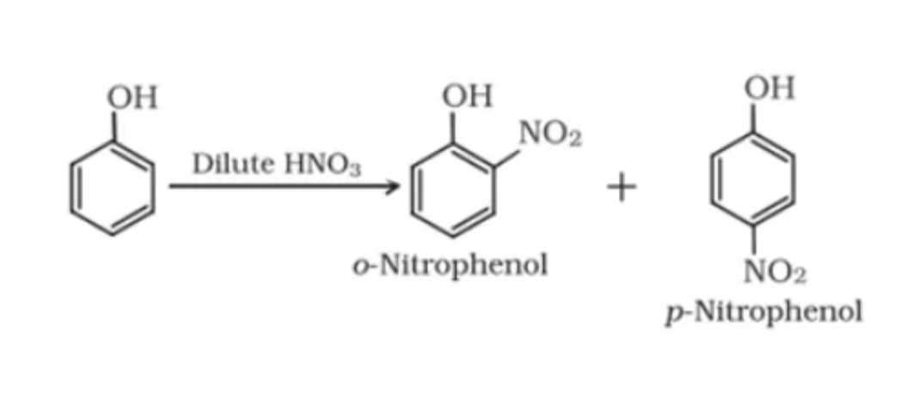
NITRATION –
REACTION WITH DIL.HNO₃ :

Slide 13
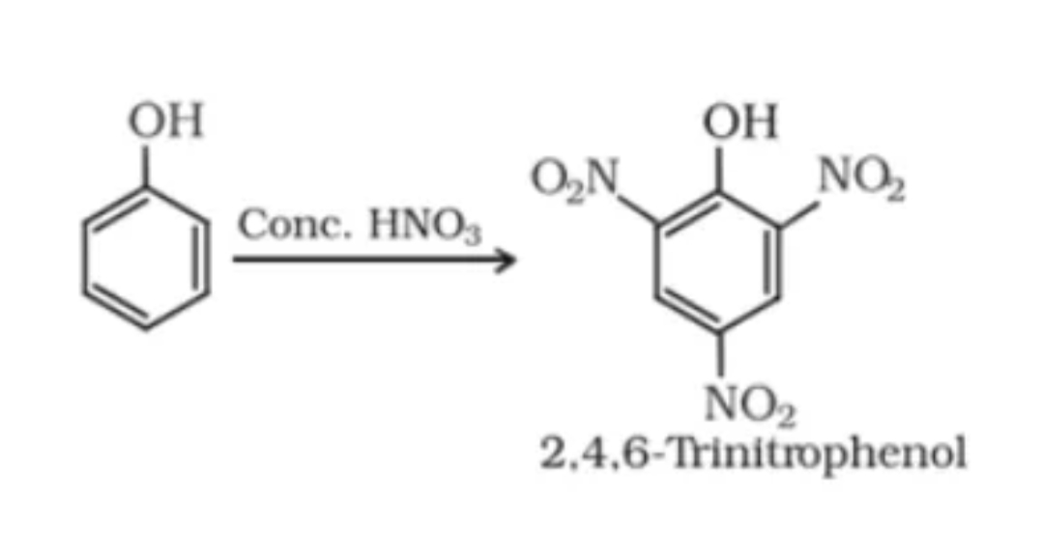
REACTION WITH CONCENTRATED HNO ₃ :

Slide 14
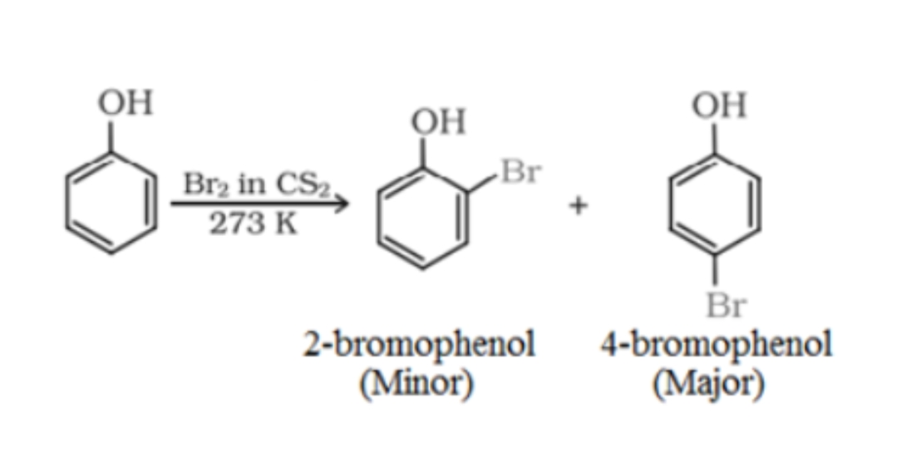
HALOGENATION –
BROMINATION IN SOLVENTS OF LOW POLARITY LIKE CS₂ :

Slide 15
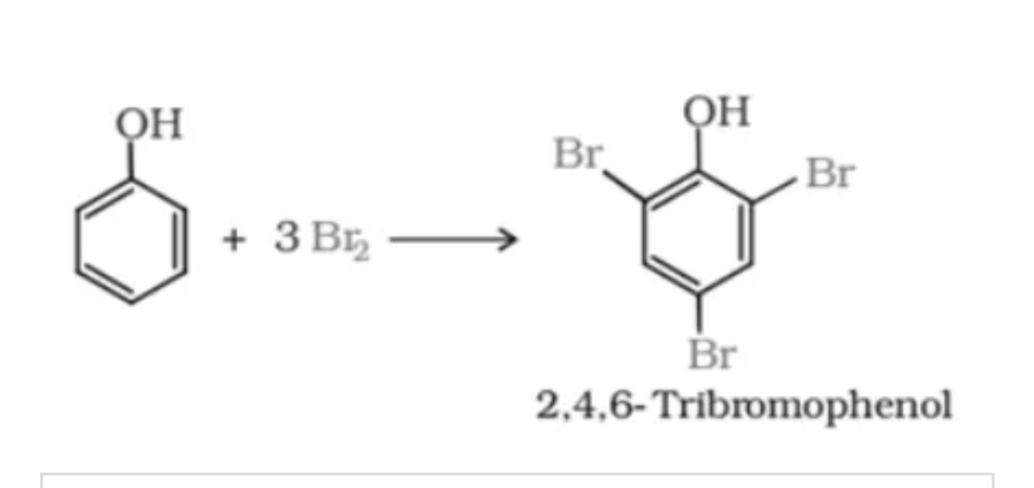
THE REACTION OF PHENOL WITH BROMINE WATER -

Slide 16
USES-
The main use of phenol is as precursors for plastics
Phenol is also a useful precursor to a huge collection of drugs, most notably aspirin but also several herbicides and pharmaceutical drugs.
Phenol is an element in liquid / liquid phenol – chloroform abstraction technique used in molecular biology for procurement of nucleic acids from tissues or cell culture samples.
It is used as an antiseptic
It is used as a disinfectant in household cleaners.
It is used in the preparation of resins , dyes, explosives, lubricants , pesticides etc.

Slide 17
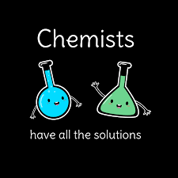
THANK YOU !!!!!

