Slide 1
Accessories Albums
Ms.S.Priya, Asst. Prof.
Dept. Of Fashion Technology And Costume Designing,
Bon Secours College for Women,
Thanjavur.

Slide 2
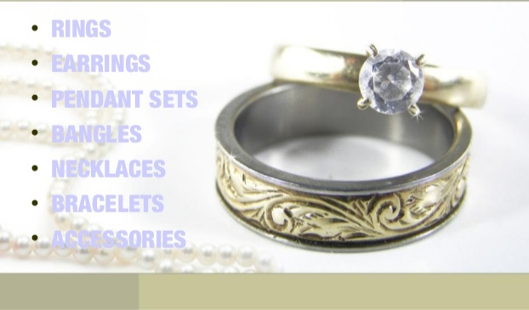

Slide 10
Thank You

