Slide 1
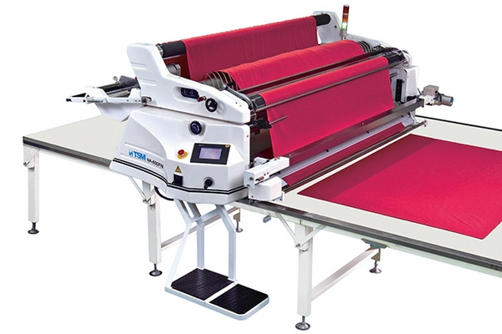
FABRIC SPREADING PROCESS
BY,
Ms. K.KATHIROLI
Assistant Professor
DEPARTMENT OF FASHION TECHNOLOGY
Bon Secours College for Women, Thanjavur
Notes:
FABRIC SPREADING PROCESS

Slide 2
SPREADING
Spreading is the process during which fabric is cut into pieces of a specific length which are then placed on top of each other to form several plies
The length of a ply is determined by the shape, size and the number of the components which are to be cut from it

Slide 3
Requirements of Fabric Spreading
“Alignment of fabric ply,
Correct ply tension,
Fabric must be flat,
Elimination of fabric flaws or defects,
Correct ply direction and lay stability,
Elimination of static electricity,
Easy separation of the cut lay into bundles,
Avoidance of fusion of plies during cutting
Avoidance of distortion in spreading,
Matching the checks and stripes.

Slide 4
METHODS OF FABRIC SPREADING
Manual Spreading Process
Mechanical Spreading Process
Notes:
TYPES OF COLLECTIVE BARGAINING

Slide 5
Manual Spreading Process
Fabric is completely laid by Hand
With the help of mechanical assistance as roller cutter
With the help of manually operated spread truck
This is most extensively used for smaller production

Slide 6
Working procedure
The fabric spreading process is carried out by one/two workers at each side of the spreading table who move the fabric ply to the beginning of a spread.
The end of the fabric ply is placed precisely at the beginning of the spread and secured.
Returning to the initial position (the place where the fabric roll is fixed) one worker aligns the laid down fabric ply with the edge of the table and the previously spread fabric plies with a permitted variant of +/-0.5 cm.
The second worker smoothes the surface of the ply, ensures an even tension in the fabric and prevents creases or folds appearing during the spreading process.
The spreading process is repeated until the desired number of fabric plies are laid down.

Slide 7
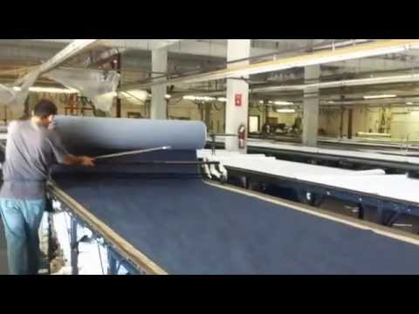
Manual Spreading Process

Slide 8
Contd….
Advantages of manual Spreading Process
Convenient for small scale industries
Low investment
Disadvantages of manual Spreading Process
Time consuming
Low speed
Requires skilled Labour

Slide 9
Mechanical method
Semi-automated Spreading Process
Automated Spreading Process
Notes:
Thee

Slide 10
Semi-automated Spreading Process
In a semi-automated spreading process, the operator moves along the spreading table and follows the spreading process.
The operator smoothes the surface of the lay, recognises faults in the spread fabric and makes decisions to leave faults in the spread or cut them out

Slide 11
SEMI AUTOMATIC SPREADING MACHINE

Slide 12
Semi-automated Spreading Process
ADVANTAGES
Fast & Economical
Proper selvedge alignment
Ease to operate with electronic Clutch
Disadvantages
Fabric Loading & Cutting is Manual
Not suitable for Large Scale Manufacturing

Slide 13
FULLY AUTOMATIC SPREADING PROCESS
The fully automated spreading process is used for high quality materials which are easily spread.
An operator sets the necessary parameters (the length of the lay, the spreading speed, the fabric tension, etc.).
The spreading machine automatically performs the following operations: lays the fabric in the required length of the spread, cuts the material at the end of every ply, counts the number of plies and stops after laying the required number of plies.

Slide 14
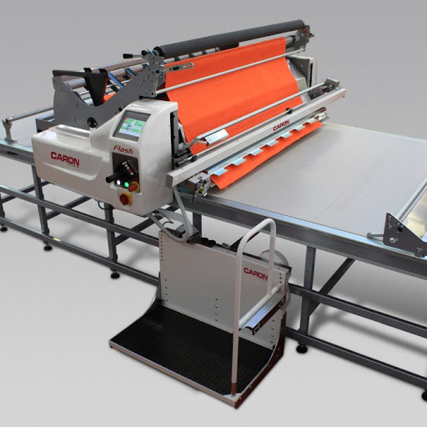
FULLY AUTOMATIC SPREADING MACHINE

Slide 15
Comparison of manual and automated spreading processes:
Parameters | Manual spreading | Automated spreading
Spreading equipment | Spreading table Fabric feeder Cutting device | Spreading table Spreading machine
Spreading principles | Spreading of pre-set number of plies Visual flaw identification by an operator Splicing manually using on the table marked splice marks and printed markers | Spreading of pre-set number of plies Visual flaw identification by an operator Splicing using registered data about flaw placements and special software

Slide 16
Parameters | Manual spreading | Automated spreading
Spreading method | All kind of fabrics – manually | High-quality easy spread fabrics – fully automated way
Advantages of the method | Ability to spread all kind of materials Low expenses | High productivity Only one operator needed Low work load for an operator
Disadvantages of the method | Low productivity Two operators needed High work load for an operator | High expenses Cannot spread materials with intricate patterns

