Slide 1
GARMENT MARKER MAKING
BY,
K.KATHIROLI,
Asst professor,
Department of fashion Technology,
Bon Secours College for women,
Thanjavur

Slide 2
What is Marker Making ?
Marker making is the most useful process to draw the pattern pieces over a thin marker paper and this marker paper is placed on the fabric lay for minimizing the fabric wastage.

Slide 3
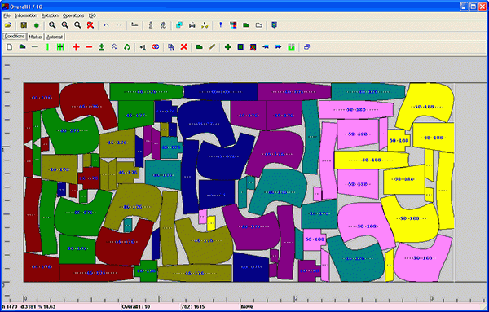
What is a Marker ?
A marker is commonly done by large thin paper that holds all the size of pattern pieces for a specific style of garments.
Marker is the perfect way to reduce fabric wastage.
Marker gives actual guide line for completing the flawless or correct fabric cutting.

Slide 4
Objectives of marker making:
To minimize the fabric wastages
By the help of marker making similar size and styles of apparels are gained.
For bulky production marker is essential.
Marker making is the guide of fabric cutting.
It saves the production time and cost
.

Slide 5
Methods of Marker Making
Manual method
Computerized method

Slide 6
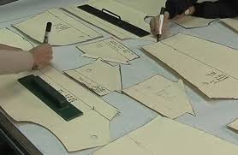
Manual marker making method:
In garments industry, manual market making is the oldest, traditional and typically used method. In this processes pattern maker make the all pattern pieces manually and after that fabrics are spread on cutting table and set up all pattern pieces directly onto the marker paper. Then mark by chalk, pencil or pen.
Manual marker making method:
In garments industry, manual market making is the oldest, traditional and typically used method. In this processes pattern maker make the all pattern pieces manually and after that fabrics are spread on cutting table and set up all pattern pieces directly onto the marker paper. Then mark by chalk, pencil or pen.
Manual Marker Making Method:
Manual marker making is the oldest, traditional and typically used method.
In this processes pattern maker make the all pattern pieces manually and after that fabrics are spread on cutting table and set up all pattern pieces directly onto the marker paper.
Then mark by chalk, pencil or pen.

Slide 7
Marker with minimized pattern:
Normally the patterns are made up of hard paper or plastic sheet.
For this method full size patterns are minimized 1/5 part by a panto-graph.
Marker is planned with small pattern pieces.
When marker making is done, snaps are taken by camera.
Planimeter is applied to examine covered area of pattern lies in the marker.
The marker efficiency is examined by marker area and pattern area.
All of the marker photograph and minimized pattern are carefully stored.

Slide 8
Types of Manual Marker Making Method
Manual methods are two types. Such as: i. Marker planning with full size pattern
ii. Marker with minimized pattern

Slide 9
Marker planning with full size pattern
According to standard measurement all patterns are in full dimension.
To minimize the fabric wastage, hard patterns are placed on thin marker paper and then all patterns are marked by turning different direction.
The top of the table on which marker making are fixed or fitting and the fitting table top are placed in various angle.
For fabric suction vacuum system is arranged under the table.
For minimize the marker length this method is perfect.

Slide 10
Advantages of manual method:
It is suitable for small production
Investment cost is low.
Disadvantages of manual method:
More time is required
High labour cost

Slide 11
Computerized marker making method:
In this marker making method every specific style and part of the patterns are kept in the computer memory and grade rule is also mentioned.
To do this marker making, computerized marker paper directly placed on fabric layer.
Then the computer makes the marker by its programming techniques.
Computer Aided Design (CAD) system are used to make marker.

Slide 12
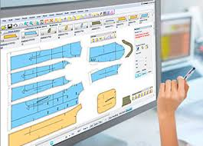
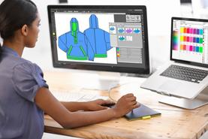
Computerized marker making method:
.

Slide 13
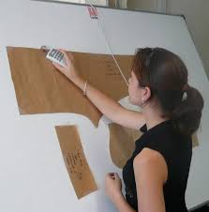
Computerised pattern can be done by
a. Digitizing system b. Scanning system
Digitizing system: Patterns are placed in computer by using the digitizing board to run this process.
Every component is send to the computer memory by clicking special mouse around the pieces.

Slide 14
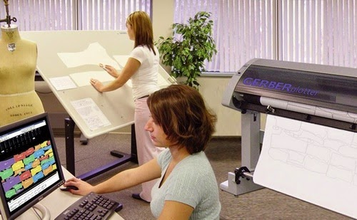
Scanning system: This is special kind of photocopier machine.
Two things are done here.
They are: Production or Working patterns are set up on the scanning glass and then marker is made in a selected size.
For making other size grade rule is used.

Slide 15
Types of computerized marker making method:
Computerized marker making method is mainly two types. Such as: i. Automatic marker making
ii. Interactive marker making

Slide 16
Automatic marker making:
To do this automatic marker making method, computer can make marker itself according to given commands.
From this method most efficient marker can be got.
Computer makes marker with the help of permutation and combination but it required more time

Slide 17
Interactive marker making:
Interactive marker making is a very common process.
Computer operator takes a marker plan by interacting directly with the system through a computer screen.
Every pattern pieces are shown in a miniature of the screen.
Operators are transferring patterns information by the use of pen drive or tablet.

Slide 18
Advantages of computerized marker making:
Perfect method for large scale production
Marker efficiency is high
Low fabric wastage
Marker print out is possible.
Pattern grading could be done by automatically
Low time consumption
This method help to prepare marker quickly

Slide 19
Disadvantage of computerized marker making
High investment cost
Required skilled operator

