Slide 1
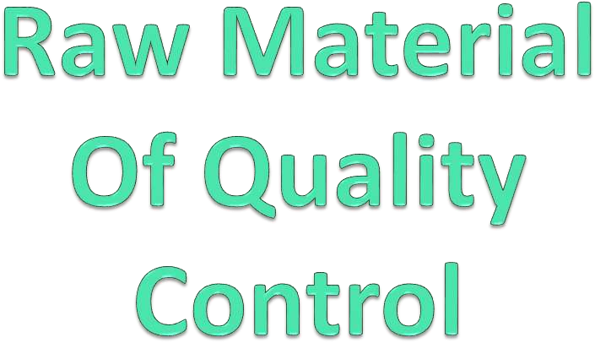
By
M. Vandhana
Asst.Prof.Dept of fashion technology
Bon Secours College for women
Thanjavur

Slide 2

Quality control of raw material is the maintaining of all the procedures that are needed to be taken to produce a quality full product . Maintaining of quality of whole processes helps us to get the desirable output. quality means customer need is to be satisfied . For maintaining this whole process different steps , process, procedure are need to be taken to get the accepted garments out put. The different stages can be raw material inspection, fabric inspection, sewing thread inspection, garments finishing, packing , cartooning , spot removing & final inspection
.This are the main flow of garments production. there are also others steps left behind , those will be described step by step thoroughly.

Slide 3

To minimize the production of goods within the specified
tolerance correctly the first time.
To achieve a satisfactory design of the fabric or garments in relation to the leave of choice in design , style , color , stability of components and fitness of product for the market.
To ensure the quality of finish product or garments is satisfactory for buyer demand .

Slide 4

Quality is of prime importance in any aspect of business. Customers demand depends on the value of money.
The systems required for programming and coordinating the efforts of the various groups in an organization to maintain the desirable quality". As such Quality Control is seen as the agent of Total Quality Control.
In the garment industry quality control is practiced right from the initial stage of sourcing raw materials to the stage of final finished garment. For textile and apparel industry product quality is calculated in terms of quality and standard of fibres, yarns, fabric construction, colour fastness, surface designs and the final finished garment products.

Slide 5

To ensure, at minimum practicable cost, that the requisite quality of product is being achieved at every stage of manufacture from raw materials to boxed stock

Slide 6

Test Properties of Yarn
If routine checks are carried out on yarn choose a delivery
of average Tex (count, denier).
Carry out other appropriate tests on yarn e.g. crimp nylon- Crimp Rigidity test. Knit a small sample and check that dye is fast to light, washing and perspiration etc.
Record details of yarn type, supplier, Tex (denier, count) etc. and pass information to knitting room.

Slide 7
Knitting Specification
Record all details required to produce the fabric or garment blanks including chain set out, stitch length and any instrument measurements.
Record all details of making the trimmings.
Note any difficulties encountered e.g. stitch pattern causing occasional drop stitches. Pass information to making- up room.
Making-up Specification
Record all details of making-up, including the type and
count of the sewing thread, and the order of seaming the parts.
Note any difficulties encountered e.g. difficult operation to attach collar.

Slide 8
Test for Physical Properties of Garments
Record the dimensions of the garment as soon as it is completed.
For a fiber of high moisture regain find the weight in correct condition.
Wash garment and recheck the measurements.
Relation Between Quality Control with Cost Department
On completion, supply cost department with all information.
For the correct Tex (count, denier) of yarn, costing may be made directly on sample. For a count which is above or below the average (although within an acceptable tolerance) make an appropriate adjustment to yarn costs and weight.
Make an allowance for any anticipated extra difficulties, or a higher than normal rate of seconds.
Subsequent Alteration
Make any necessary alterations required by firm or by buyers.
Record changes at each stage.

Slide 9

To achieve the overall objective we shall need to establish, document and maintain a system capable of ensuring that products conform in total to standards, specifications and sealed samples. This will be required at every stage of manufacture. Records must be maintained to give objective evidence that the specified requirements. There are a number of factors on which quality fitness of garment industry is based such as - performance, reliability, durability, visual and perceived quality of the garment. Quality needs to be defined in terms of a particular framework of cost.

Slide 10

Sewing defects
Color effects
Sizing defects
Garment defects

Slide 11
Sewing defects –
Like open seams, wrong stitching techniques used, same colour garment, but usage of different color threads on the garment, miss out of stitches in between, creasing of the garment, erroneous thread tension and raw edges are some sewing defects that could occur so should be taken care of.
Color effects –
Color defects that could occur are - difference of the color of final produced garment to the sample shown, accessories used are of wrong color combination and mismatching of dye amongst the pieces.

Slide 12
Sizing defects –
Wrong gradation of sizes, difference in measurement of a garment part from other, for example- sleeves of 'XL' size but body of 'L' size. Such defects do not occur has to be seen too.
Garment defects –
During manufacturing process defects could occur like - faulty zippers, irregular hemming, loose buttons, raw edges, improper button holes, uneven parts, inappropriate trimming, and difference in fabric colors.

Slide 13

Count Variation: Variation in diameter along the length of yarn beyond acceptable range.
Unevenness or Irregularity: It is mass variation per unit length (cm). This fault is expressed as U% or CV% and evenness tester is used to measure it.
Periodic Faults: If any fault repeats after a certain length/time then the fault is called periodic or systematic fault.
Hairiness: This is the measure for the protruding fibers from the yarn body.
Lot Mixing: Some times yarn lot can be mixed at the stages of spinning process as well as in the preparatory section of weaving/knitting mill. This type of mixing causes severe problem in subsequent processes.

Slide 14
6. Frequently Occurring Faults: These are the faults that occur in range of the 10 to 5000 times per 1000 m of yarn. Yarns spun from staple fibers contain imperfections, which can be subdivided into three groups:
Thin places: Cross sectional size -30% to -60% of normal yarn its fault length of 4 to 25 mm.
Thick places: Cross sectional size +30% to +100% of normal
yarn with fault length of 4 to 25 mm.
Naps: Normal yarn with fault length of 1 mm. Naps are defined as small tight balls of entangled fibers on linear textile strands.

Slide 15

[N.B: The fabric inspection part will be described in raw material inspection classification]

Slide 16

2. In process inspection
1. Raw material inspection
3. Final inspection
Raw material inspection
Fabric inspection
Sewing thread inspection
Trims and accessories check

Slide 17

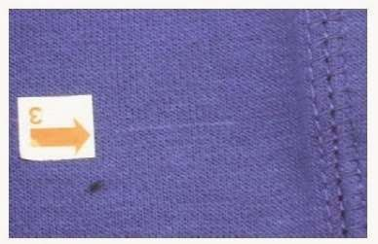
Fabric inspection is an important task to garments manufacturing to avoid rejects due to fabric quality and facing with unexpected loss in manufacturing. Fabric inspection is done for fault / defect rate fabric construction end to end or edge to edge shedding , color , hand / feel , length / width , print defect and appearance .

Slide 18
During stitch fabric frequency breakage of sewing thread is one of the greatest problem for garment manufacturing .so it is necessary to check.
Thread construction
Suability
Color
Imperfection
Finish, package
Density
Winding
Trims and accessories check
Button
Zippers
Interlining
label and tags

Slide 19

It start from marker making then fabric spreading , fabric
cutting , pressing or finishing checking is done in process.
Marker making
Fabric spreading
Fabric cutting
Sorting
Fabric sewing
Seam defects
Assembly defects

Slide 20

Garments finishing means, mainly applies of pressing to
packing of garments. This step are given below:
Pressing
Folding
Packing
Barcode
Assortment
Metal Check
Spot Removing and
Cartooning .

Slide 21

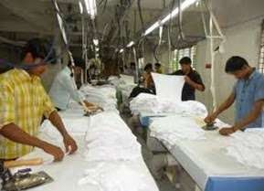
Pressing is a finishing process done by a cloth to heat and pressure with or without steam to remove creases and to impart a flat appearance to the cloth or garments.
Pressing
In garment industries pressing is also called ironing. After completing pressing the garments have to be folded.

Slide 22

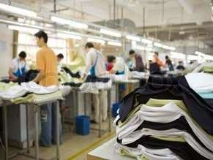
After completing pressing, the garments are folded with a predetermine area. Garments are folded according to the buyers direction, requirements in a standard area.
Folding

Slide 23

There are mainly four types of folding. They are –
Stand Up,
Semi Stand Up,
Flat Pack,
Hanger Pack.

Slide 24

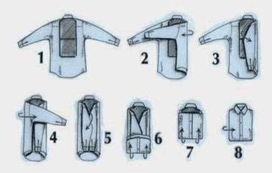
Collar is folded and situated at 90* angle.
Semi stand up:
Collar is folded with body and situated at 45 degree angle.
Semi stand up

Slide 25

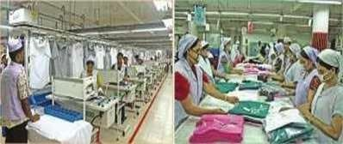
Collar is separated as a hole on the body of shirt.
Flat Pack

Slide 26

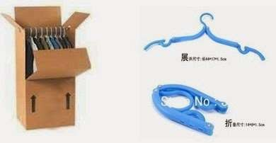
shirt is packed and transported by hanging on the hanger.
Hanger pack
At the end of the folding, garments are placed into a polythene
packet.

Slide 27

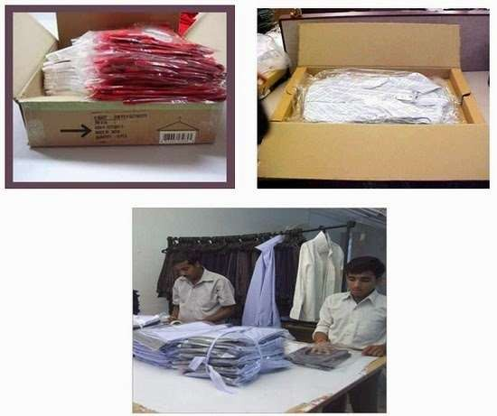
After folding, garments are packing the size of polythene packet is permanent. Specially, it is needed to ensure the placement of sticker in proper place.
Packing

Slide 28

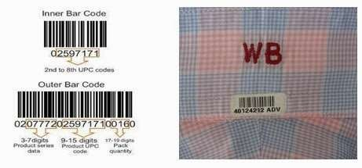
Barcode is a specially Buyer wise sticker.
Barcode

Slide 29

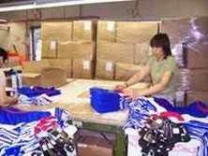
After completing the packing of garments, it must be placed the garments in a predetermined pack by sorting according to the size and color then garments are packed into inner box according to the size and color. This process working in order is called assortment.
Assortment

Slide 30

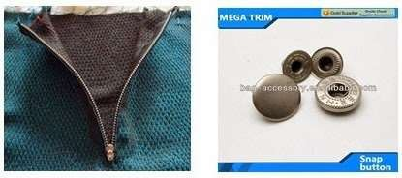
Checking the metal type component into the garments or with its accessories like button, zipper etc. is called metal check.
Metal Check

Slide 31

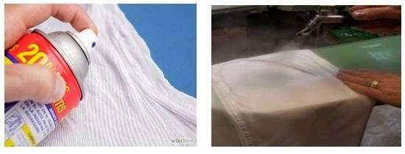
Spot removing is one of the special inspections which are done after initial quality check.
Spot Removing

Slide 32

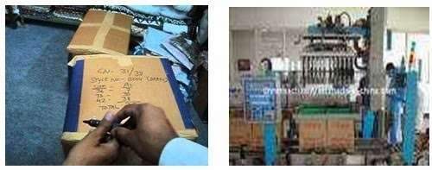
At last cartooning or packing the garments according to Buyer comment. The process of packing of inner boxes entered into the carton is called cartooning.
Cartooning
The carton is properly warped by the scotch tape. Some information like carton box no, size, shipping mark and the destination are printed on the carton.

Slide 33

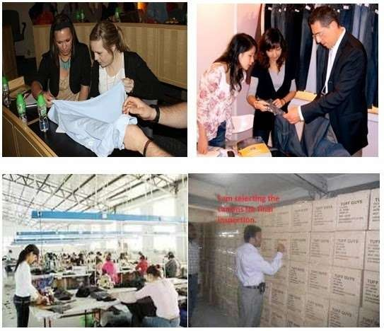
Final inspection is made by buyer. He checks the garments according some rules like AQL.
Final inspection

Slide 34

Good quality products or processes can only be produced by the operatives. They cannot produce quality without being fully aware of what exactly is required. At last we conclude that Quality is ultimately a question of customer satisfaction. The perceived quality of a garment is the result of a number of aspects, which together help achieve the desired level of satisfaction for the customer.

