Slide 1
ABSTRACT ALGEBRA
BASIC DEFINITIONS UNDER GROUP

Slide 2
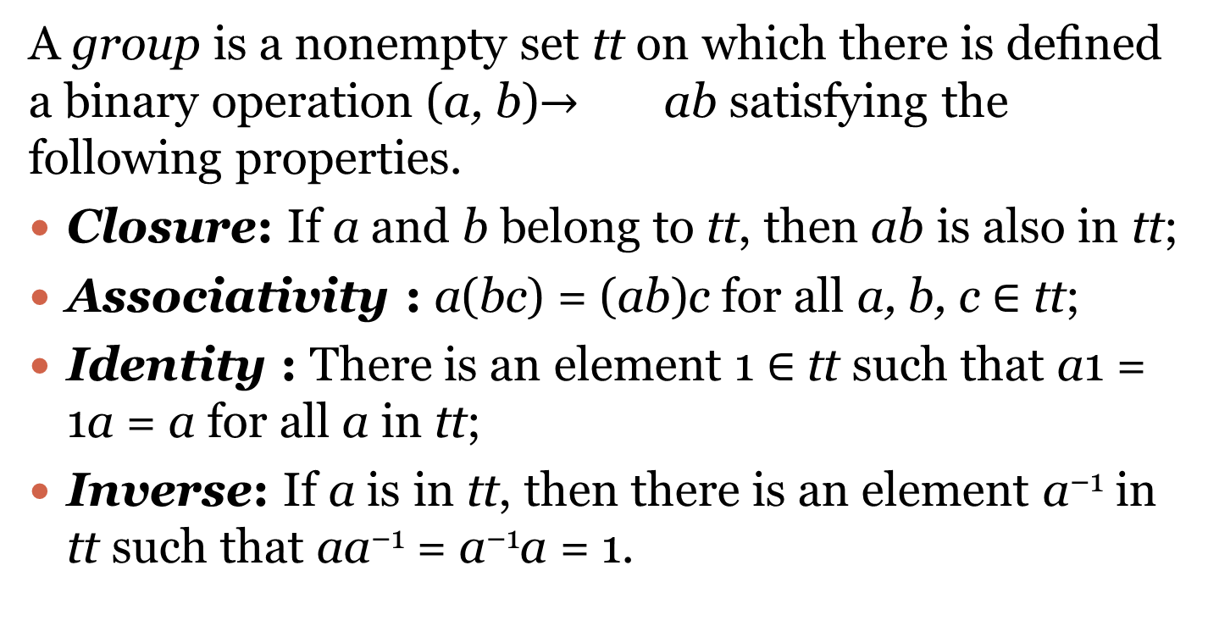
GROUP
A group is a nonempty set tt on which there is deﬁned a binary operation (a, b)$→$ ab satisfying the following properties.
Closure: If a and b belong to tt, then ab is also in tt;
Associativity : a(bc) = (ab)c for all a, b, c ∈ tt;
Identity : There is an element 1 ∈ tt such that a1 = 1a = a for all a in tt;
Inverse: If a is in tt, then there is an element a⁻¹ in tt such that aa⁻¹ = a⁻¹a = 1.

Slide 3
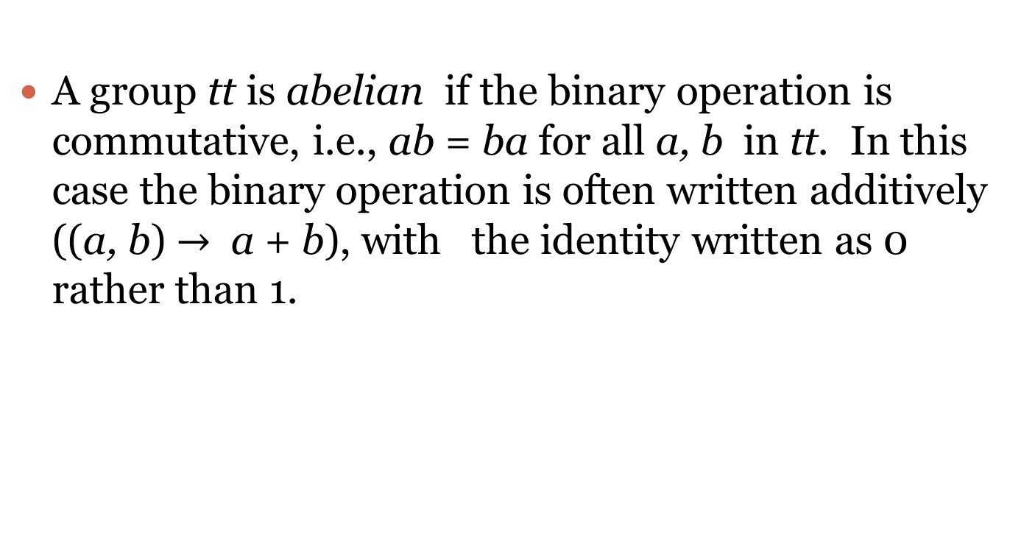
ABELIAN GROUP
A group tt is abelian if the binary operation is commutative, i.e., ab = ba for all a, b in tt. In this case the binary operation is often written additively ((a, b) $→$ a + b), with the identity written as 0 rather than 1.

Slide 4
SUBGROUP
A subgroup H of a group tt is a nonempty subset of tt that forms a group under the binary operation of tt. Equivalently, H is a nonempty subset of tt such that if a and b belong to H, so does ab⁻¹.

Slide 5
ISOMORPHIC
The groups tt₁ and tt₂ are said to be isomorphic if there is a bijection f : tt₁ tt₂ that preserves the group operation, in other words, f (ab) = f (a)f (b). Isomorphic groups are essentially the same; they diﬀer only notationally.

Slide 6
ORDER OF AN ELEMENT
If tt is a ﬁnite cyclic group of order n, then tt has exactly one (necessarily cyclic) subgroup of order n/d for each positive divisor d of n, and tt has no other subgroups.

Slide 7
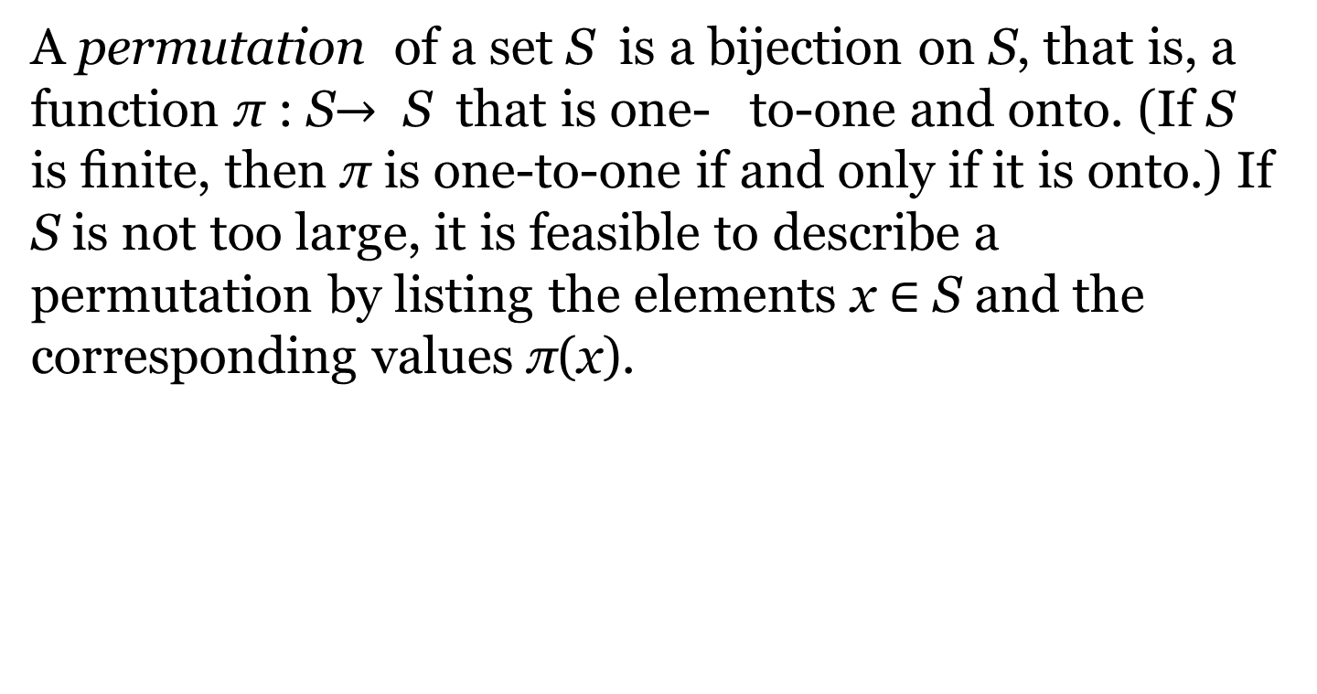
PERMUTATION GROUPS
A permutation of a set S is a bijection on S, that is, a function π : S$→$ S that is one- to-one and onto. (If S is ﬁnite, then π is one-to-one if and only if it is onto.) If S is not too large, it is feasible to describe a permutation by listing the elements x ∈ S and the corresponding values π(x).

Slide 8
NORMAL SUGROUPS
Let H be a subgroup of tt. If any of the following equivalent conditions holds, we say that H is a normal subgroup of tt, or that H is normal in tt:
cHc⁻¹ ⊆ H for all c ∈ tt (equivalently, c⁻¹Hc ⊆ H for all c ∈ tt).
cHc⁻¹ = H for all c ∈ tt (equivalently, c⁻¹Hc = H for all c ∈ tt).
cH = Hc for all c ∈ tt.
Every left coset of H in tt is also a right coset.
Every right coset of H in tt is also a left coset.

Slide 9
QUOTIENT GROUPS
If H is normal in tt, we may deﬁne a group multiplication on cosets, as follows. If aH
and bH are (left) cosets, let
(aH)(bH) = abH;
by (1.3.7), (aH)(bH) is simply the set product. If a₁ is another member of aH and b₁ another member of bH, then a₁H = aH and b₁H = bH (Problem 5). Therefore the set product of a₁H and b₁H is also abH. The point is that the product of two cosets does not depend on which representatives we select.
To verify that cosets form a group under the above multiplication, we consider the four deﬁning requirements.
Closure: The product of two cosets is a coset.
Associativity : This follows because multiplication in tt is associative.
Identity : The coset 1H = H serves as the identity.
Inverse: The inverse of aH is a⁻¹H.

Slide 10

HOMEOMORPHISM
If f : tt $→$H, where tt and H are groups, then f is said to be a homomorphism if for all a, b in tt, we have
f (ab) = f (a)f (b).

Slide 11
THANK YOU

