Slide 1
COMPLEX ANALYSIS
DALLY MARIA EVANGELINE A
ASSISTANT PROFESSOR OF MATHEMATICS
BON SECOURS COLLEGE FOR WOMEN
THANJAVUR, TAMIL NADU

Slide 2
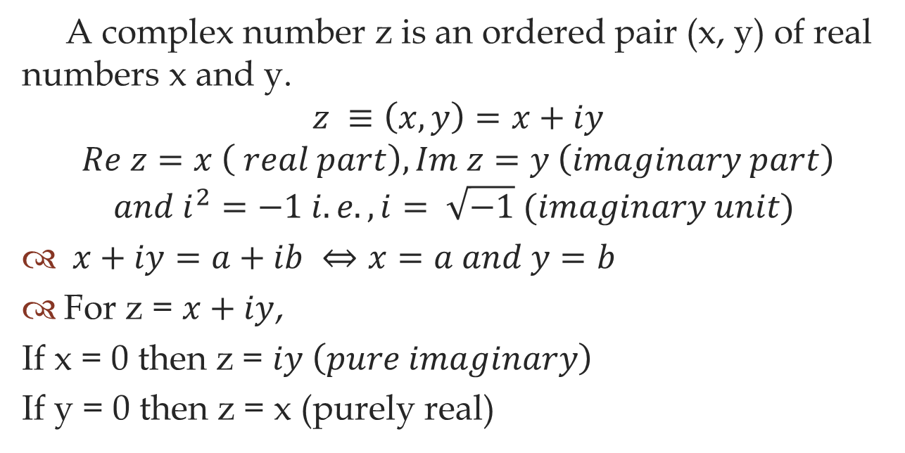
Complex Number
A complex number z is an ordered pair (x, y) of real numbers x and y.
$$z ≡\left(x, y\right)=x+iy$$
$$Re z=x \left( real part\right), Im z=y \left(imaginary part\right)$$
$$and i^{2}=−1 i.e., i= \sqrt{−1} (imaginary unit)$$
$x+iy=a+ib ⇔x=a and y=b$
For z = $x+iy$,
If x = 0 then z = $iy \left(pure imaginary\right)$
If y = 0 then z = x (purely real)

Slide 3
FUNCTIONS OF A COMPLEX NUMBERS
Let us denote a complex valued function of a complex variable as w = f (z).
In general, if u (x, y) and v (x, y) are real valued functions of two variables both defined on a region S of the complex plane then f (z) = u (x, y) +i v (x, y) is called a complex valued function defined on S.
Each complex function w = f (z) can be put in the form
w = f (z) = u (x, y) +i v (x, y).

Slide 4
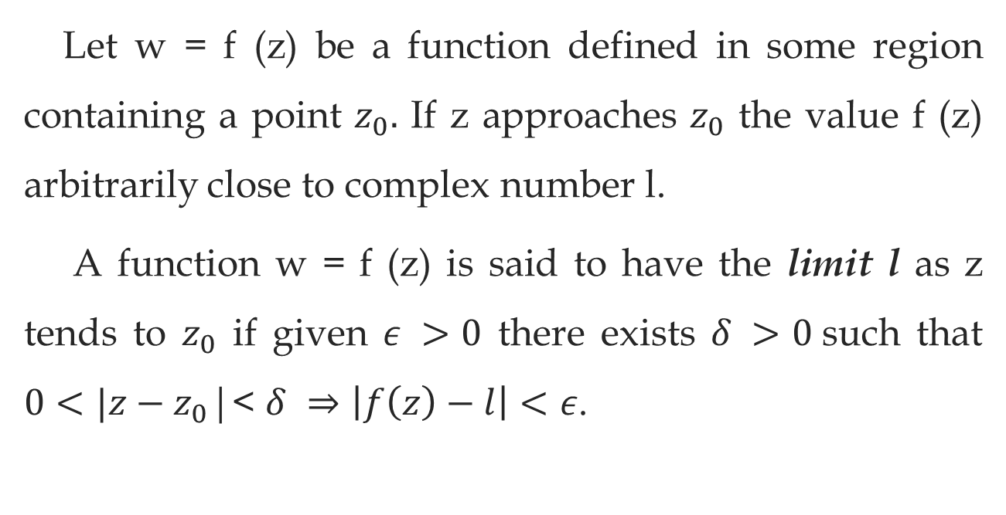
LIMIT OF A COMPLEX VALUED FUNCTION
Let w = f (z) be a function defined in some region containing a point $z_{0}.$ If z approaches $z_{0}$ the value f (z) arbitrarily close to complex number l.
A function w = f (z) is said to have the limit l as z tends to $z_{0}$ if given $ε >0$ there exists $δ >0$such that $0<|z−z_{0}$|< $δ ⇒\left|f\left(z\right)−l\right|<ε$.

Slide 5
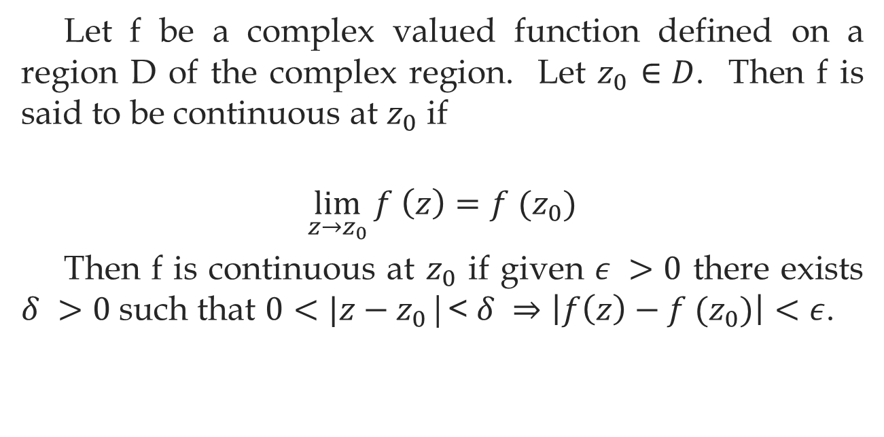
CONTINUITY OF A COMPLEX FUNCTION
Let f be a complex valued function defined on a region D of the complex region. Let $z_{0}$ $∈D$. Then f is said to be continuous at $z_{0}$ if
$$\lim_{z→z_{0}}{f \left(z\right)=f (z_{0})}$$
Then f is continuous at $z_{0}$ if given $ε >0$ there exists $δ >0$such that $0<|z−z_{0}$|< $δ ⇒\left|f\left(z\right)−f (z_{0})\right|<ε$.

Slide 6
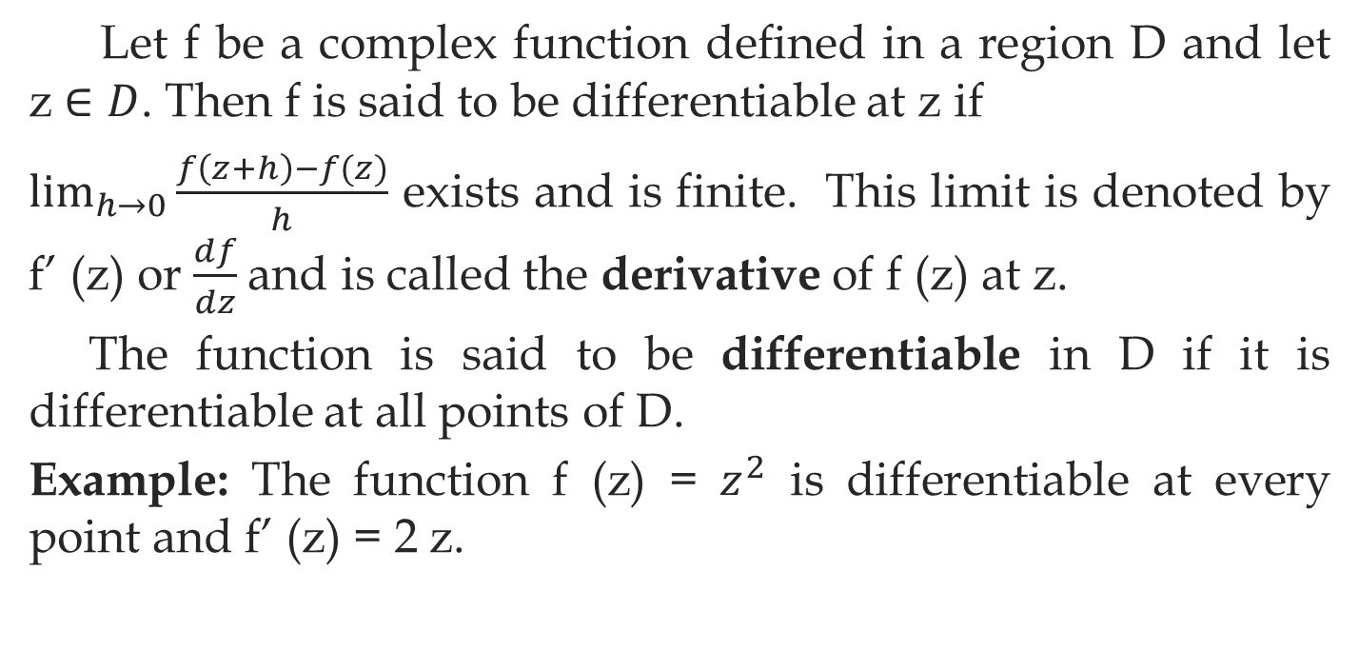
DIFFERENTIABILITY
Let f be a complex function defined in a region D and let z $∈D$. Then f is said to be differentiable at z if
$\lim_{h→0}{\frac{f\left(z+h\right)−f(z)}{h}}$ exists and is finite. This limit is denoted by f’ (z) or $\frac{df}{dz}$and is called the derivative of f (z) at z.
The function is said to be differentiable in D if it is differentiable at all points of D.
Example: The function f (z) = $z^{2}$ is differentiable at every point and f’ (z) = 2 z.

Slide 7
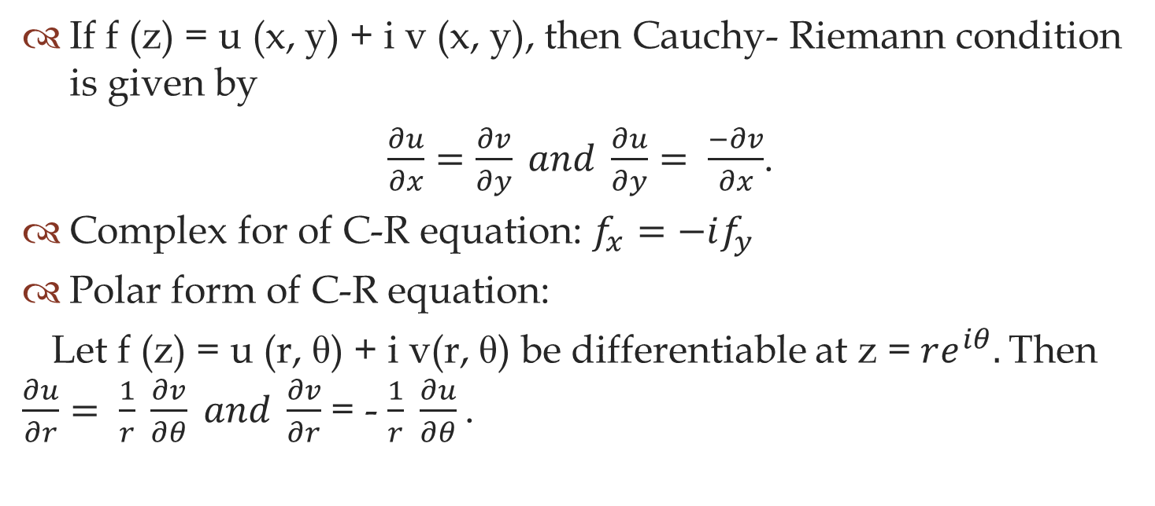
CAUCHY-RIEMANN EQUATION
If f (z) = u (x, y) + i v (x, y), then Cauchy- Riemann condition is given by
$\frac{∂u}{∂x}=\frac{∂v}{∂y} and \frac{∂u}{∂y}= \frac{−∂v}{∂x}$.
Complex for of C-R equation: $f_{x}=−if_{y}$
Polar form of C-R equation:
Let f (z) = u (r, θ) + i v(r, θ) be differentiable at z = $re^{iθ}.$Then $\frac{∂u}{∂r}= \frac{1}{r} \frac{∂v}{∂θ} and \frac{∂v}{∂r}$ = - $\frac{1}{r} \frac{∂u}{∂θ}$.

Slide 8
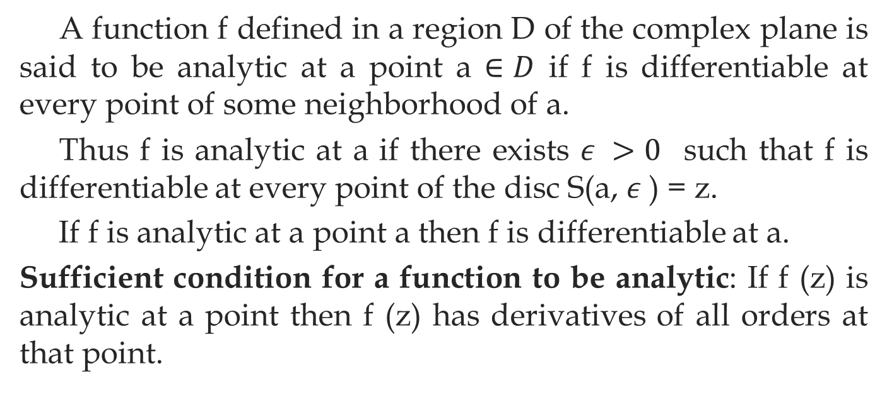
ANALYTIC FUNCTIONS
A function f defined in a region D of the complex plane is said to be analytic at a point a $∈D$ if f is differentiable at every point of some neighborhood of a.
Thus f is analytic at a if there exists $ε >0$ such that f is differentiable at every point of the disc S(a, $ε$) = z.
If f is analytic at a point a then f is differentiable at a.
Sufficient condition for a function to be analytic: If f (z) is analytic at a point then f (z) has derivatives of all orders at that point.

Slide 9
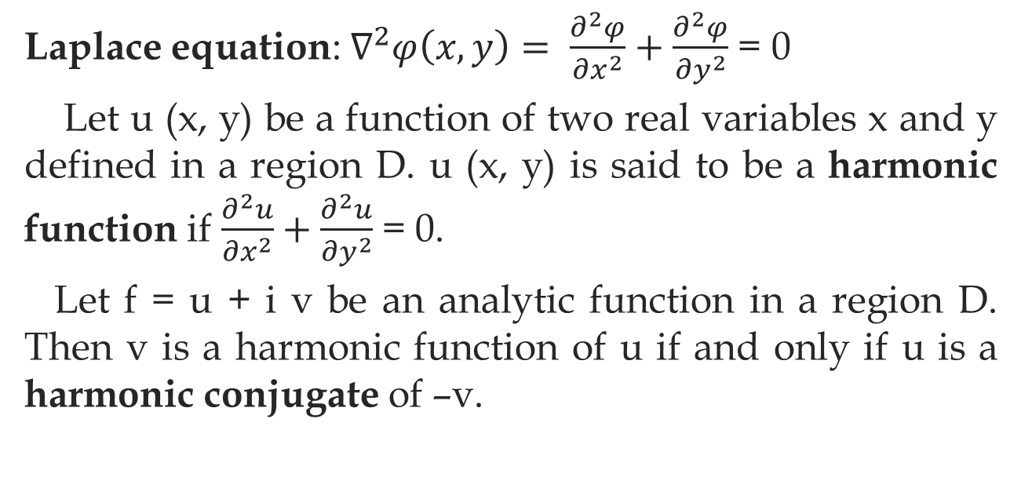
HARMONIC FUNCTION
Laplace equation: $∇^{2}φ\left(x,y\right)= \frac{∂^{2}φ}{{∂x}^{2}}+\frac{∂^{2}φ}{{∂y}^{2}}$= 0
Let u (x, y) be a function of two real variables x and y defined in a region D. u (x, y) is said to be a harmonic function if $\frac{∂^{2}u}{{∂x}^{2}}+\frac{∂^{2}u}{{∂y}^{2}}$= 0.
Let f = u + i v be an analytic function in a region D. Then v is a harmonic function of u if and only if u is a harmonic conjugate of –v.

