Slide 1
Analytical Geometry 3D
Cartesian coordinate System

Slide 2
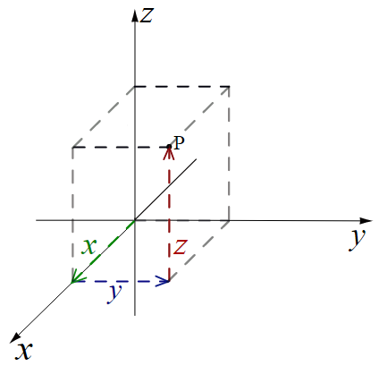
Coordinate Geometry
Cartesian Coordinates
In the two-dimensional Cartesian coordinate
system, a point P in the xy-plane is represented
by a pair of numbers (x,y).
x is the signed distance from the y-axis to the
point P, and
y is the signed distance from the x-axis to the
point P.
In the three-dimensional Cartesian coordinate
system, a point P in the xyz-space is represented
by a triple of numbers (x,y,z).
x is the signed distance from the yz-plane to the
point P,
y is the signed distance from the xz-plane to the
point P, and
z is the signed distance from the xy-plane to the
point P.

Slide 3
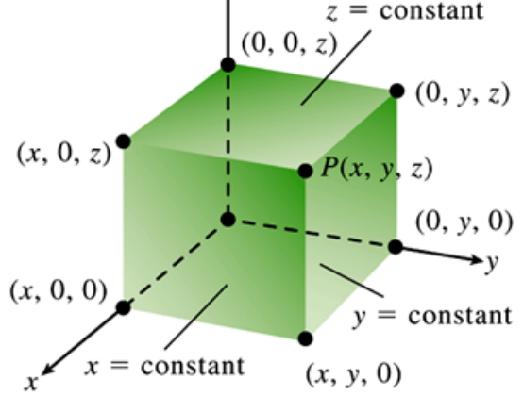
Cartesian coordinate
The Point P(x,y,z) in Cartesian Space

Slide 4
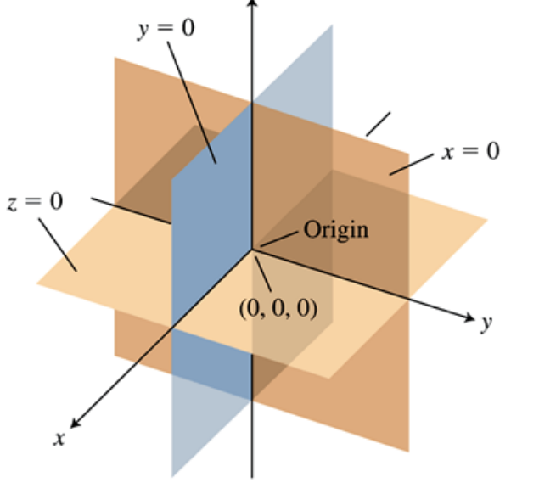
The Coordinate Planes Divide Space into Eight
Octants

Slide 5
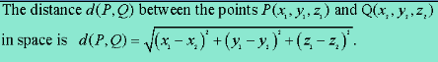
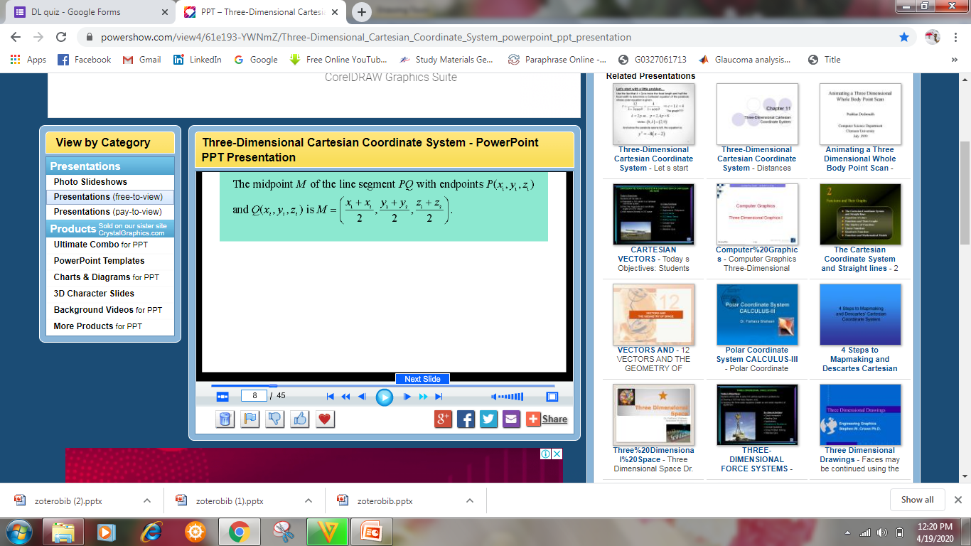
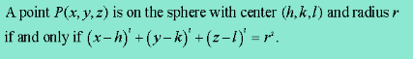

Slide 6


Example
Find the distance between the points p(4,3,-6) and Q(-2, 1,-3), and find the mid point of the line segment PQ.
Solution:
d(P,Q) =
=
The midpoint M =
=

Slide 7
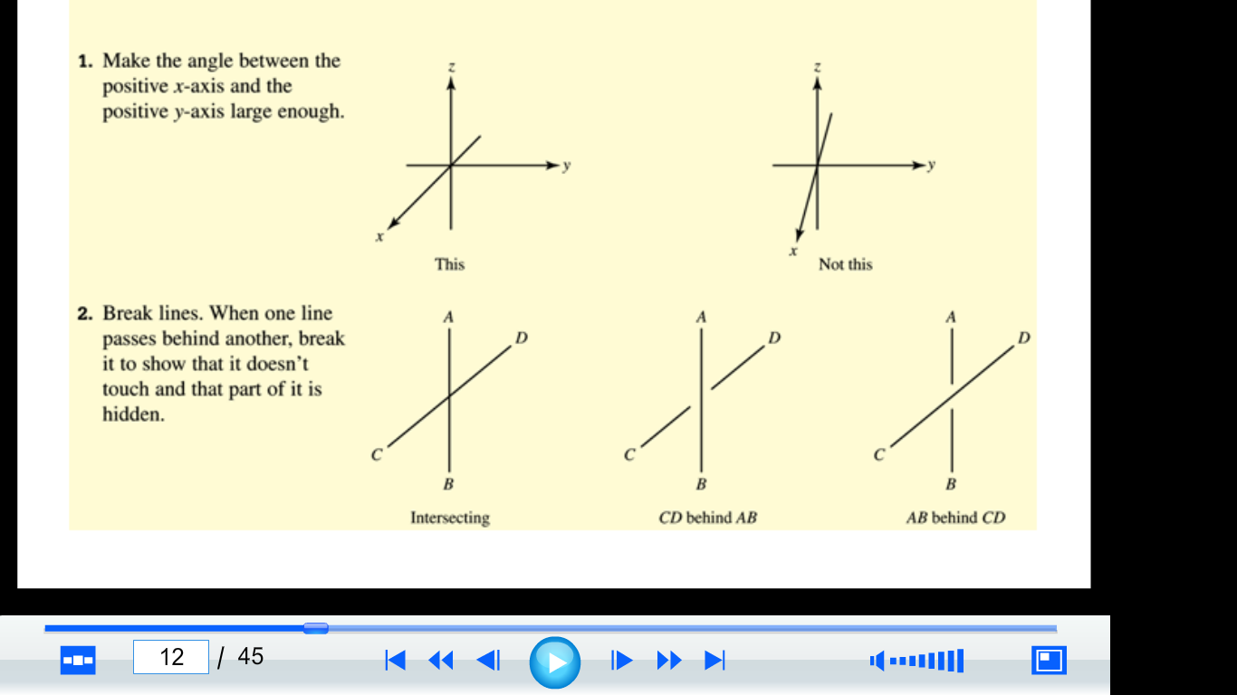

Slide 8
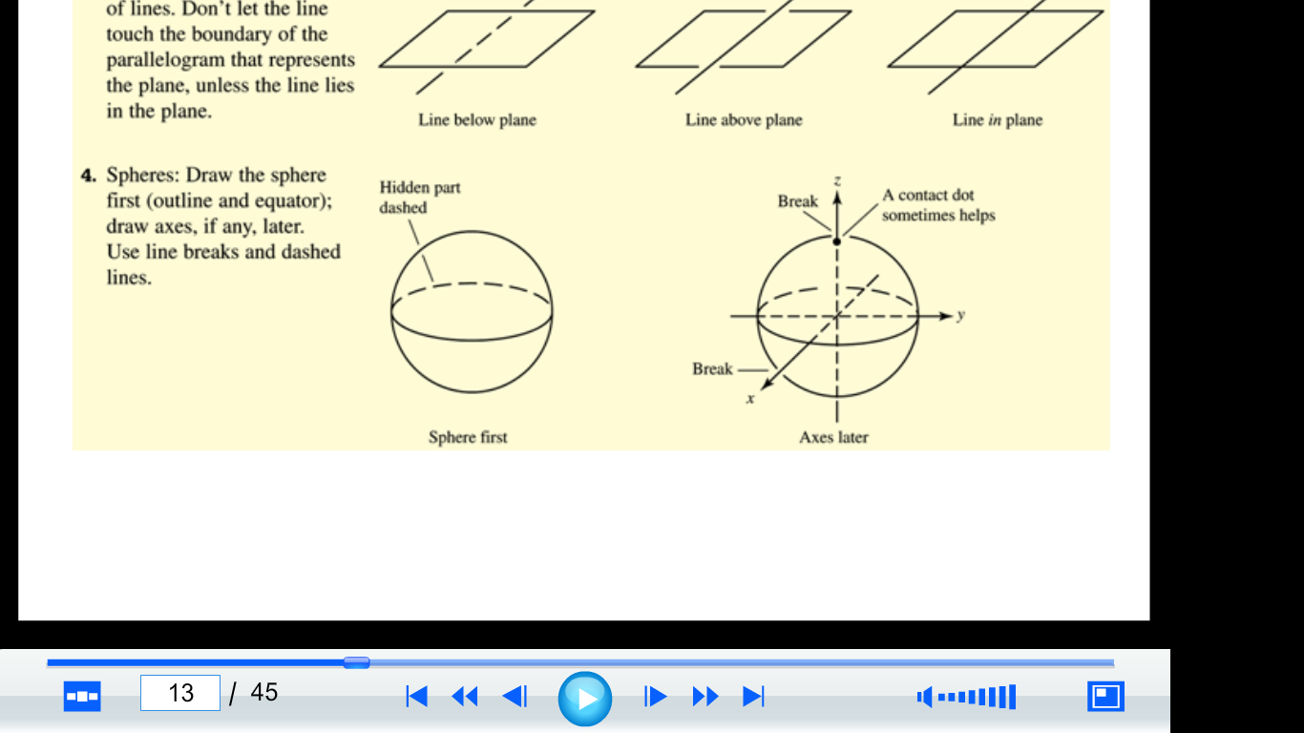

Slide 9
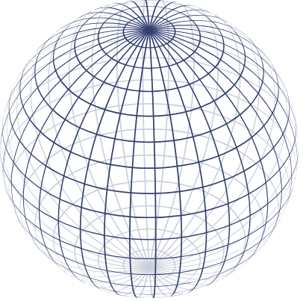
Sphere
Spherical surface has been defined as the locus of points in three-dimensional space, at a given distance from a given point.
The given point is called the center. The given distance is called a radius.
Sphere is a solid bounded by a spherical surface.

Slide 10
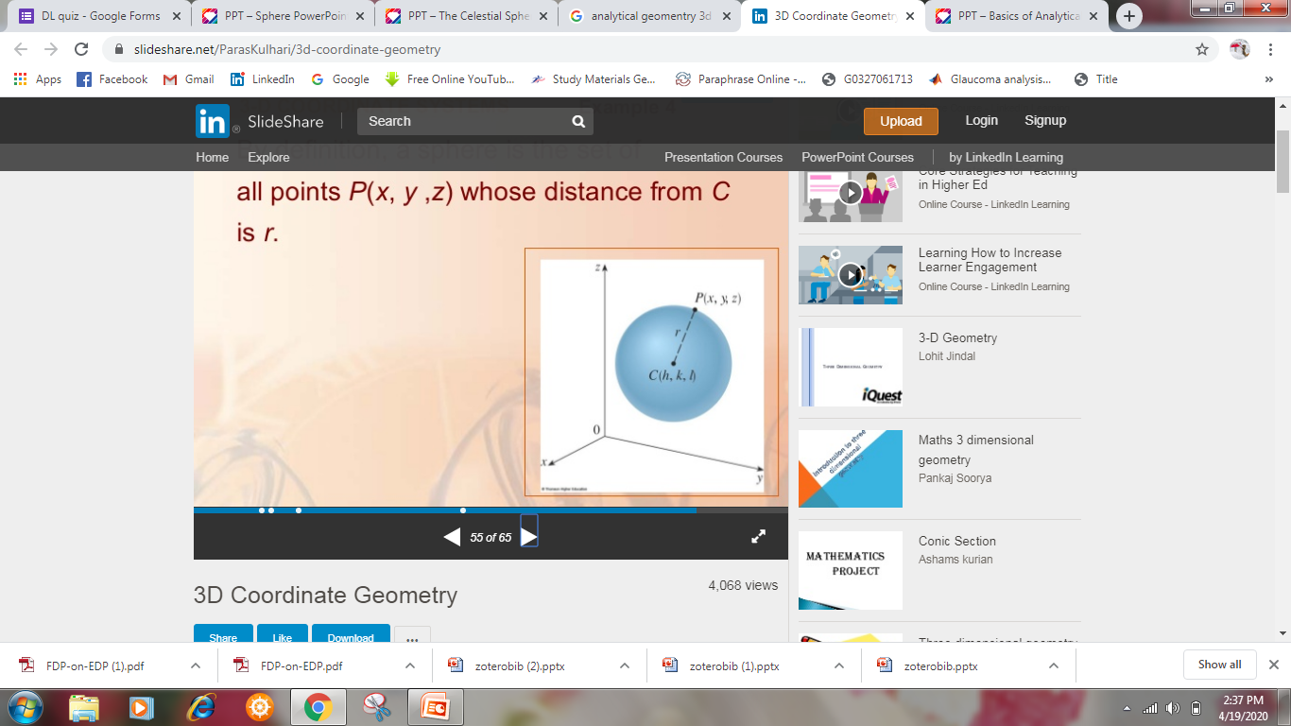
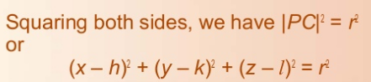
Find the equation of the sphere with radius r and center C(h,k,l)
Solution:
By definition, a sphere is a set of all points P(x,y,z)whose distance from C is r
Thus P is on the sphere if and only if |PC|=r

Slide 11
Thank You

