Slide 1


Slide 2
Nuclear Chemistry
presented by
Dr. V.RAJASUDHA. M.Sc., M.Phil., B.Ed. Ph.D.,
Assistant Professor
Department of Chemistry
Bon Secours College - Thanjavur

Slide 3
What is Nuclear Chemistry
Nuclear chemistry is the subfield of chemistry dealing with radioactivity, nuclear processes, and transformations in the nuclei of atoms, such as nuclear transmutation and nuclear properties.
It is the chemistry of radioactive elements such as the actinides, radium and radon together with the chemistry associated with equipment (such as nuclear reactors) which are designed to perform nuclear processes.
This includes the corrosion of surfaces and the behavior under conditions of both normal and abnormal operation. An important area is the behavior of objects and materials after being placed into a nuclear waste storage or disposal site.

Slide 4
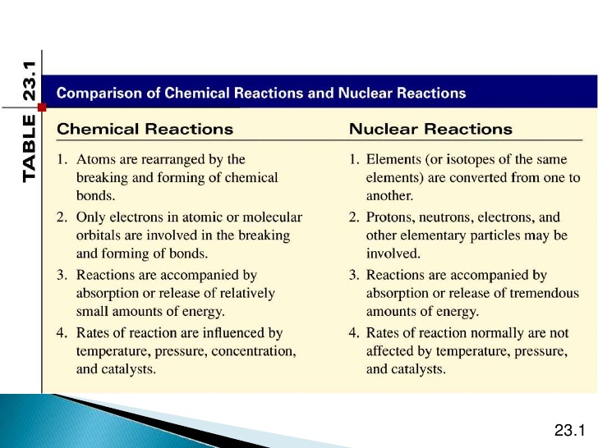
Comparision of Chemical Reaction and Nuclear Reaction

Slide 5
RadioActivity – What is it?
All substance are made of atoms. These have electrons (e) around the outside, and a nucleus in the middle.
The nucleus consists of protons (p) and neutrons (n), and is extremely small. (Atoms are almost entirely made of empty space!)
In some types of atom, the nucleus is unstable, and will decay into a more stable atom. This radioactive decay is completely spontaneous.
The energy that is released from the nucleus of the atom is radiation.

Slide 6
RadioActivity – What is it?
When an unstable nucleus decays, there are three ways that it can do so. It may give out:
An alpha particle ( We use the symbol α )
A beta particles ( We use the symbol β)
A gamma ray ( We use the symbol γ )

Slide 7
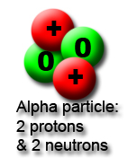
RadioActivity – Alpha Particles

Slide 8
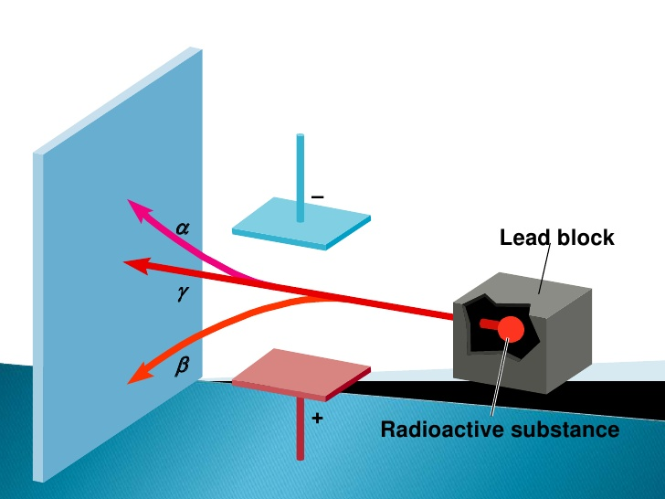
Particles that ionize other atoms strongly have a low penetrating power, because they lose energy each time they ionize an atom. therfore alpha particles are easy to stop and gamma rays are hard to stop.

Slide 9
RadioActivity – Beta Particles
Beta particles have a charge -1 and a mass of about 1/2000 th of a proton.
this means that beta particles are the same as an elecron.we can write them as β-
or because they are the same an eletron e- , written in isotope notation as ₋₁β⁰
They are fast and light.
Beta particles have a medium penetrating power -they are stopped
by a sheet of aluminium or plastics.
Beta particles ionize atoms that they pass, but not as stongly as alpha particles do.

Slide 10
RadioActivity – GAMMA WAVES
A gamma ray, or gamma radiation (symbol γ), is a penetrating electromagnetic radiation arising from the radioactive decay of atomic nuclei.
It consists of the shortest wavelength electromagnetic waves and so imparts the highest photon energy. Gamma rays from radioactive decay are in the energy range from a few kiloelectronvolts (keV) to approximately 8 megaelectronvolts (~8 MeV), corresponding to the typical energy levels in nuclei with reasonably long lifetimes.
The energy spectrum of gamma rays can be used to identify the decaying radionuclides using gamma spectroscopy. Very-high-energy gamma rays in the 100–1000 teraelectronvolt (TeV) range have been observed from sources such as the Cygnus X-3 microquasar.

Slide 11
ISOtope notation
Isotope Notation includes additional information about an isotope.
In addition to the chemical symbol, the mass number and the atomic number are included.
This allows information about the nucleus to be determined.

Slide 12
NUCLEAR DECAY REACTIONS
SOME Elements are naturally unstable
they tend to undergo alpha-decay or beta-decay to become more stable.
They may take several steps in order to achieve this, thus we observe decay chains (also known as series decay) for most radioactive elements.
For example, it takes U-238 14 steps of alpha and beta decay to become completely stable

Slide 13
Identifying alpha and beta decay REACTIONS
Alpha decay is one process that unstable atoms can use to bocome more stable.
During alpha decay, an atoms nucleus sheds two protons and two neutrons
in a packet that scientists call an alpha particles.Since an atom loses two protons
during alpha decay, it changes from one elements to another.
for example, after under going alpha decay, an atom of uranium with92 protons
becomes an atom of thorium with 90 protons
The reaction above would be written as: ₉₂U²³⁸→ ₉₀Th²³⁴+ ₂He⁴

Slide 14
HALF LIFE
When radioactive isotopes decay, they do so exponentially. Their rate of decay is determined through an understanding of half-life.
Half-life is the amount of time it takes for half of the atoms of an unstable isotope to decay.
ATOMS with short half-lives are more unstable than those with long half-lives.

Slide 15
magic number
From the study of the electronic confiquration of elements, we find that netural atoms
containing a total of 2, 10, 18, 36, 54 and 86 extranuclear electrons are remarkably stable.
They are so inert that they do not undergo chemical reactions.
Similarly, for nuclei, it is found that, those with 2, 820, 50 82 or 126 nucleons
of the same kind are very stable. These numbers are calles magic numbers.
These numbers appear to be he required number of nucleons to complete
the energy levels in the nuclei .

Slide 16
THANK YOU

