Slide 1
MOCKLENO WEAVES
Presented By,
K.Kathiroli,
Asst professor ,
Bon Secours College for women,
Thanjavur

Slide 2
About Mock leno
Mock lenos, also known as imitation leno are a variety of weaves of ordinary construction which produce effects that are similar in appearance to the gauze or leno styles obtained with the aid of doup mounting

Slide 3
Contd......
Mock leno is derivative weave which looks like a gauze
It is a imitation of leno weave
These mock leno weave is interlaced with two or three warp yarns
These warp yarns are grouped together & they act as a unit
Mock leno are woven with both plain weave & mock leno weave
Notes:
contd

Slide 4
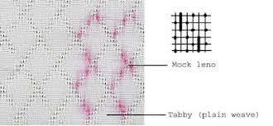
MOCK LENO FABRIC
Notes:
MOCK LENO FABRIC

Slide 5
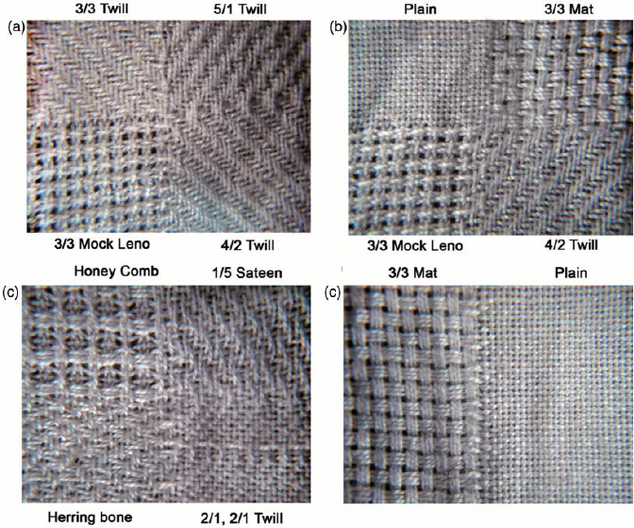

Slide 6
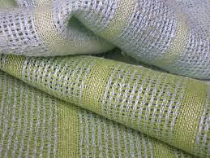
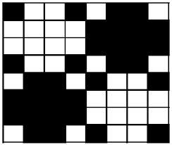

Slide 7
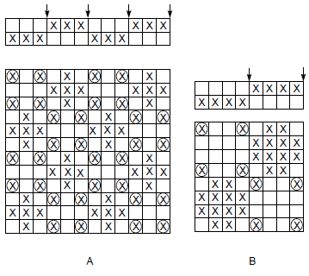
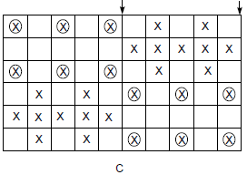
Perforated mock leno
Notes:
Perforated mockleno

Slide 8
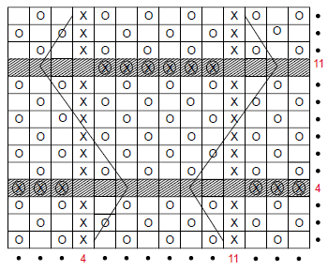
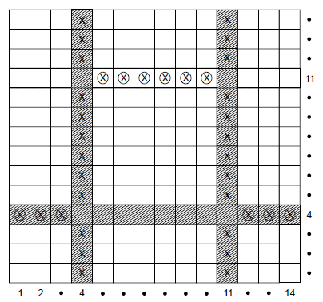
The DISTORTED THREAD EFFECTS

Slide 9
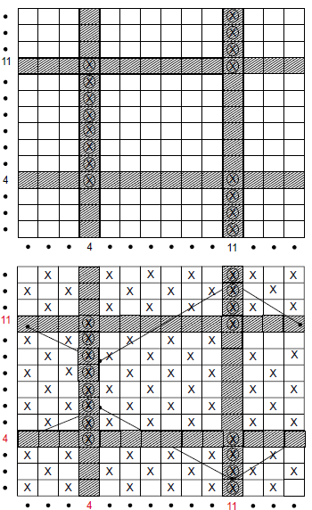
Weft way
Notes:
Weft way

Slide 10
END USES OF MOCK LENOS
Mock lenos find uses in canvas cloths, cheap fabrics for window curtains, light dress fabrics, blouses, aprons etc.
In many cases, they are generally employed in combination with other weaves.

