Slide 1
Computer Virus Worm and Logic Bomb
Presented by
D.Seethalakshmi MCA.,M.Phil.,
Assistant Professor
Bon Secours College for women,
Thanjavur.

Slide 2
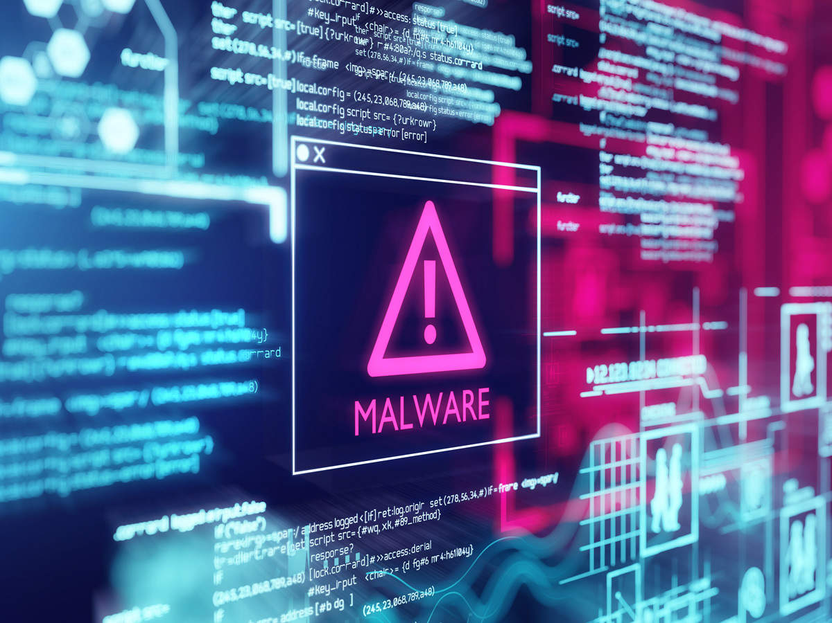
Malware :
Malware is a program designed to gain access to computer systems, normally for the benefit of some third party, without the user’s permission.
Malware includes computer viruses,
Worms,
Trojan horses,
Ransom ware,
Spyware and other malicious programs.

Slide 3
Virus :
A Virus is a malicious executable code attached to another executable file.
The virus spreads when an infected file is passed from system to system.
Viruses can be harmless or they can modify or delete data.
Opening a file can trigger a virus.
Once a program virus is active, it will infect other programs on the computer.

Slide 4
Types of Virus :
Computer viruses come in different forms, and the most common infections are:
Boot Sector Virus
Direct Action Virus
Resident Virus
Multipartite Virus
Polymorphic Virus
Overwrite Virus
Space filler Virus
File Infector Virus

Slide 5
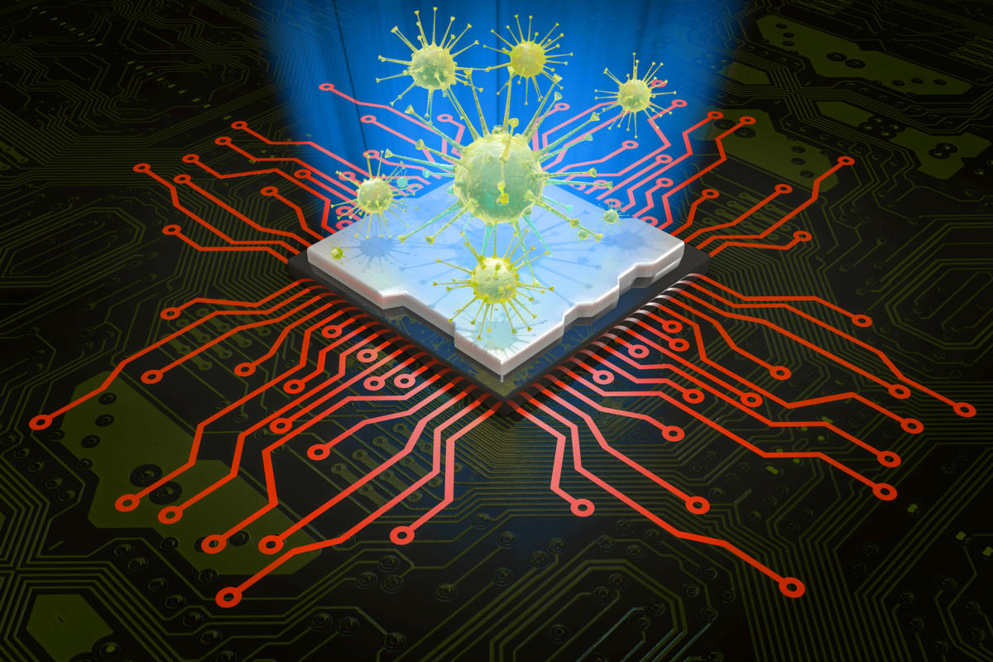
Worm Virus :
A computer worm is a type of malicious software program which infects other systems by making multiple copies of itself and spreading itself onto other computers within the network.
Computer worms exploit certain parts of the operating system that are not visible to the user.
The infection is only noticed when the system consumes most of the resources due to the worm’s uncontrolled replication.
This in turn slows and stops the performance of other services in the computer’s operating system.

Slide 6
Symptoms of Computer Worms :
Slow performance of the computer
Unexpected freezing and crashing of system
Annoying pop-ups
Blue screen of death
Removing a computer worm can be challenging.
In worst cases, network administrators will have to reformat the system and reinstall software.
Users need to use an effective malware removal tool to identify and remove the worm.
When removing the worm, users and administrators should disconnect the system from the Internet to make sure the malicious program does not escape to another device or system.

Slide 7
Logic bomb :
The term logic bomb refers to the malware also called slag code which gets activated by a response to an event.
For instance, launching an application or when a specific date/time is reached – it triggers the logic bomb malware to start running on a computer.
Online fraudsters make use of the logic bomb malware in a variety of ways.
Attackers usually embed the code within a bogus application, or Trojan horse, and will automatically execute whenever the user launches the fake software.

Slide 8
How to prevent logic bombs :
Some of the necessary steps to recover from the attack are listed here go through them keenly
Never download pirated software – cybercriminals implant Logic bombs using such software.
Make sure that the shareware/freeware applications that you install are from a trusted source since Logic bombs can be embedded within Trojan horses.
Email attachments may come with the logic bombs malware so be extra careful when opening email attachments.
Implement patches to all the software installed on the computer whenever there is a release.

