Slide 1
Fundamentals of Computer
Prepared by
V.Santhi
Assistant Professor
Department of Computer Applications
Bon Secours College for Women
Thanjavur

Slide 2
Basics of Computer
Computer
types of computer
Generation of computer
characteristics of computer
Components of computer
Input devices
Output devices
hardware and software

Slide 3
COMPUTER
A computer is an electronic machine.
Accepts user supplied data and instructions using various input methods.
performs arithmetic and logical operations using the given data
stores the data in storage devices.

Slide 4
Types of computer
TYPES OF COMPUTERS
ANALOG COMPUTER
HYBRID COMPUTER
DIGITAL COMPUTER
MICRO COMPUTER
MINI COMPUTER
MAIN
FRAME COMPUTER
SUPER COMPUTER

Slide 5
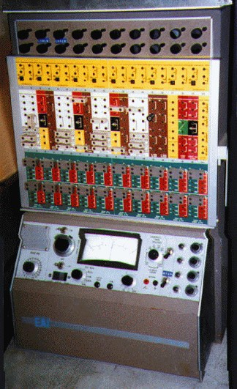
ANALOG COMPUTER
Analog computer measures and answer the questions by the method of “HOWMUCH”.
The input data is not a number infect a physical quantity like temp, pressure, speed, velocity.
Accuracy 1% Approximately
High speed
Output is continuous
Signals are continuous of (0 to 10 V)
Time is wasted in transmission time

Slide 6
HYBRID COMPUTER
A hybrid computer is a type of computer that offers the functionalities of both a digital and analog computer.
it is designed to include a working analog unit I that is powerful for calculations yet has a readily available digital memory.
In large industries and business, a hybrid computer can be used to incorporate logical operations as well as provide efficient processing of differential equations.

Slide 7
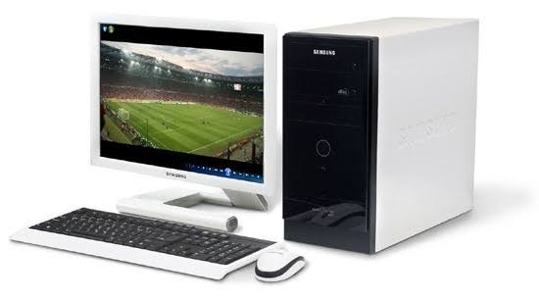
DIGITAL COMPUTER
Digital computer counts and answer the questions by the method of “HOW Many”.
The input data is represented by a number.
These are used for the logical and arithmetic operations.
Signals are two level of (0 V or 5 V)
Accuracy unlimited
low speed sequential as well as parallel processing
Output is continuous but obtain when computation is completed.

Slide 8
MICRO COMPUTER
Micro computer are the smallest computer system.
There size range from calculator to desktop size.
Its CPU is microprocessor. It also known as Grand child Computer.
Application : - personal computer, Multi user system, offices.

Slide 9
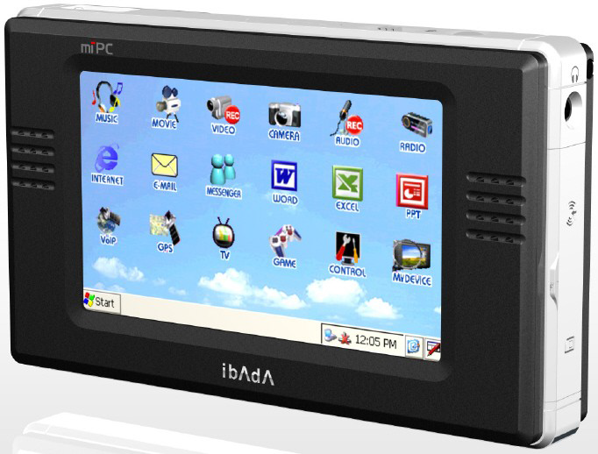
MINI COMPUTER
These are also small general purpose system.
They are generally more powerful and most useful as compared to microcomputer.
Mini computer are also known as mid range computer or Child computer.
Application :- Departmental systems , Network Servers, work group system.

Slide 10
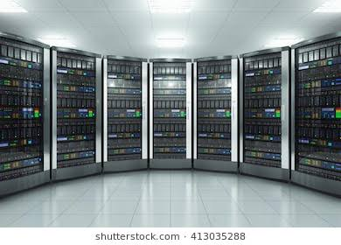
MAIN FRAME COMPUTER
Mainframe computers are those computers that offer faster processing and greater storage area.
The word “main frame” comes from the metal frames. It is also known as Father computer.
Application – Host computer, Central database server.

Slide 11
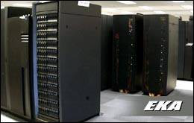
SUPER COMPUTER
Super computer are those computer which are designed for scientific job like whether forecasting and artificial intelligence etc.
They are fastest and expensive.
A super computer contains a number of CPU which operate in parallel to make it faster.
It also known as grandfather computer.
Application – whether forecasting, weapons research and development.

Slide 12
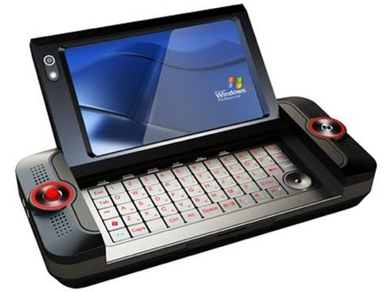
HYBRID COMPUTER
A hybrid computer is a type of computer that offer the functionalities of both a digital and an analog computer.
It is a design to include a working analog unit that is powerful for calculations, yet has a readily available digital memory.
In large industries and business, a hybrid computer can be used to incorporate logical operations as well as provide efficient processing of differential equations.

Slide 13
GENERATION OF COMPUTERS
The computer has developed through five generations. they are
GENERATION OF COMPUTERS
THIRD GENERATION
FOURTH GENERATION
FIFTH GENERATION
FIRST GENERATION
SECOND GENERATION

Slide 14
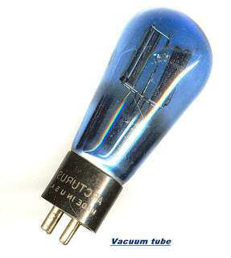
FIRST GENERATION OF COMPUTER
The first generation computers are used vacuum tubes.
It is large in size.
Slow operation speed.
High consumption of electricity.
eg: UNIVAC-I,IBM-650.

Slide 15
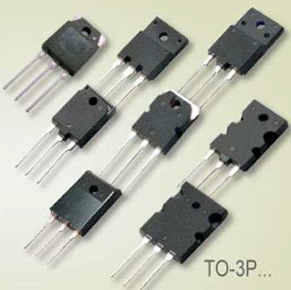
SECOND GENERATION OF COMPUTER
The second generations computers are used transistors.
Transistors were very small compared to vacuum tubes.
It consumed less electricity.
It is reduced the size of computer.
Eg: CDC-3600, UNIVAC-1108

Slide 16
THIRD GENERATION OF COMPUTER
The third generation of computers are used integrated circuits(IC).
IC is made up of silicon.
These computers were thousand times faster than first generations.
The memory capacity and storage capacity of these computers were very high.
Eg: CDC-1700,ICL-2903.

Slide 17
FOURTH GENERATION OF COMPUTER
The fourth generations of computer used large scale integrated circuits.
It reduced the size and increased the speed of computers.
It is high processing speed and low heating effect.
Eg: INTEL-4004,apples-I.

Slide 18
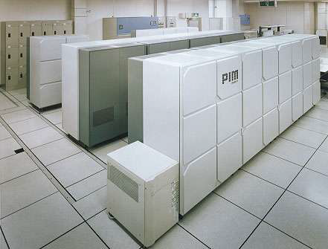
FIFTH GENERATION OF COMPUTER
The fifth generation of computer used very large scale integrated circuits.
These computer are capable of taking their own decisions without human invention.
These computers called “KIPS”(knowledge information processing system).

Slide 19
Characteristics of computer
The characteristics of computers that have made them so powerful and universally useful are speed, accuracy , diligence, versatility and storage capacity. Let us discuss them briefly
SPEED
Computers work at an incredible speed.
A powerful computer is capable of performing about 3-4 million simple instructions per second

Slide 20
ACCURACY
In addition to being fast, computers are also accurate.
Errors that may occur can almost always be attributed to human error (inaccurate data, poorly designed system or faulty instructions/programs written by the programmer)
DILIGENCE
Unlike human beings, computers are highly consistent.
They do not suffer from human traits of boredom and tiredness resulting in lack of concentration.
Computers, therefore, are better than human beings in performing voluminous and repetitive jobs.

Slide 21
VERSATILITY
Computers are versatile machines and are capable of performing any task as long as it can be broken down into a series of logical steps.
The presence of computers can be seen in almost every sphere – Railway/Air reservation, Banks , Hotels, Weather forecasting and many more.
STORAGE CAPACITY
Today’s computers can store large volumes of data.
A piece of information once recorded (or stored) in the computer , can never be forgotten and can be retrieved almost Instantaneously.

Slide 22
COMPONENTS OF COMPUTER
A computer performs five major operations or functions irrespective of its size and make. These are
It accepts data or instructions as input,
It stores data and instruction
It processes data as per the instructions,
It controls all operations inside a computer, and
It gives results in the form of output.

Slide 23
CPU
ALU
INPUT
CU
OUTPUT
MMU
SECONDARY MEMORY

Slide 24
THREE COMPONENTS OF COMPUTER
Input
Output
Central processing unit
Input
This unit is used for entering data and programs into the computer system by the user for processing.

Slide 25
Output
The output unit is used for storing the result as output produced by the computer after processing.
Central processing unit
The Central Processing Unit (CPU) takes data and instructions from the storage unit and makes all sorts of calculations based on the instructions given and the type of data provided.
It is then sent back to the storage unit.
CPU includes Arithmetic logic unit (ALU) and control unit.

Slide 26
CENTRAL PROCESSING UNIT
The units contains are
Arithmetic and logic unit
control unit
main memory unit

Slide 27
Arithmetic and logic unit
It performs arithmetic functions like addition, subtraction, multiplication , division and also logical operations like greater than , less than and equal to etc.
Control unit
Controlling of all operations like input , processing and output are performed by control unit. It takes care of step by step processing of all operations inside the computer.

Slide 28
Main memory unit
It holds all data and instructions temporarily. it is otherwise called primary memory or internal memory. There are two types of main memory.
primary memory
secondary memory
primary memory
Random access memory(RAM)
Read only memory(ROM)
Random access memory(RAM)
It is a volatile memory.
The contents of RAM are no more available once the computer is turned off.

Slide 29
Read only memory(ROM)
It is non volatile memory.
Read Only Memory is a special type of memory which can only be read and contents of which are not lost even when the computer is switched off. It typically contains manufacturer’s instructions.
The other types of ROM are
PROM
EPROM
EEPROM

Slide 30
PROM
It stands for programmable read only memory.
It is user records its content only one time.
EPROM
It stands for erasable programmable read only memory.
The contents of EPROM are removed by focusing the chip ultra violet light.
EEPROM
It stands for electrical erasable programmable read only memory.
The contents of are removed by applying electrical charge.

Slide 31
Secondary memory
Secondary/auxiliary memory is storage other than the RAM.
These include devices that are peripheral and are connected and controlled by the computer to enable permanent storage of programs and data.
Secondary storage devices are of two types; magnetic and optical. Magnetic devices include hard disks and optical storage devices are CDs, DVDs, Pen drive, Zip drive etc.

Slide 32
Input devices
Keyboard
Mouse
Joystick
Light pen
Track ball
Track ball
OCR
OMR
MICR

Slide 33
INPUT DEVICES
MICR
BCR
Scanner
digital camera
Digitizing tablet
Touch screen

Slide 34
Output devices
Printer
Plotter
Monitor

Slide 35
Hardware and software
Hardware
The physical components of a computer are callefd hardware.
Keyboard
Mouse
Microprocessor
Floppy disk
Hard disk
Optical disk
Modem

Slide 36
Software
a set of computer program is called software. There are two software are
system software
Application software
System software
System software consists of a group of programs that control the operations of a computer equipment including functions like managing memory, managing peripherals, loading, storing, and is an interface between the application programsand the computer.
MS DOS (Microsoft’s Disk Operating System), UNIX are examples of system software

Slide 37
Application software
Software that can perform a specific task for the user, such as word processing, accounting, budgeting or payroll, fall under the category of application software. Word processors , spreadsheets, database management systems are all examples of general purpose application software.

