Slide 1
Computer Virus
Presented by
V.Santhi
Assistant Professor
Department of Computer Applications
Bon Secours College for Women
Thanjavur

Slide 2
Virus
A virus is a program designed by a computer programmer (malicious hacker) to do a certain unwanted function.
Computer virus refers to a program which damages computer systems and/or destroys or erases data files

Slide 3
A Computer Virus is a program that can copy itself and infect a computer without the permission or knowledge of the user.
A Computer Virus has 2 major characteristics: the ability to replicate itself, and the ability to attach itself to another computer file...
Computer Viruses affect the computer in many ways. It can destroy data, files or programs and cause the system malfunction. The destructive effects of viruses are different according to their types.

Slide 4
Symptoms
The following are a few Symptoms that your computer might have a virus:
Slow response and slow program execution.
Random hard drive crashes and restarts.
Distorted graphics and text.
Files that have mysteriously vanished.
Extensive pop-up ads.
Inability to open files with existing passwords.

Slide 5
Types of Computer Virus
Time Bomb
Logical Bomb
Worm
Boot Sector Virus
Macros Virus
Script Virus
Trojan Horse

Slide 6
Time Bomb
A time bomb is a virus program that performs an activity on a particular date

Slide 7
Logical Bomb
A logical bomb is a destructive program that performs an activity when a certain action has occurred.

Slide 8
Worm Virus
A worm is also a destructive program that fills a computer system with self-replicating information, clogging the system so that its operations are slowed down or stopped

Slide 9
Boot Sector Virus
A boot sector virus infects boot sector of computers. During system boot, boot sector virus is loaded into main memory and destroys data stored in hard disk

Slide 10
Macro Virus
A macro virus is associated with application software like word and excel. When opening the infected document, macro virus is loaded into main memory and destroys the data stored in hard disk

Slide 11
Script Virus
Commonly found script viruses are written using the Visual Basic Scripting edition (VBS) and the JavaScript programming languages

Slide 12
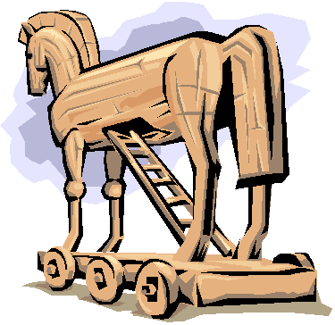
Trojan Horse
Trojan Horse is a destructive program. It usually pretends as computer games or application software. If executed, computer system will be damaged.

Slide 13
Trojan Horse
Trojan Horse usually comes with monitoring tools and key loggers

Slide 14
WHAT A COMPUTER VIRUS DO?
SLOW DOWN THE NETWORK
CORRUPT DATA
HIJACK YOUR COMPUTER
DISABLE
STEAL CONFIDENTIAL DATA
HARDWARE
DISPLAY MESSAGES
DELETE DATA

Slide 15
Kespersky Antivirus
Data fellows E-Plot
Mcafee Antivirus
Symantec Norton Antivirus
Bit Defender 2010
Quick Heal Antivirus
ESaSS ThunderBYTE

Slide 16
Actions to prevent virus infection
Always update your anti-virus software at least weekly.
Back up your important files and ensure that they can be restored.
Change the computer's boot sequence to always start the PC from its hard drive

Slide 17
Actions to prevent virus infection
Don't share Drive C: without a password and without read-only restrictions.
Empty floppy drives of diskettes before turning on computers, especially laptops.

Slide 18
Actions to prevent virus infection
Forget opening unexpected e-mail attachments, even if they're from friends
Get trained on your computer's anti-virus software and use it.
Have multiple backups of important files. This lowers the chance that all are infected.

Slide 19
Actions to prevent virus infection
Install security updates for your operating system and programs as soon as possible.
Jump at the chance to learn more about your computer. This will help you spot viruses.

