Slide 1
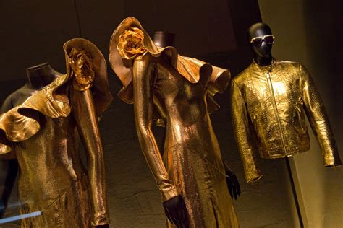
MANNEQUIN

Slide 2
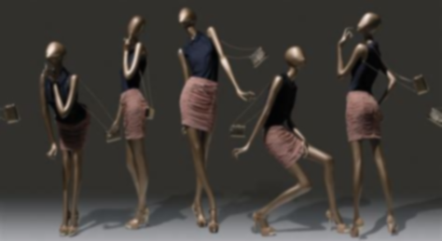
What is mannequin?
It is an often articulated doll used by artists, tailors, dressmakers, window dressers and others especially to display or fit clothing.
The artificial dolls used by the retailers to display their merchandise (can be anything) are called as mannequins.
A mannequin are also called as manikin, dummy, lay figure or dress form.

Slide 3
Purpose of Mannequins
Mannequins are used to highlight the unique collections of the store.
Mannequins display the latest trends in fashion and influence the customers to buy the particular merchandise.
Mannequins attract the customers into the store and thus increase the revenue and profit.
Mannequins are also responsible for up selling at the retail store

Slide 4
TYPES OF MANNEQUINS
There are mainly 5 types of mannequins they are as follows,
REALISTIC
SEMI-REALISTIC
ABSTRACT
SEMI-ABSTRACT
HEADLESS

Slide 5
REALISTIC MANNEQUIN
Realistic mannequins are maybe the real mannequins among different ranges of mannequins.
They look more like human being.
The quality realistic mannequins must have the perfect wigs, fine and trendy makeups, elegant poses, with all these points, sometimes you even could not recognize that they are mannequins, and they do look as the super models on the stage or the fashion weeks.
The natural flesh tone skin color is the most important of the realistic mannequins which decides whether it's really lifelike or not.

Slide 6
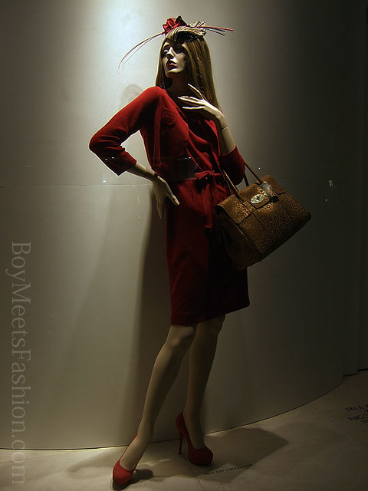
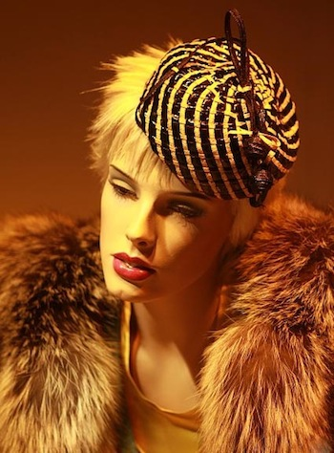
REALISTIC

Slide 7
SEMI-REALISTIC
Similar to realistic mannequins except that their make-up does not have the same definition
The entire figure from top to bottom can be all one colour, even grey or purple.
Hair may be part of the sculpture and cannot be replaced or restyled.

Slide 8
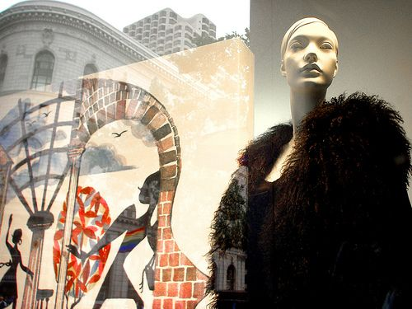
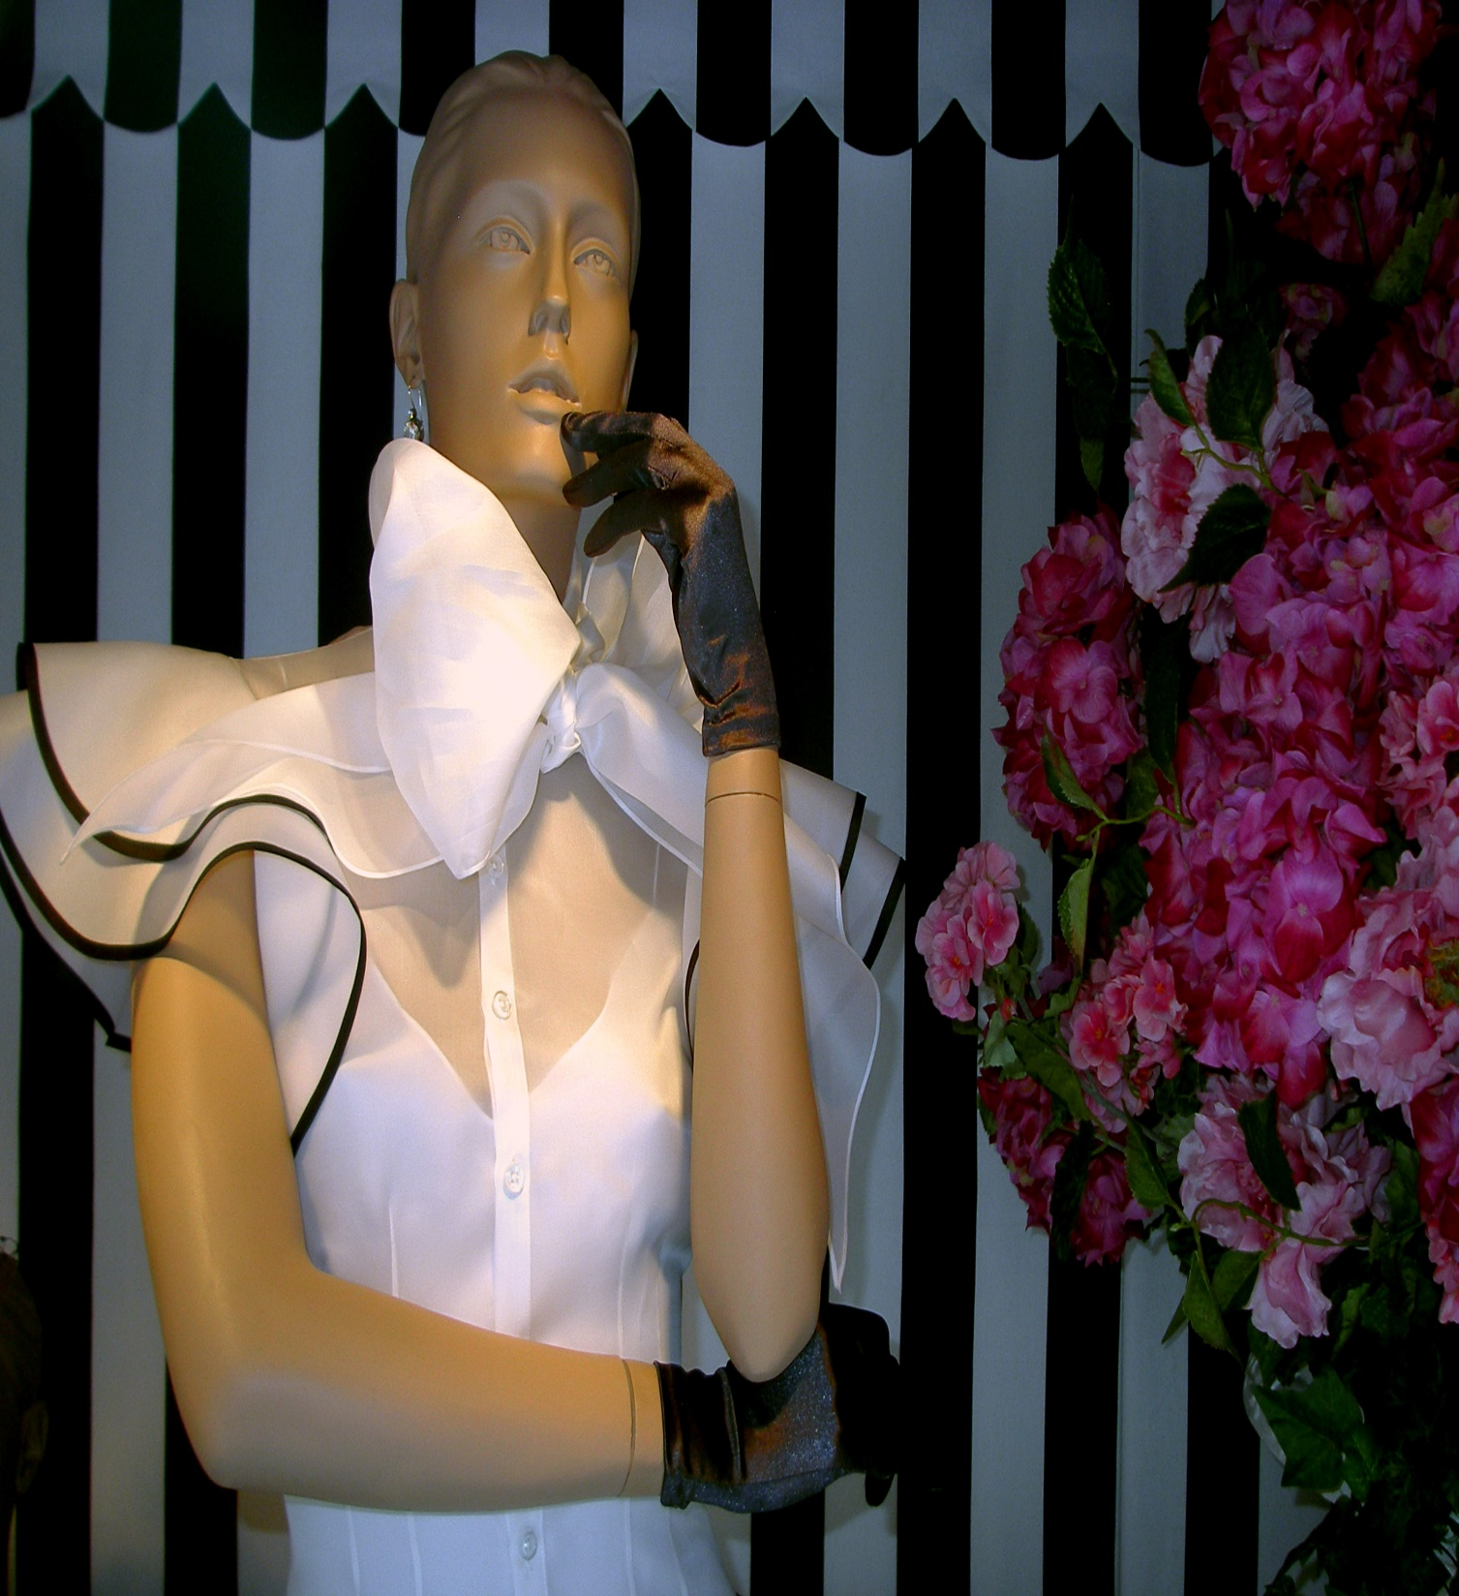
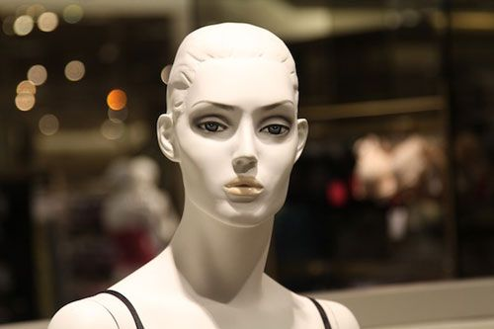
SEMI-REALISTIC

Slide 9
ABSTRACT MANNEQUIN
ABSTRACT MANNEQUINS is about the mannequins with the abstract head.
Mainly for a mannequin factory, abstract head means NON-realistic head which doesn’t have all the parts as a real person has.
It is also called as stylized mannequins.
Available in a multitude of poses and in various finishes (e.g., glossy or matte), these stylish mannequins are the perfect backdrop for your most eye-catching outfits and accessories.

Slide 10
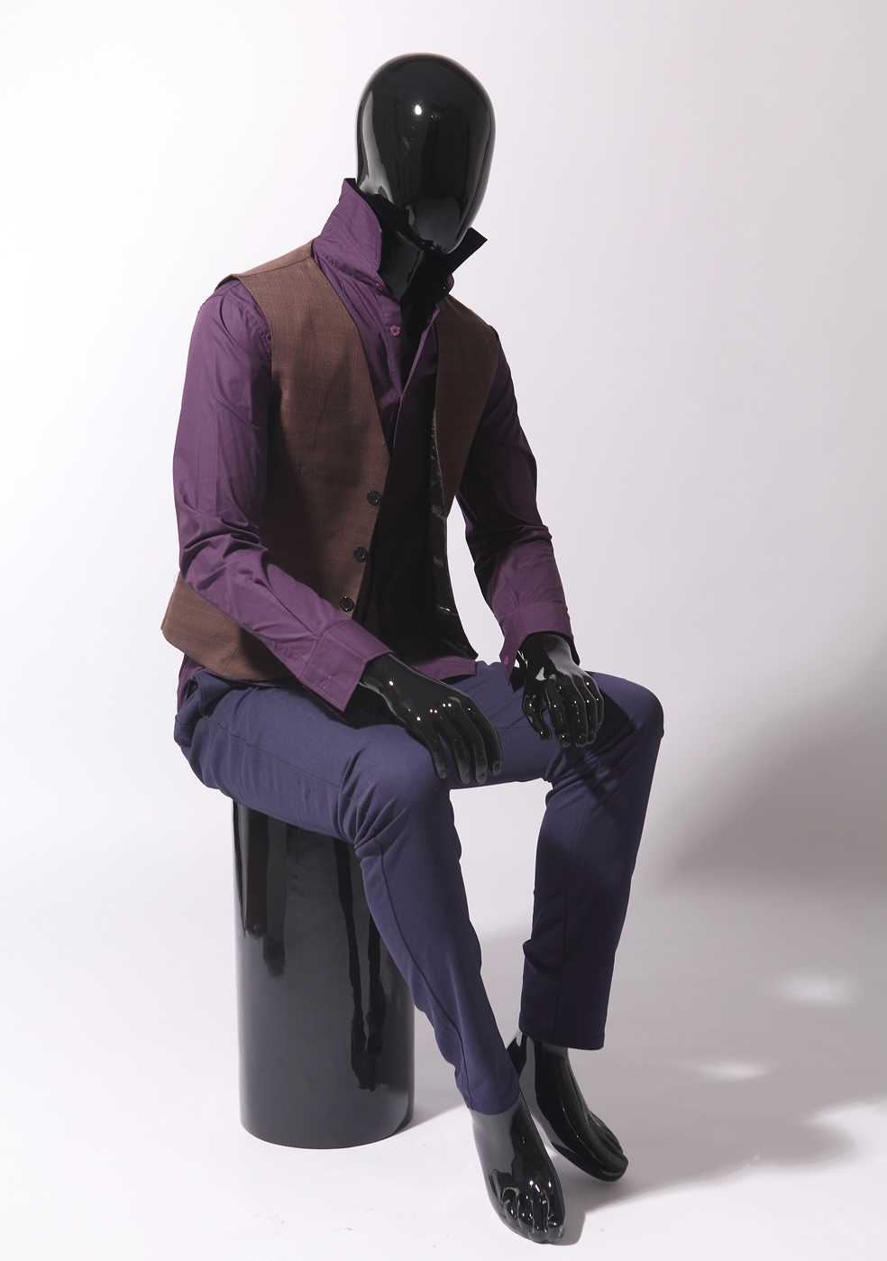
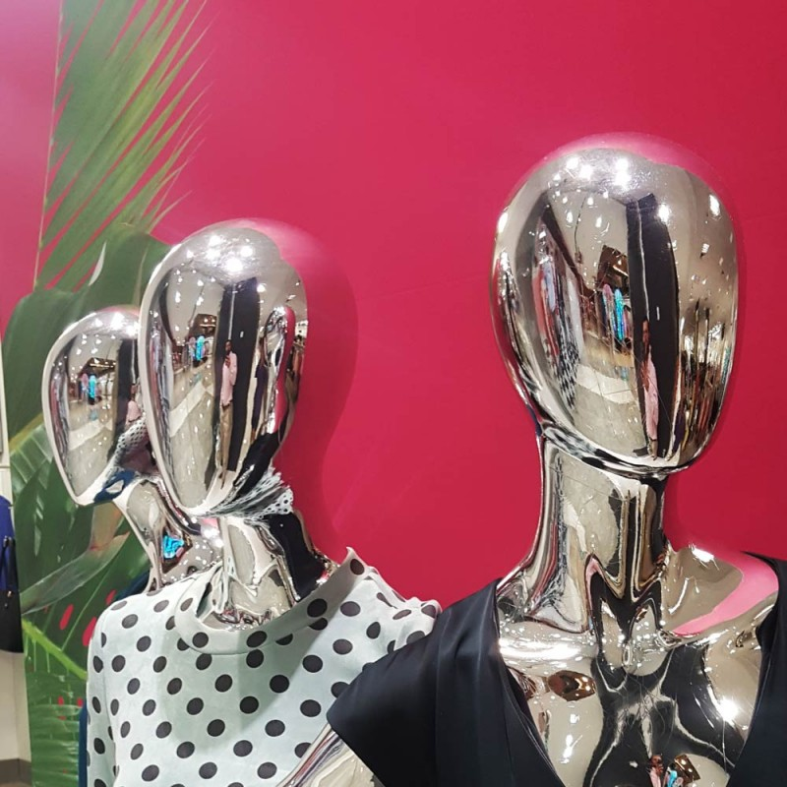
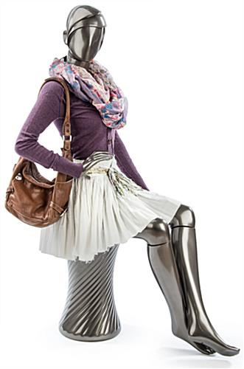
ABSTRACT

Slide 11
SEMI-ABSTRACT MANNEQUIN
semi-abstract mannequin are even more stylized and decorative than the semi-realistic mannequin.
This type of mannequin is doll like and decorative and more popular-priced than elegant in appeal.

Slide 12
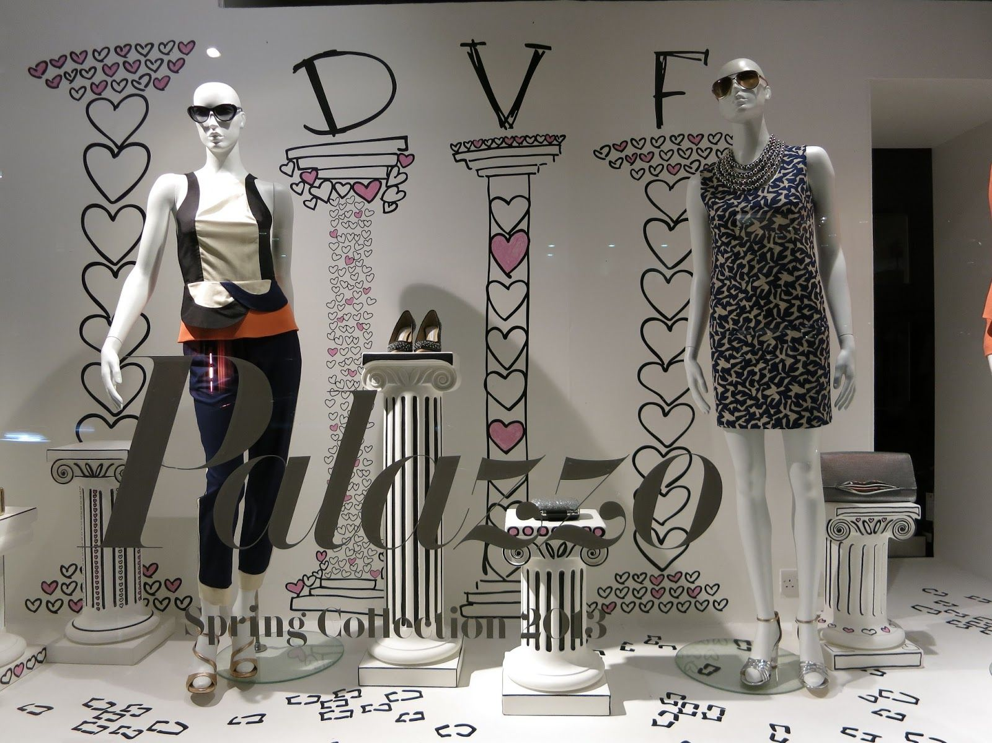
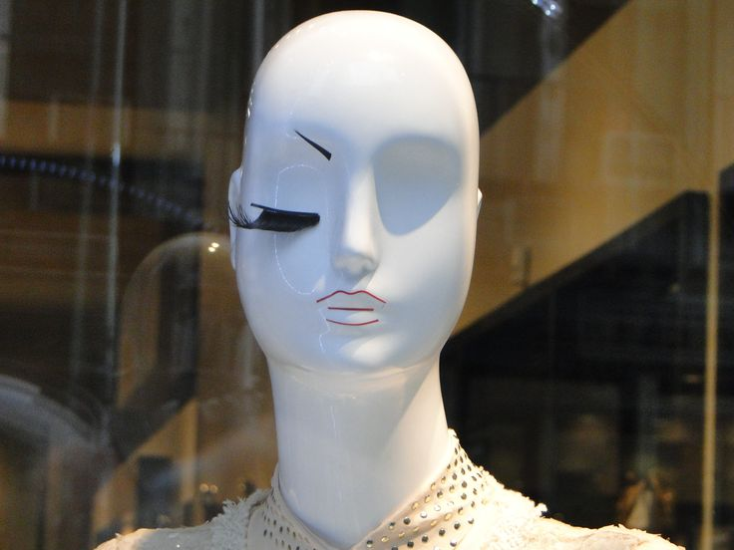
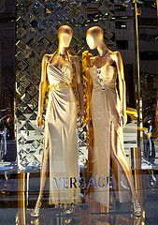
SEMI ABSTRACT

Slide 13
HEADLESS MANNEQUIN
Headless mannequin is the most standard and most widely used in clothing stores.
This kind of mannequin is more than perfect for stores or rooms with limited space, given that they do not feature a head.
Due to that, these mannequins also don’t feature any facial characteristics, therefore they do not need any make-up or any wigs as well.
Headless mannequins come in both genders too; they feature all kinds of poses.

Slide 14
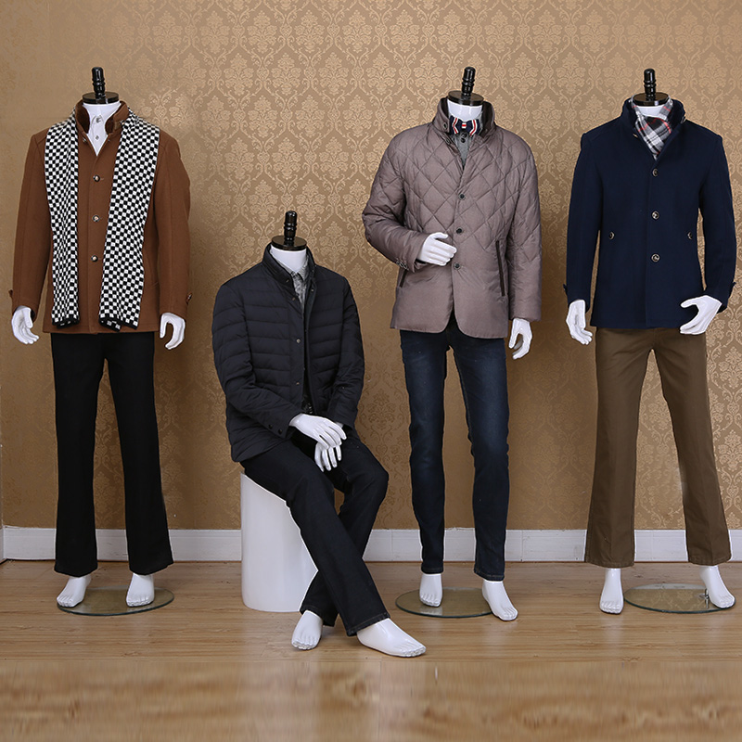
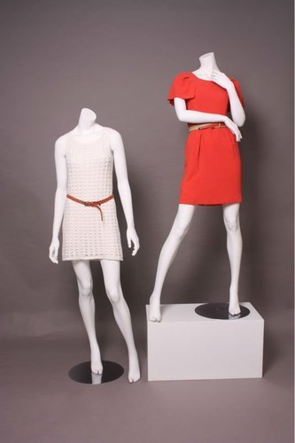
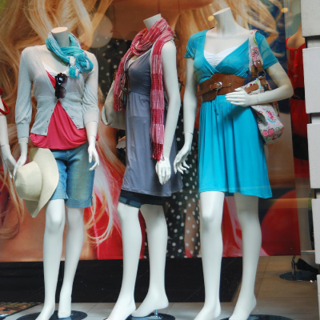
HEADLESS MANNEQUIN

Slide 15
ALTERNATIVES TO MANNEQUIN
Some of the most utilized alternatives for mannequins are:
Three-quarter forms
Articulated Figures
Hangers
Inflatables
Cutout Figures

Slide 16
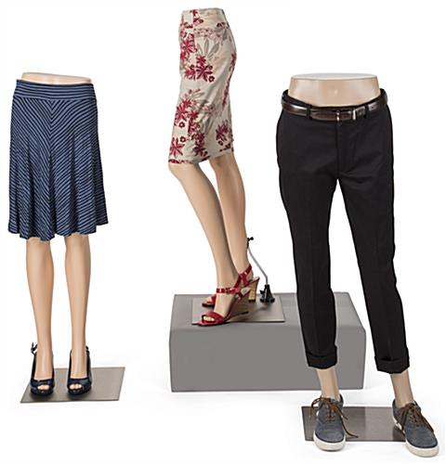
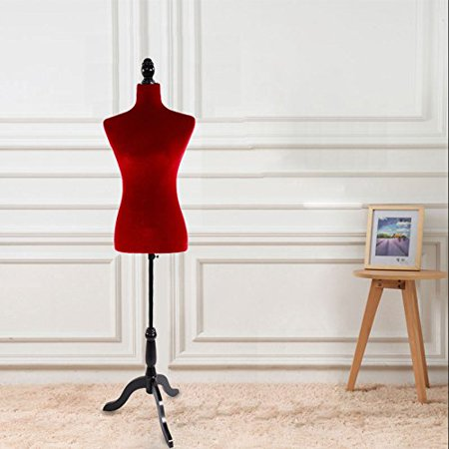
THREE QUARTER FORMS
It is the representation of a part of the human anatomy such as torso, burst or area from shoulder to waist or from hip to ankles.

Slide 17
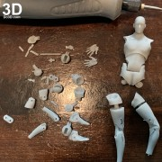
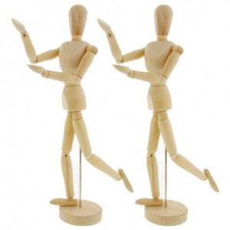
Articulated Artistic Figures
These are life-sized human representations that are made especially from wood or white plastic and are generally used by artists and designers in the process of drawing when they don’t have a real human body to help them.
They can be handled easily by removing joints or tilting them in various positions.
They can be used effectively in stores in order to provide a classy style or a traditional look.

Slide 18
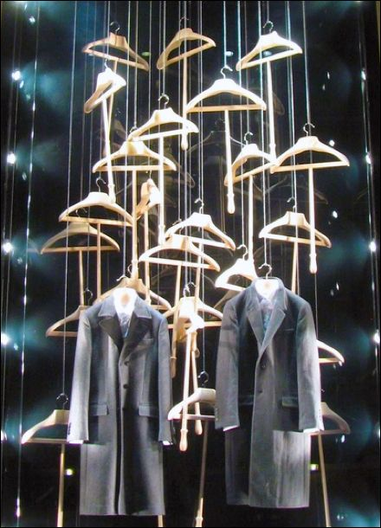
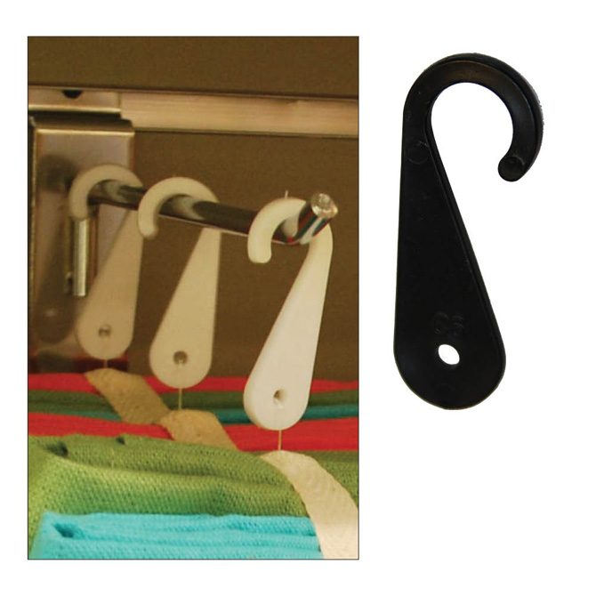
HANGERS
A hanger can provide a useful device to display merchandise, but it must be handled carefully because it may create the feeling of negligence, looking like something pulled out of stock without any prior attention.
Hangers can help you display almost everything, from blouses, scarf to ties and dresses.
Another thing: don’t forget about clothes that might slide, and take care of this aspect by choosing the right hanger for the items you want to display.

Slide 19
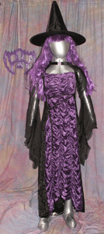
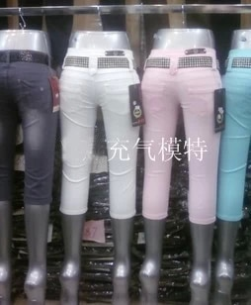
INFLATABLES
They are life-sized ballons.
Inflatables are fragile objects and you need to make sure they won’t blow while people touch them.

Slide 20
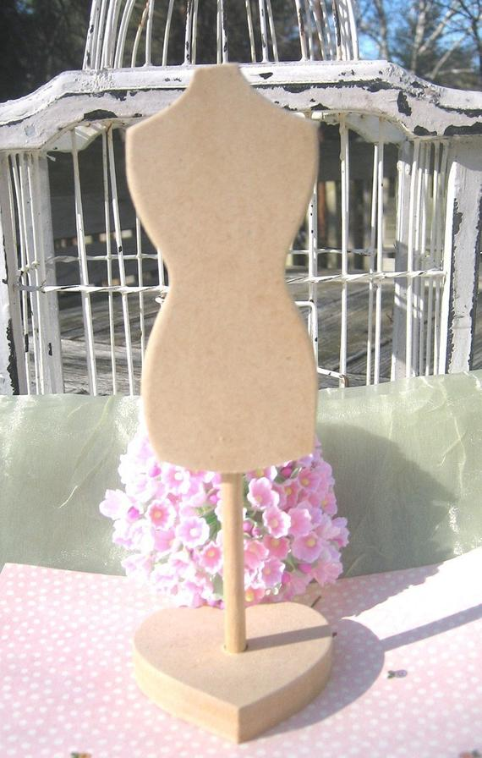
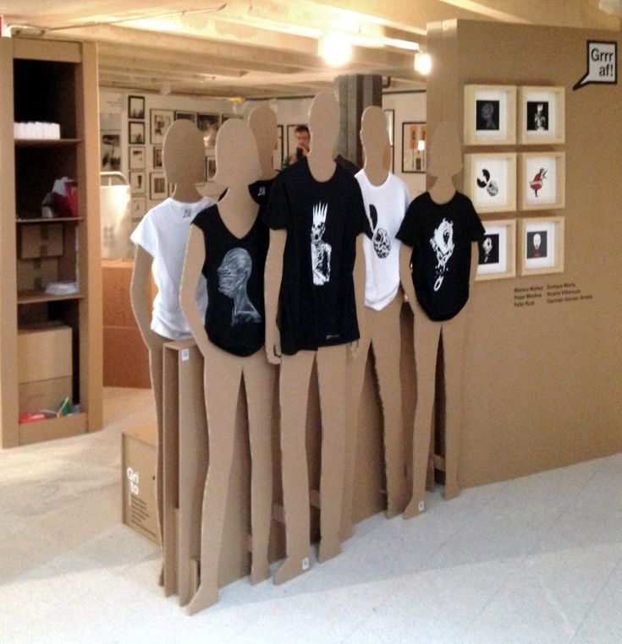
CUTOUT FIGURES
Cutout figures can represent a cheap and effective way to display certain items of clothing.
If you combine cardboard or any material that can help you so as to create a 3D assembly.
Make sure you use a quality material that won’t be cracked by certain heavy items of clothing.

Slide 21
DRESSING UP MANNEQUIN
One might think that dressing a mannequin is pretty easy and pretty obvious, but there is a technique or strategy that is involved in order for it to be “easy”.
PANTS
Remove the mannequin from its base.
Either lay the form on the ground or use an assistant to hold it up.
Remove the detachable leg.
Slide pants partway up the detached leg.
With the detached leg in the pants, start to slide pants onto the still-attached leg.
Reattach the detached mannequin leg once the pants are mostly on both legs.
Pull pants up all the way and button.
Return the mannequin to its base.

Slide 22
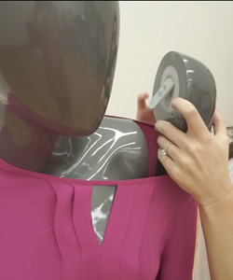
T-shirt
Remove both arms from the mannequin and place to the side.
Slide t-shirt over the head and shoulders of the mannequin.
Roll up t-shirt sleeves and reattach mannequin arms through the t-shirt arm holes
Long Sleeve Shirts
Remove both arms from the mannequin and place to the side.
Slide the long sleeve shirt over the head and shoulders of the mannequin.
Put mannequin arms through the collar of the shirt - hand end first - and slide the arms down through the sleeves of the shirt.
Reattach arms
.

Slide 23
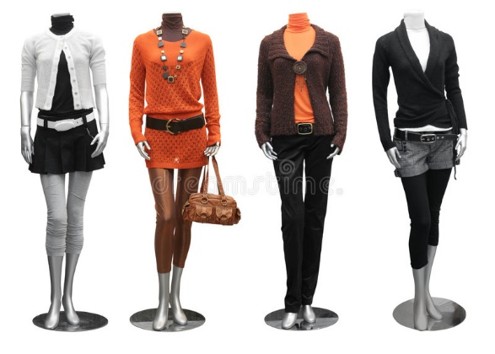
Styling Tips
Use full body mannequins to mix and match apparel and show how your clothes can go together. This helps to inspire your customers to buy more.
Add accessories! Hats, necklaces, bracelets, scarves & belts all help to complete the outfit and add realism to the look.
Use binder clips to get the clothes to fit right. Pins can also be helpful for more delicate adjustments, just make sure they won't damage the clothing!

Slide 24
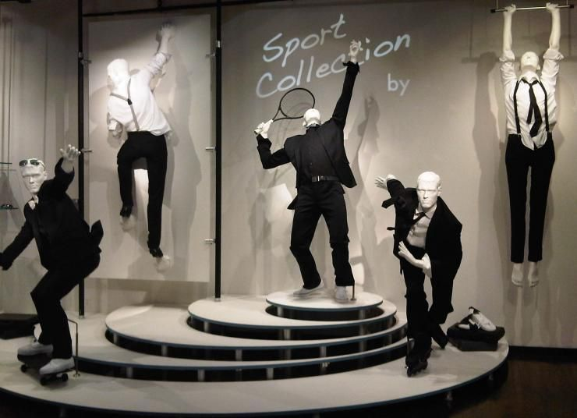
THANK YOU

