Slide 1
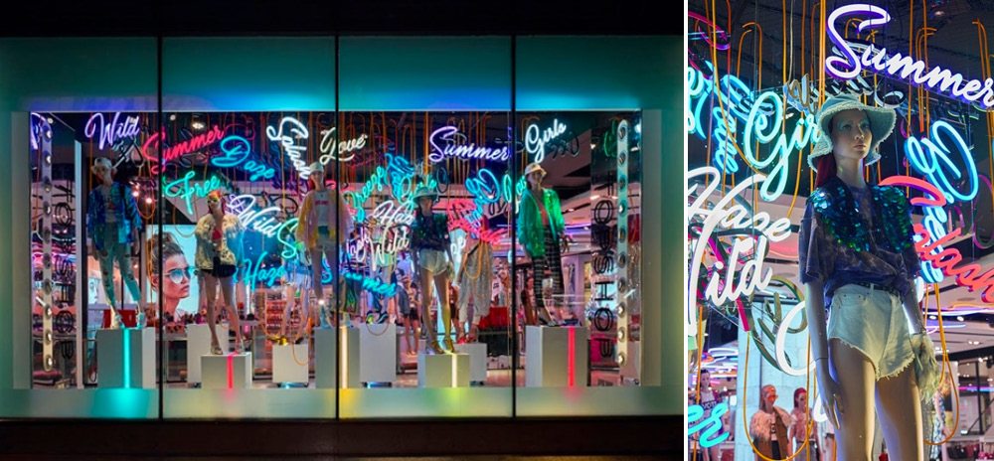
Window display ms.m.vandhana asst. prof. dept. of fashion technology bon secours college for women

Slide 2
Window Displays
From the elements incorporated within visual merchandising, window displays are often the most direct in attracting potential new customers.
They are usually the first point of visual contact a consumer has with a store and the starting step of the retail experience.
Eye-catching and appealing window displays can easily be the difference between a consumer coming into the store to view more or walking by.

Slide 3
The importance of window displays
Retailers need an effective window display in order to drive traffic into their stores. It's a unique form of advertising which defines a store and gives the consumer an idea of what the brand is all about.
They are an effective form of merchandising and often creative and different types of window displays create talking points amongst consumers and other retailers.

Slide 4
Types of window displays
Open back Window Display
Closed back Window Display
Straight front Window Display
Angled front Window Display
Corner Window Displays
Windowless Displays
Shadowbox window displays
Island Window Display

Slide 5
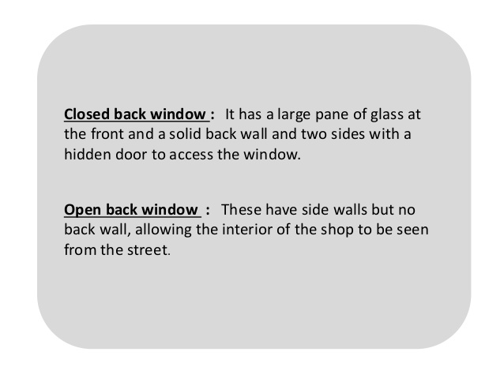

Slide 6
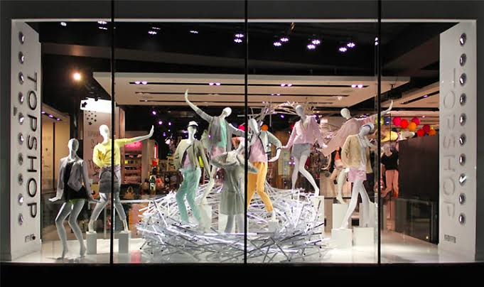
Open back window

Slide 7
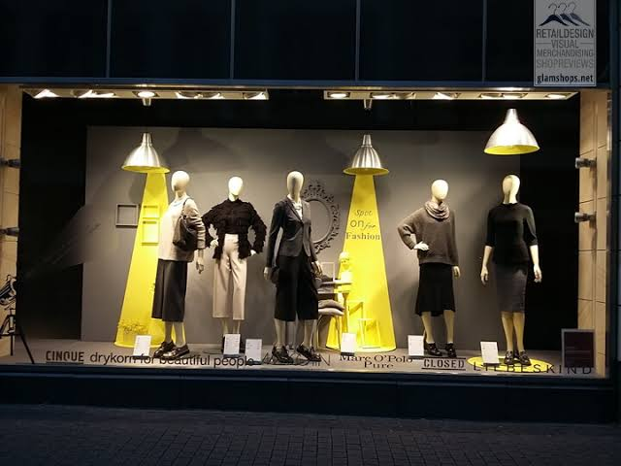
Closed back window

Slide 8
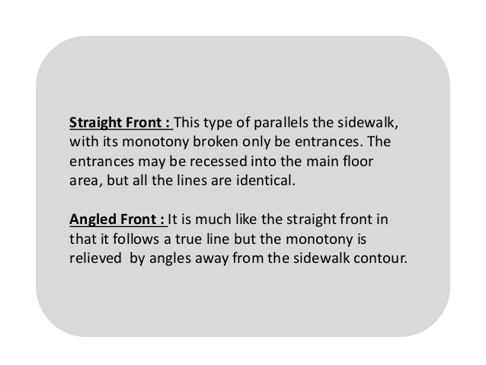

Slide 9
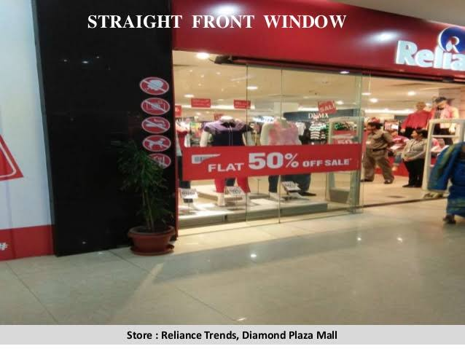

Slide 10
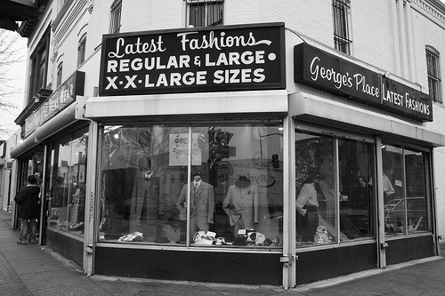
Angled front display

Slide 11
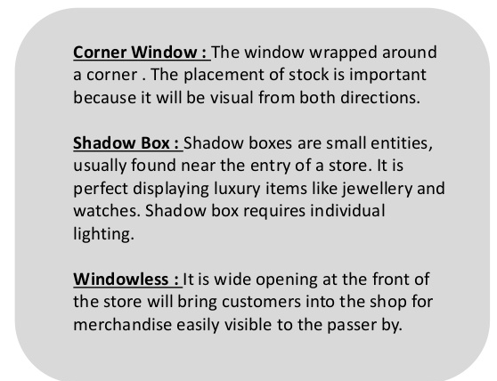

Slide 12
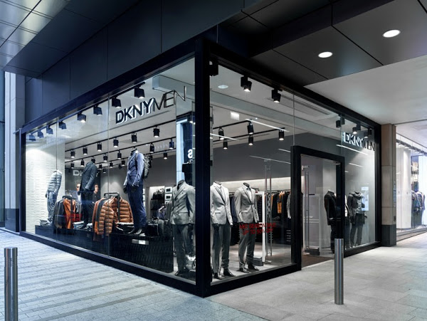
Corner window

Slide 13
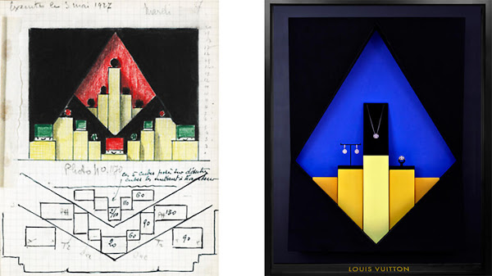
Shadow box window

Slide 14
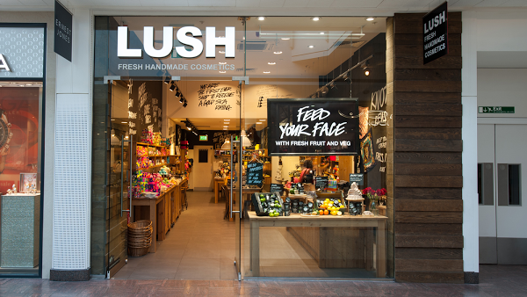
Windowless

Slide 15
Island Window Display
Island window displays are usually found in large department and flagship stores, where retailers have a huge space to fill but also want to create a sense of focus on the latest products or promotions.

Slide 16
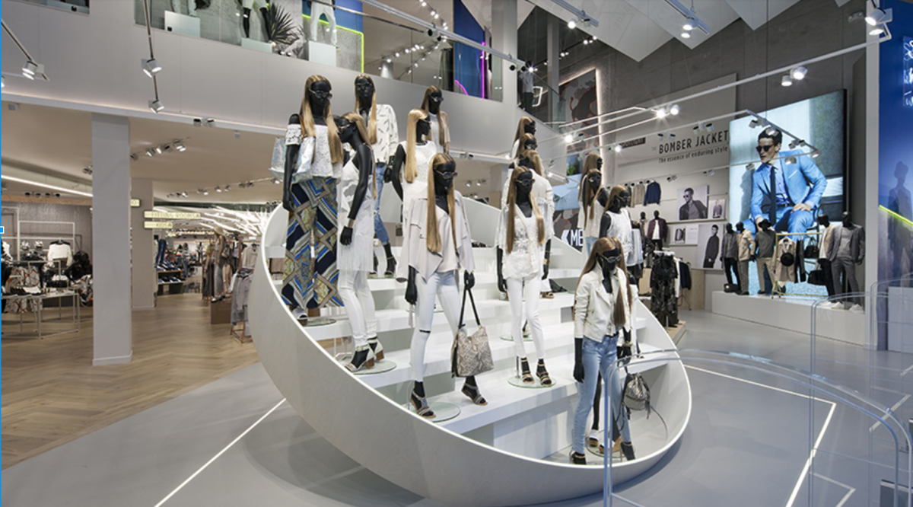
Island Window Display

Slide 17
Thank you

