Slide 1
S.SUGANTHI M.Sc., M.Phil. ASSISTANT PROFESSOR DEPARTMENT OF FASHION TECHNOLOGY BON SCOURS COLLEGE FOR WOMEN THANJAVU
TYPES OF STORE LAYOUT

Slide 2
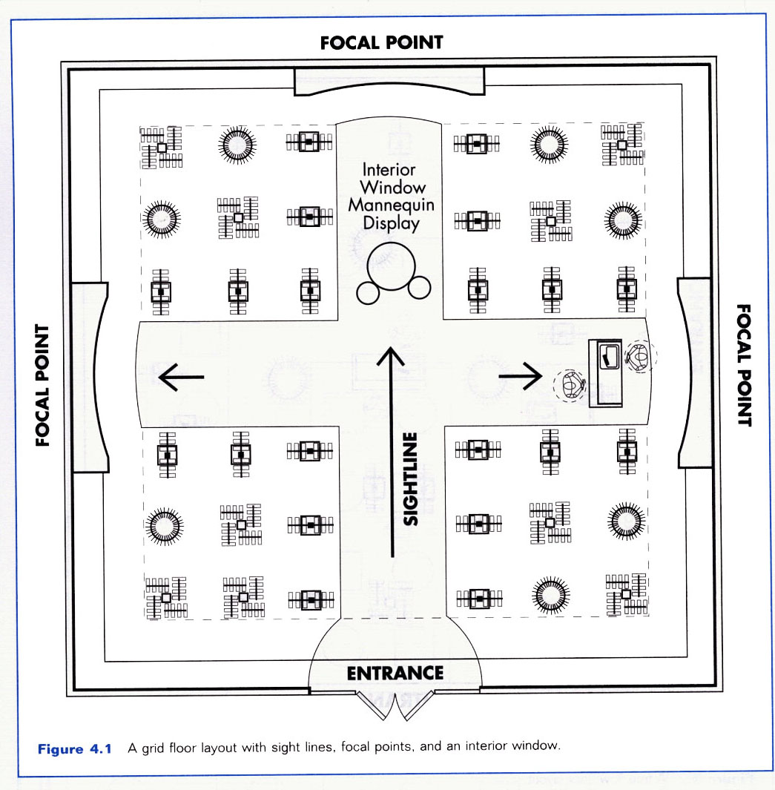

Slide 3
GRID LAYOUT
Linear design, checkerboard pattern.
Vertical and horizontal aisles
May have one main aisle and many secondary aisles.
Efficient use of space
Simple and predictable to navigate
Focal points at aisle ends

Slide 4
CURVING/LOOP (RACETRACK) DESIGN
Major Customer Aisle(s) Begins At Entrance, Loops Through The Store (Usually In Shape Of Circle, Square Or Rectangle) And Returns Customer To Front Of Store.
Exposes Shoppers To The Greatest Possible Amount Of Merchandise By Encouraging Browsing And Cross-shopping

Slide 5
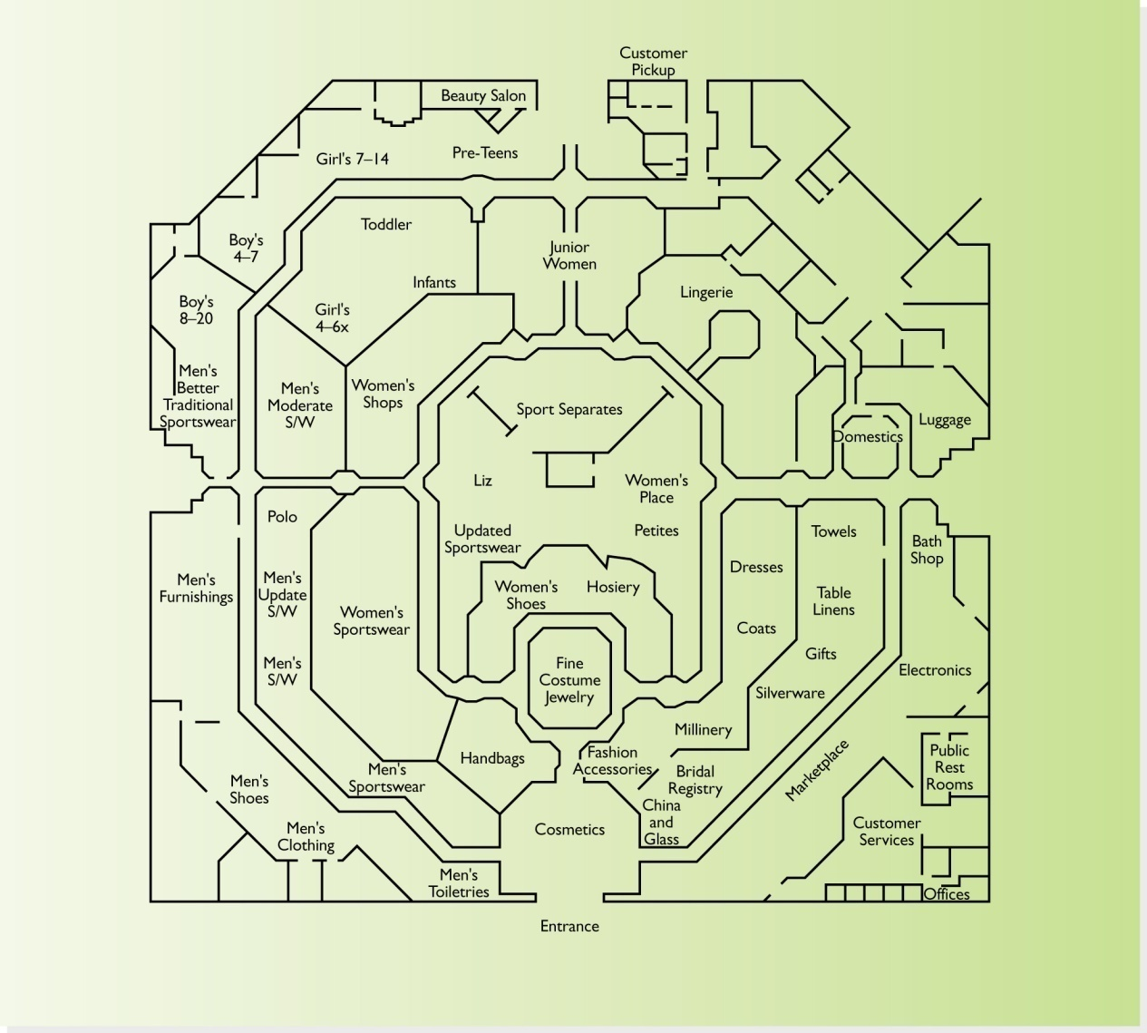

Slide 6
Free-Flow Layout
Storage, Receiving, Marketing
Dressing Rooms
Tops
Accessories
Jeans Casual Wear Stockings
Checkout counter
Skirts and Dresses Hats and Handbags
Pants
Clearance Items
Tops
Fixture
Fixture
Open Display Window
Open Display Window

Slide 7
Fixtures And Merchandise Grouped Into Free-flowing Patterns On The Sales Floor – No Defined Traffic Pattern
Must Provide Enough Room Between Fixtures
Works Best In Small Stores (Under 5,000 Square Feet) In Which Customers Wish To Browse
Encourages Browsing
Works Best When Merchandise Is Of The Same Type, Such As Fashion Apparel
If There Is A Great Variety Of Merchandise, Fails To Provide Cues As To Where One Department Stops And Another Starts

Slide 8
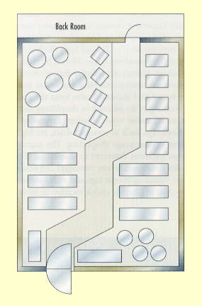
Spine Layout
Variation of grid, loop and free-form layouts
BASED ON SINGLE MAIN AISLE RUNNING FROM THE FRONT TO THE BACK OF THE STORE (TRANSPORTING CUSTOMERS IN BOTH DIRECTIONS)
Heavily used by medium-sized specialty stores ranging from 2,000 – 10,000 square feet

Slide 9
Ways to Display
Window Displays
Interior Window Displays
Wall Displays
Focal Point displays

Slide 10
Window Display Types
One Item Display
Related Merchandise Display
Variety or Assortment Display
Merchandise to be PRESENTED in consistent with store image- fashion forward or simple image

Slide 11
Types of merchandise presentation techniques
Idea oriented- furniture , linen
Color presentation
Price lining
Frontage presentation- presenting one out of the lot
Vertical merchandise- presented vertically high. people have a tendency to see from top left to right. All national level brand are displayed up and their own brand in the middle.

Slide 12
Store Front Design
Storefronts must:
Clearly identify the name and general nature of the store
Give some hint as to the merchandise inside
Includes all exterior signage
In many cases includes store windows – an advertising medium for the store – window displays should be changed often, be fun/exciting, and reflect merchandise offered inside.

Slide 13
Atmospherics
The design of an environment via
visual communications
lighting
color
sound
scent
To stimulate customers’ perceptual and emotional responses and ultimately influence their purchase behavior

Slide 14
Visual Communications
Name,
logo
Directional, departmental and category signage
Point-of-Sale (POS) Signage
Graphics

Slide 15
Lighting
Important but often overlooked element in successful store design
Highlight merchandise
Capture a mood
Level of light can make a difference
Can be used to hide objects as well

Slide 16
Color
Can influence behavior
Warm colors increase blood pressure, respiratory rate and other physiological responses – attract customers and gain attention but can also be distracting
Cool colors are relaxing, peaceful, calm and pleasant – effective for retailers selling anxiety-causing products

Slide 17
Sound & Scent
Sound
Music viewed as valuable marketing tool
Often customized to customer demographics
volume and tempo according to crowd and image
Scent
Smell has a large impact on our emotions
Can be administered through time release atomizers or via fragrance-soaked pellets placed on light fixtures

Slide 18
Thank you

