Slide 1
BIOFERTILIZER

Slide 2
INTRODUCTION
A biofertilizer (also bio-fertilizer) is a substance which contains living micro-organisms which, when applied to seeds, plant surfaces, or soil, colonize the rhizosphere or the interior of the plant and promotes growth by increasing the supply or availability of primary nutrients to the host plant.
It comprises living organisms which include mycorrhizal fungi, blue-green algae, and bacteria. Mycorrhizal fungi preferentially withdraw minerals from organic matter for the plant whereas cyanobacteria are characterized by the property of nitrogen fixation.

Slide 3
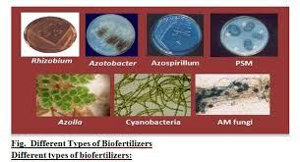
TYPES OF BIOFERTILIZERS
BACTERIAL
FUNGAL
ALGAL
AQUATIC FERN

Slide 12
THANK YOU

