Slide 1
cDNA AND GENOMIC LIBRARIES
MRS. S.AMIRTHAM
ASSITANT PROFESSOR
PG & RESEARCH DEPARTMENT OF BIOTECHNOLOGY
BON SECOURS COLLEGE FOR WOMEN
THANJAVUR

Slide 2
INTRODUCTION
A DNA library is a collection of DNA clones ,gathered together as a source of DNA for sequencing, gene discovery , or gene function studies .
There are two types of DNA libraries:
  DNA
  Genomic

Slide 3
cDNA LIBRARY
A cDNA library is a set of cDNA clones prepared from the mRNAs isolates from a particular type of tissue.
The cDNA library contains only complementry DNA molecules synthesized from mRNA molecules in a cell.
This molecules represents all the gene that are expressed in the cell at different stage of its development.

Slide 4
No cDNAwas made from prokaryotic mRNA
Prokaryotic mRNA is very unstable.
Genomic libraries of prokaryotes are easier to make and contain all the genome sequences.

Slide 5
cDNA Libraries Are Very Useful For Eukaryotic Gene Analysis
Condensed protein encoded gene libraries,Have much less junk sequences
cDNAs have no introns→genes can be expressed in E. coli directly
Are very useful to identify new genes
Tissue or cell type specific(differential expression of genes)

Slide 6
Synthesis of Cdna:
FIRST STAND SYNTHESIS: materials as reverse transcriptase, primer(oligo(dT) or hexanucleotides) and dNTPs
SECOUND STRAND SYNTHESIS: best way of making full- length cDNA is to ‘tail’ the 3’- end of the first strand and then use a complementary primer to make the secound.

Slide 7
CONSTRUCTION
cDNA libraries are constructed by synthesizing cDNA from purified cellular mRNA via oligo(dT)-cellulose chromatography.
This is done to recover the poly(A) mRNA so as to anneal with the oligo(dT) chains .

Slide 8
SCREENING
A prope is a piece of DNA or RNA used to detect specific nucleic acid sequence by hybridization ( binding of two nucleic acid chains by base pairing). Oligonucleotide can be used as a probe.
They are radioactivity labeled so that the hybridized nucleic acid
can be identified by autoratiography.

Slide 9
Two general approaches are avilable for screening libraries to
identify clones carrying a gene or other DNA region of interest.
Detection with oligonucleotide probes that bind to the clone of interest .
Detection based on expression of the encoded protein.

Slide 10
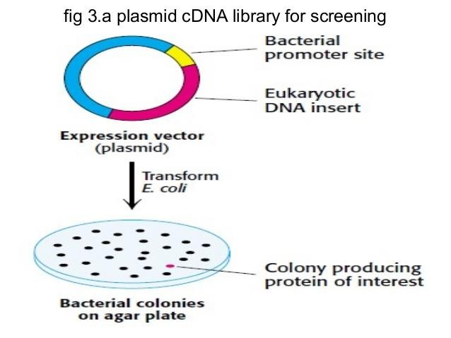
A PLASMID cDNA LIBRARY FOR SCREENING

Slide 11
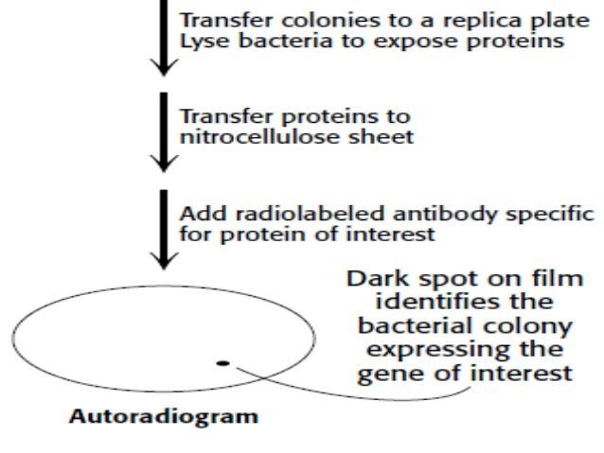

Slide 12
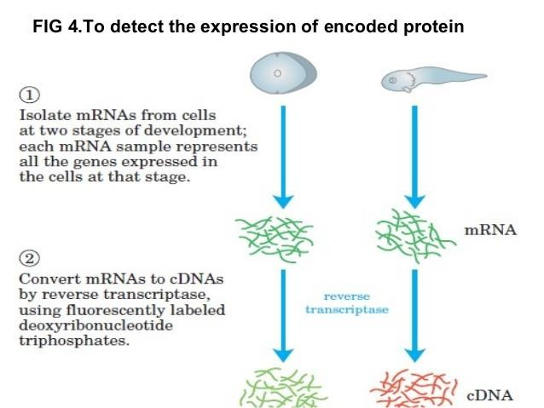
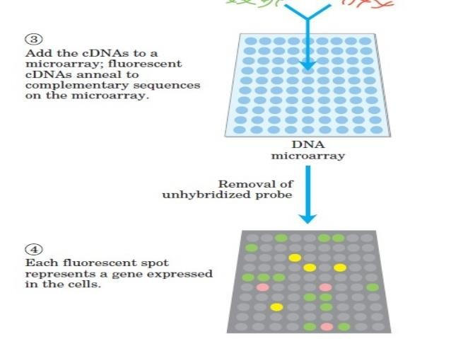

Slide 13
GENOMIC LIBRARY
Is the largest type of library which consist of the complete genome of a complete genome of a particular organism which is cleaved into thousands of fragments, are all the fragments are cloned by insertion into a cloning vector.
A collection of clones that collectively represent all the DNA
sequences in the genome of a particular organism.

Slide 14
CONSTRUCTION
The first step in preparing a genomic library is partial digestion of the DNA by restriction endonucleases, such that any given sequences will appear in fragments of a range of sizes and is represented in the library.
Secondly,the cloning vector ,such as a BAC or YAC plasmid
,is cleaved with the same restriction endonuclease and
ligated to the genomic DNA fragment.

Slide 15
Thereafter ligated DNA mixture is then used to transform bacterial or yeast cells to produce a library of cell types,each type harboring a different recombinant DNA molecule.
Each transformed bacterium or yeast cell grows into a colony,or “clone”,of
identical cells,each cell bearing the same recombinant plasmid.
The ability to clone such large DNA fragments raise the possibility of the Genomic library,but it has been found that there is a problem as to what number of clones are required to construct a genomic library.

Slide 16
A solution has been provided with thw use of a fornuker:
N=ln(1-P)/ln(1-a/b)
Which enchances the capacity of constructing a genomic library,and also ease the problem of screening.(i.e..the higher the fragments,the smaller the number of clones).

Slide 17
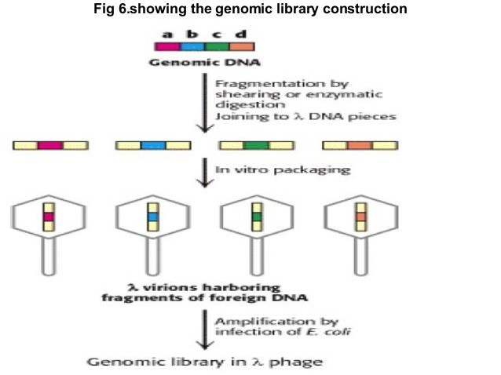

Slide 18
SCREENING
A common method of screening is the plasmid- based genomic libraries which is to carry out a colony hybridization experiment. Host bacteria containing either a plasmid based or bacteriophage- based library are plated out on petri dish and allowed to grow overnight to form colonies.

Slide 19
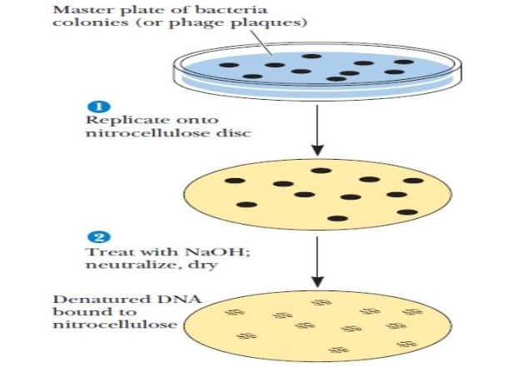
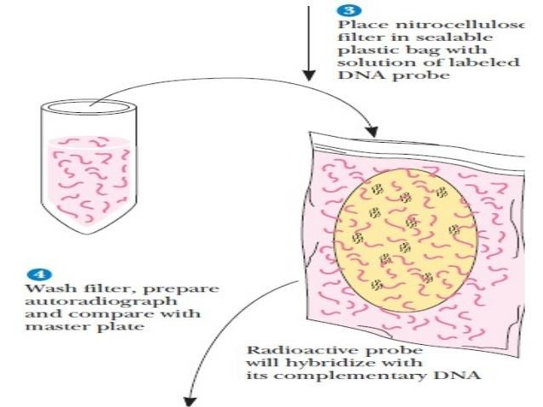
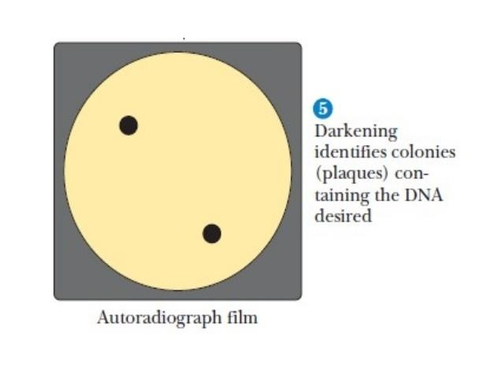

Slide 20
CONCLUSION
In conclusion, genomic DNA segments can be organized in libraries known as genomic libraries and cDNA libraries with a wide range of designs and purposes.

Slide 21
THANK YOU

